Slide 1
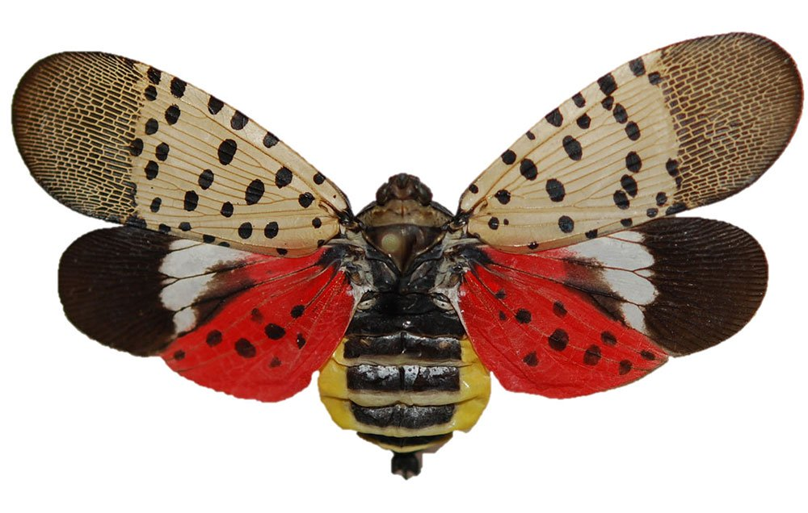

Spotted Lanternfly: A Threat to NC Agriculture
Whitney G. Swink
Plant Industry Division – Plant Protection Section
North Carolina Department of Agriculture & Consumer Services

Slide 2
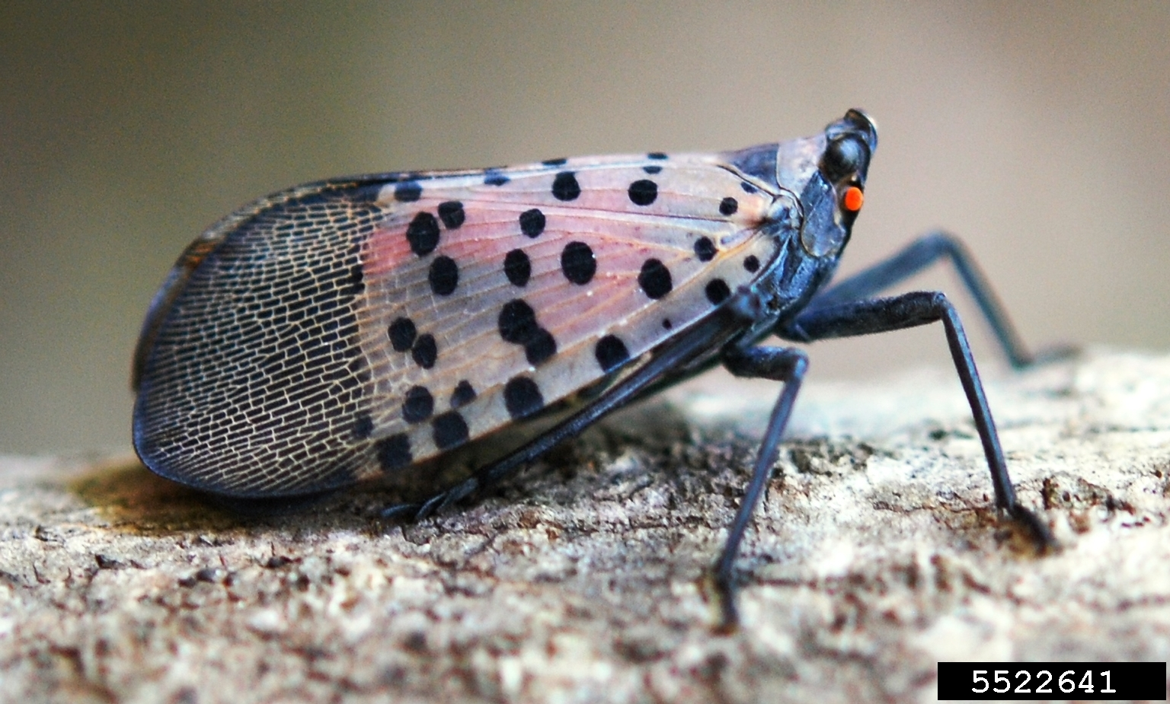
What is spotted lanternfly?
Planthopper; member of the family Fulgoridae
  One of the only pests known in this insect family
Native to parts of Asia (northern China, Vietnam, Bangladesh)
  Introduced to Korea in 2004 where it has become a major pest
  First detected in Pennsylvania in 2014
Univoltine
Very broad host range
Notes:
The egg mass is approximately 1 inch long and resembles a smear of mud
Females lay eggs on smooth surfaces such as buildings, trees, rocks, under bark or rocks, and many other objects
SLF overwinters in the egg stage

Slide 3
What is spotted lanternfly?
“Spotted lanternfly is a freak among planthoppers.”
~Julie Urban, Penn State University Entomologist
Planthopper; member of the family Fulgoridae
  One of the only pests known in this insect family
Native to parts of Asia (northern China, Vietnam, Bangladesh)
  Introduced to Korea in 2004 where it has become a major pest
  First detected in Pennsylvania in 2014
Univoltine
Very broad host range
Notes:
The egg mass is approximately 1 inch long and resembles a smear of mud
Females lay eggs on smooth surfaces such as buildings, trees, rocks, under bark or rocks, and many other objects
SLF overwinters in the egg stage

Slide 4
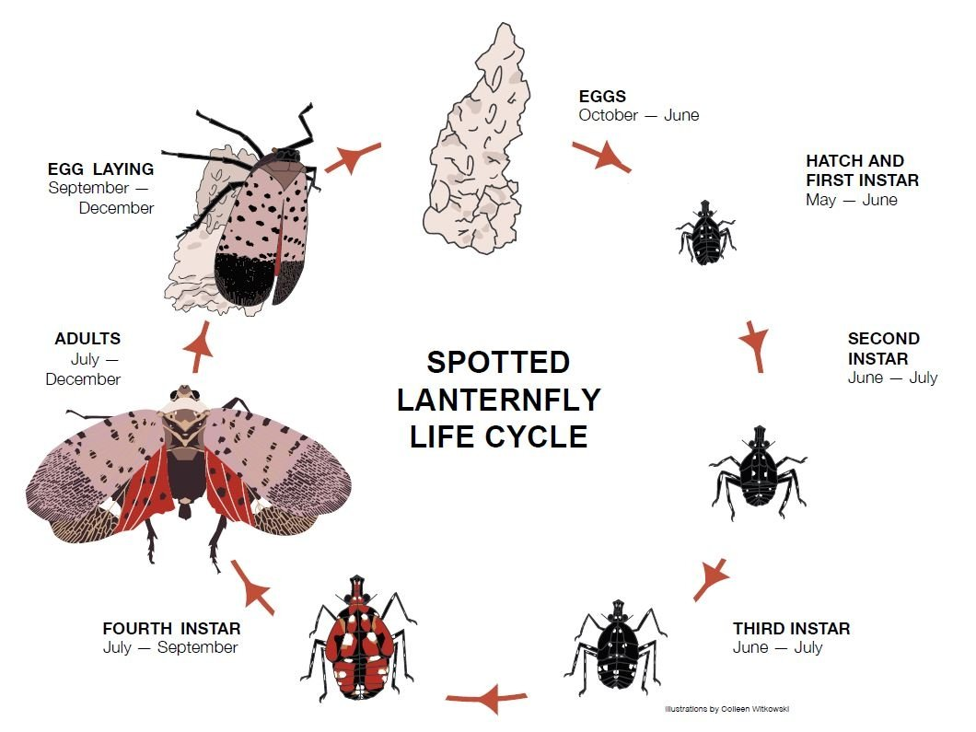
What is spotted lanternfly?
Notes:
The egg mass is approximately 1 inch long and resembles a smear of mud
Females lay eggs (approx. 35 eggs to a mass) on smooth surfaces such as buildings, trees, rocks, under bark or rocks, and many other objects
SLF overwinters in the egg stage

Slide 5
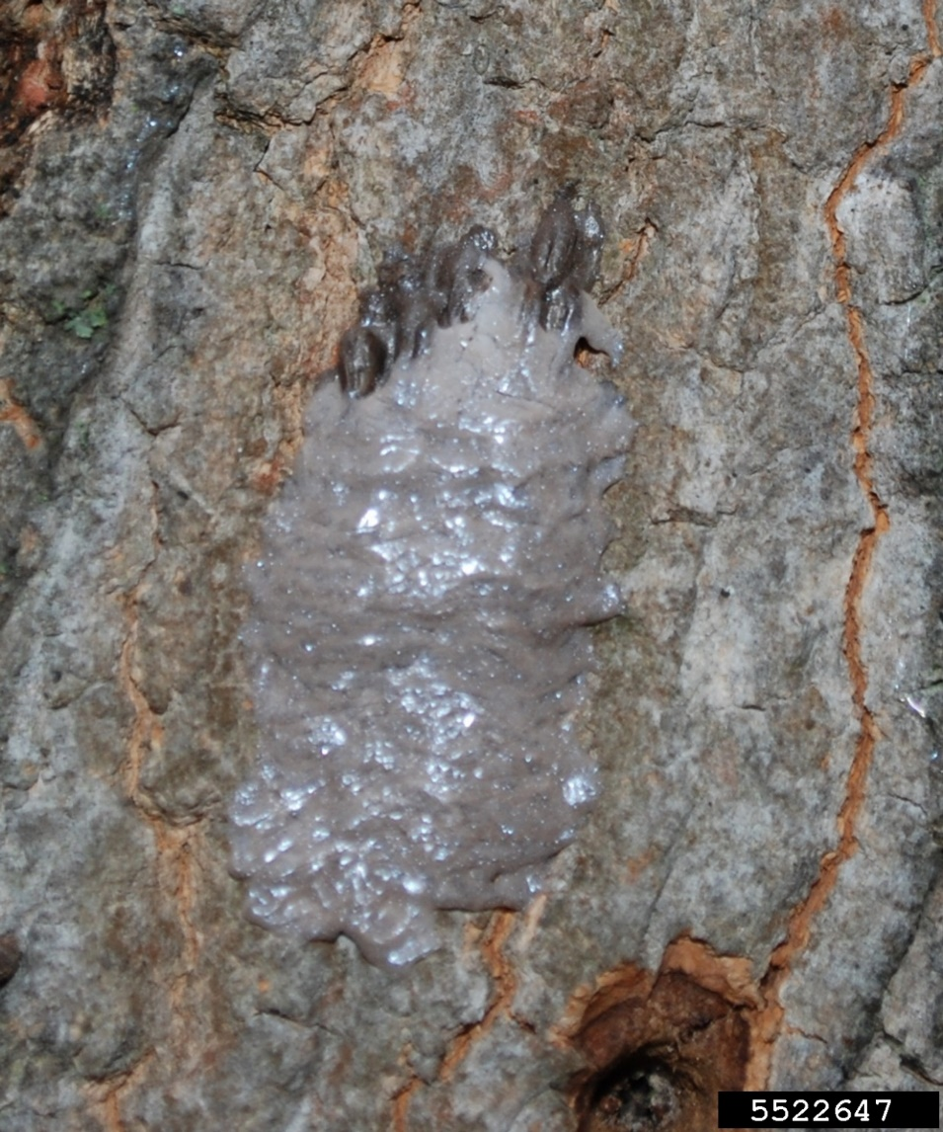
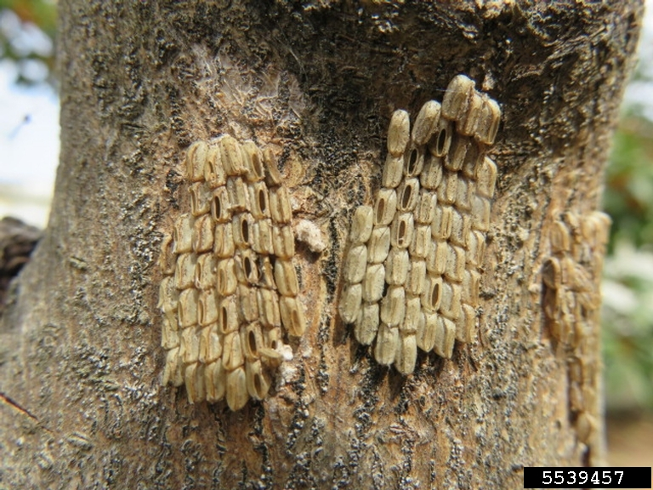
What is spotted lanternfly?
Notes:
The egg mass is approximately 1 inch long and resembles a smear of mud
Females lay eggs (approx. 35 eggs to a mass) on smooth surfaces such as buildings, trees, rocks, under bark or rocks, and many other objects
SLF overwinters in the egg stage

Slide 6
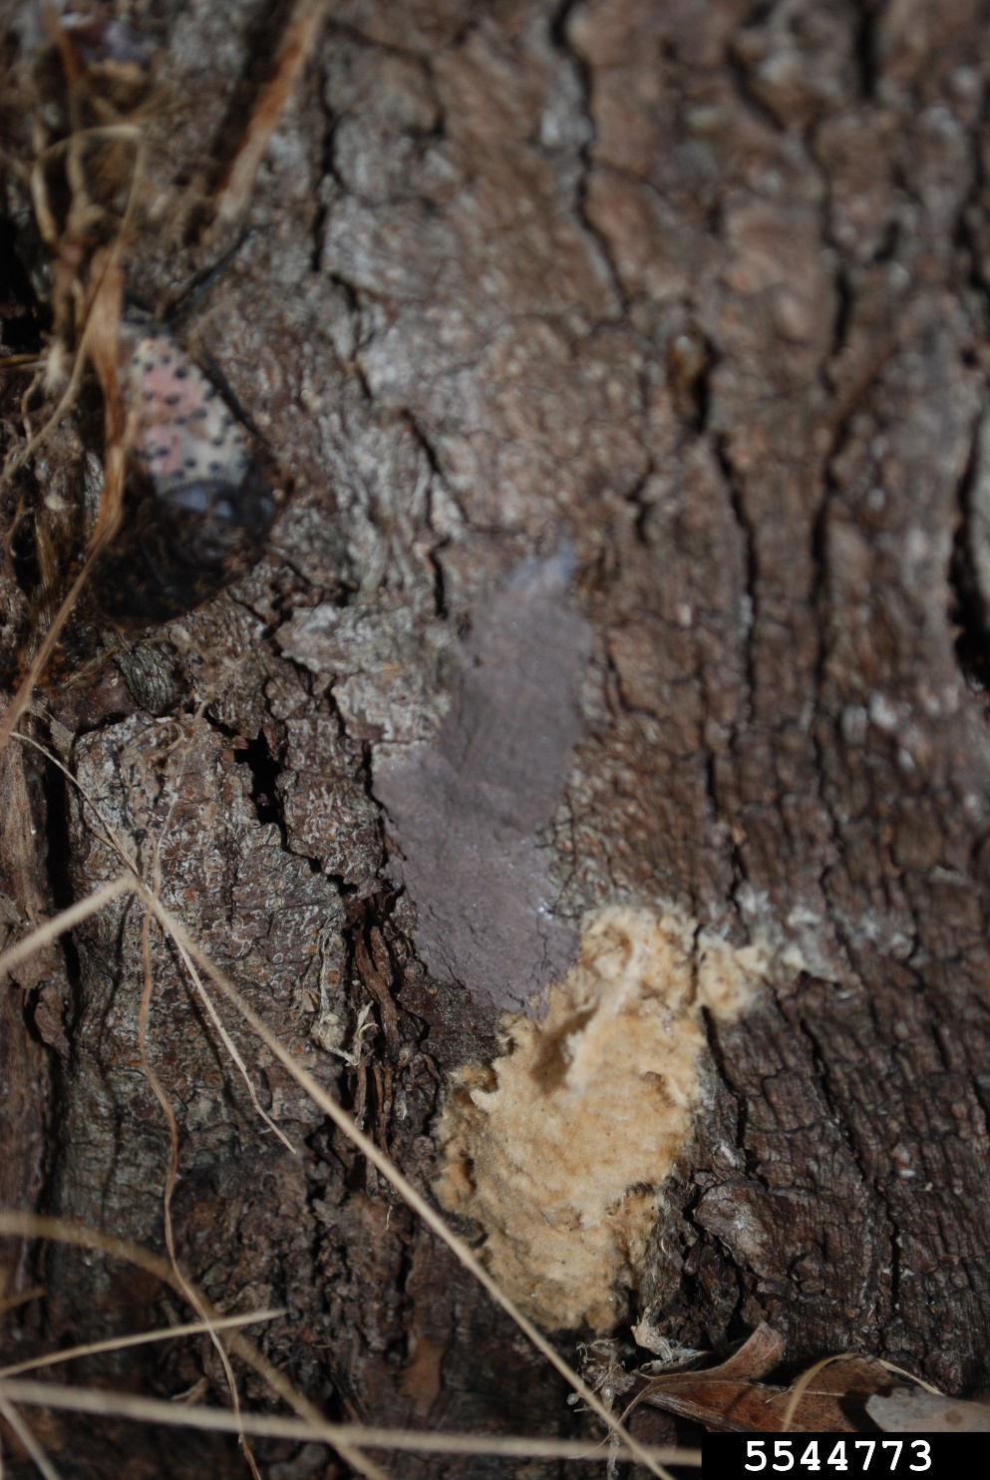
What is spotted lanternfly?
Spotted Lanternfly
Gypsy Moth
Notes:
The egg mass is approximately 1 inch long and resembles a smear of mud
Females lay eggs (approx. 35 eggs to a mass) on smooth surfaces such as buildings, trees, rocks, under bark or rocks, and many other objects
SLF overwinters in the egg stage

Slide 7
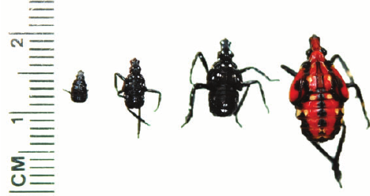
What is spotted lanternfly?
Notes:
The egg mass is approximately 1 inch long and resembles a smear of mud
Females lay eggs (approx. 35 eggs to a mass) on smooth surfaces such as buildings, trees, rocks, under bark or rocks, and many other objects
SLF overwinters in the egg stage

Slide 8
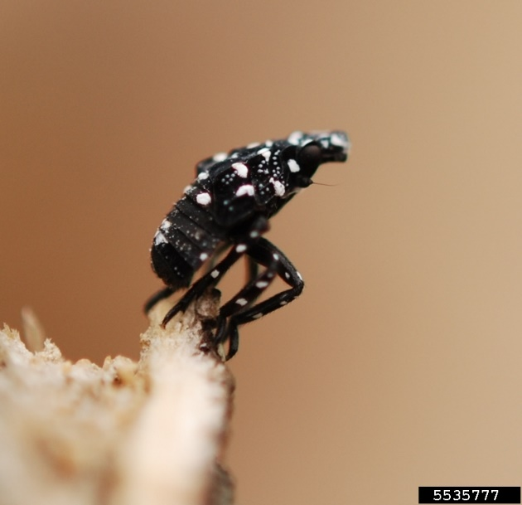
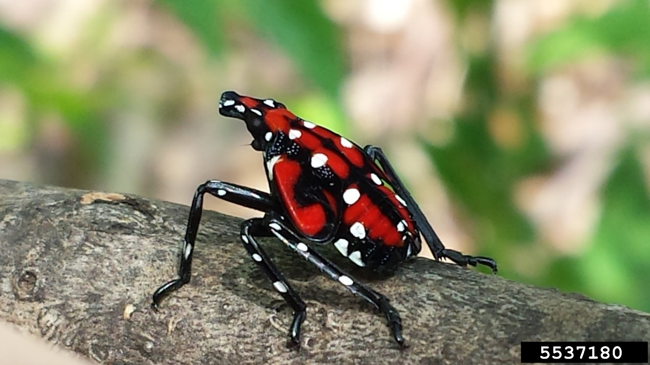
What is spotted lanternfly?
Notes:
The egg mass is approximately 1 inch long and resembles a smear of mud
Females lay eggs (approx. 35 eggs to a mass) on smooth surfaces such as buildings, trees, rocks, under bark or rocks, and many other objects
SLF overwinters in the egg stage

Slide 9
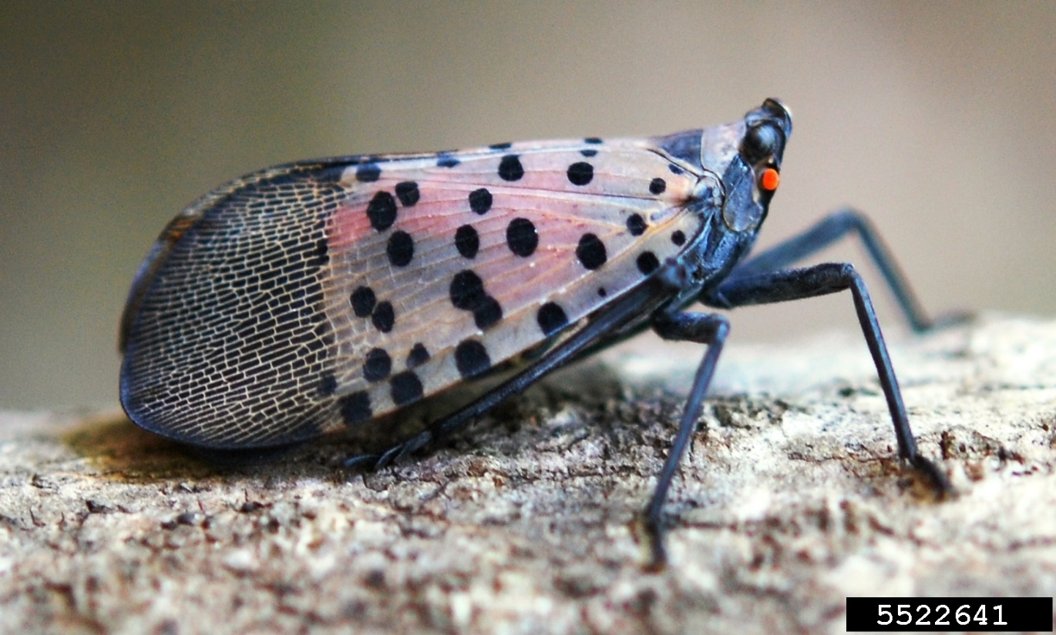
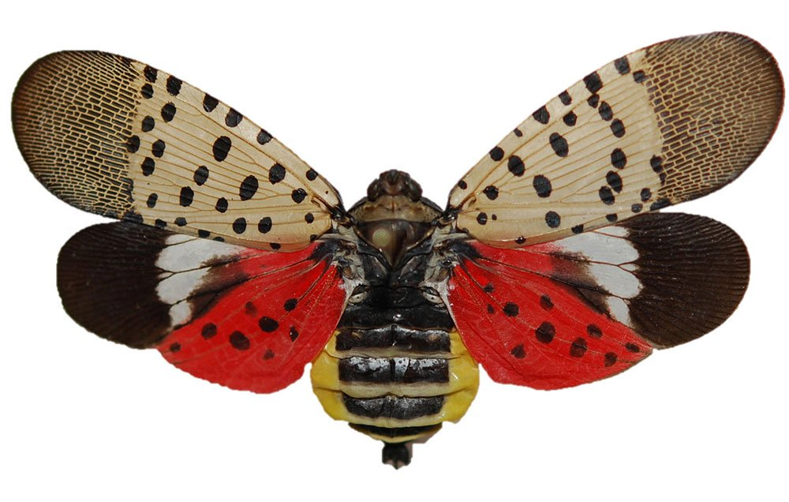
What is spotted lanternfly?
Notes:
The egg mass is approximately 1 inch long and resembles a smear of mud
Females lay eggs (approx. 35 eggs to a mass) on smooth surfaces such as buildings, trees, rocks, under bark or rocks, and many other objects
SLF overwinters in the egg stage

Slide 10

What is spotted lanternfly?
Notes:
The egg mass is approximately 1 inch long and resembles a smear of mud
Females lay eggs (roughly 35 eggs per egg mass) on smooth surfaces such as buildings, trees, rocks, under bark or rocks, and many other objects
SLF overwinters in the egg stage

Slide 11
Regultory Updates on Spotted Lanternfly
What is spotted lanternfly?
Spotted Lanternfly
Gypsy Moth

Slide 12
What is spotted lanternfly?
Notes:
There are 4 nymphal instars: the first to third are black-bodied with white spots on the head, body and legs; the fourth is red with white spots and distinct red wing pads

Slide 13


What is spotted lanternfly?

Slide 14
What is spotted lanternfly?

Slide 15
Why the concern over SLF?
?
Notes:
Tree of heaven is the preferred host for egg-laying adults

Slide 16
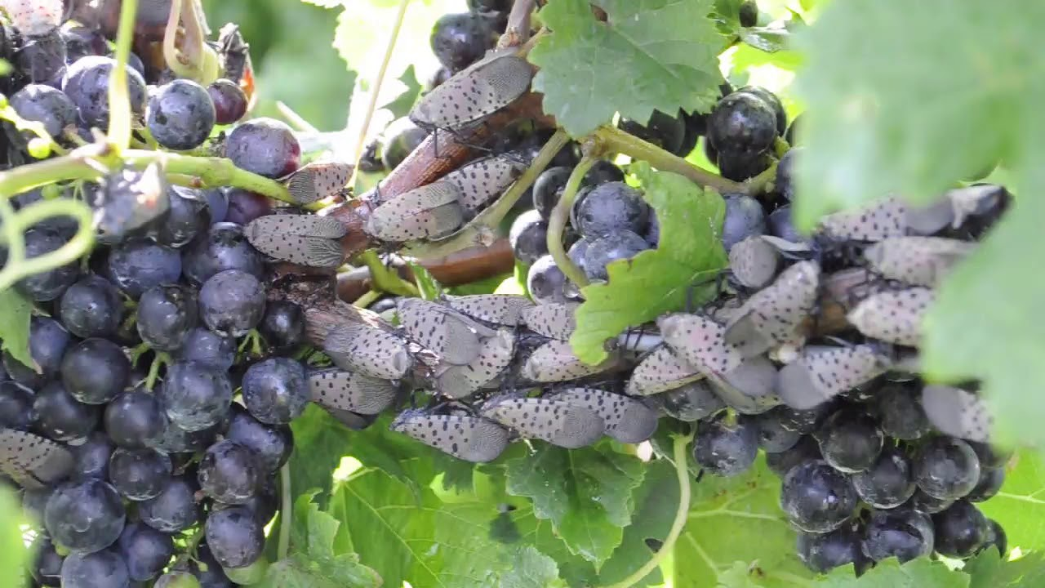
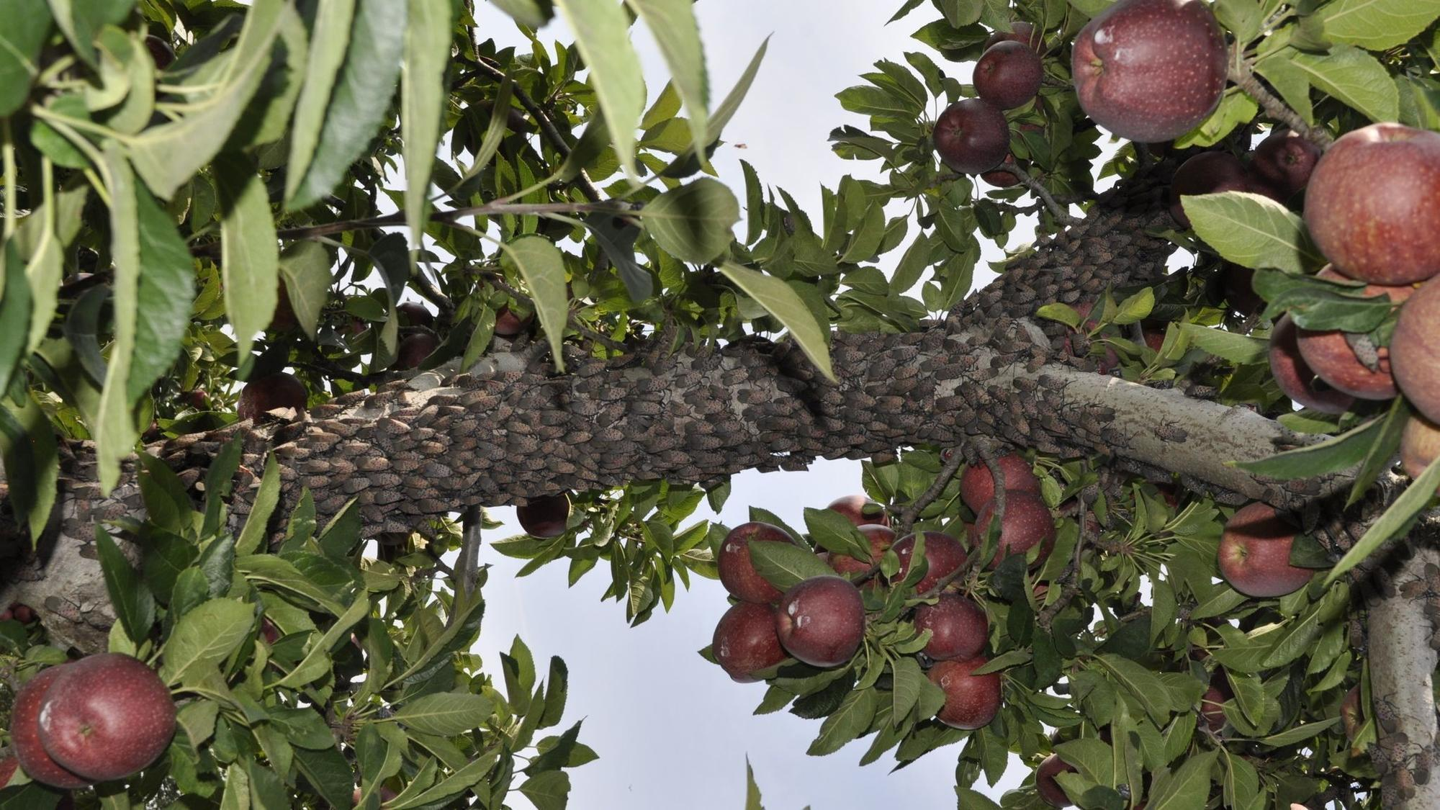
Why the concern over SLF?
Hosts:
Apples
Birch
Cherry
Grapes
Hops
Lilac
Maple
Pine
Poplar
Stone fruits
Tree-of-heaven
Walnut
Willow
To date, >70 species of woody plants have been identified as hosts of spotted lanternfly
Notes:
Tree of heaven is the preferred host for egg-laying adults

Slide 17
Why the concern over SLF?
Hosts:
Apples
Birch
Cherry
Grapes
Hops
Lilac
Maple
Pine
Poplar
Stone fruits
Tree-of-heaven
Walnut
Willow
To date, >70 species of woody plants have been identified as hosts of spotted lanternfly
Notes:
Tree of heaven is the preferred host for egg-laying adults

Slide 18
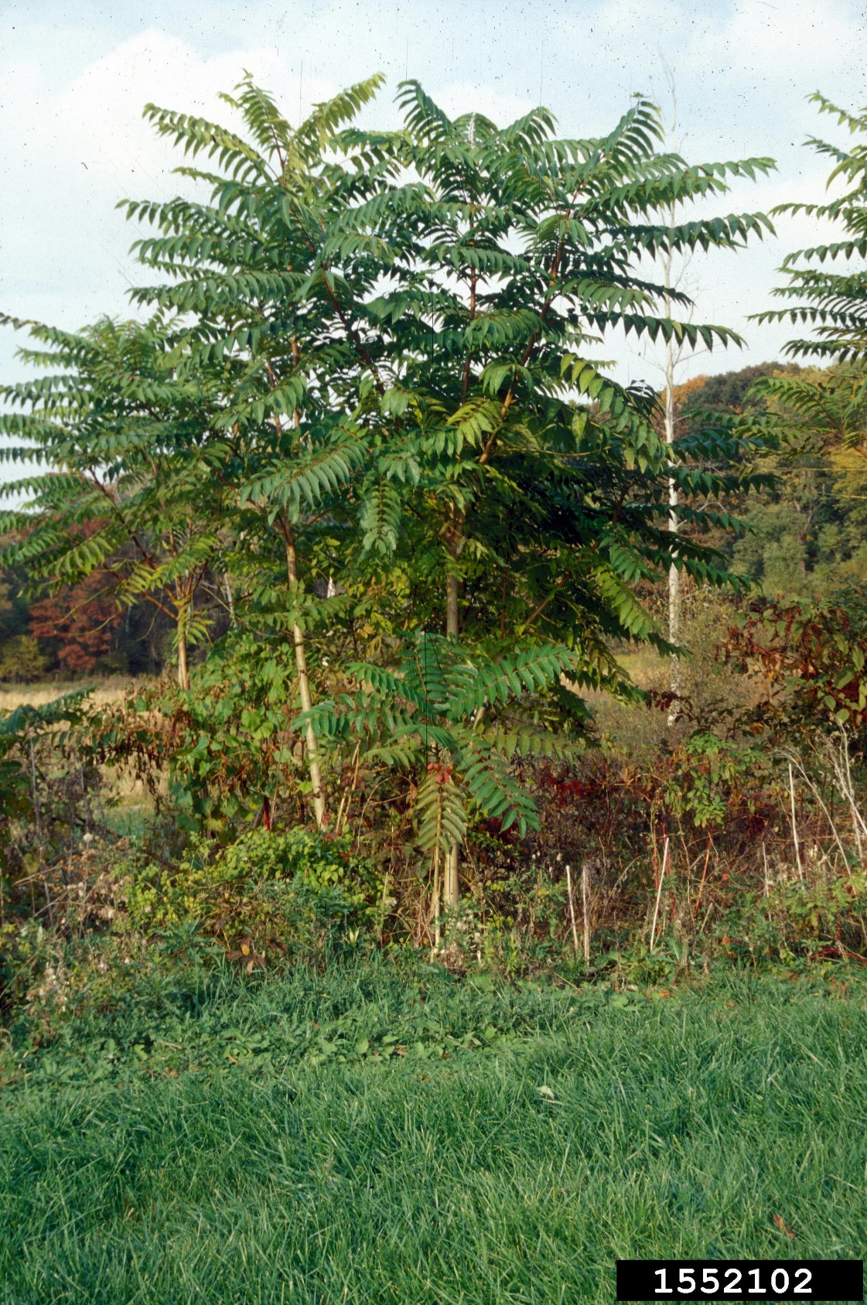
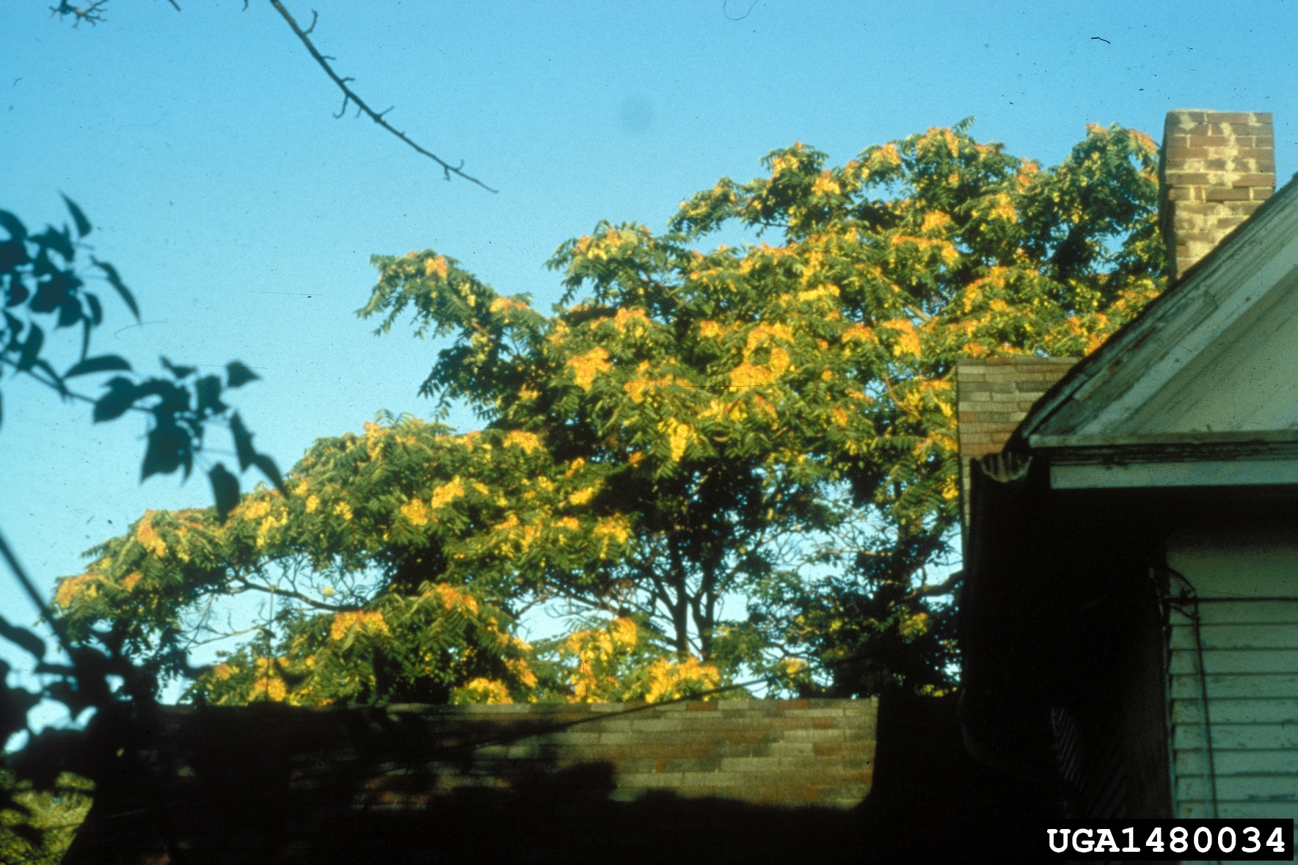
Tree-of-Heaven (Ailanthus altissima)

Slide 19
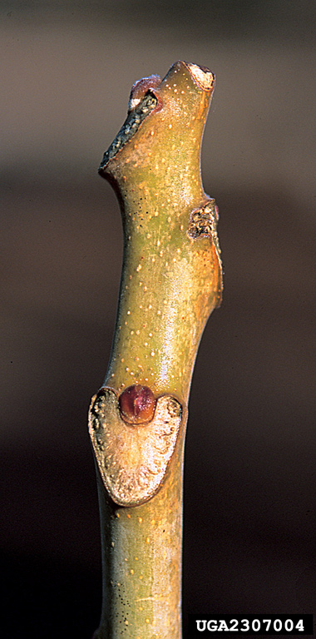
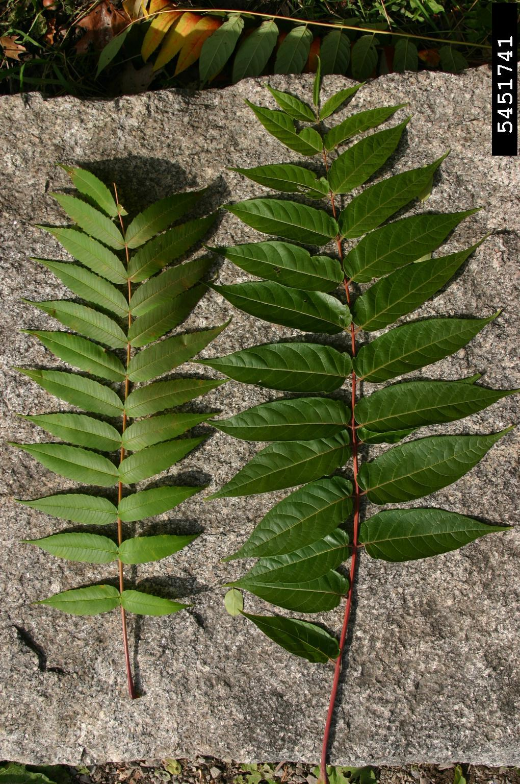
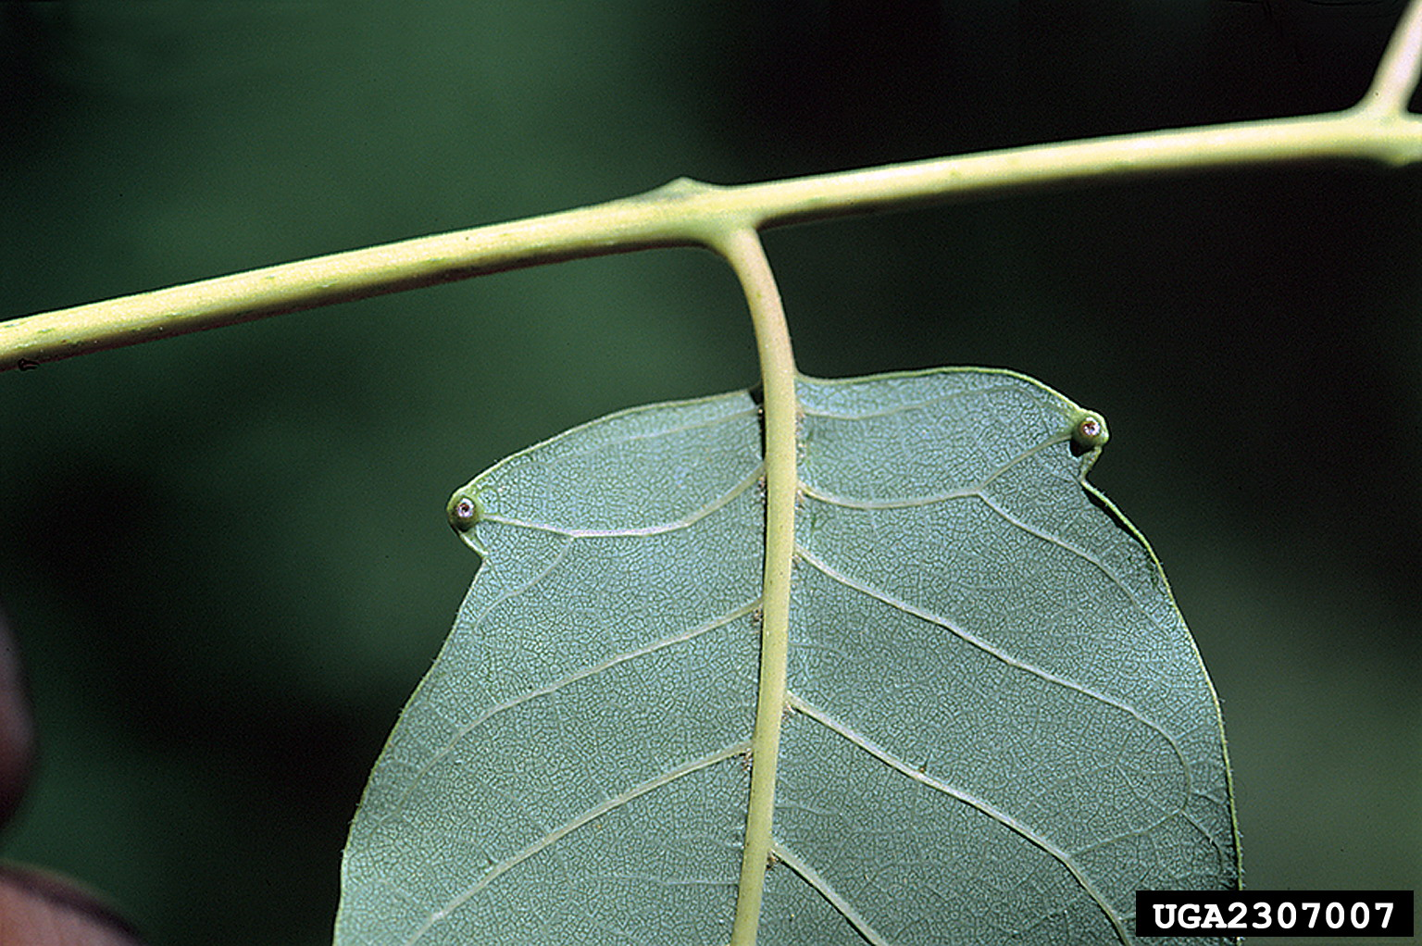
Tree-of-Heaven (Ailanthus altissima)

Slide 20
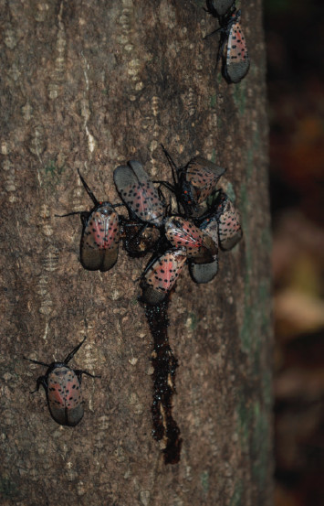
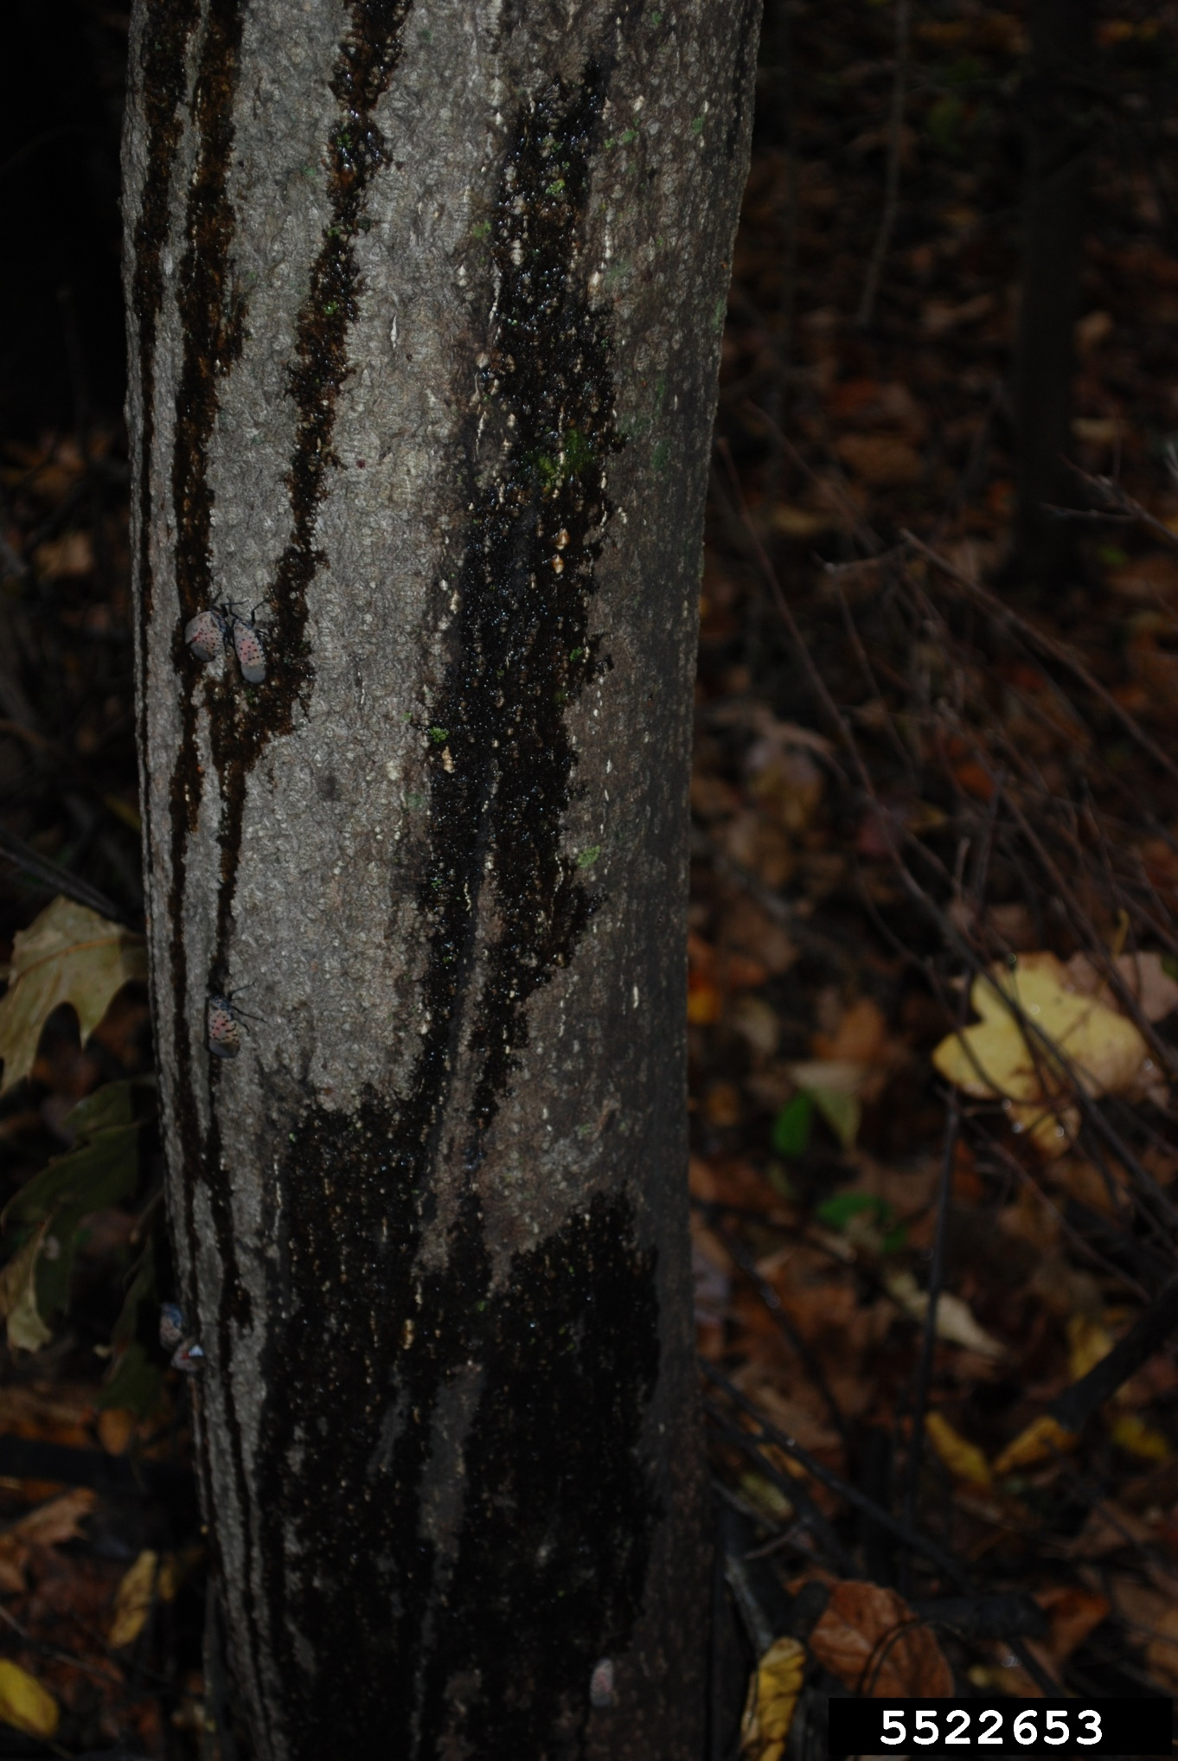
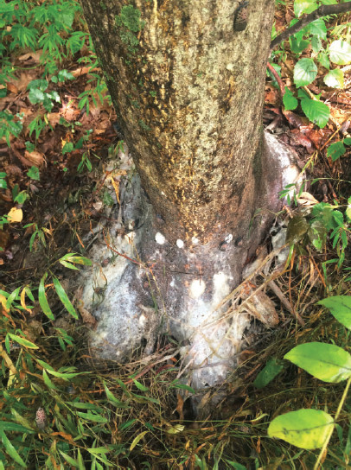
Why the concern over SLF?
Notes:
In Pennsylvania, treatment costs increased 271% between 2016 and 2018
In vineyards, infested grape vines are either not surviving the winter or those that do survive aren’t producing fruit (90% loss)
Produce copious amounts of honeydew coating everything beneath the tree canopy with thick layers of sooty mold
This is also attracting stinging insects
Affected commodities have combine value over billions of dollars

Slide 21
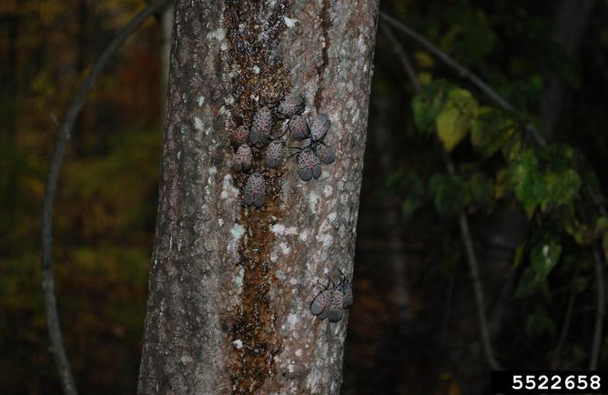
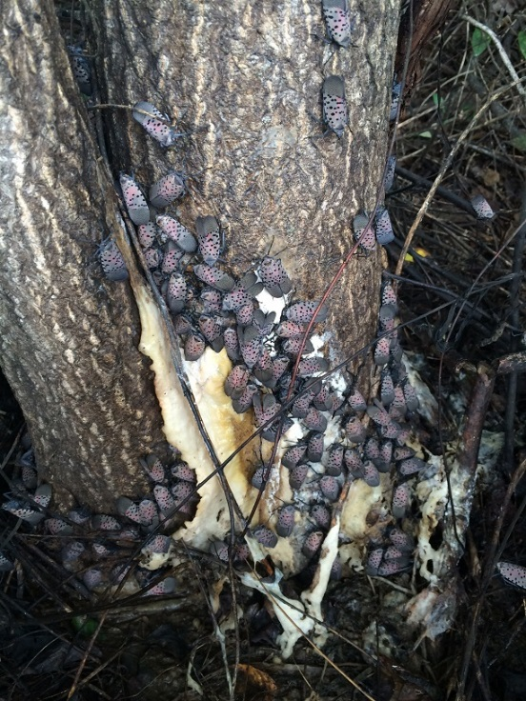
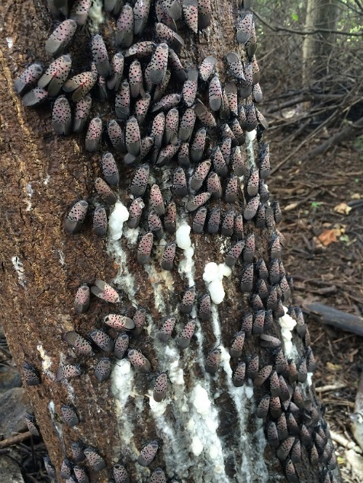
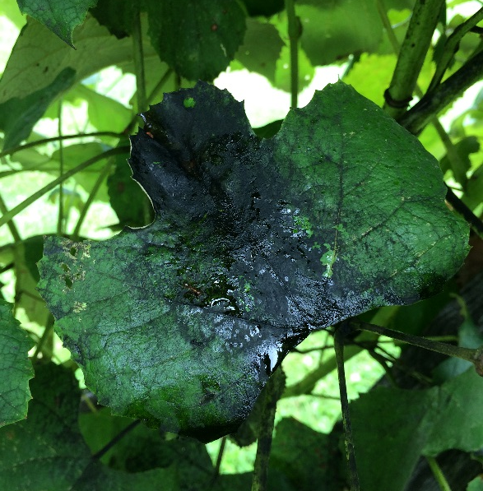
Target: Spotted Lanternfly
Damage
Weeping sap
Photos Lawrence Barringer, PDA, Bugwood.org (top); Erica Smyers, PSU (bottom)
Sooty Mold
Photo Erica Smyers, Pennsylvania State University
Slime Flux
Photo Erica Smyers, Pennsylvania State University
Notes:
Damage commonly observed in areas of infestation. If damage symptoms observed, but no individuals are detected, the site should not be marked as positive. Instead the site should be revisited. These sites can be visually inspected or a combination of visual inspection and banding (w/lure). Site become positive when life stage is detected.

Slide 22
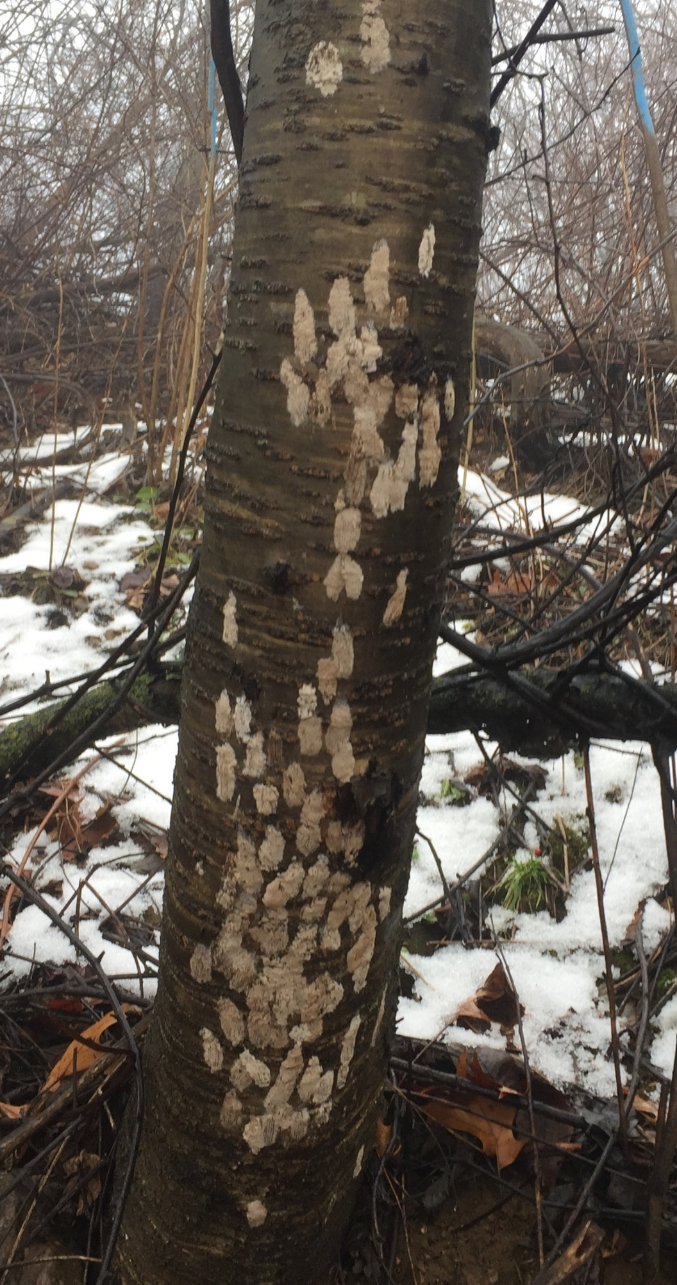
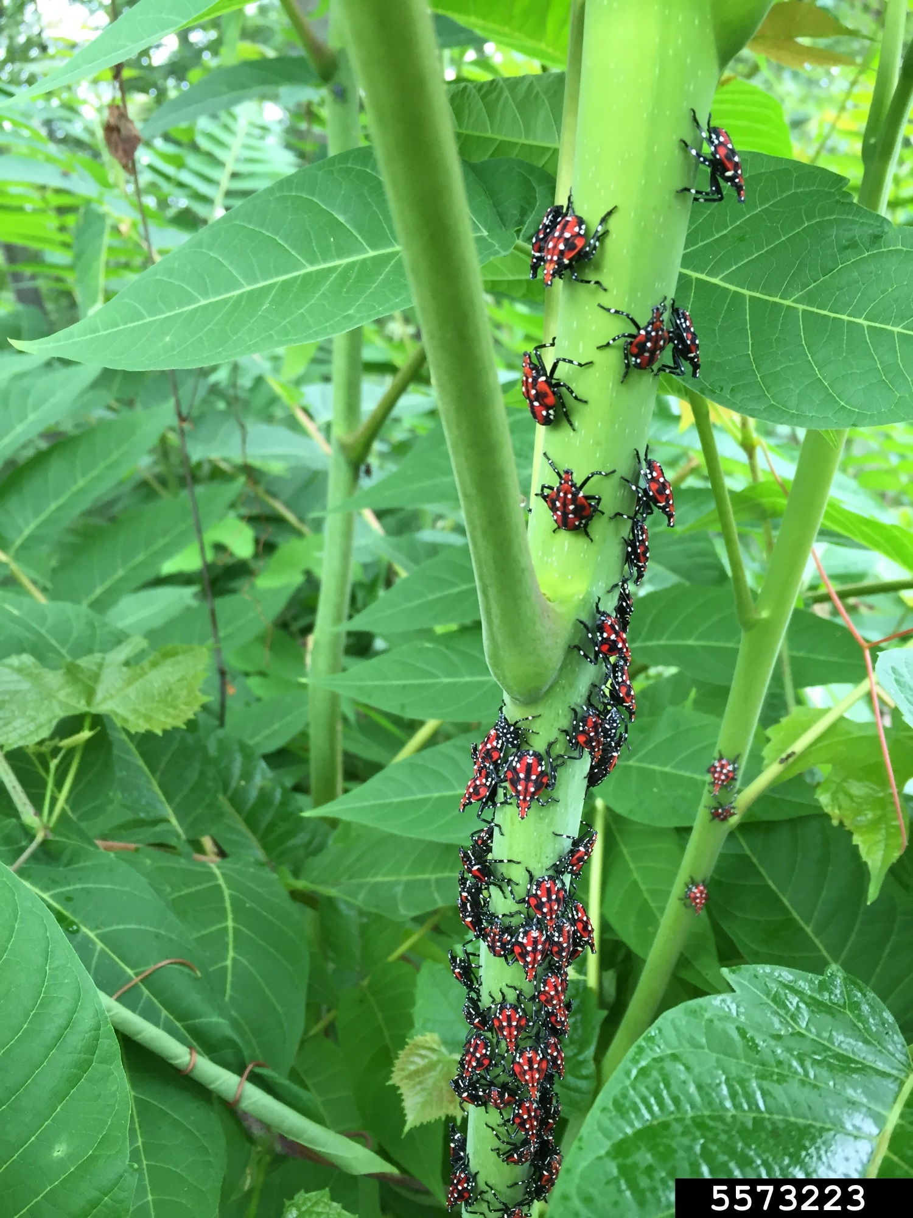
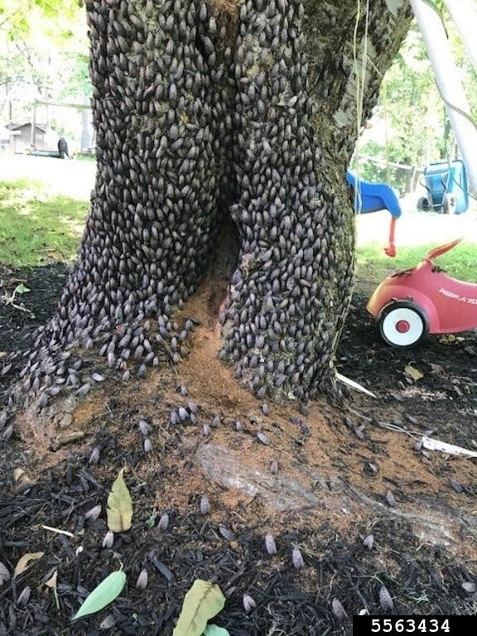
Why the concern over SLF?
Notes:
Eggs masses on birch
4th instars on Ailanthus
Adults on plum or cherry

Slide 23

Why the concern over SLF?
Notes:
SLF on grapes

Slide 24
Why the concern over SLF?
Notes:
SLF swarm over apple orchard

Slide 25
Why the concern over SLF?
Notes:
SLF on apples

Slide 26
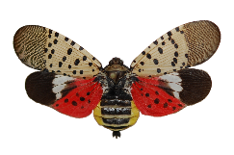
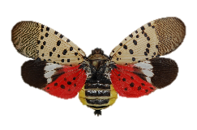
Approach: Control
Use preferred host, ailanthus, to our advantage
Reduce ailanthus presence
Treat remaining ailanthus with insecticide = Trap Tree
retreated annually
Notes:
Reduce ailanthus presence using herbicide.
Herbicide: Garlon
Treat the remaining ailanthus with insecticide establishing Trap Trees (trees to be retained and treated with systemic insecticide annually)
Insecticide: Dinotefuran, bark spray application.

Slide 27
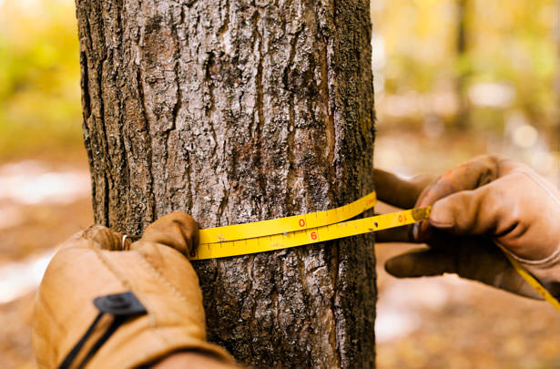
Approach: Control
<6” DBH =
Herbicide
April to Oct
>6” DBH =
Insecticide
May to Aug
Photo from concrete-landscape.com/how-to-properly-measure-your-tree-for-merit-injections
Notes:
The 6” DBH split:
Ailanthus trees below 6” DBH will be removed through herbicide application. Herbicide treatment window: April to October.
Ailanthus trees at or above 6” DBH will established as trap trees. Insecticide treatment window: May to August.

Slide 28
Regulatory Status of Spotted Lanternfly
Spotted lanternfly, Lycorma delicatula (White), was first detected in Berks County, Pennsylvania in 2014.

Slide 29
Regulatory Status of Spotted Lanternfly
Spotted lanternfly, Lycorma delicatula (White), was first detected in Berks County, Pennsylvania in 2014.
Believed to have been introduced from Asia in 2012 on stone products.

Slide 30
Regulatory Status of Spotted Lanternfly
Spotted lanternfly, Lycorma delicatula (White), was first detected in Berks County, Pennsylvania in 2014.
Believed to have been introduced from Asia in 2012 on stone products.
13 counties in Pennsylvania have been placed under quarantine for this pest.

Slide 31
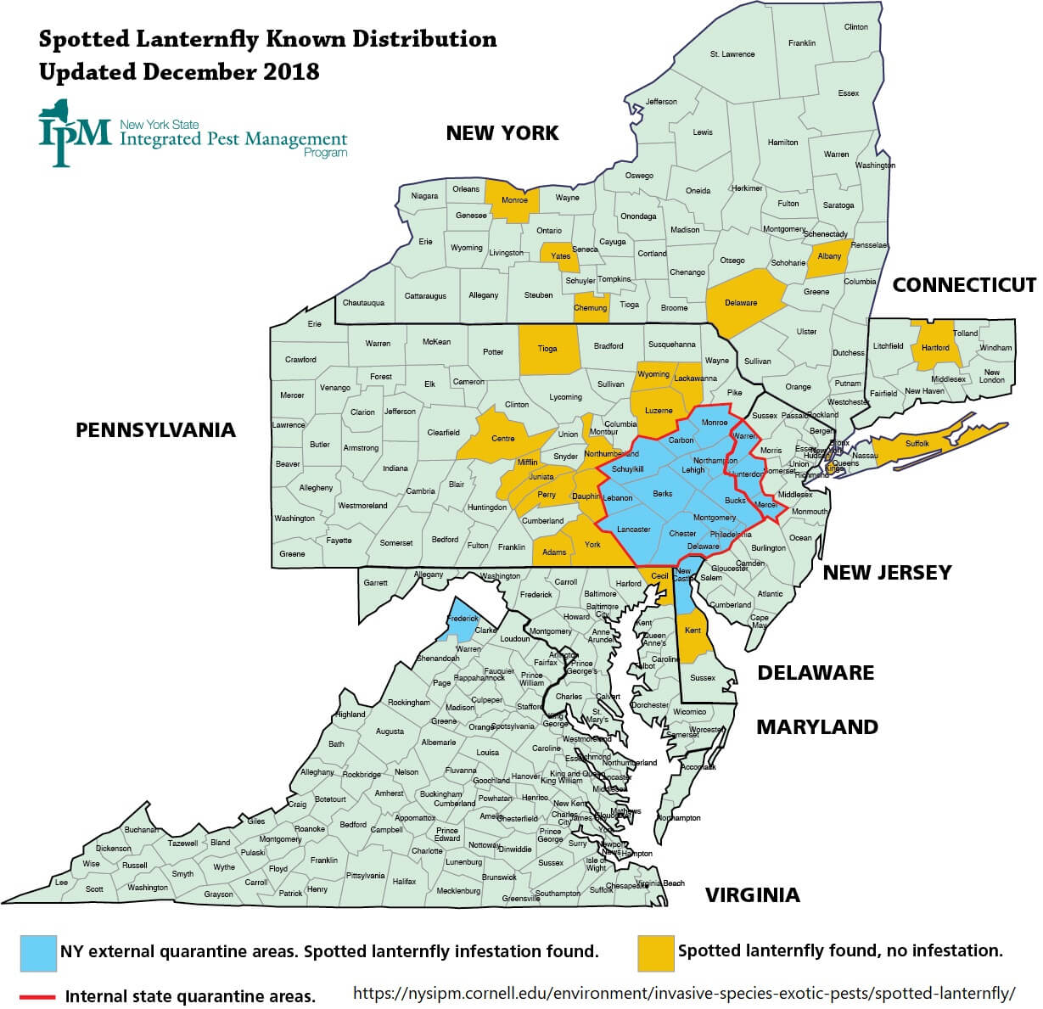
Regulatory Status of Spotted Lanternfly
Spotted lanternfly, Lycorma delicatula (White), was first detected in Berks County, Pennsylvania in 2014.
Believed to have been introduced from Asia in 2012 on stone products.
13 counties in Pennsylvania have been placed under quarantine for this pest.
As of February 2019 SLF has been intercepted in Connecticut, Delaware, Maryland, Massachusetts, New Jersey, New York, and Virginia

Slide 32
Regulatory Status of Spotted Lanternfly
Quarantines by State
Pennsylvania – began by quarantining municipalities then quickly shifted to counties
Delaware – New castle County specific to zip codes
New Jersey – Warren, Hunterdon, Mercer counties under quarantine
New York – external quarantine on Delaware, New Jersey, Pennsylvania, and Virginia
Virginia – nothing yet

Slide 33
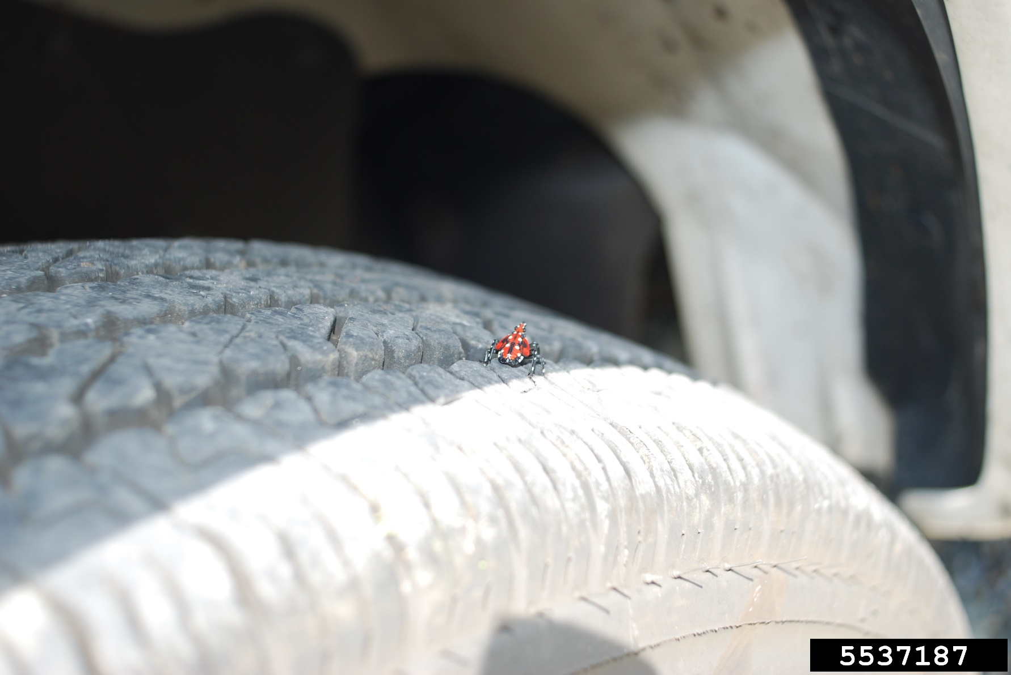
So what’s actually regulated?
Regulated Articles:
Any living stage of SLF including egg masses, nymphs, and adults
Brush, debris, bark, or yard waste
Landscaping, remodeling or construction waste
Logs, stumps or any tree parts
Firewood of any species
Grapevines for decorative purposes or as nursery stock
Nursery stock
Crated materials
Outdoor household articles including recreational vehicles, lawn tractors and mowers, mower decks, grill and furniture covers, tarps, mobile homes, tile, stone, deck boards, mobile fire pits, any associated equipment and trucks or vehicles not stored indoors

Slide 34
So what’s actually regulated?
Regulated Articles:
Any living stage of SLF including egg masses, nymphs, and adults
Brush, debris, bark, or yard waste
Landscaping, remodeling or construction waste
Logs, stumps or any tree parts
Firewood of any species
Grapevines for decorative purposes or as nursery stock
Nursery stock
Crated materials
Outdoor household articles including recreational vehicles, lawn tractors and mowers, mower decks, grill and furniture covers, tarps, mobile homes, tile, stone, deck boards, mobile fire pits, any associated equipment and trucks or vehicles not stored indoors
EVERYTHING!

Slide 35

The Spotted Lanternfly Permit
Businesses operating in the quarantine zone must have permits to move equipment and goods within and out of the zone.
Notes:
Over 100,000 permits have been issued to businesses
List is updated regularly and available online
WHO IS THIS FOR?
This is a “train the trainer” course to train designated employees -­ usually an owner, manager, or supervisor - ­ within a company on how to comply with the quarantine regulations. The designated employee must then train fellow employees.
WHAT WILL YOU LEARN?
You will learn how to:
understand the importance of stopping spotted lanternfly
outline the lifecycle and habits of spotted lanternfly
understand why there is a quarantine zone and how it works
find and destroy spotted lanternfly
implement best practices to follow as you work in the quarantine zone

Slide 36
What studies are underway?
Host preference and suitability studies
  Is tree-of-heaven required for SLF to complete its life cycle?
Traps & Lures
  Web-cote sticky bands vs. Bug Barriers vs. Circle traps
  Attractants: methyl salicylate, pheromone
Biological control
  Predators in North America: Apoecilus cynicus (Pentatomidae), Arilus cristatus (Reduviidae), preying mantids, spiders
  Fungal pathogens: Entomophaga sp.
  Parasitoids: Ooencyrtus kuvanae, Dryinus lycormae, Dryinus sp. nr. browni, Anastatus orientalis

Slide 37
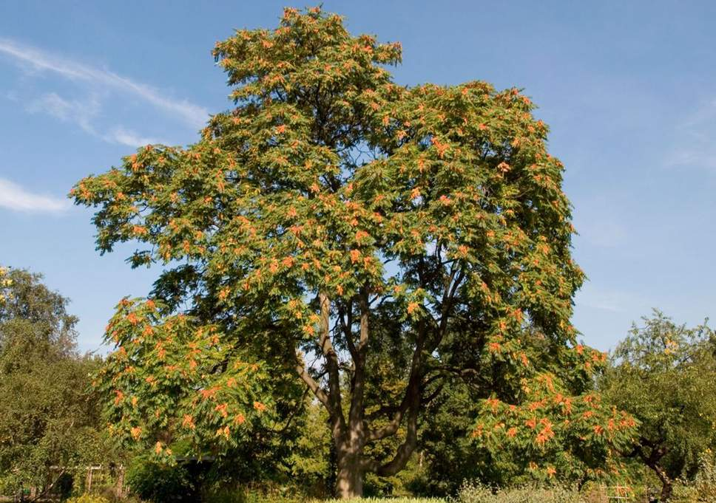
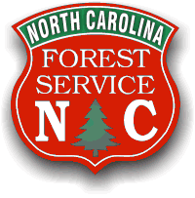


What is the plan for North Carolina?
Farm Bill Funding to complete a statewide survey for Tree-of-Heaven
Visual survey for life stages:
State Parks
Rest areas
Railyards
Hardscape businesses
Metropolitan areas
Tourist hotspots (NASCAR, campgrounds, beaches, etc.)
Outreach
Working closely with NC Forest Service, NC Cooperative Extension, North Carolina State University
Notes:
USDA funding incumbent upon surveying for tree-of-heaven similar to the ash survey when EAB was first exploding
Outreach: presenting at commodity events throughout the state, BugFest, State Fair, Green and Growin’ Show, etc.

Slide 38
Questions?
Contact Whitney Swink at whitney.swink@ncagr.gov or (919)707-3742

