Slide 1
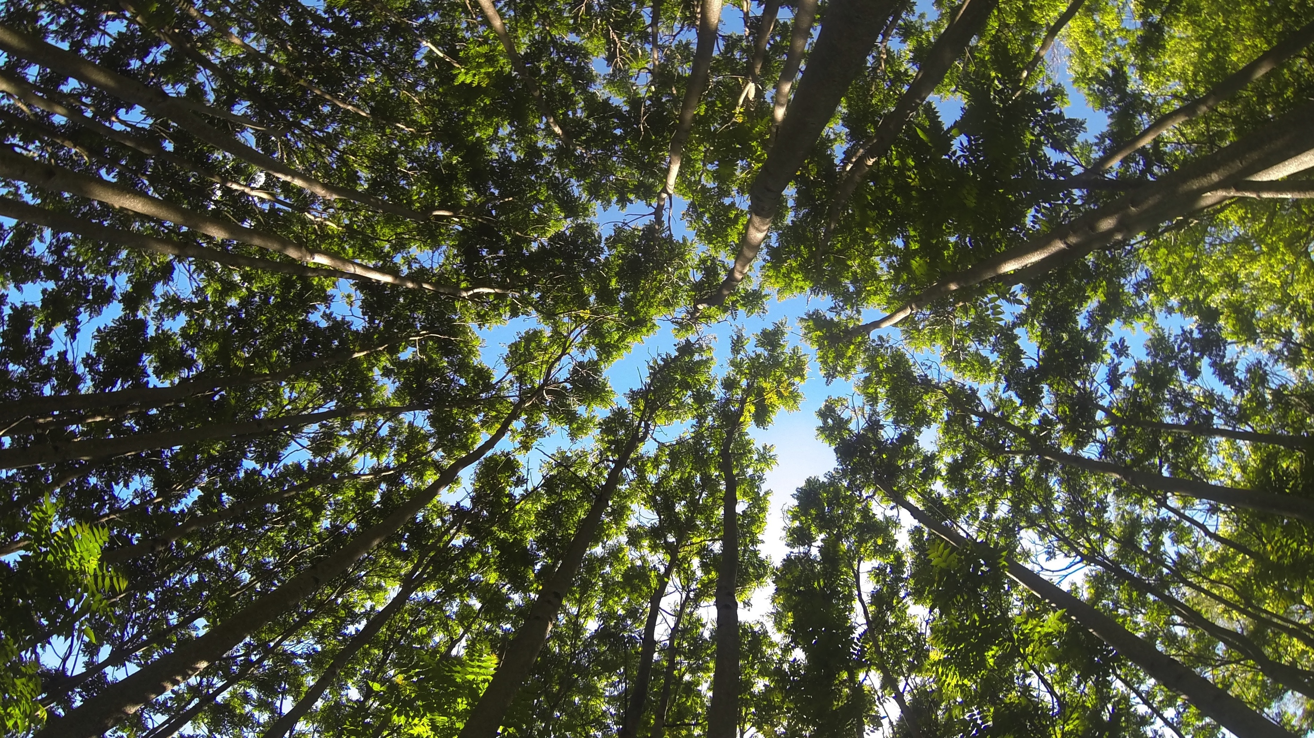
Ailanthus altissima (tree-of-heaven) and Verticillium wilt
Rachel Brooks, Scott Salom, & Anton Baudoin

Slide 2
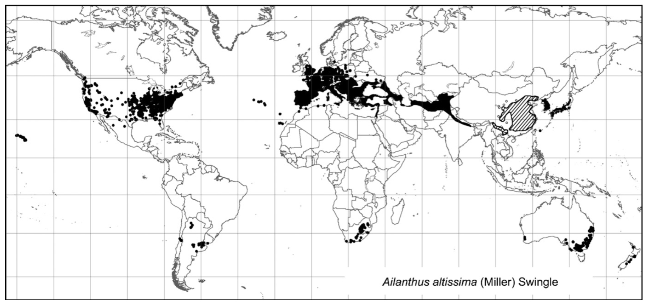
Current distribution
1784
(Kowarik et al. 2007)

Slide 3
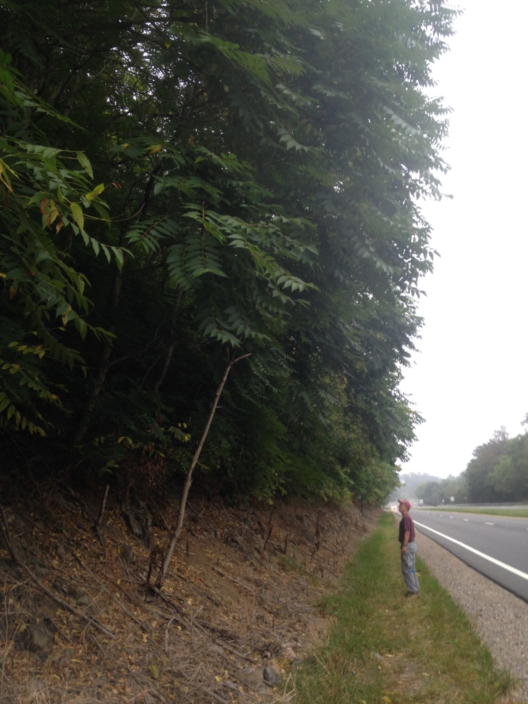
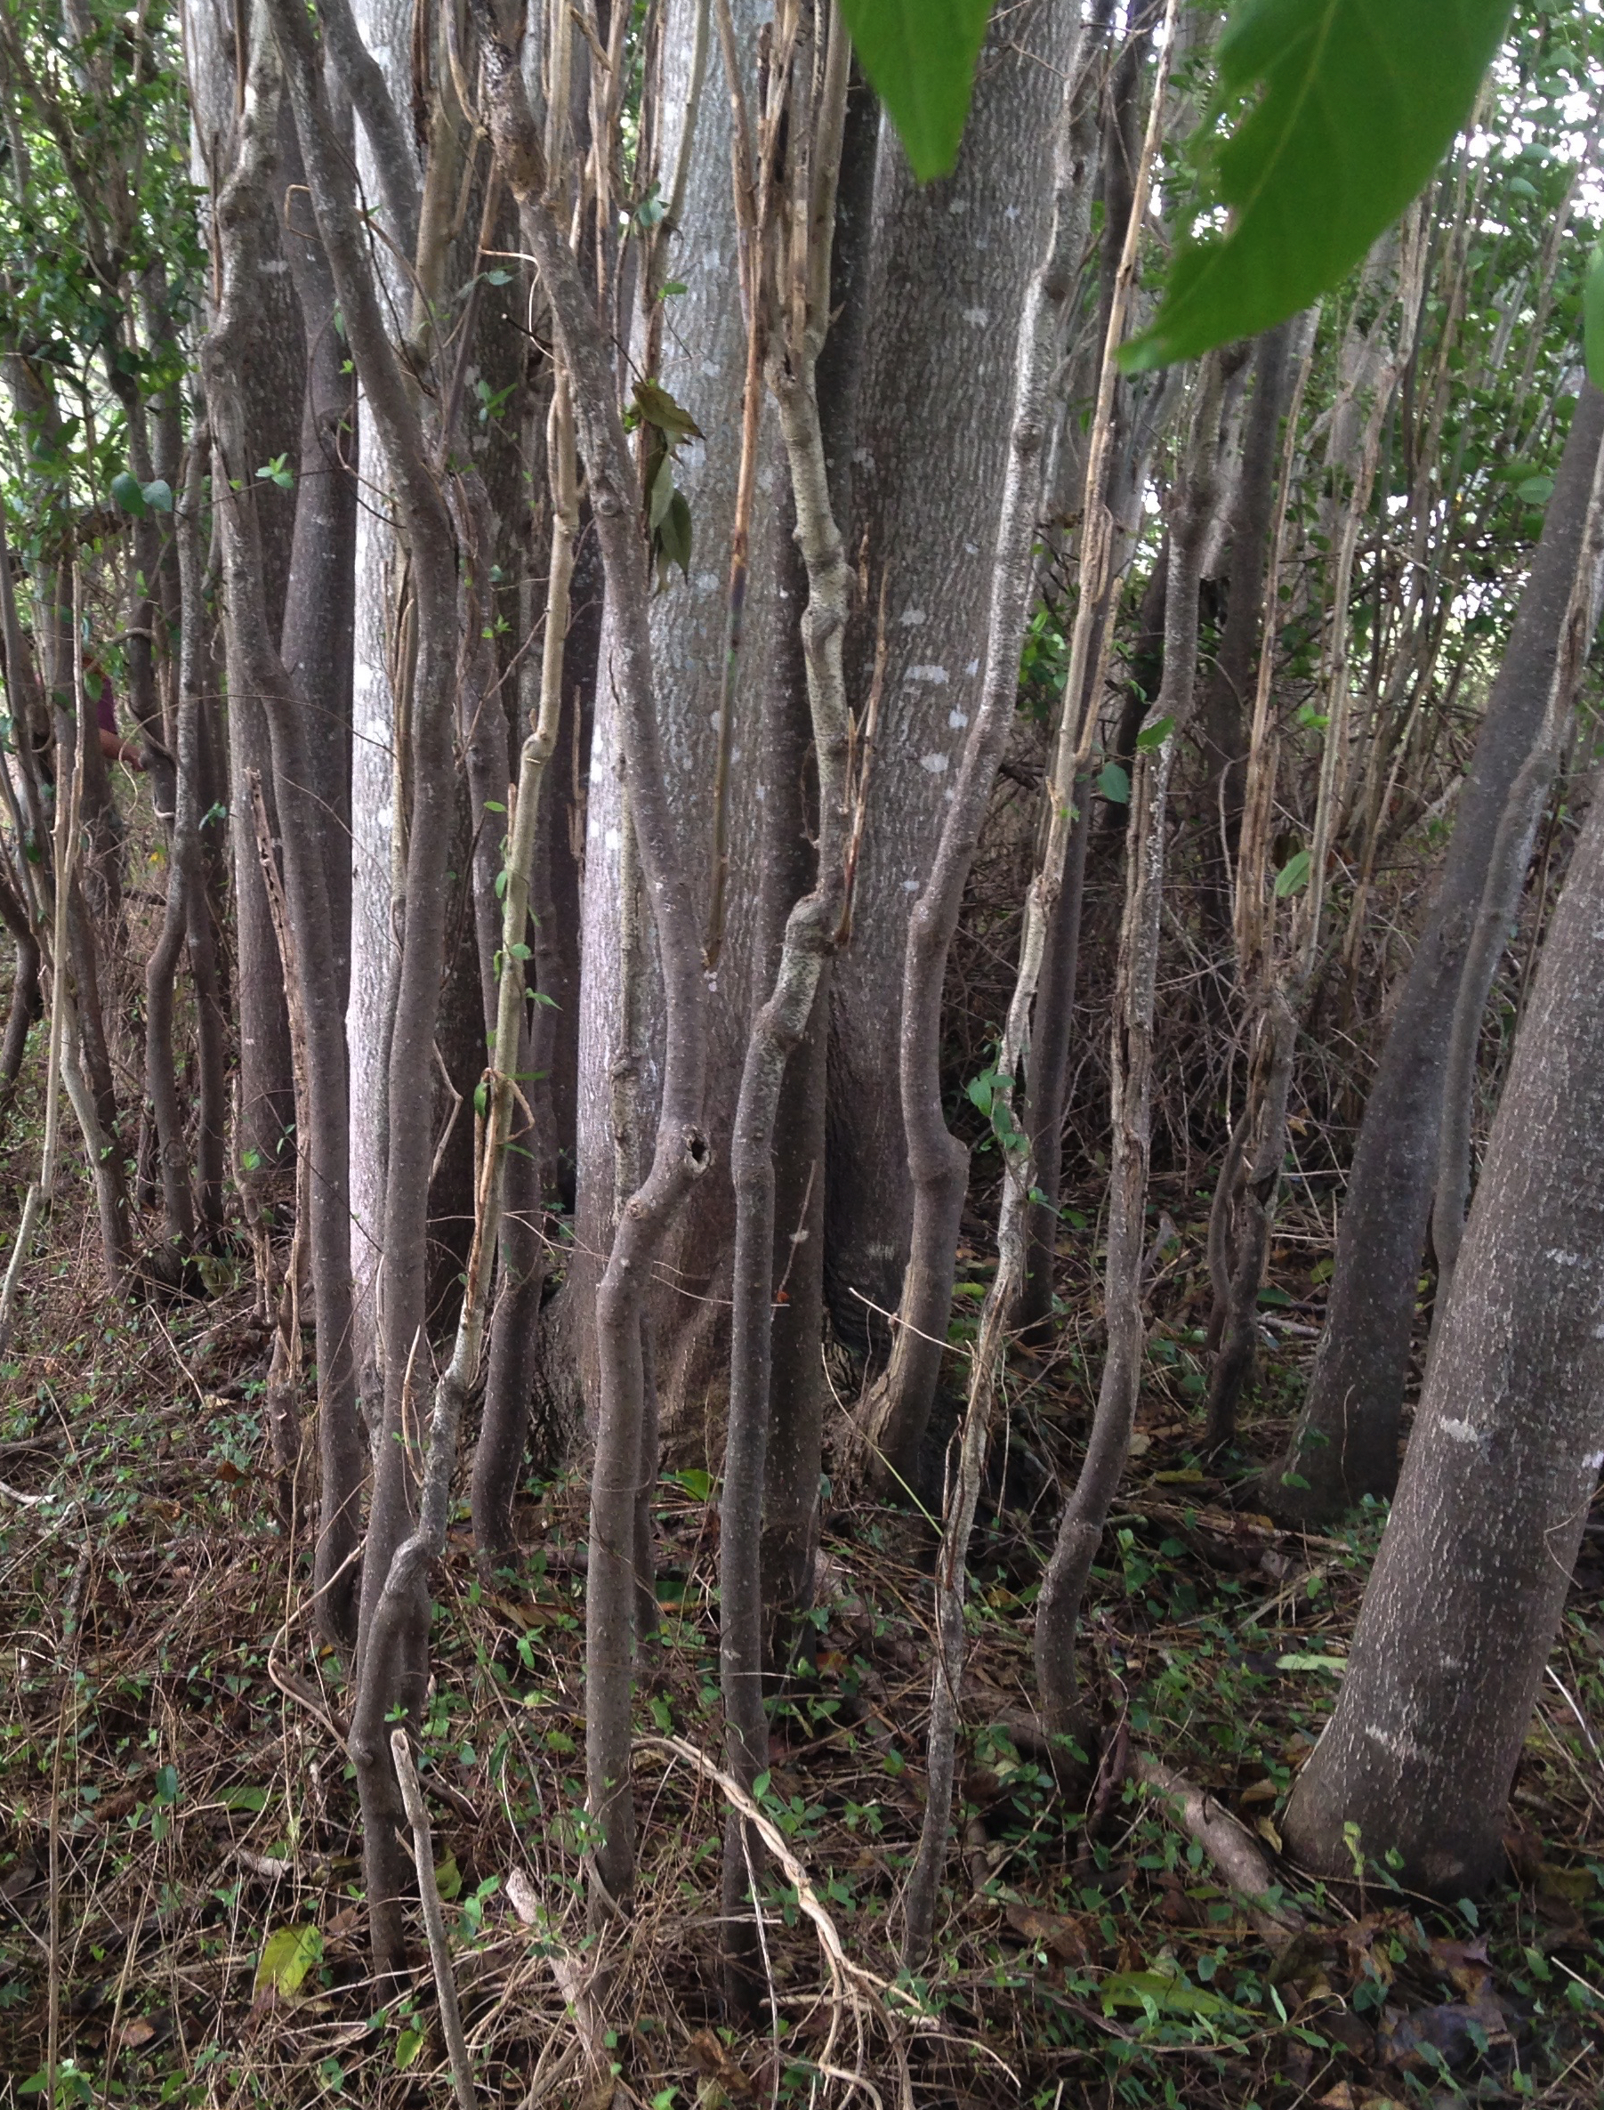
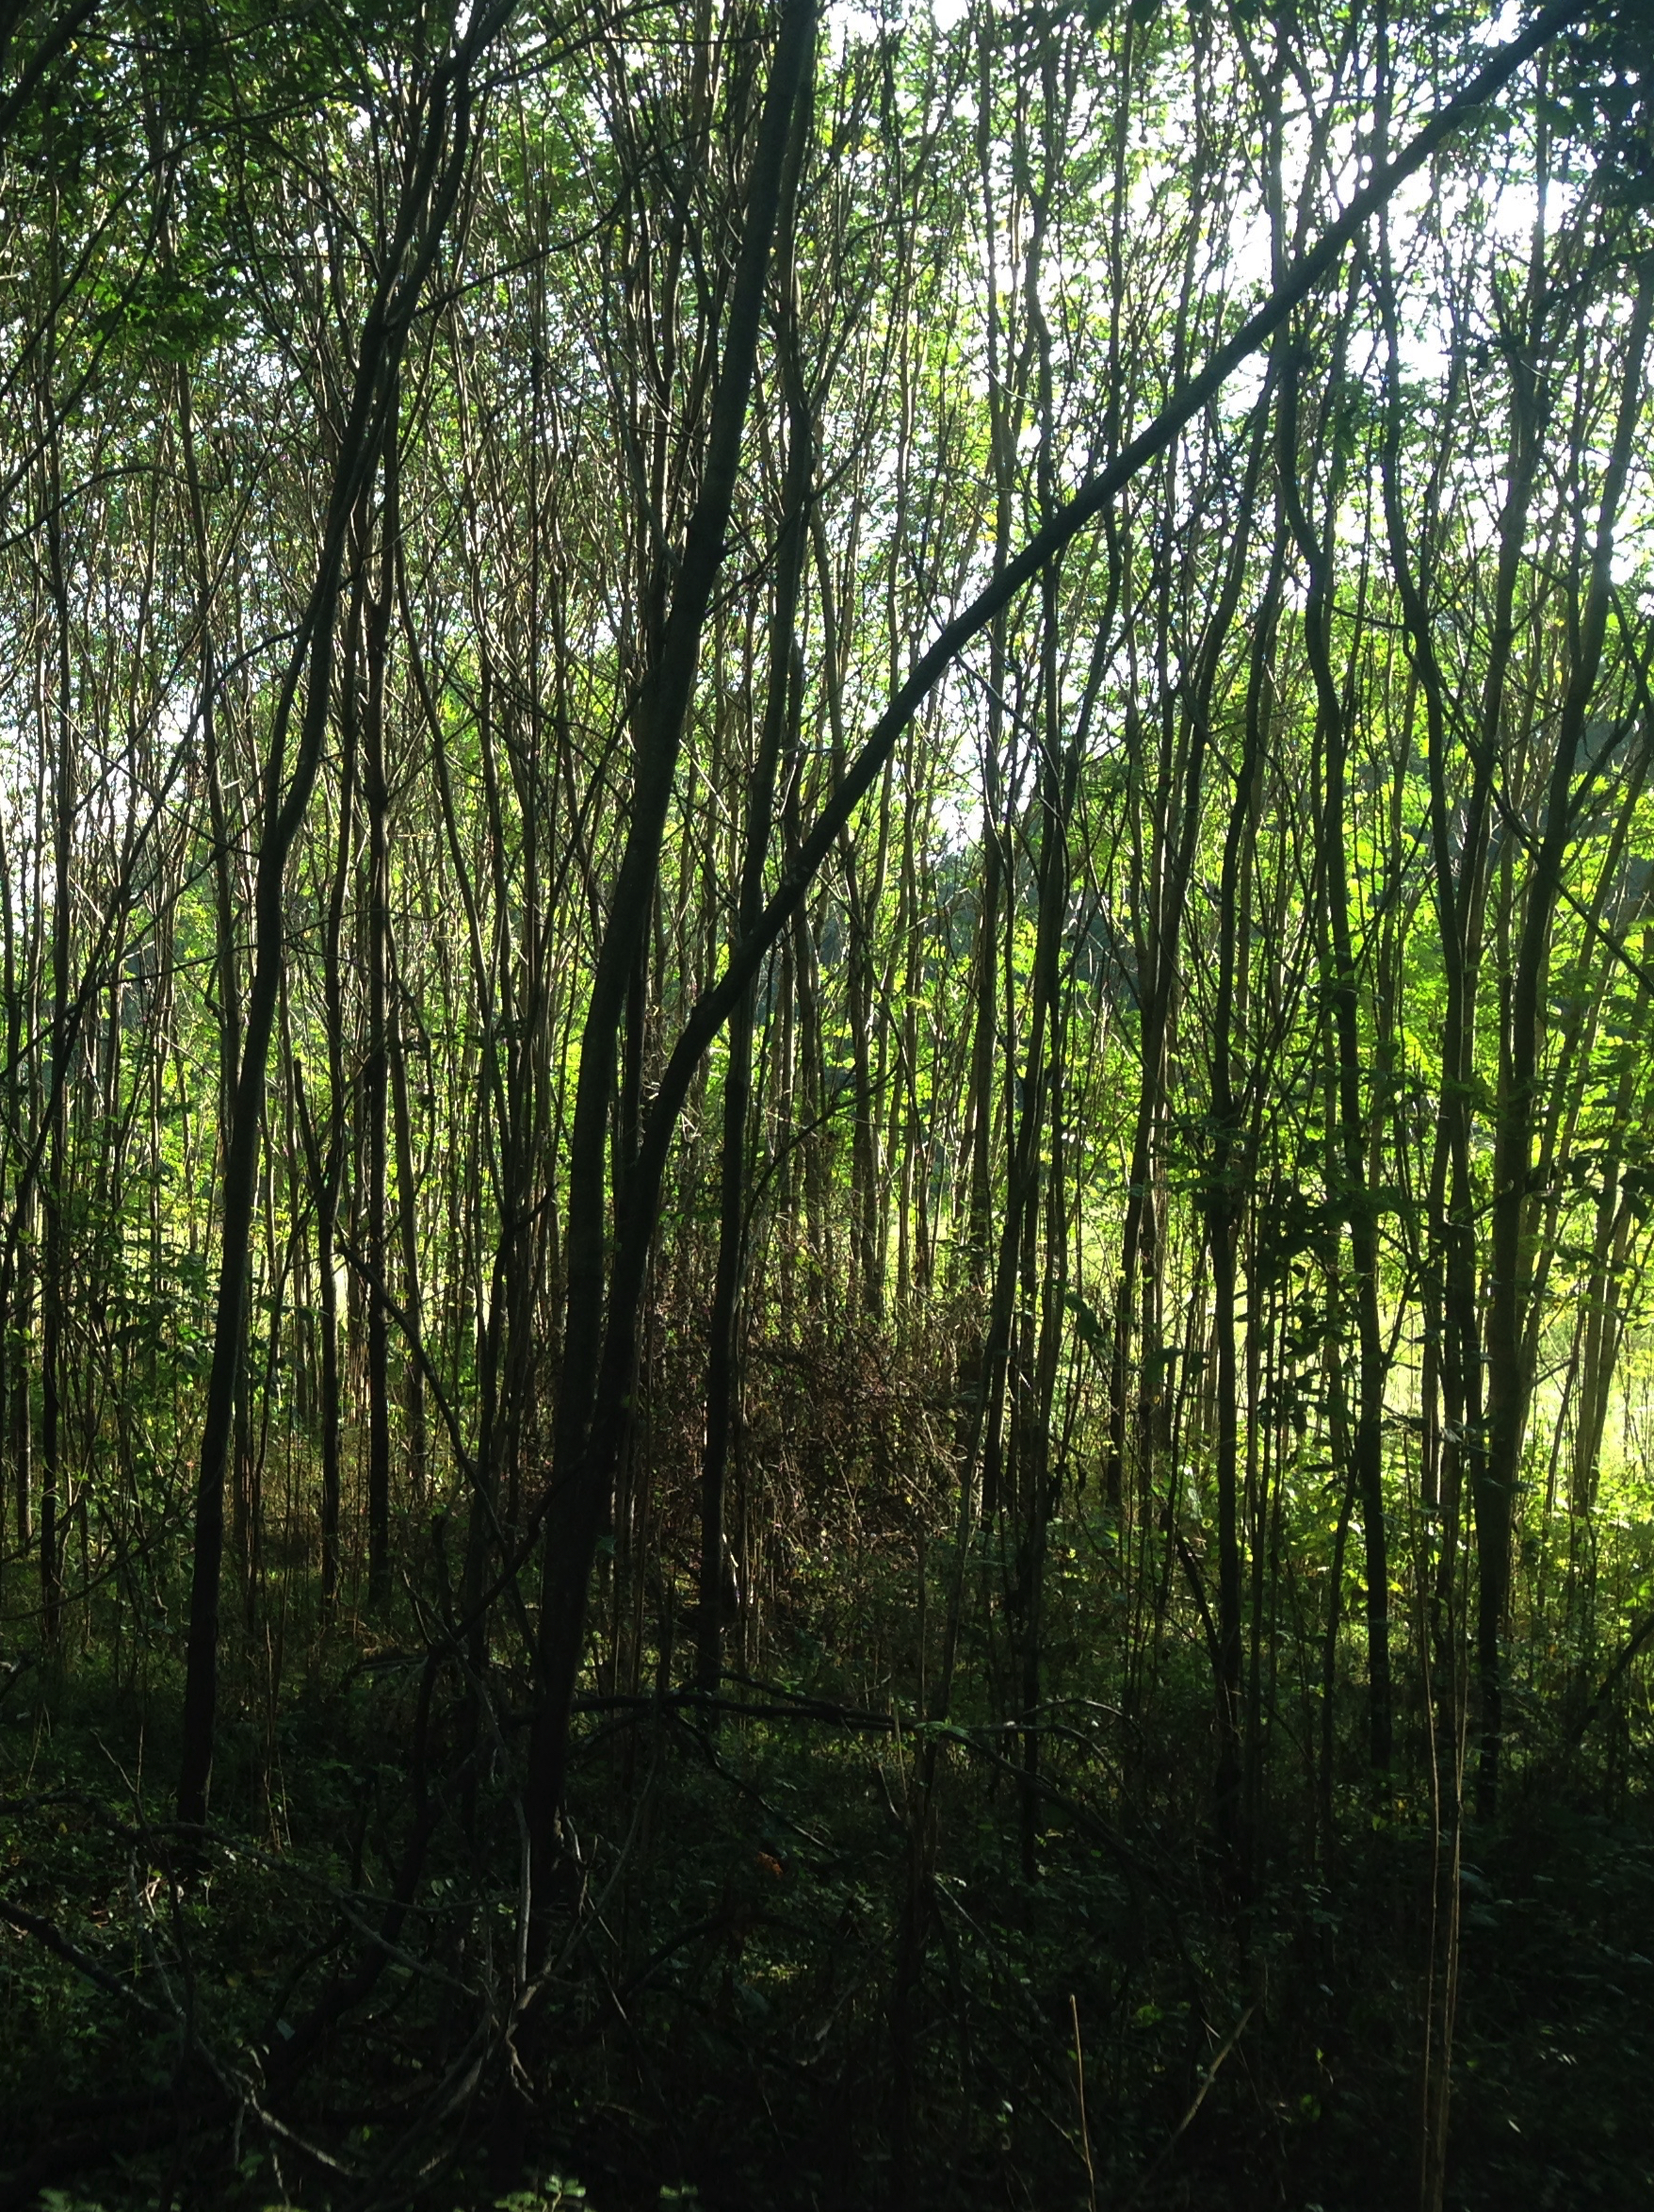
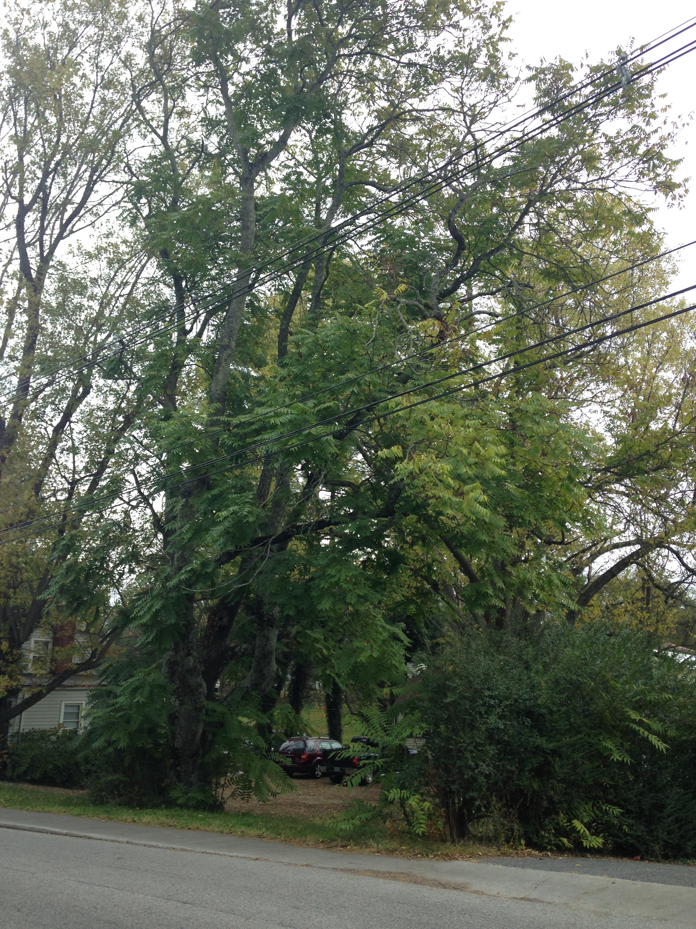
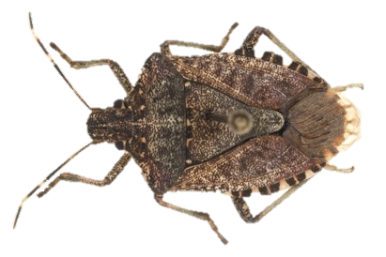
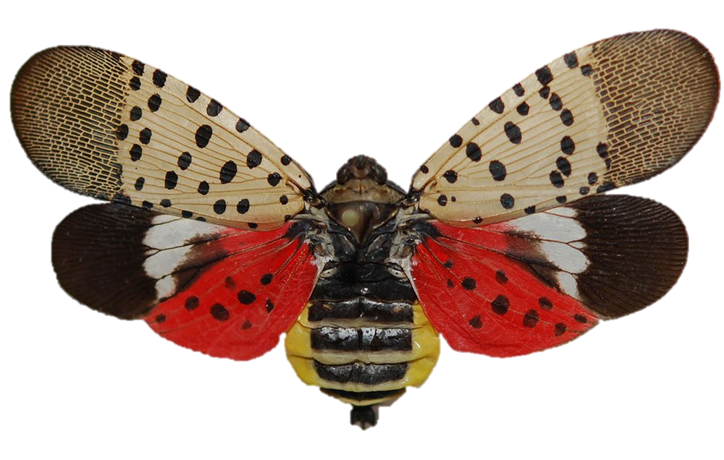
Ailanthus in Virginia
Roadways
Forests
Urban areas
Agricultural lands
Notes:
Roadways: blocks line-of-sight
Forests: outcompetes native veg, decreases native species richness
Urban: messy yard tree, produces allergenic pollen, cause contact dermatitis
Agricultural: invades field lands
Control: widespread and long-term = losing battle, not realistic, ineffective

Slide 4
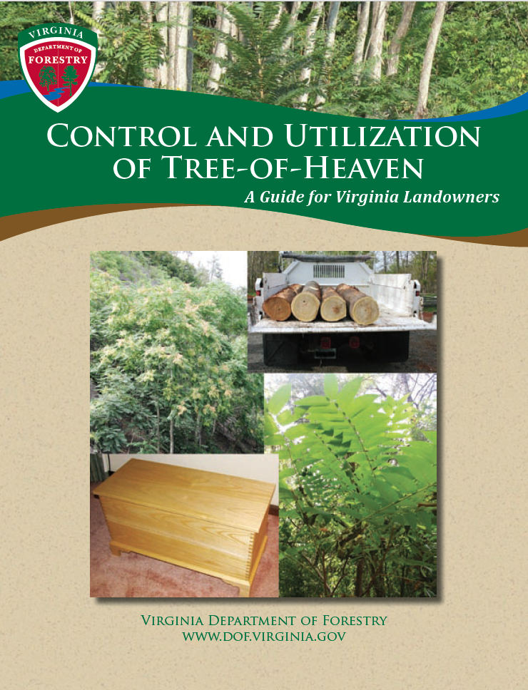
Current Control Options
General “rules”:
Combination of mechanical and chemical treatment
Target seed-bearing trees first
Resurvey and retreat yearly
Costly and time consuming
Notes:
Manual/Mechanical:
Pulling, cutting, digging, girdling, chopping, cutting, mowing, scarification, etc.
Chemical:
Foliar spray, cut stump treatments, hack-and-squirt, etc.
Can be costly!!
$25,000 spent in Shenandoah NP
$8,750/ha (Kok et al. 2008)
General “rules”:
Combination of mechanical and chemical
Target seed-bearing trees first
Resurvey and retreat yearly

Slide 5
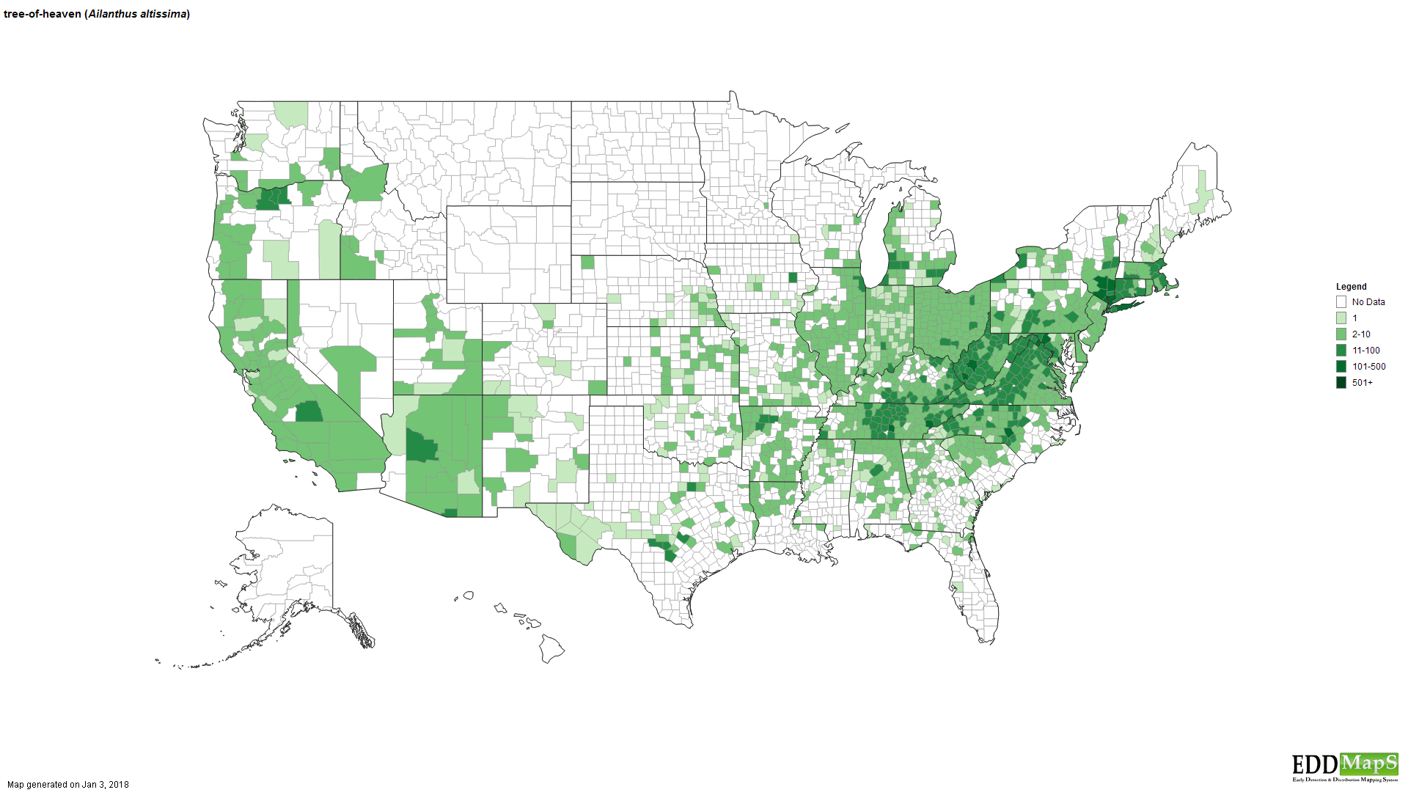
Today

Slide 6
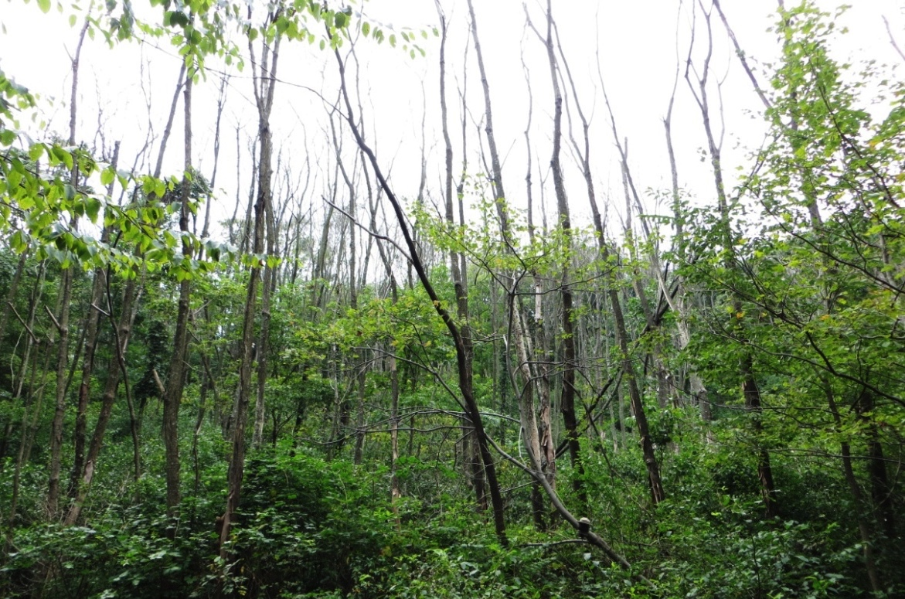
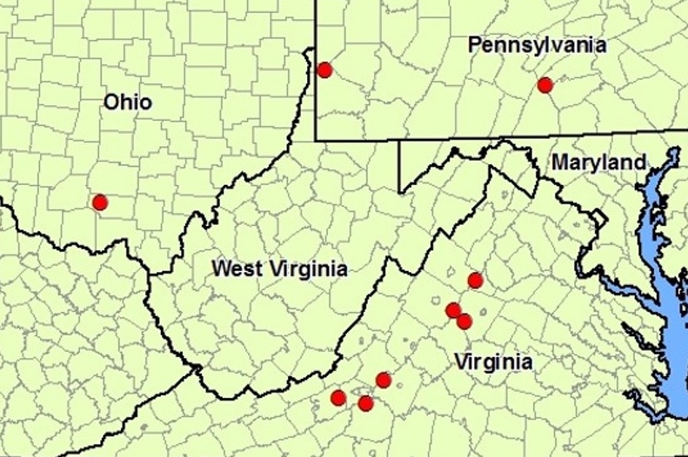
Areas of decline
Causing severe damage only on Ailanthus
2002
2012
2009
(Schall and Davis 2009, Snyder et al 2013, Snyder et al 2014, Rebbeck et al 2013)
Notes:
*Field observations show no other species impacted!
Using what is already here
No permitting!
Less risk!
Insects
Damage “insignificant”
Pathogens
Very rare
One major disease: Verticillium Wilt

Slide 7
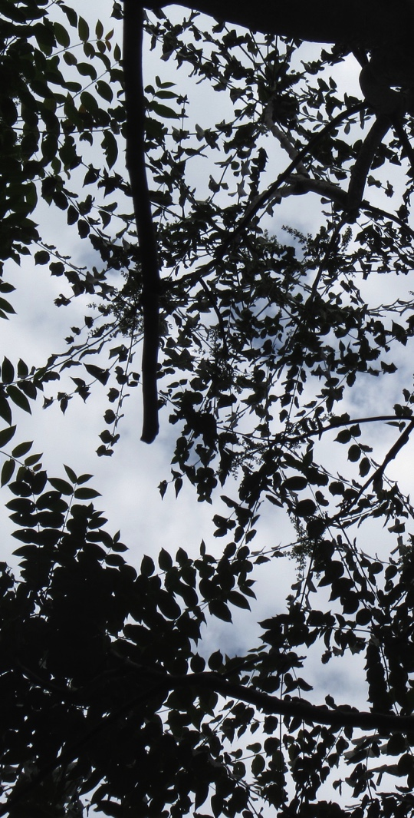
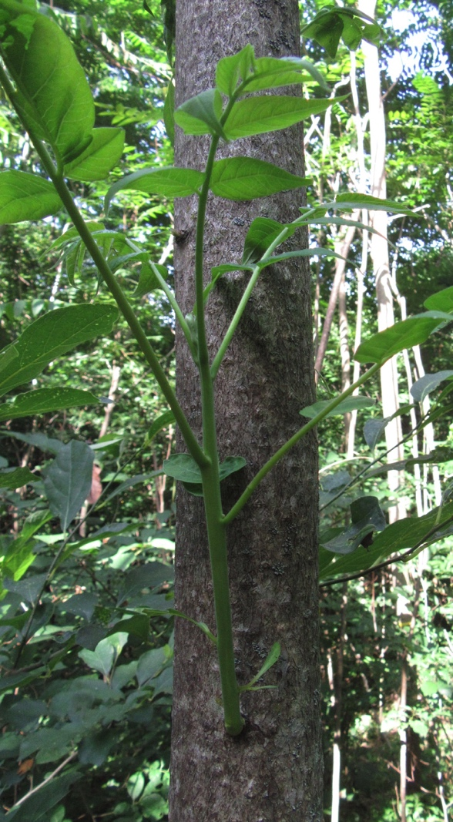
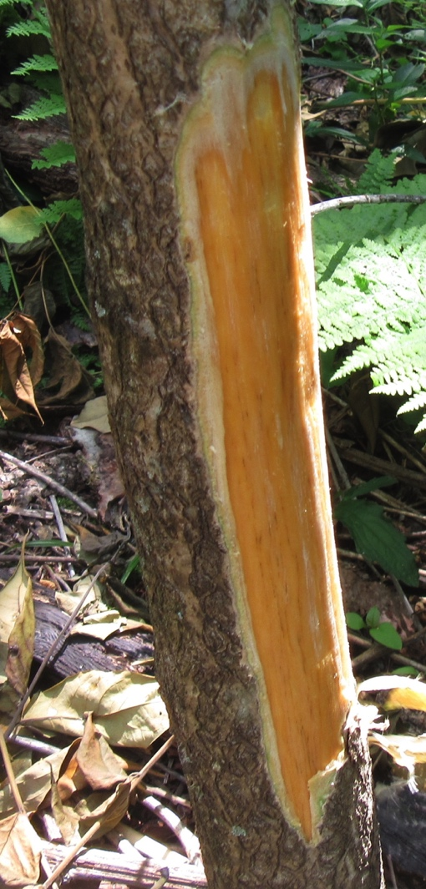
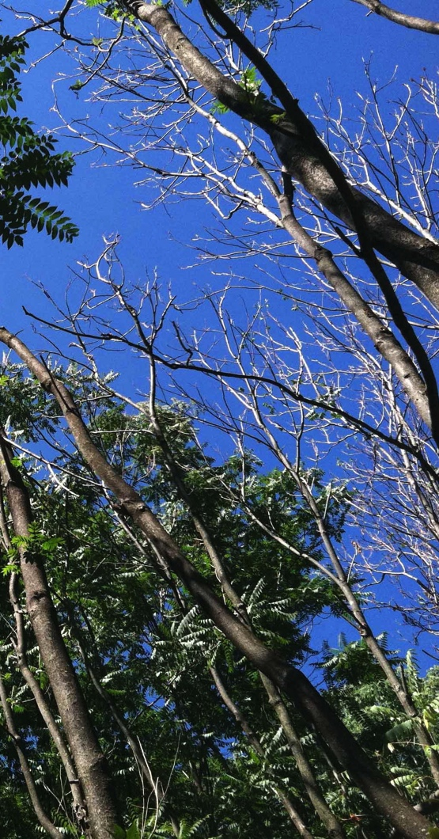
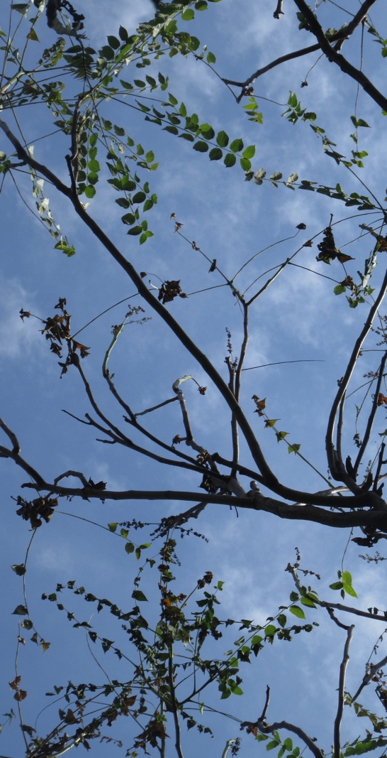
Disease symptoms

Slide 8
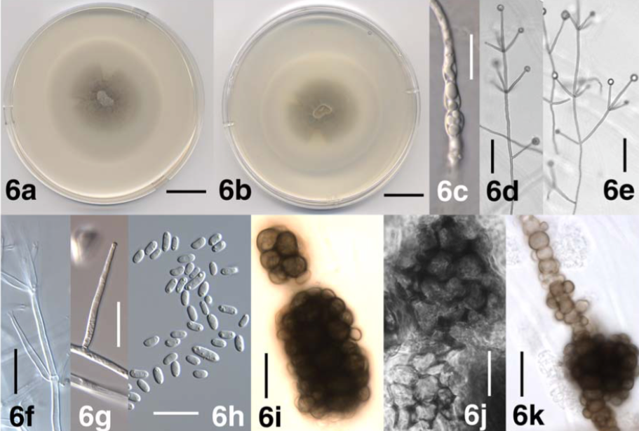
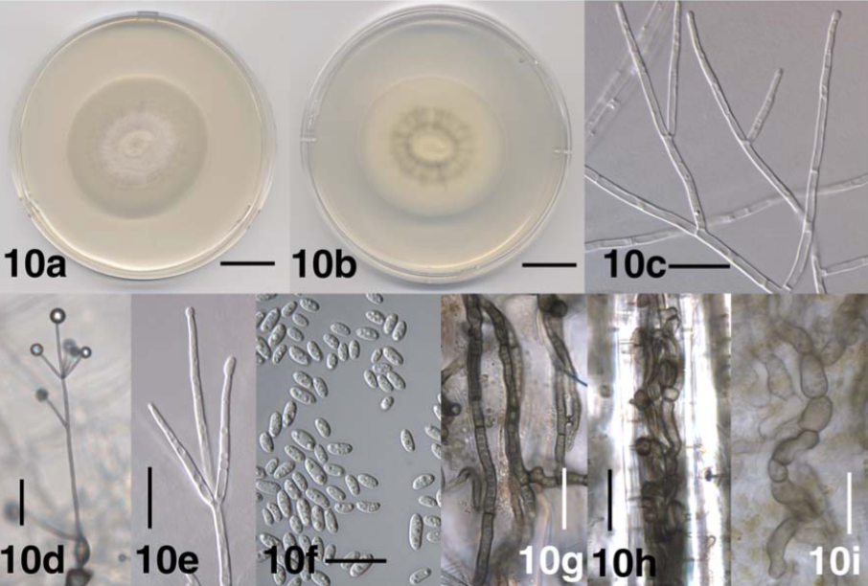
Verticillium wilt disease
Verticillium dahliae (Vd)
Verticillium nonalfalfae (Vn)
(Inderbitzin et al. 2011)

Slide 9
Verticillium wilt disease cycle
(Pegg and Brady 2002, Fradin and Thomma 2006, Hiemstra and Harris 1998)
Notes:
Resting structures in soil
Root exudate stimulates growth, fungi penetrates root tip
Hyphae colonize root cortex and enter stem xylem
Dungus produces conidia (asexual) to spread through xylem
Vascular stem compromised
Foliage wilts and dies
Restring structures develop within dead plant tissue
Resting structures return to soil

Slide 10
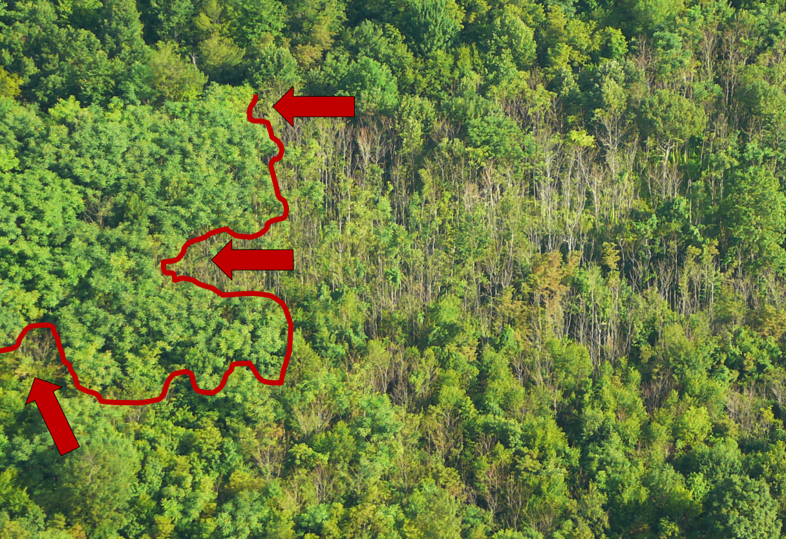
Studies in PA are promising!
Vn > Vd
Spreads through roots
Host specific
Inoculation is easy
Inoculation can occur year round
Effectively removes Ailanthus from a forest
(Schall and Davis 2009, Kasson et al 2014, O’Neal and Davis 2015, Schall 2008)

Slide 11
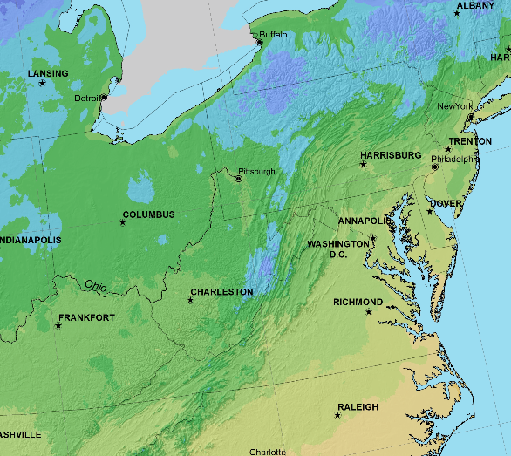
My research: regional inoculations
Are Verticillium fungi effective biocontrol agents in Virginia?
Are there any variables that might limit their success?

Slide 12
VA specific sites
Radford Army Ammunition Plant (RA)
Little North Mountain WMA (GM)
McCormick Farm AREC (SV)
Powhatan State Park (PW)
Sailor’s Creek Battlefield State Park (SC)
White Oak Mountain WMA (WM)

Slide 13
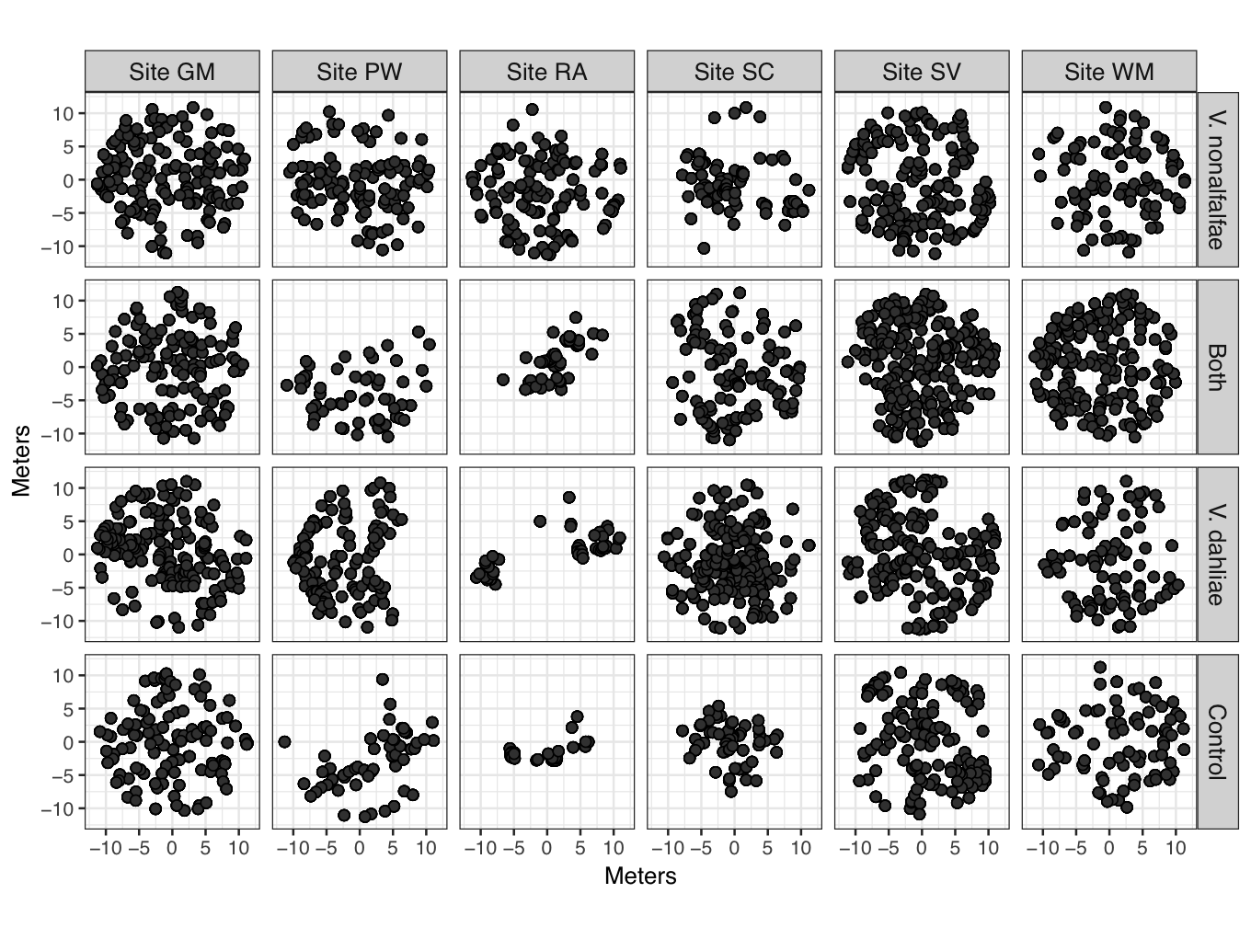
Site layout
Meters
Meters

Slide 14
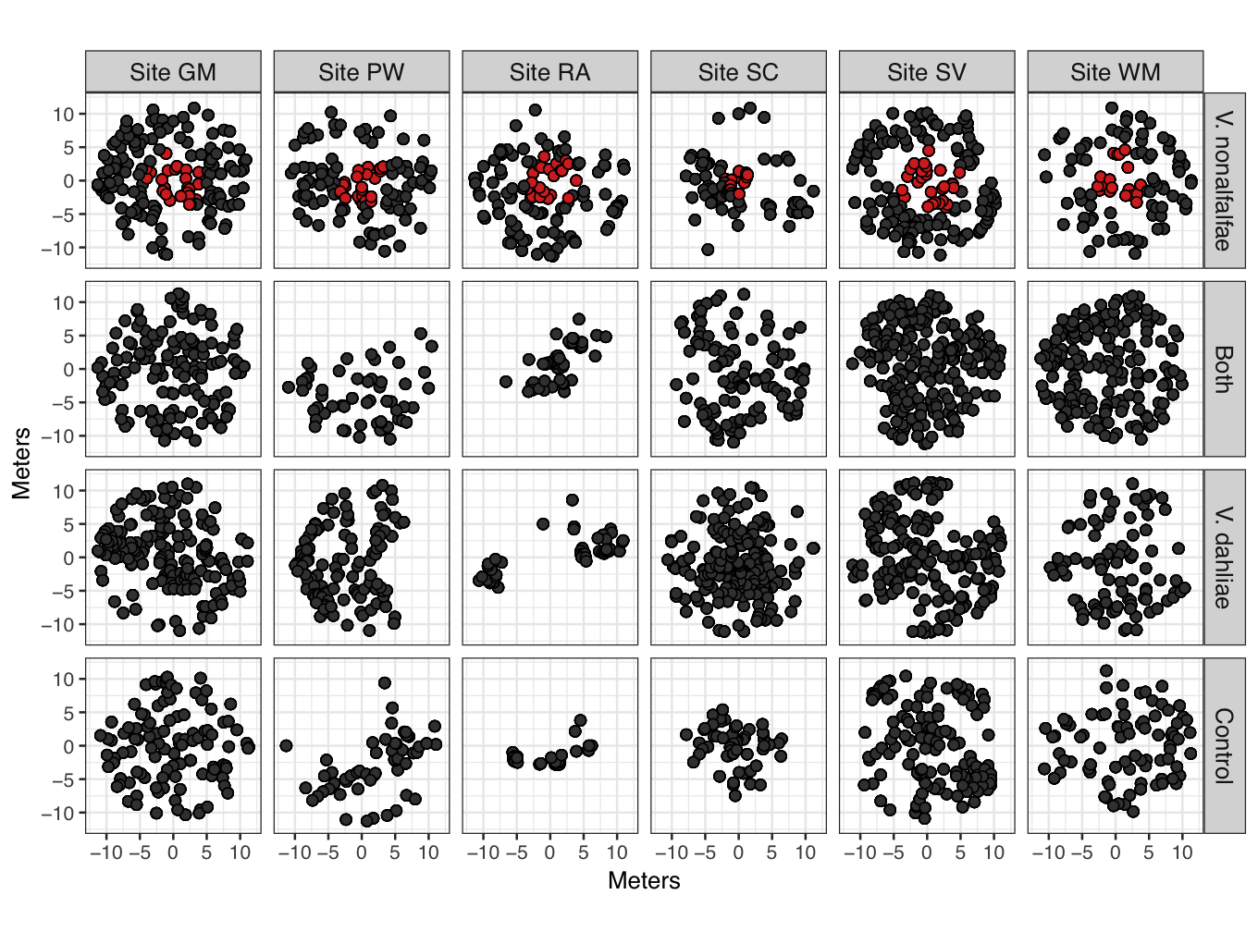
Site layout
Meters
Meters

Slide 15
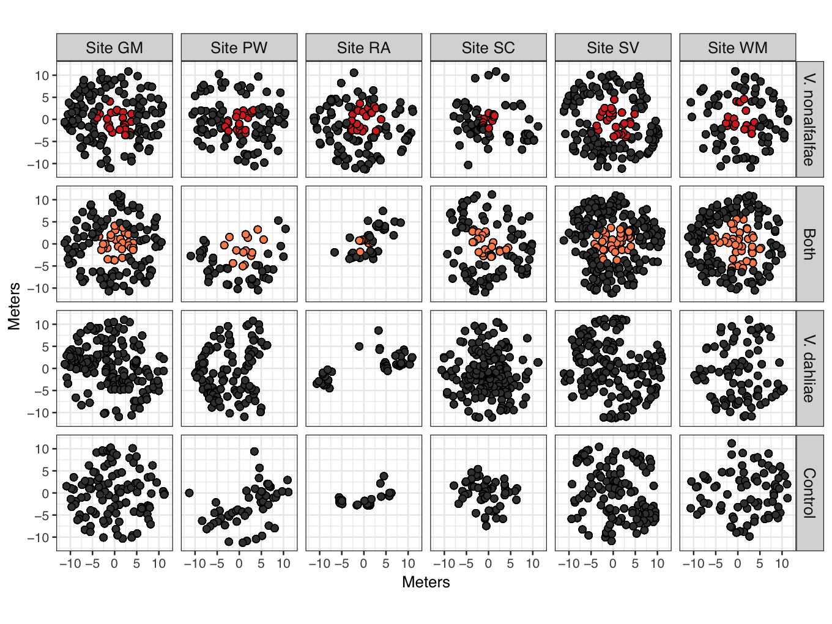
Site layout
Meters
Meters

Slide 16
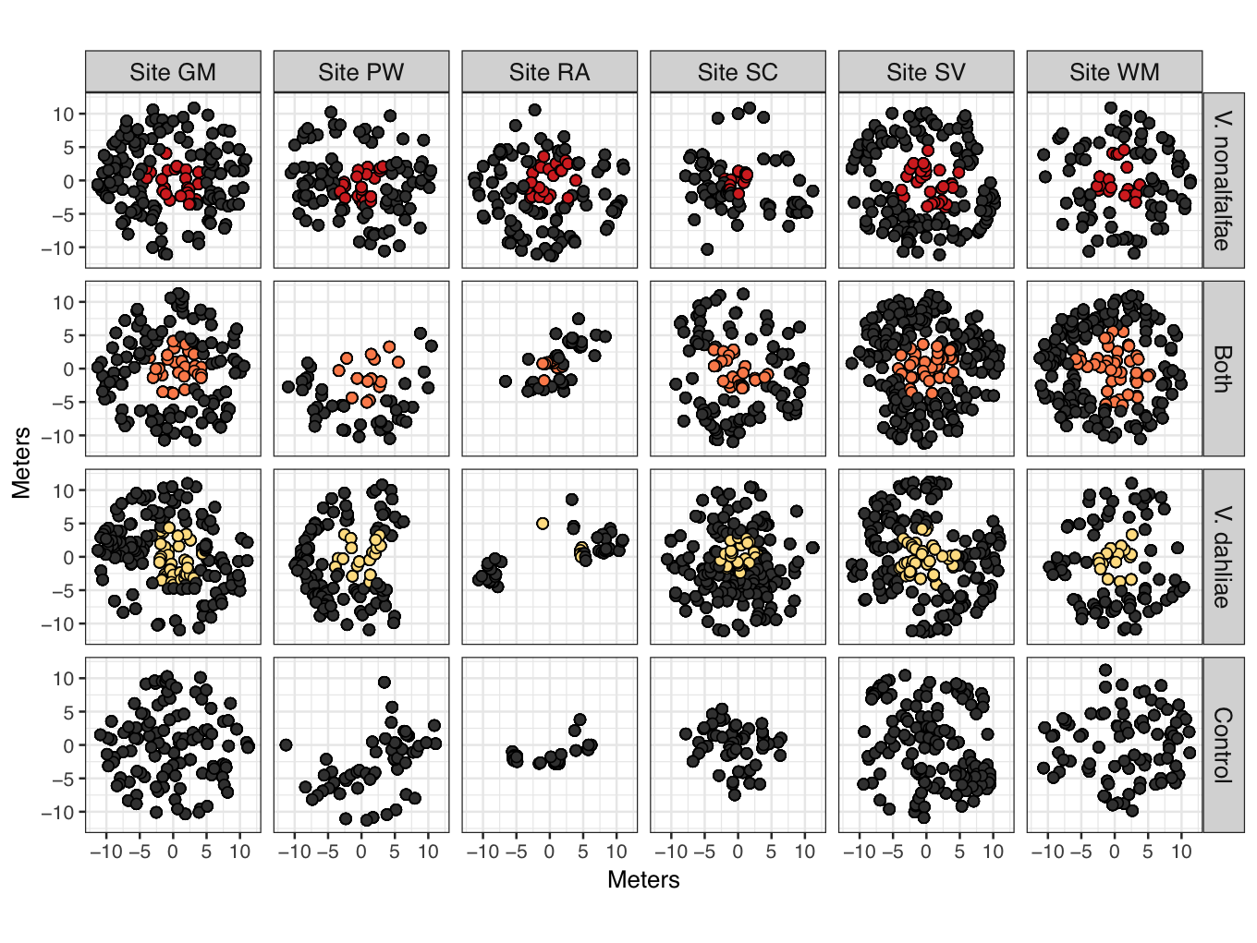
Site layout
Meters
Meters

Slide 17
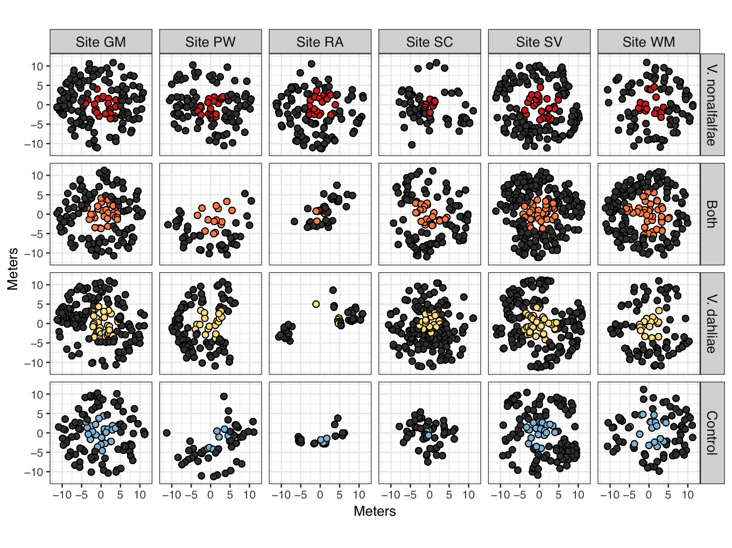
Site layout
Meters
Meters

Slide 18
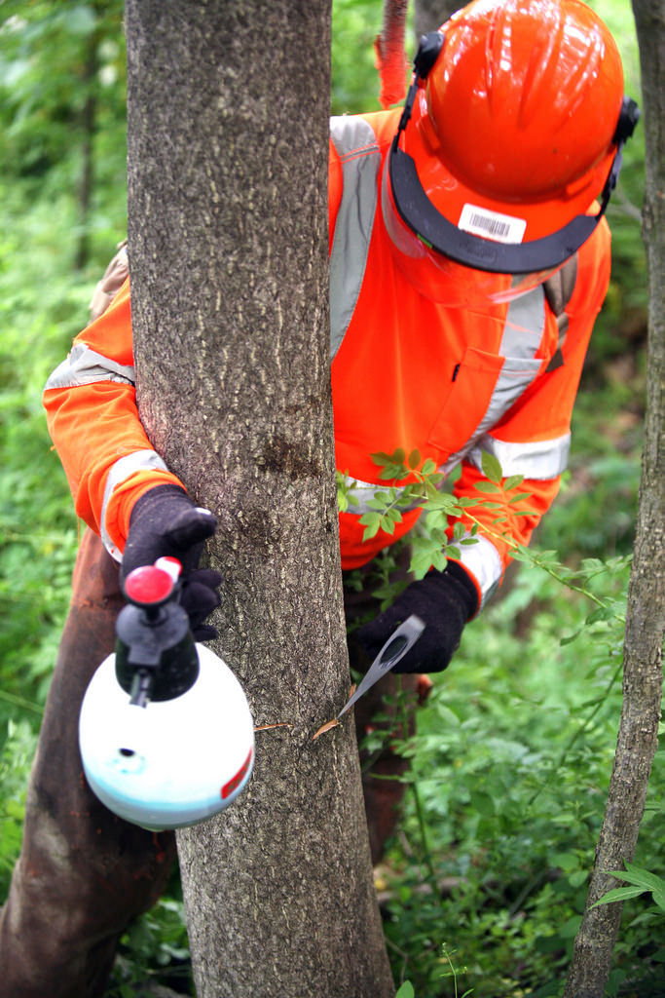

Hack n squirt inoculation method
OR
OR
(Photo Courtesy of Wayne National Forest)

Slide 19
0
Months Post Inoculation
(May 2017)
Control
Vd
Vn
Both

Slide 20
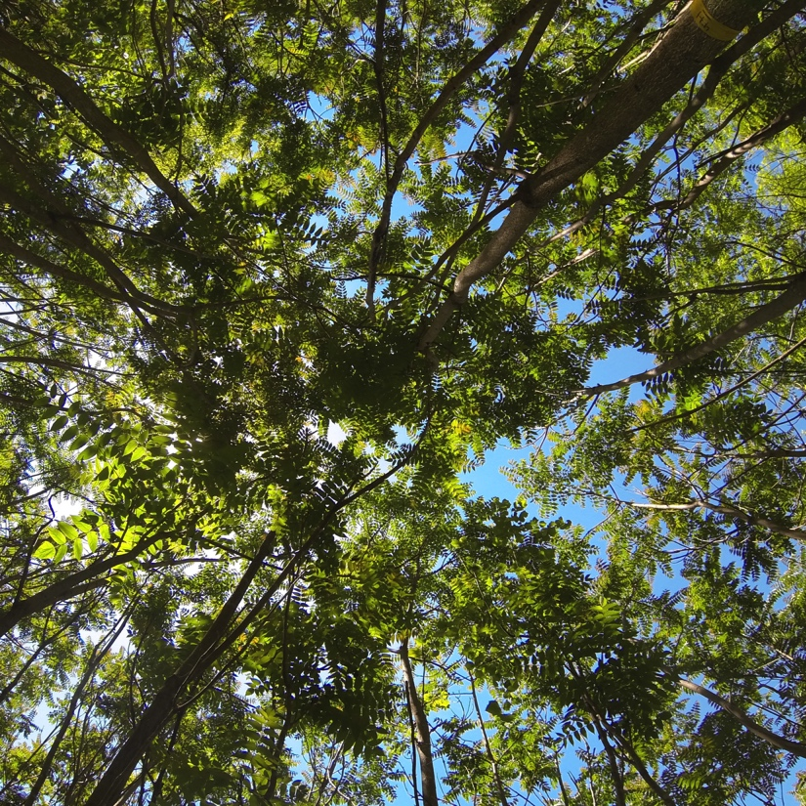
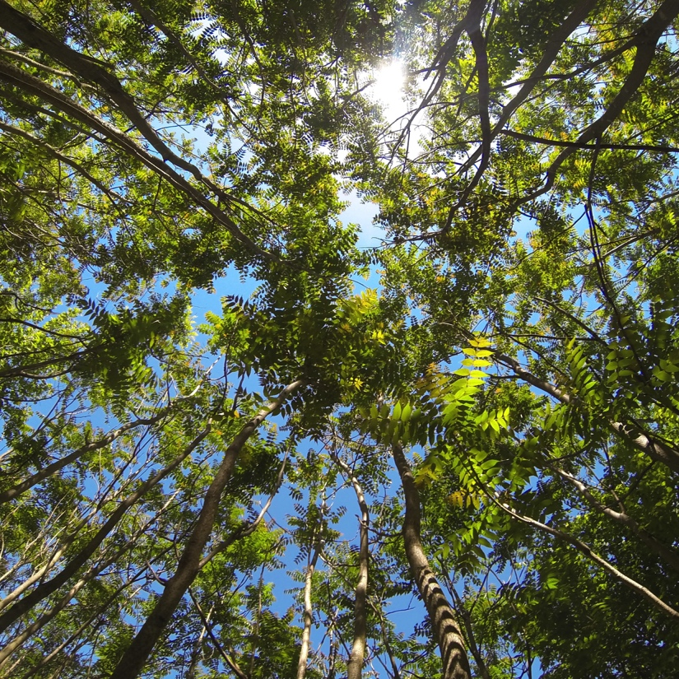
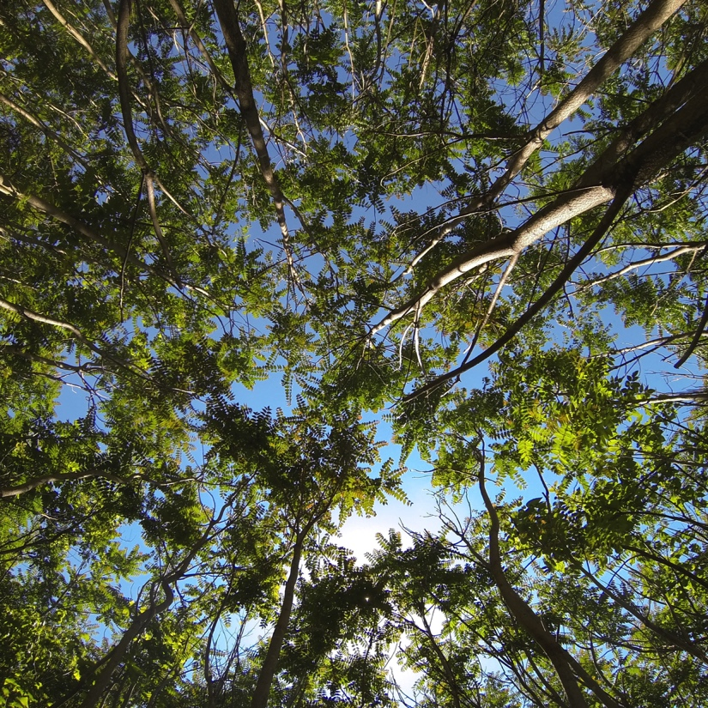
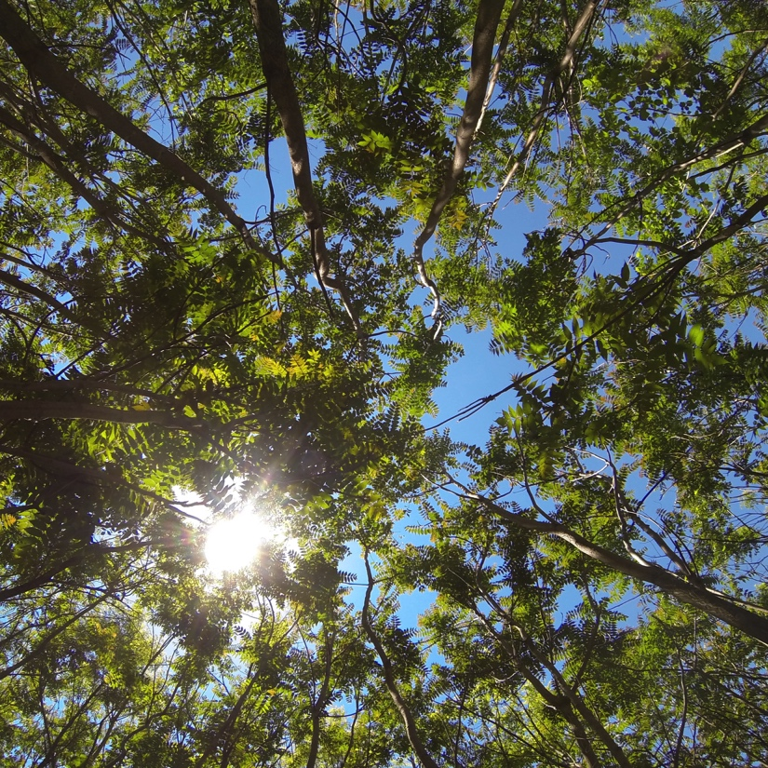
0
Months Post Inoculation
(May 2017)
Control
Vd
Vn
Both

Slide 21
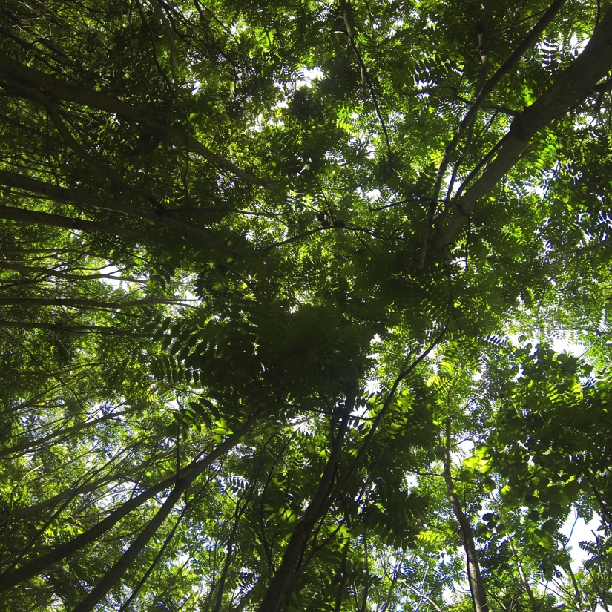
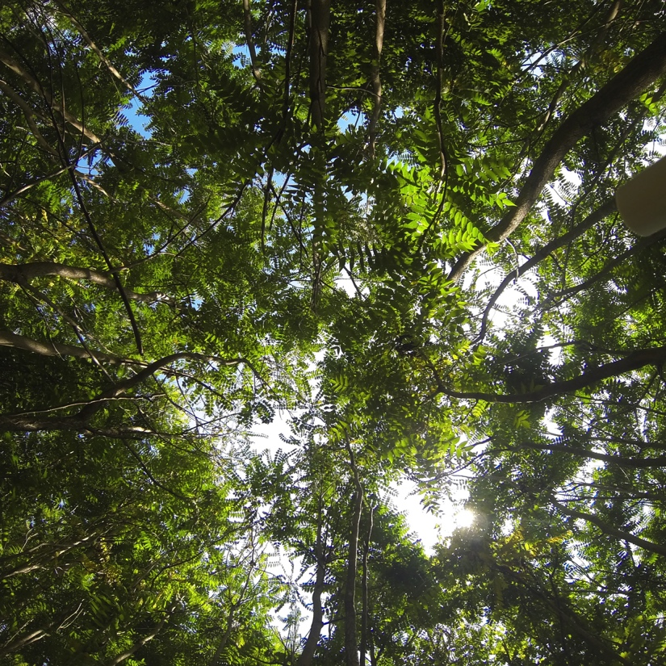
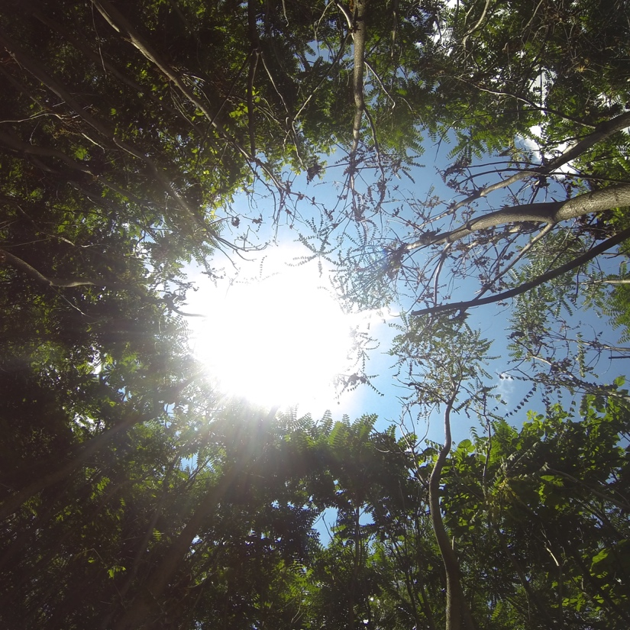
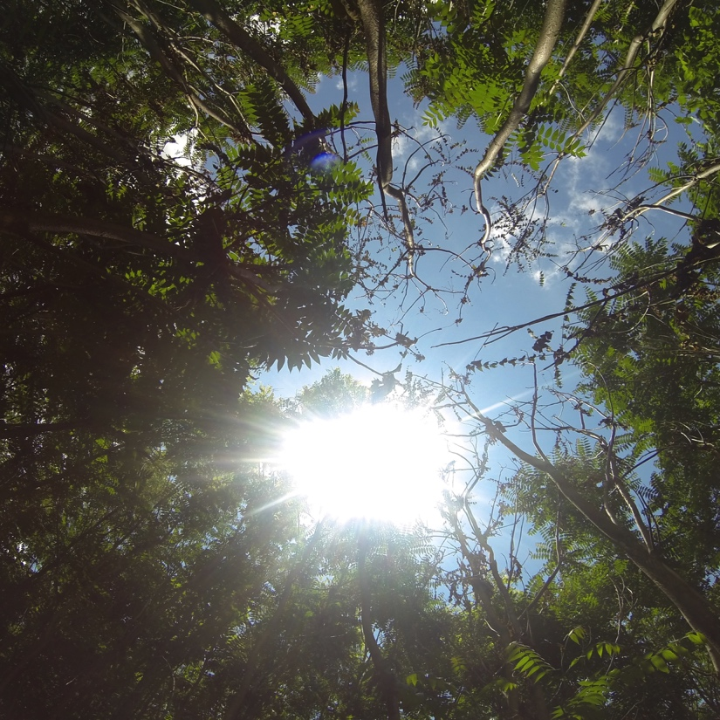
1
Months Post Inoculation
(June 2017)
Control
Vd
Vn
Both

Slide 22
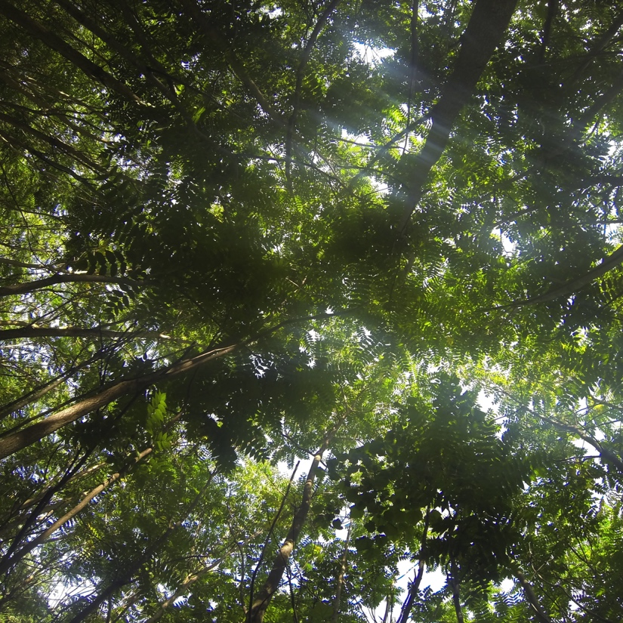
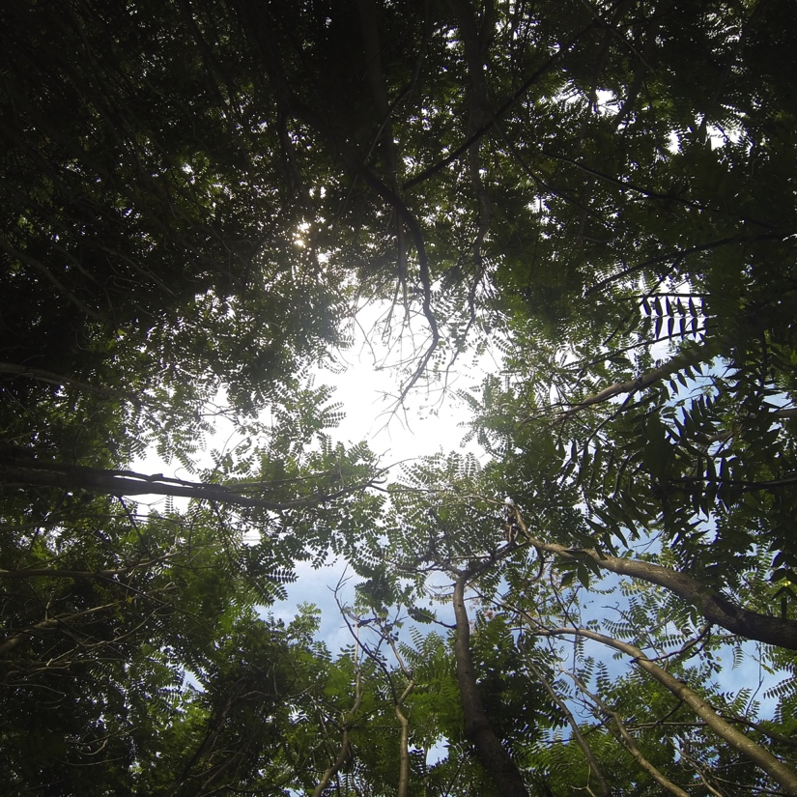
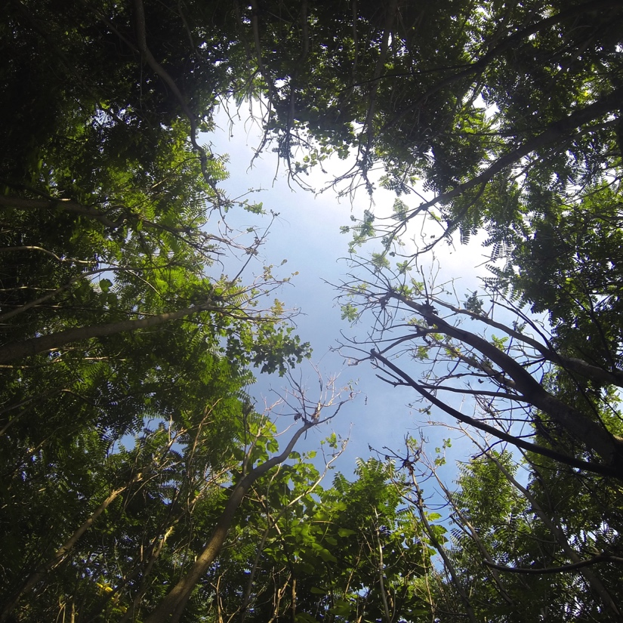
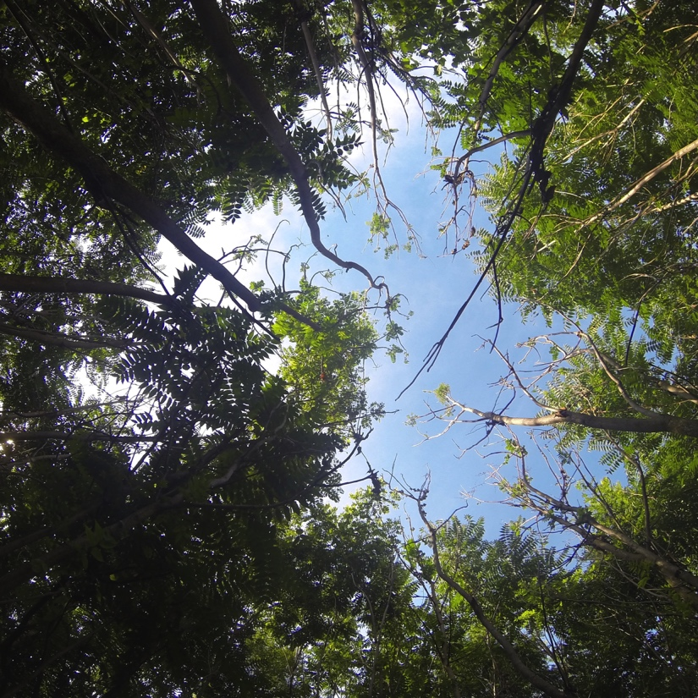
2
Months Post Inoculation
(July 2017)
Control
Vd
Vn
Both

Slide 23
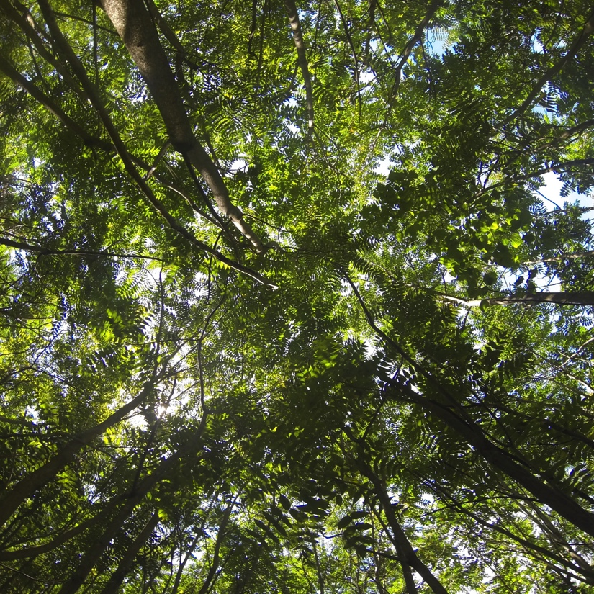
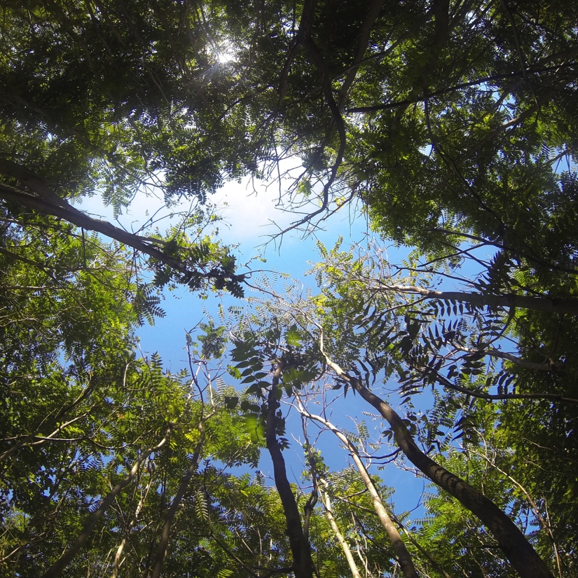
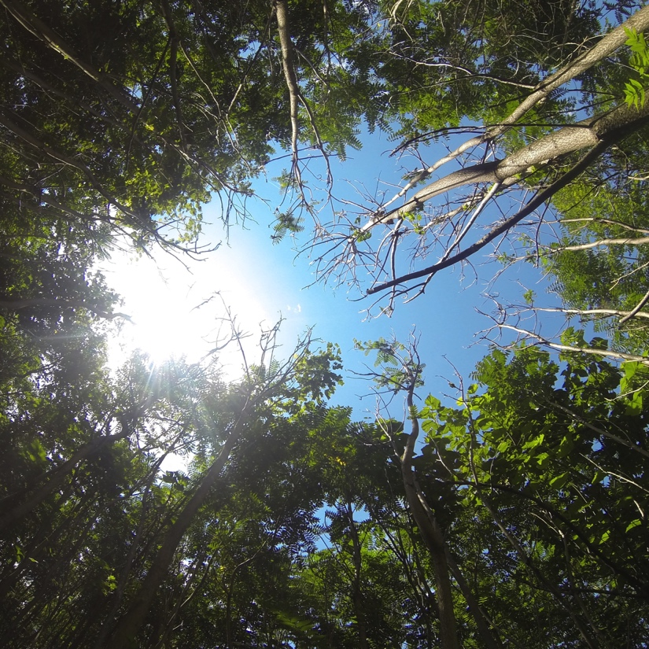
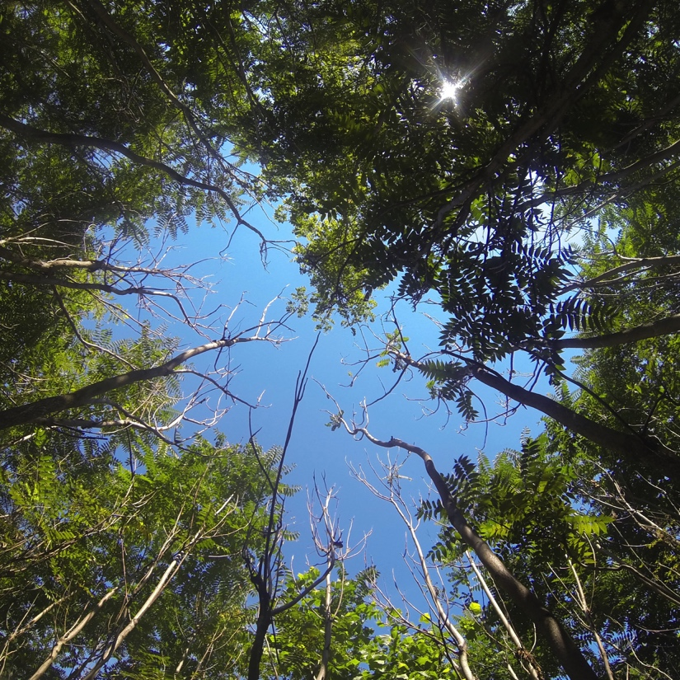
3
Months Post Inoculation
(Aug 2017)
Control
Vd
Vn
Both

Slide 24
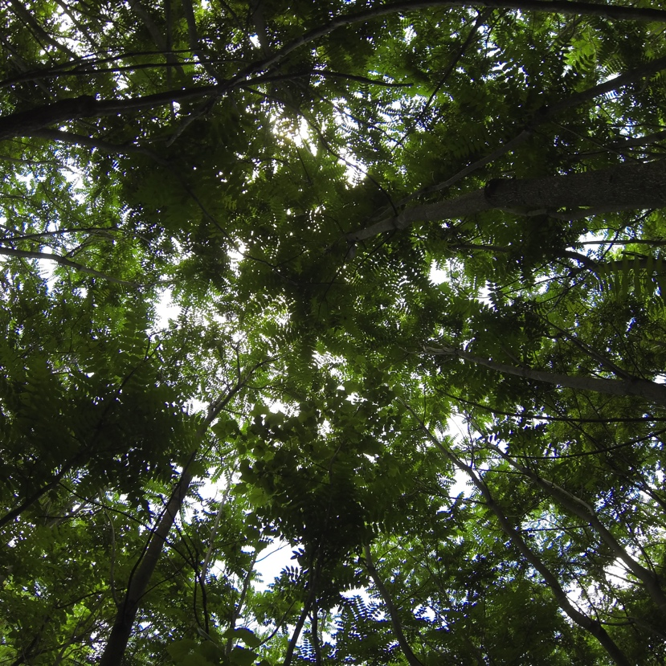
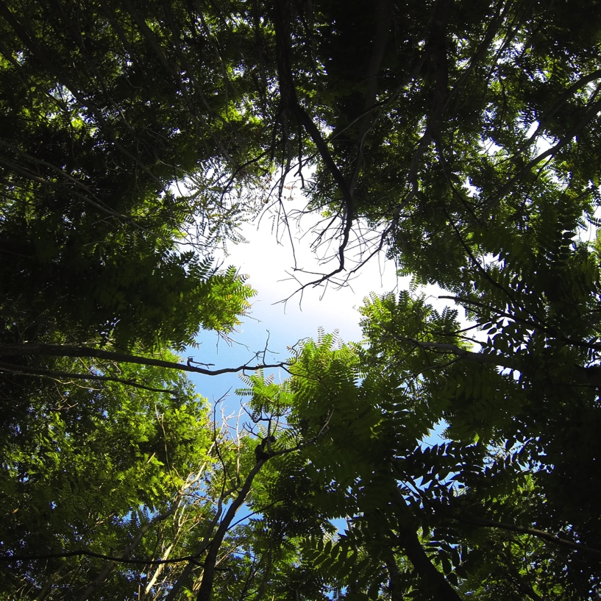
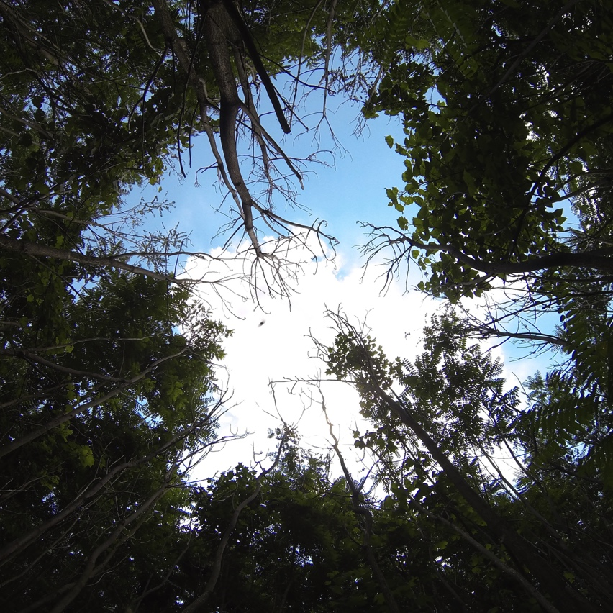
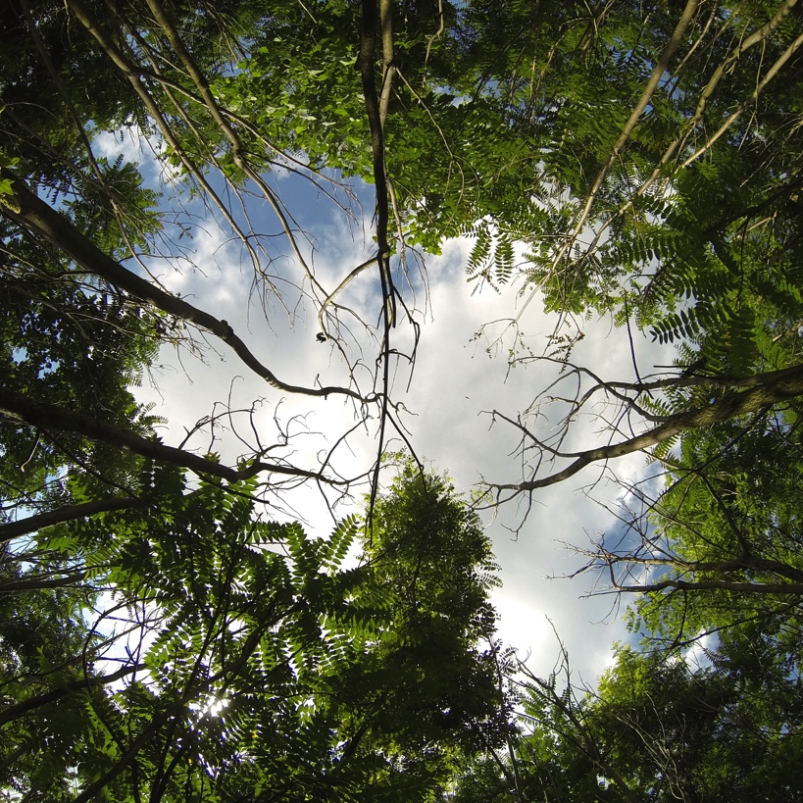
13
Months Post Inoculation
(June 2018)
Control
Vd
Vn
Both

Slide 25
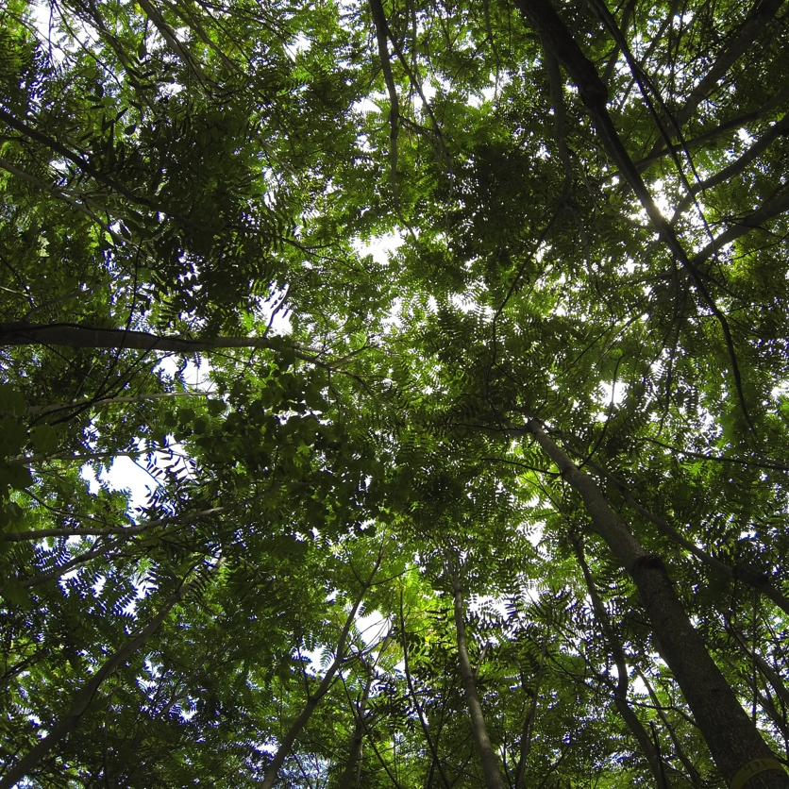
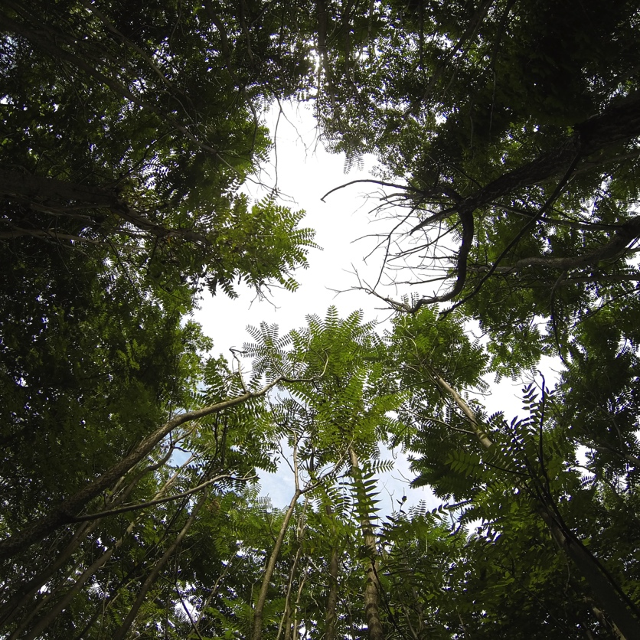
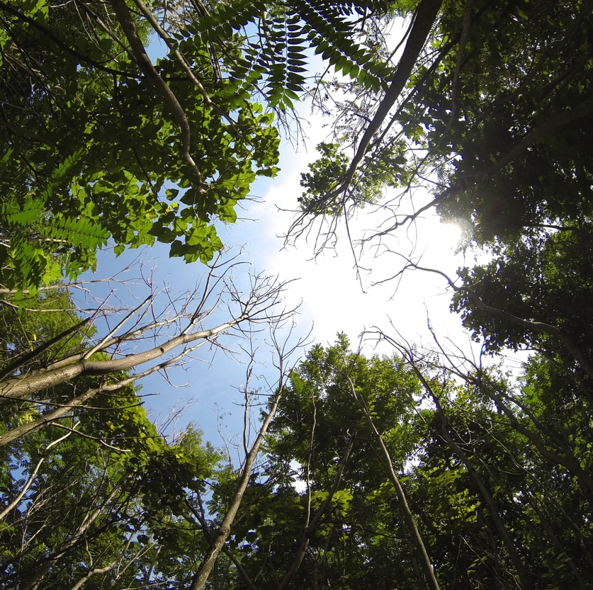

15
Months Post Inoculation
(Aug 2018)
Control
Vd
Vn
Both

Slide 26

From Above
(14 months post inoculation)
(Kevin Heffernan VA DCR)

Slide 27
Preliminary results
Which direct inoculation treatments are most effective?
Which treatments are effective at spreading (if any)?

Slide 28
Which direct inoculation treatments are most effective?
A A B C
100% dead
or dying!
Disease Rating (AUDPC)
AUDPC~treatment+site F(8,14)=32.64,p=0.00000009
Vn Both Vd Control
Treatment
Vn and Both treatments are the most effective!

Slide 29
Which treatments are spreading (if any)?
A A B B
Disease Rating (AUDPC)
~50% dead
or dying!
Vn Both Vd Control
Treatment
AUDPC~treatment+site
F(8,14)=4.797,p=0.005287
Vn and Both are both spreading!

Slide 30
Are there any variables that might limit this regionally?
Stand: Average DBH (diameter at breast height)
Temperature: Average temperature
Moisture: Total rainfall

Slide 31
DBH, temperature, or rainfall?
Direct inoculations
Spread
No variables play a significant role in disease spread!
Disease Rating (AUDPC)
Average DBH (cm)
DBH may slow down disease progression

Slide 32
What is “both” treatment?
Verticillium dahliae (Vd)
Verticillium nonalfalfae (Vn)
3%
97%

Slide 33

Preliminary results are promising!
Vn appears ideal with no indication it wouldn’t be effective regionally!
(1 more field season left)

Slide 34


Vn biocontrol next steps

Slide 35




Acknowledgements
Committee: Scott Salom, Anton Baudoin, Matt Kasson, & Jacob Barney
Field help: Tom McAvoy, Lainey Metz, Caleb Gore, Ryan Mays, Jamie Buttler, Andrew Dechaine, Jeremiah Foley, Holly Wantuch, & Max Ragozzino
Funding: US Forest Service Grant 15-CA-11420004-161
Field Sites: Virginia State Parks & Wildlife Management Areas, Shenandoah Valley AREC, Radford Army Ammunition Plant
Contact info: rkbrooks@vt.edu

Slide 36
Registration Process
Goal: registration as a minor use pesticide
USFS taking lead
  Cooperative agreement with Dr. Charu
  APHIS has approved a quarantine permit to import V. nonalfalfae into the ARS lab
  Sylvan Bioproducts, PA has expressed interest in producing fungal inoculum
  Obtained APHIS funds for additional host-range testing
  Prelim agreement developed with the EPA in 2018
  Est. ~3+ years until potential registration
Notes:
USFS taking lead
Cooperative agreement with Dr. Charu (retired University of Florida professor who has lead other previous registration of pathogens)
APHIS-PPQ has approved a quarantine permit to import V. nonalfalfae into the ARS lab at Fort Pierce, FL
Sylvan Bioproducts, PA (experts in producing fungal products for research and sales) has expressed interest in producing fungal inoculum for them
Obtained APHIS funds for additional host-range testing according to the EPA guidelines
Met with US-EPA in 2018 and developed a prelim agreement and path forward for registration (est. 3 eyars)
Goal: registration as a minor use pesticide (pesticides for forestry use)
Government shutdown causing delays

Slide 37




Inoculum preparation

Slide 38





Agrilus smaradgifrons
(Hoebeke 2017, Photos: R. Rieder NJ Dept of Ag)
Notes:
The stereoscope images are of the specimen collected from the Taylor Preserve, Burlington Co. NJ and an illustration of the male aedeagus. - Ryan Rieder, NJ Dep of Ag

Slide 39




Ailanthus altissima (tree of heaven)

Slide 40
Biological vs chemical control
 | Biological Control | Chemical Control
Cost | Cheaper | Expensive
Target | Specific | Broad
Environmental Impact | Few off-target impacts but natural enemy can become a pest | Environmental and human health hazards can accumulate or move
Re-application | Rarely | Often
Removal | Won’t eradicate | Can eradicate
Resistance | Rare | Common
Time | Slow, but long-term | Fast acting, but short-term
Location | Can spread | Can’t spread
Available | No guarantees | No guarantees
Notes:
Balsam Woolly Adelgis, Adelges piceae. 25 predators released over 35 years (1933-1969) in Canada and the US, no control (why? Highly susceptibility of Albes in NA, the wrong predators were imported, didn’t look in the right place (NE Turkey and Caucusus Mtns)
(ex: Balsam Woolly Adelgid) (ex: proximity to sensitive habitat)

Slide 41



Obtain permission for release
All documents submitted in 2018
USDA APHIS Plant Protection & Quarantine (PPQ) and the Technical Advisory Group for Biocontrol Agents of Weeds (TAG) advisory committee will review
Pending government response

Slide 42
The invasion curve
Public Awareness
Detection
# of individuals or area infested
Saturation
Introduction
time
Notes:
Invasion curve, does not become invasive instantly.
Introduced – first off
Detected – later, after it is already here
Public is aware – wayyy later
The Tens rule, only a small percentage of non-native species are actually invasive. Scientisits refer to this phenomenon as the “tens rule” in which at each stage of an invasion (being transported from their native range, establishing in their new environment, and then causing an impact) a small subset (roughly 1 in 10 species) is successful.

Slide 43
Where are we with Ailanthus?
# of individuals or area infested
prevention → eradication → containment → slow the spread → suppression
time
Notes:
Invasion curve, does not become invasive instantly.
Introduced – first off
Detected – later, after it is already here
Public is aware – wayyy later
The Tens rule, only a small percentage of non-native species are actually invasive. Scientisits refer to this phenomenon as the “tens rule” in which at each stage of an invasion (being transported from their native range, establishing in their new environment, and then causing an impact) a small subset (roughly 1 in 10 species) is successful.

Slide 44
The invasion curve: management tools
Chemical Control
Biological Control
# of individuals or area infested
prevention → eradication → containment → slow the spread → local management
time
Notes:
Invasion curve, does not become invasive instantly.
Introduced – first off
Detected – later, after it is already here
Public is aware – wayyy later
The Tens rule, only a small percentage of non-native species are actually invasive. Scientisits refer to this phenomenon as the “tens rule” in which at each stage of an invasion (being transported from their native range, establishing in their new environment, and then causing an impact) a small subset (roughly 1 in 10 species) is successful.

Slide 45
Biological vs Chemical Control
 | Biological Control | Chemical Control
Cost | Cheaper | Expensive
Target | Specific | Broad
Environmental Impact | Few off-target impacts but natural enemy can become a pest | Environmental and human health hazards can accumulate or move
Re-application | Rarely | Often
Removal | Won’t eradicate | Can eradicate
Resistance | Rare | Common
Time | Slow, but long-term | Fast acting, but short-term
Location | Can spread | Can’t spread
Available | No guarantees | No guarantees
Notes:
Balsam Woolly Adelgis, Adelges piceae. 25 predators released over 35 years (1933-1969) in Canada and the US, no control (why? Highly susceptibility of Albes in NA, the wrong predators were imported, didn’t look in the right place (NE Turkey and Caucusus Mtns)
(ex: Balsam Woolly Adelgid) (ex: proximity to sensitive habitat)

