Slide 1
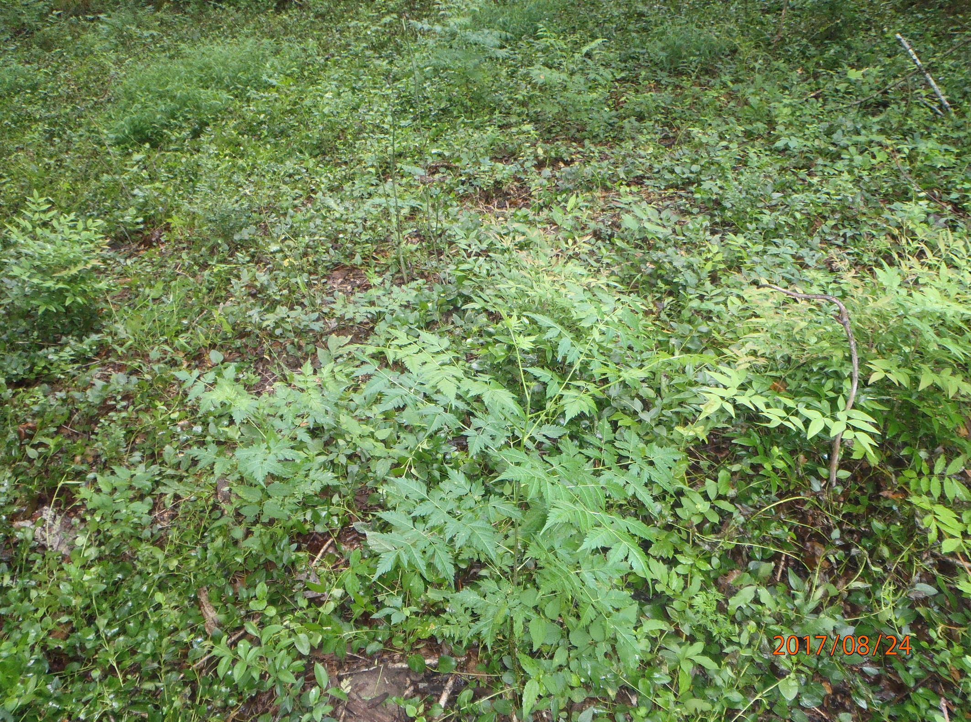

Farm Bill Program Assistance to Combat Exotic Invasive Pest Plants
Projects on private lands and summary of NRCS Programs
Sudie Daves Thomas, Wildlife Biologist
Natural Resources Conservation Service/USDA
South Carolina

Slide 2
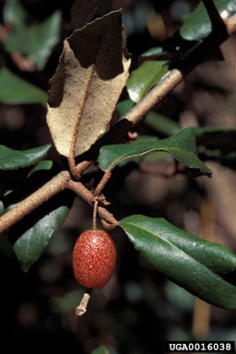
Technical and financial assistance through USDA Farm Bill Programs
Environmental Quality Incentives Program (EQIP)
Conservation Stewardship Program (CSP)
Program funds go toward addressing natural resource concerns on property through conservation practices, can include eradicating/reducing coverage of invasive exotic pest plant infestations
Easement program (Wetland Reserve Program) restoration plan/funds include vegetative restoration/invasive exotic pest plant control

Slide 3
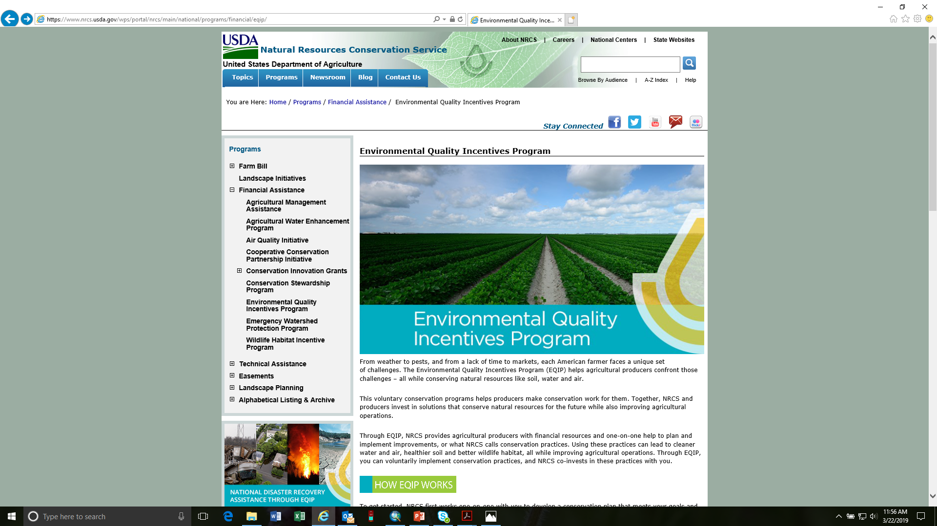
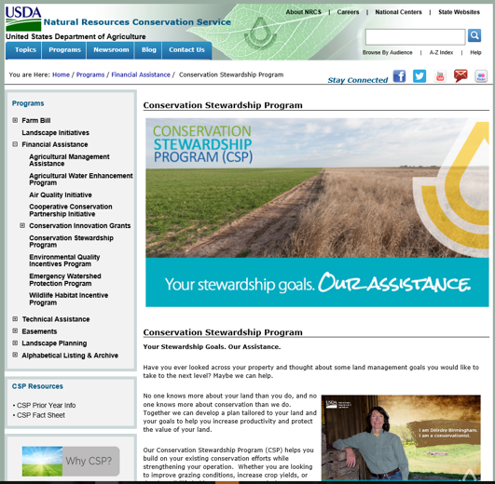

Slide 4
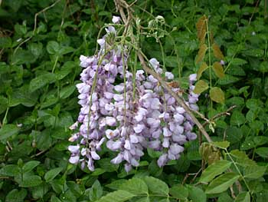
Technical and financial assistance through USDA Farm Bill Programs
Landowners apply at the County USDA/NRCS Service Center for land in that County
Sign up is continuous, application deadlines for fiscal year funding (deadlines are usually around Sept 30th)
Land must be registered with the Farm Services Agency (Land and Tract numbers), bring deed and plat
Adjusted Gross Income (AGI) form- annual income cannot exceed $900,000 (ineligible for Farm Bill Programs)
In compliance with highly erodible land and wetland conservation requirements
Work with District Conservationist and other NRCS staff on a Conservation Plan

Slide 5
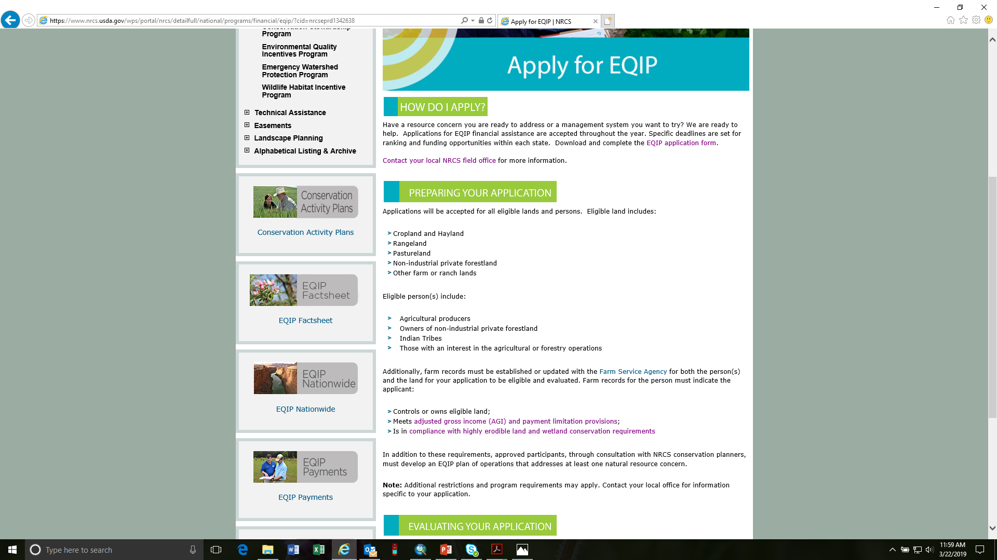

Slide 6
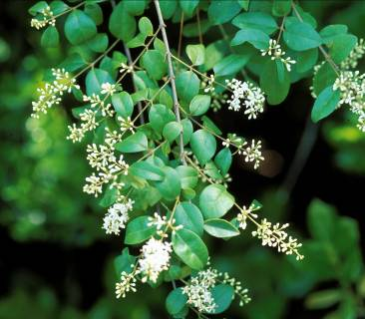
Technical and financial assistance through USDA Farm Bill Programs
Conservation Plan includes management practices, dates for completion, and guidance for implementation- based on LO goals and identified resource concerns
Conservation Practice funding based on 75% region-wide ave. cost
Woody exotic invasive plants: Brush Management (314), several components: mechanical, chemical, infestation level, etc.
Herbaceous exotic invasive plants: Herbaceous Weed Treatment (315): mechanical, chemical, can be used for aquatic invasive plants
Practice Standards and Jobsheets provided for all practices
Conservation Plan comes with plan maps showing where on land practices are to take place and # of acres

Slide 9
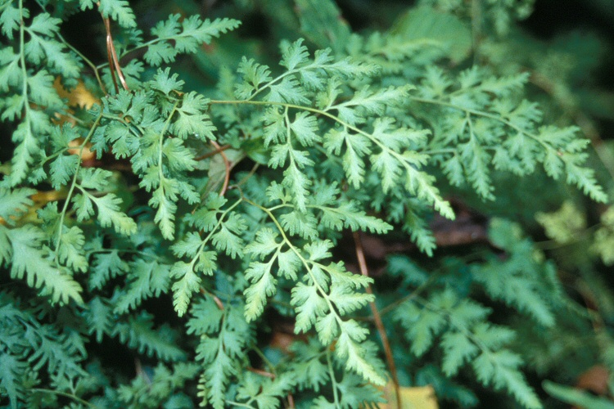
Technical and financial assistance through USDA Farm Bill Programs
Contracts usually 3 years (EQIP), or 5 years (CSP)
Landowner must complete practices in plan prior to receiving funds via direct deposit (completion checked by NRCS staff)
If practice cannot be completed contract can be modified
If practice never completed or contract canceled landowner may be responsible for administrative costs
Contract funding dependant on ranking score/national, state and local priority resource concerns and amount of funds allocated to SC

Slide 10
Example of CSP contract, CSP payments low due to annual payment

Slide 11
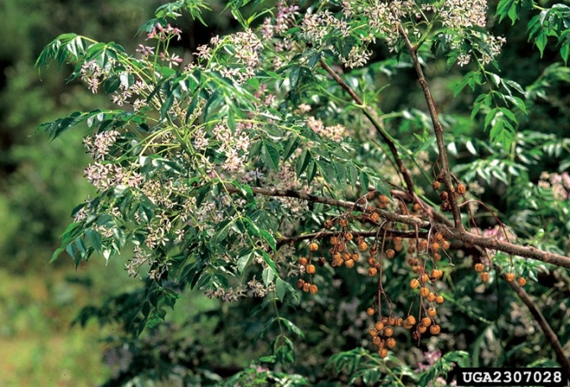
Technical and financial assistance through USDA Farm Bill Programs
National, State, and Local Priority Resource Concerns: issues may include soil health, water quality, wildlife habitat, state initiatives (bobwhite, longleaf restoration)
The most beneficial Conservation Plans will be ranked highest and therefore funded 1st
2018 EQIP funds obligated: $32,663,013.30
2018 EQIP # contracts: 1,135
2018 EQIP total # acres:121,360.00
Brush Management: obligated $520,418.00, 268 contracts, 2,337.66 acres

Slide 12
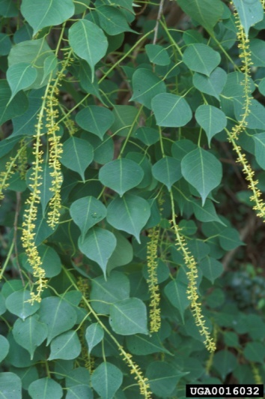
Technical and financial assistance through USDA Farm Bill Programs
Contact local county District Conservationist for technical assistance or to apply for conservation programs.

Slide 13

Private land in Darlington County – who’s who? List of problematic exotic invasive plants
Chinese privet
Thank you old home sites…
Japanese honeysuckle
Nandina
Chinaberry
Chinese Wisteria
Periwinkle
Waxy leaf privet

Slide 14
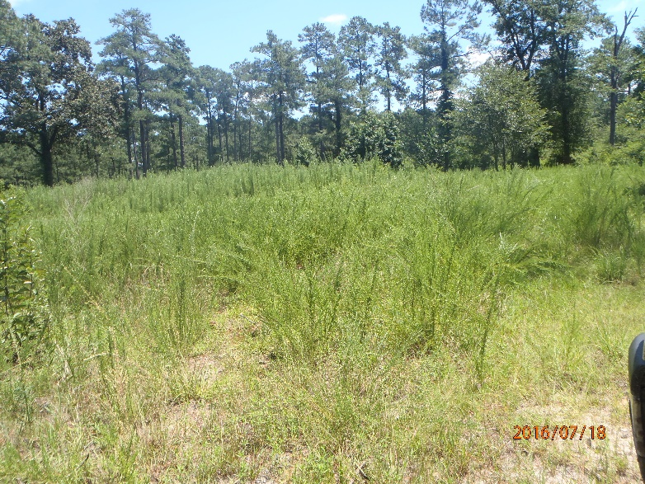
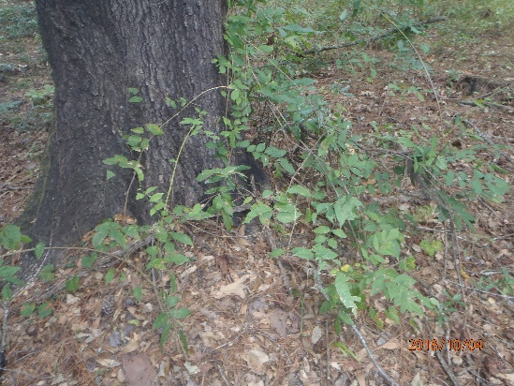
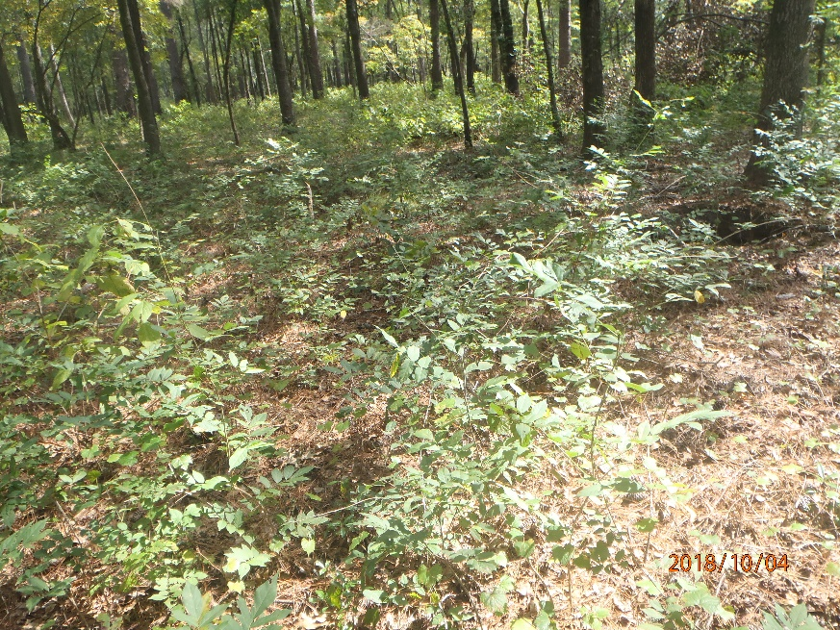
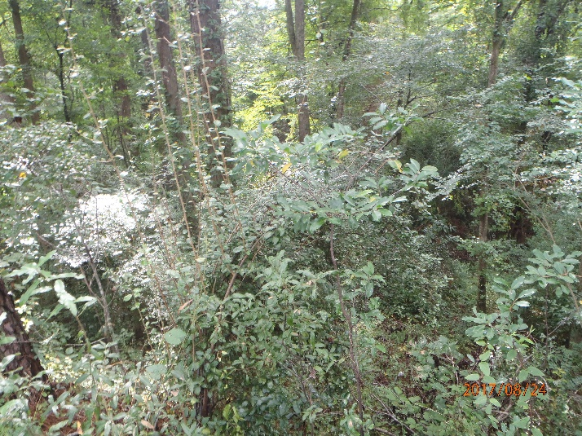
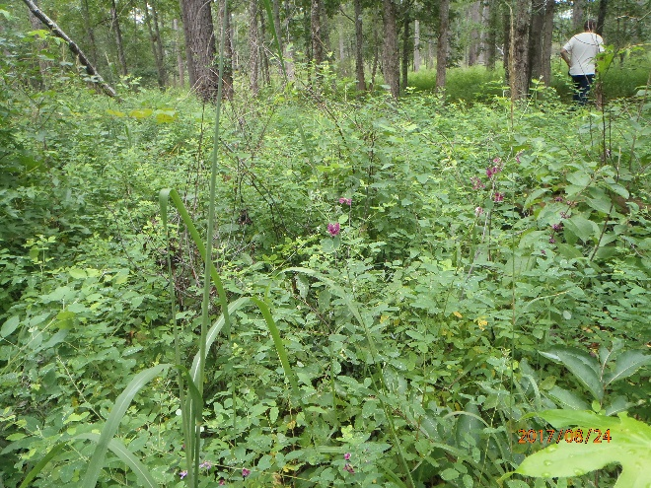
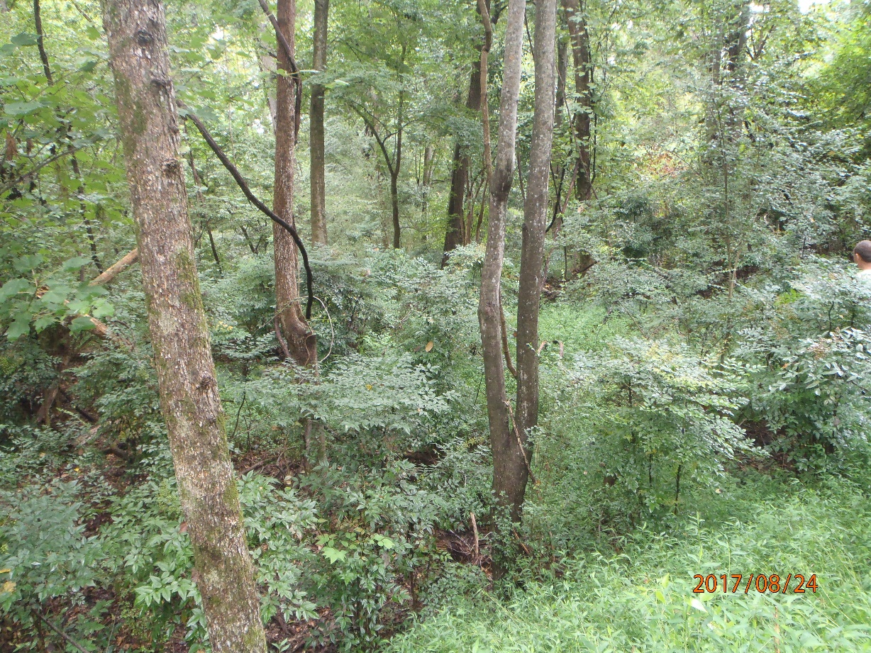
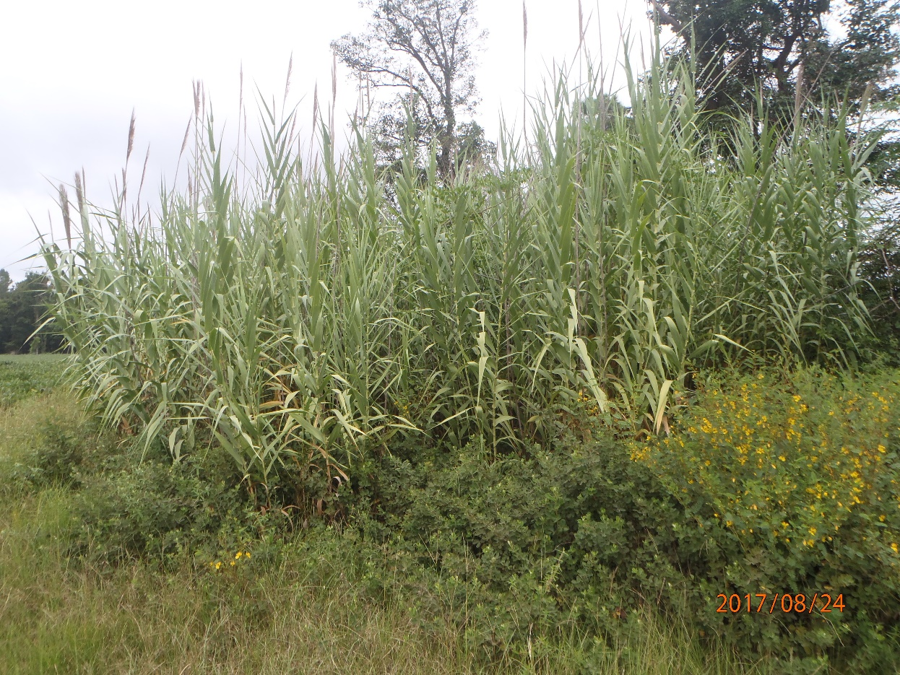
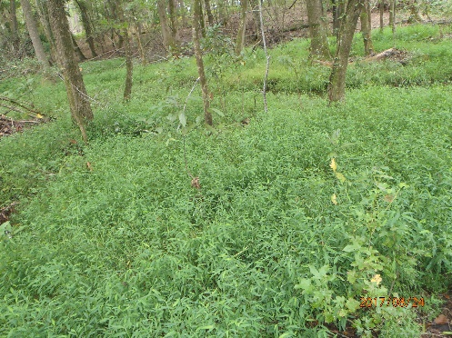
Private land in Darlington County – even more exotic plants
Chinese Wisteria
Sericea lespedeza
Elaeagnus pungens
Bicolor Lespedeza
Giant Reed
Nandina
Microstegium
“Lark” selection Large Flowered Partridge Pea

Slide 15
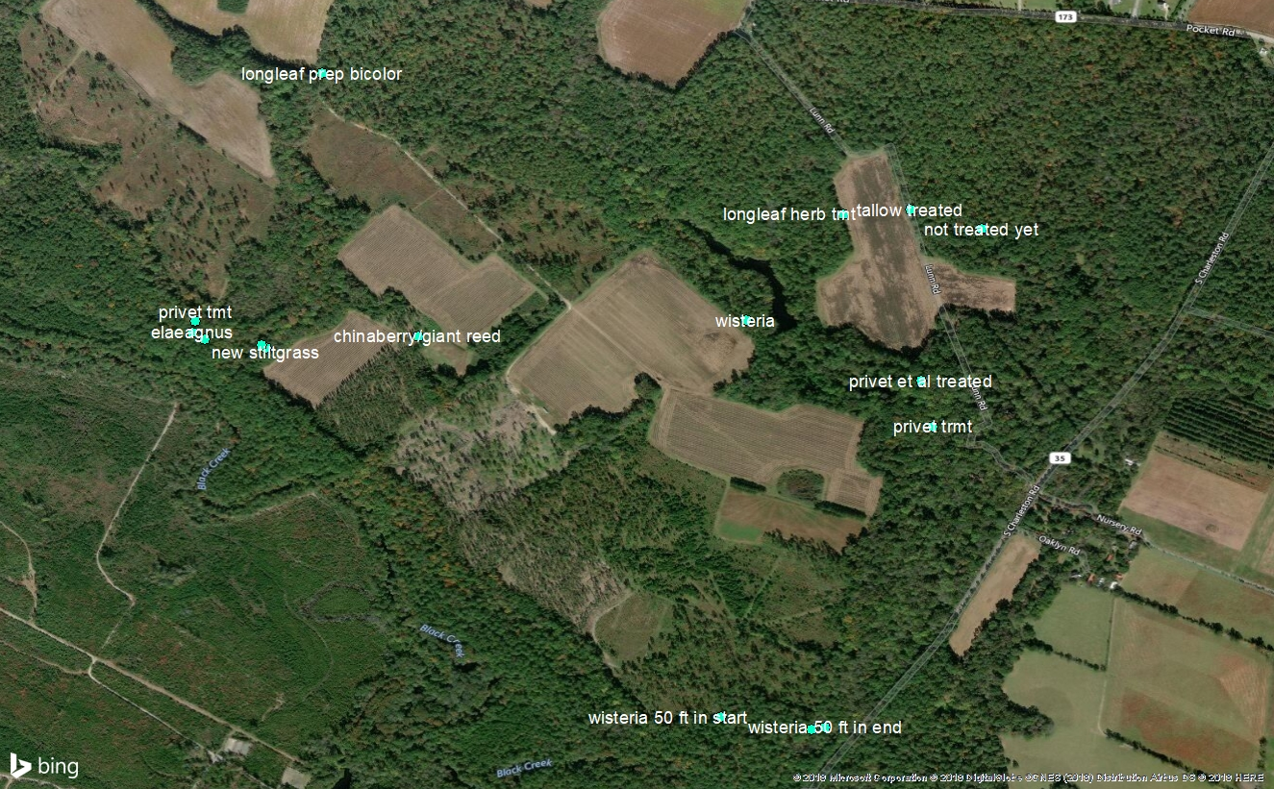
Private land in Darlington County – inventory, applied for EQIP

Slide 16
Private land in Darlington County – Conservation Plan Map, EQIP
314: Brush Management
315: Herbaceous Weed Treatment

Slide 17
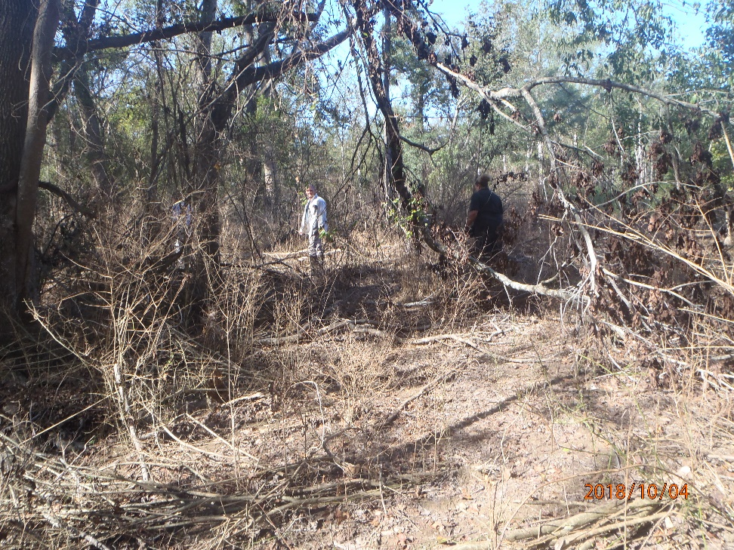
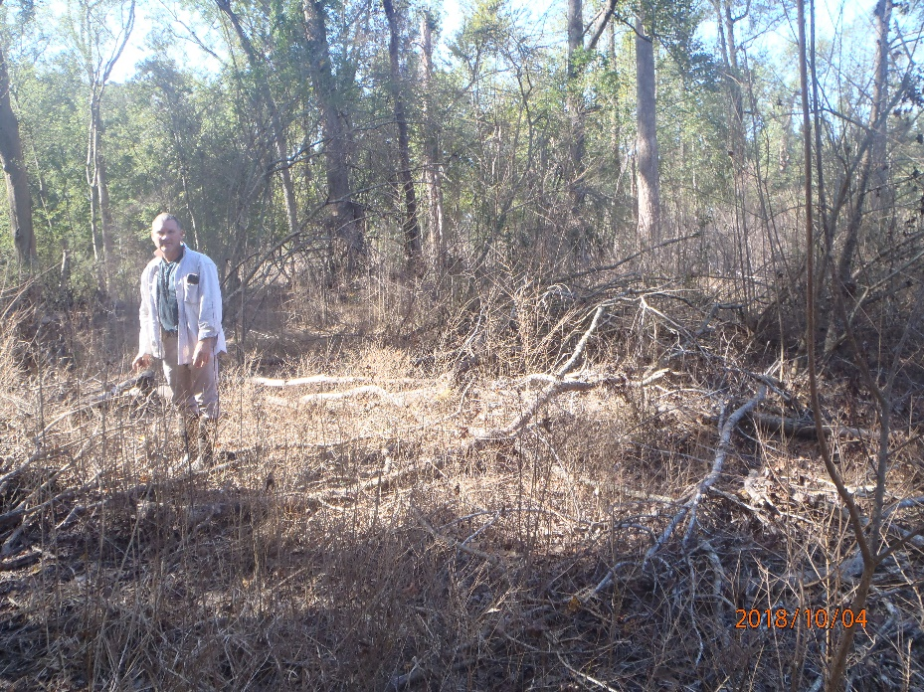
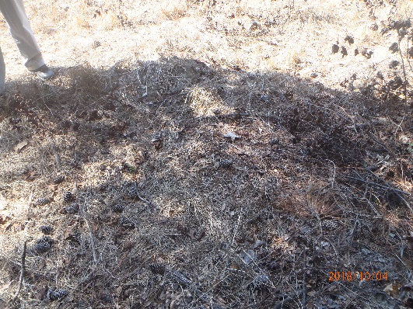
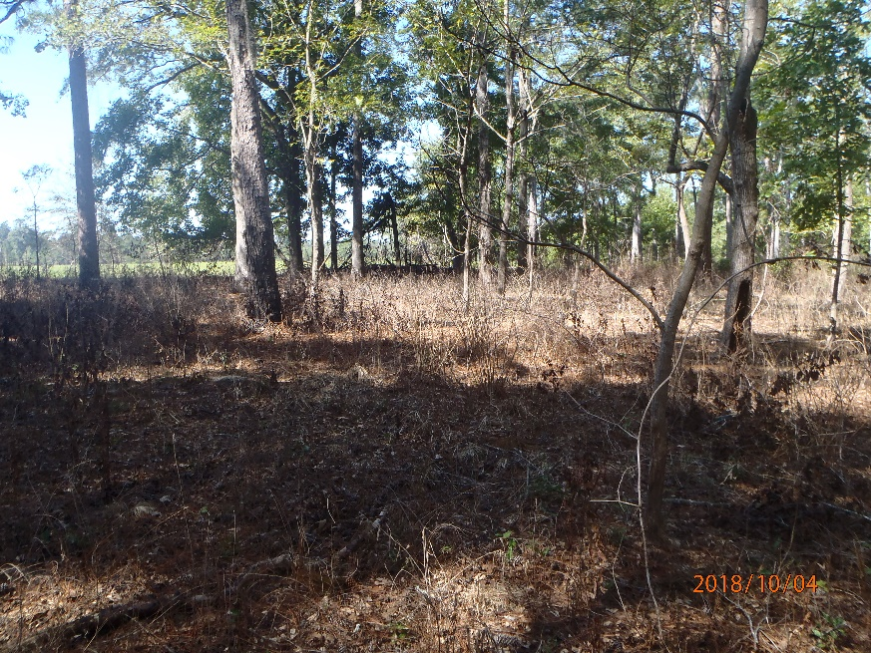
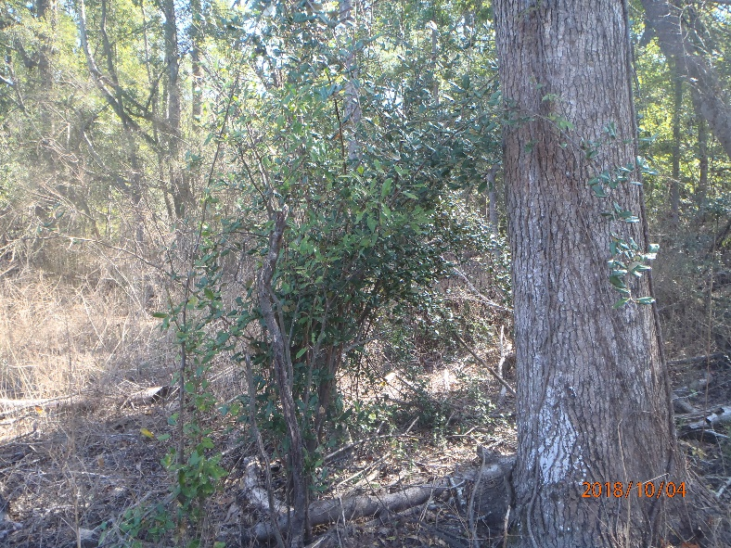
Private land in Darlington County, EQIP
1st year, after treatment, 2 more treatments planned
314: Brush Management
315: Herbaceous Weed Treatment

Slide 18
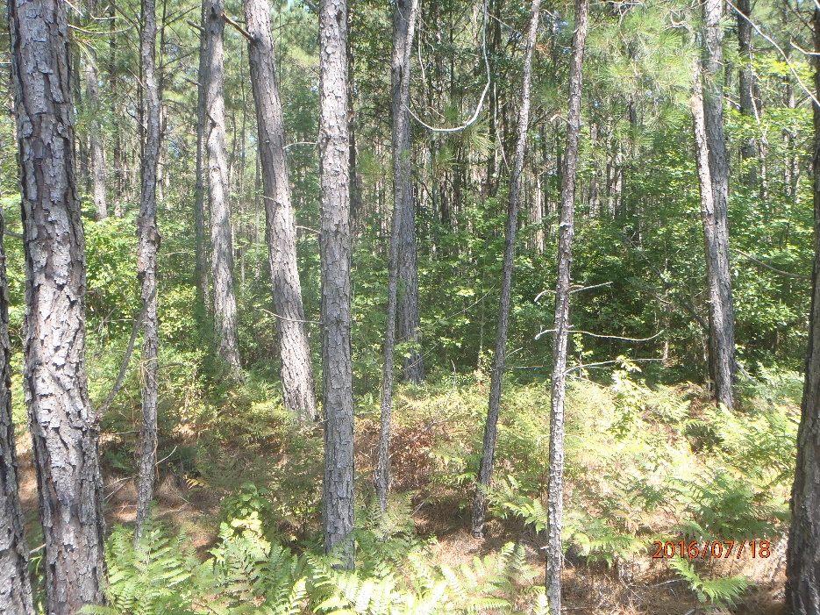
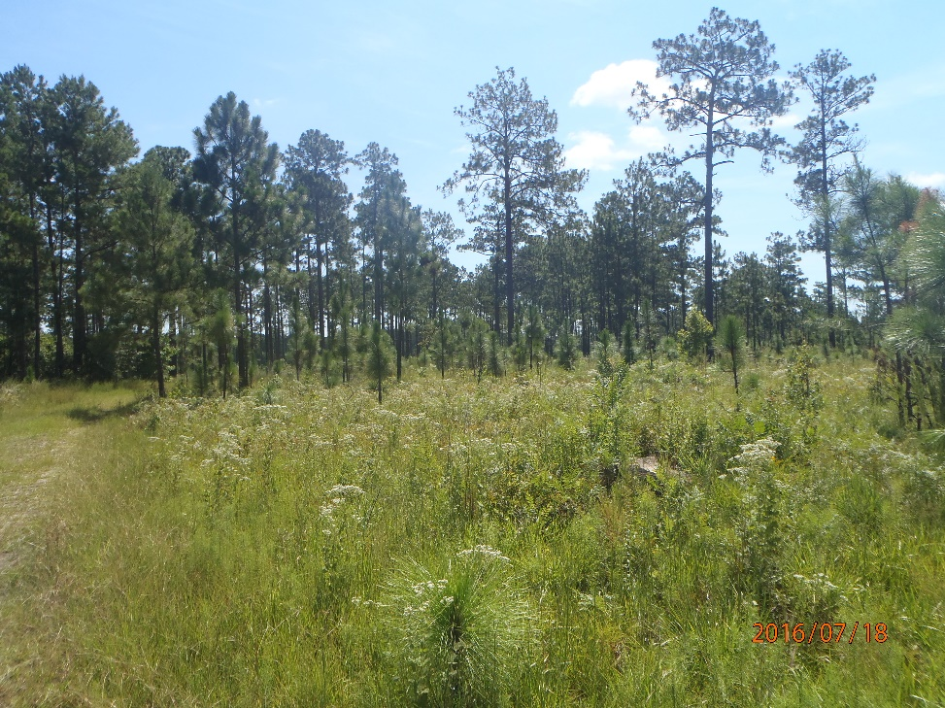
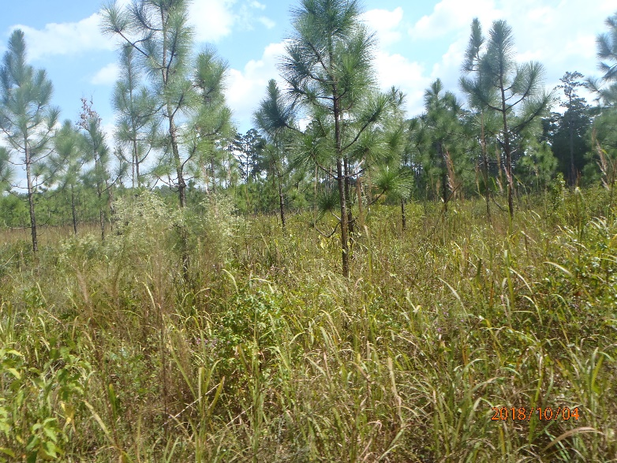
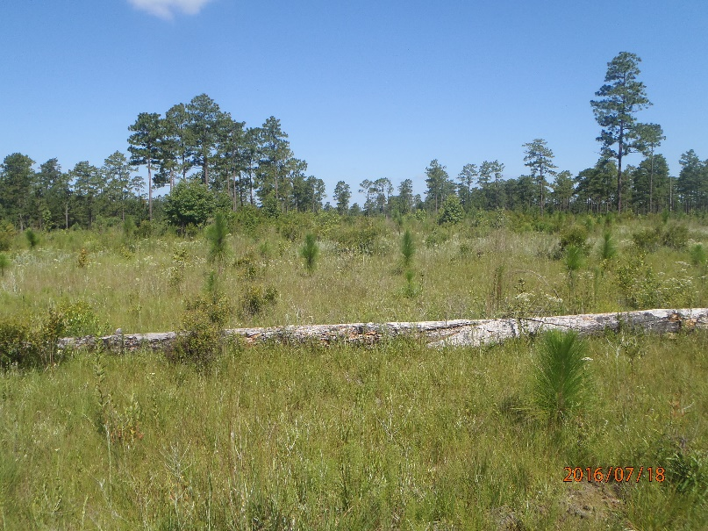
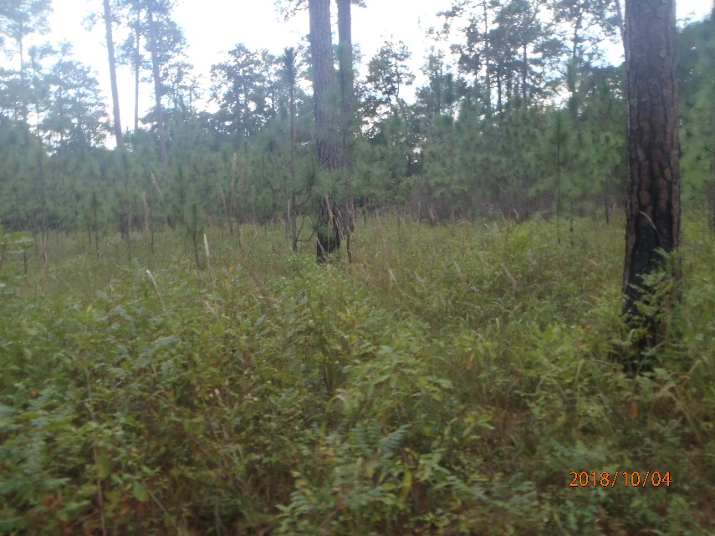
Private land in Darlington County, other Conservation Practices applied or to be applied through EQIP
Prescribed Fire (338)
Forest Stand Improvement –thinning to low Basal Area to improve habitat (666)
Tree and Shrub Establishment (612), Longleaf pine or other native trees and shrubs

Slide 19
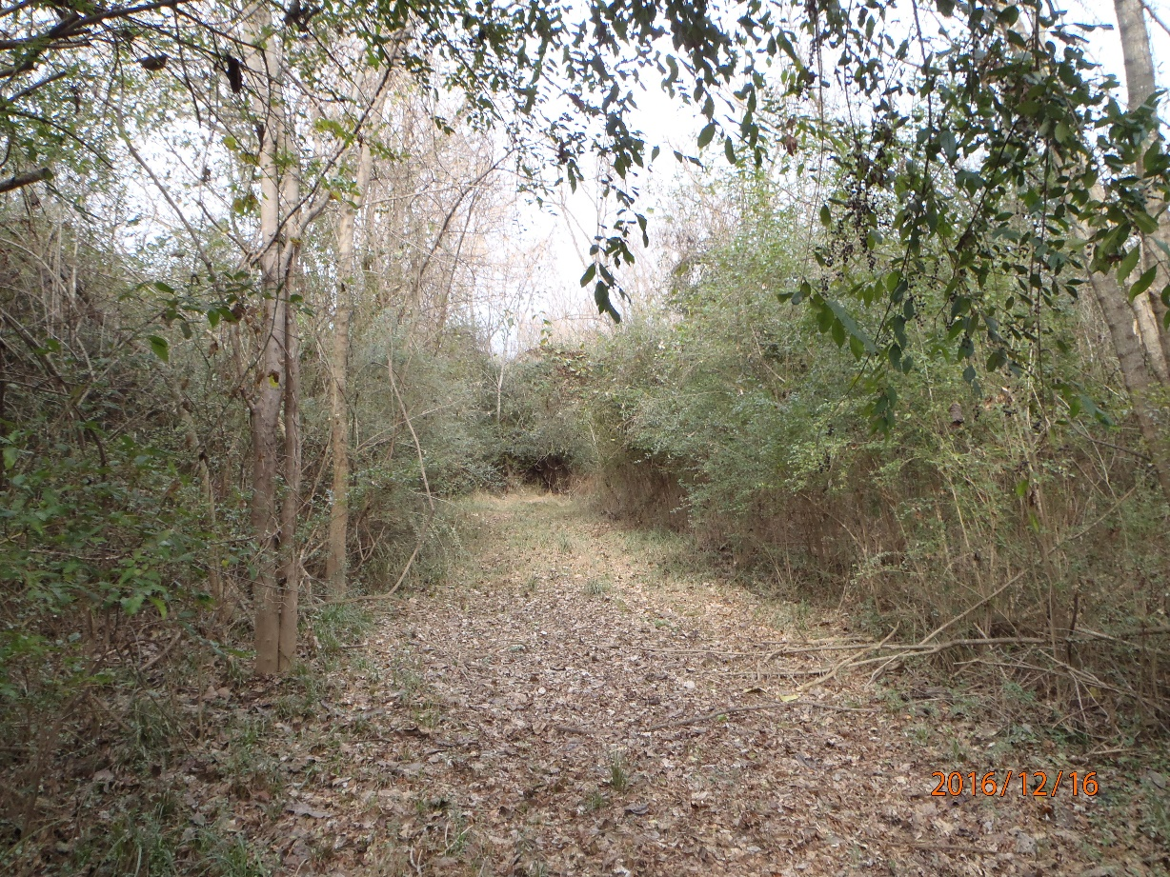
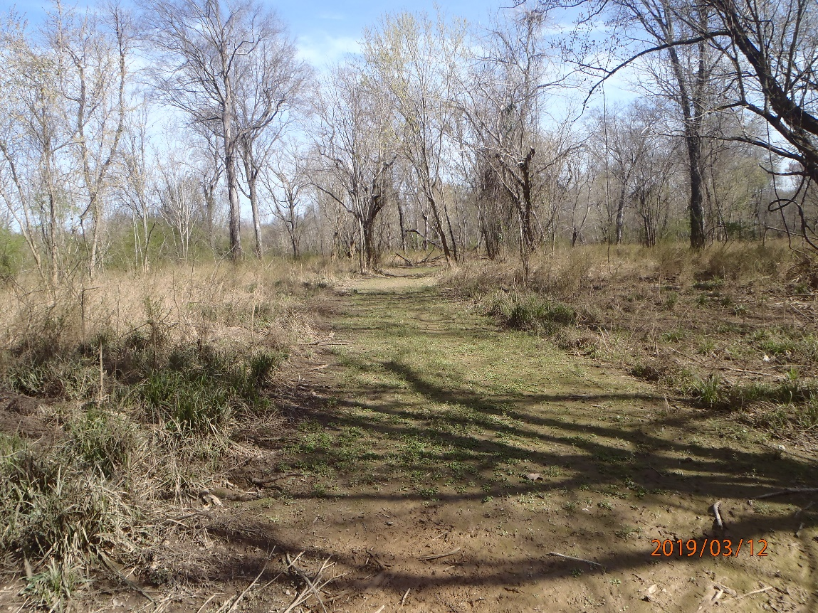
Initial site condition
Floodplain area, Great Pee Dee River, 44 acres of Brush Management for Chinese privet, 3 years of treatment planned, mechanical and chemical
Practice applied, project in progress…
Private land in Darlington County, EQIP

Slide 20
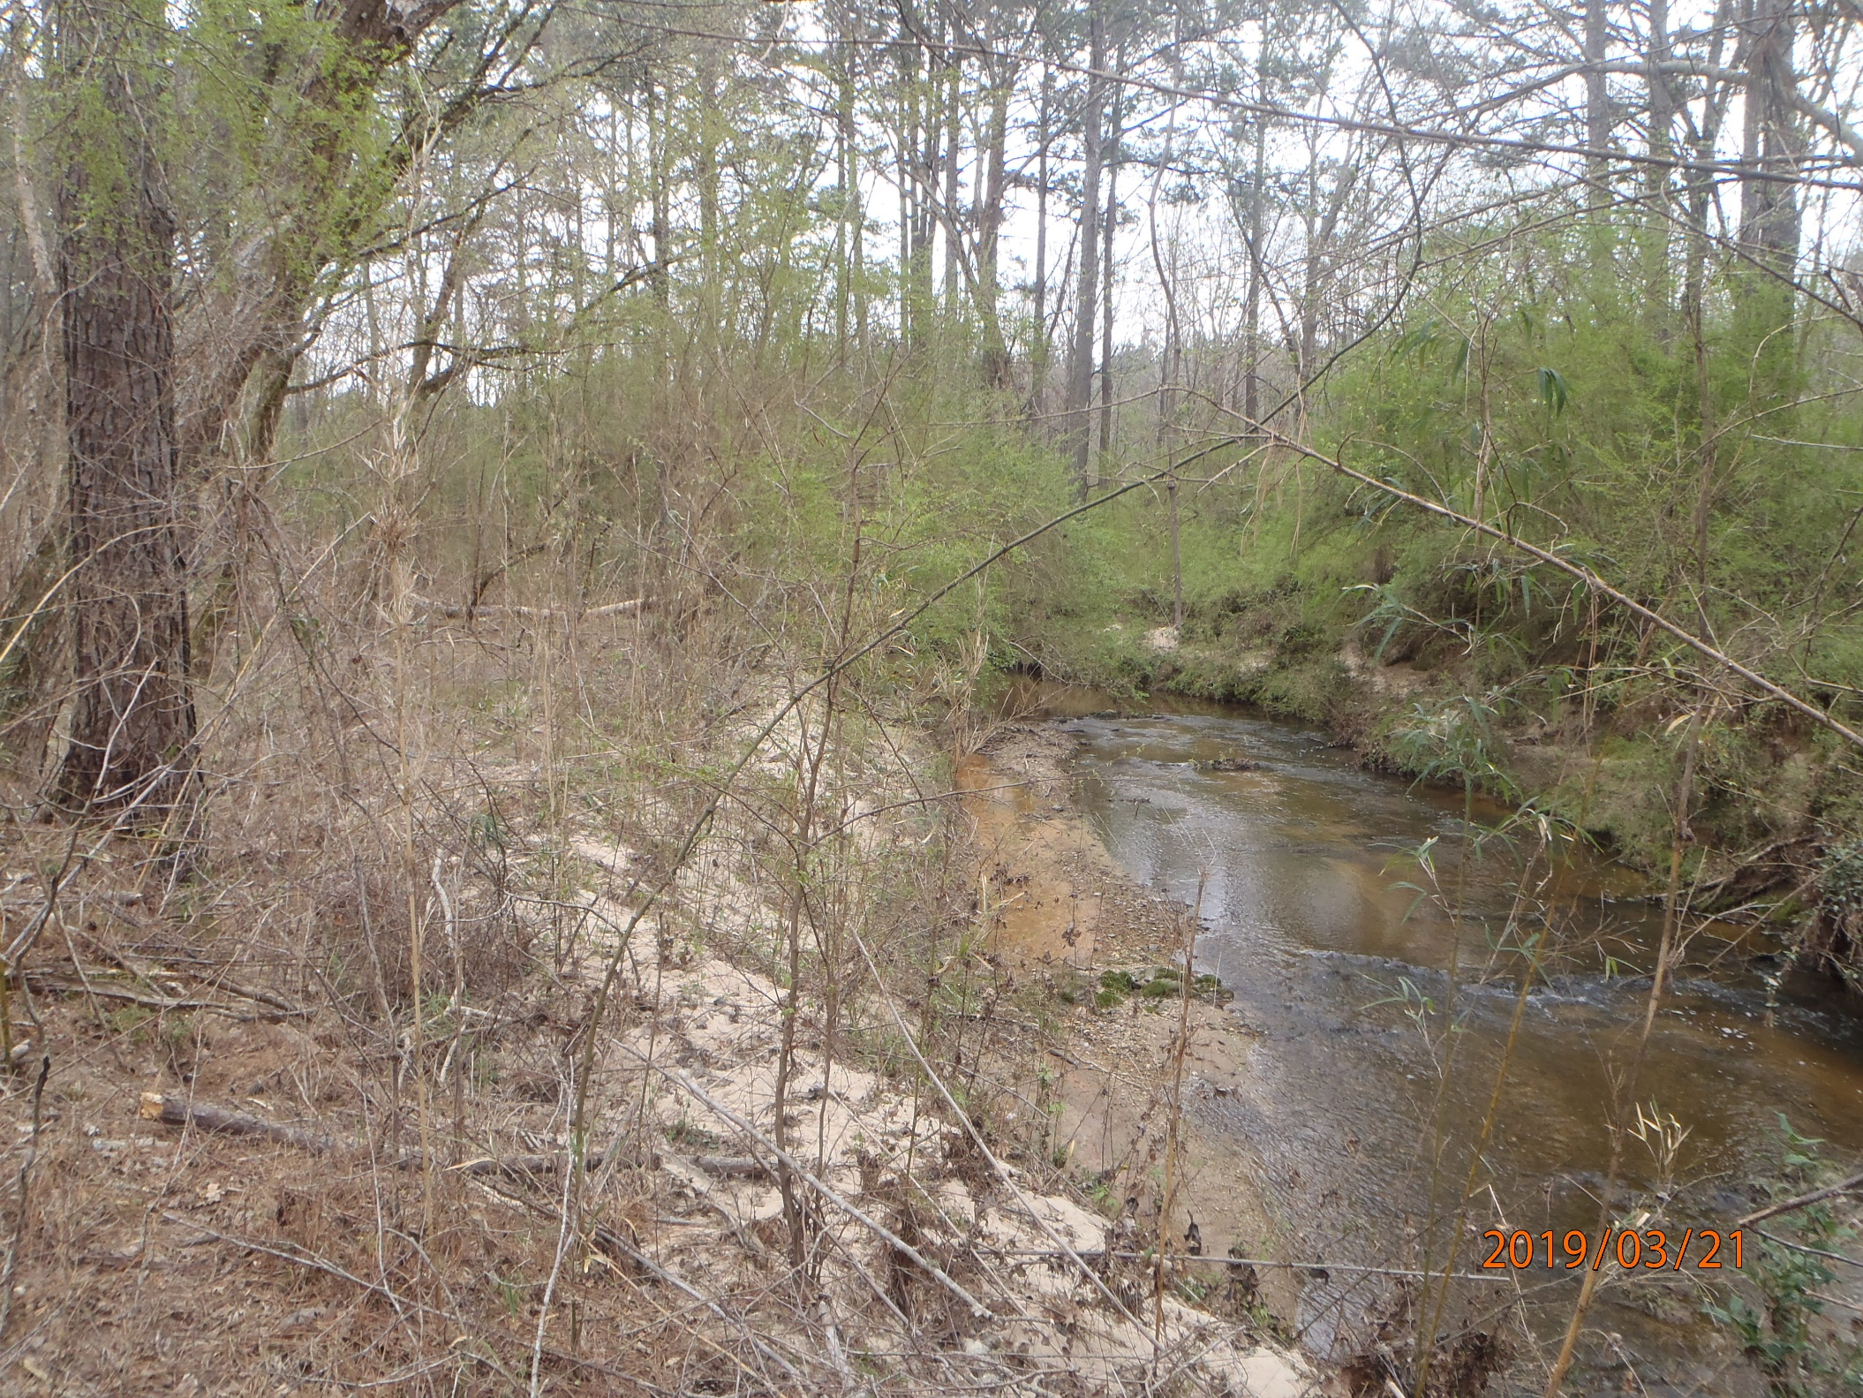
1st year/treatment practice applied, project in progress…3 years of treatment planned, mechanical and chemical
Not treated, adjacent landowner
Treated
Private land in Edgefield County, Beaverdam Creek - EQIP
Brush Management (314) – Target: Ligustrum sinense, plus management practices within uplands, prescribed fire etc.

Slide 21
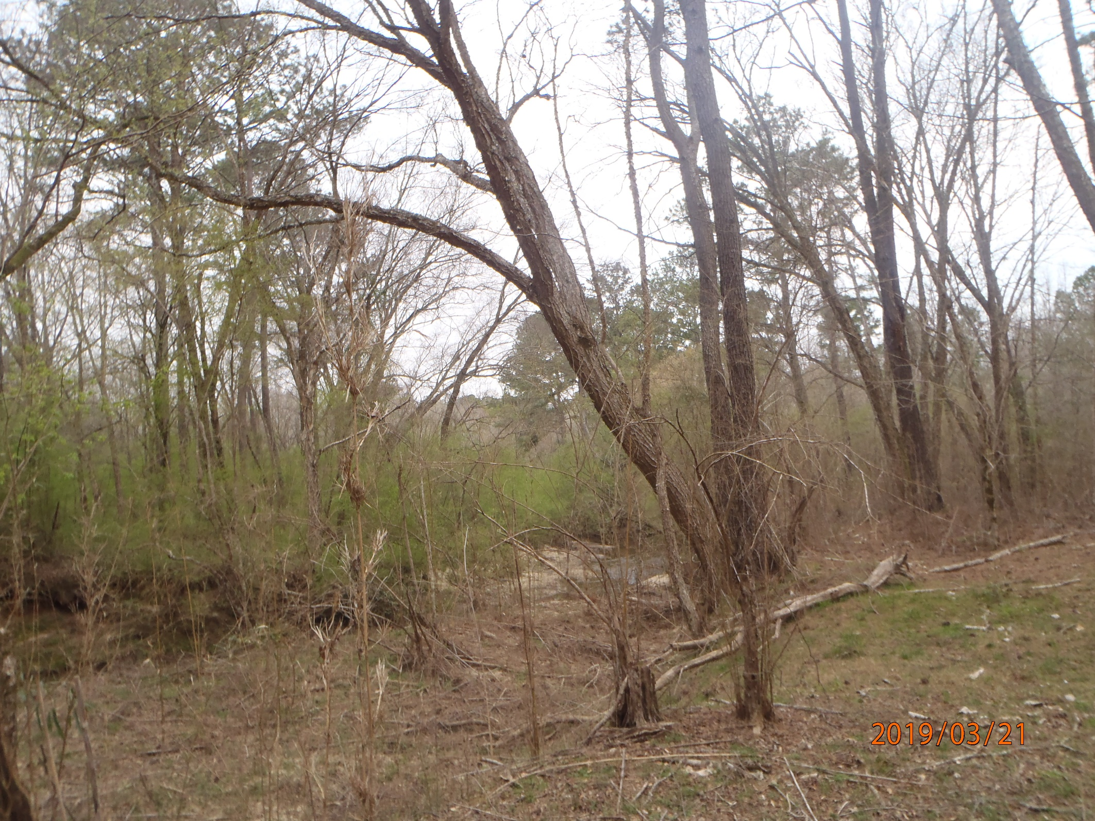
1st year/treatment practice applied, project in progress…3 years of treatment planned, mechanical and chemical
Other conservation practices in current plan or in the planning process: Stream Habitat Improvement, Prescribed Fire
Private land in Edgefield County, Beaverdam Creek -EQIP
Brush Management (314) – Target: Ligustrum sinense

Slide 22
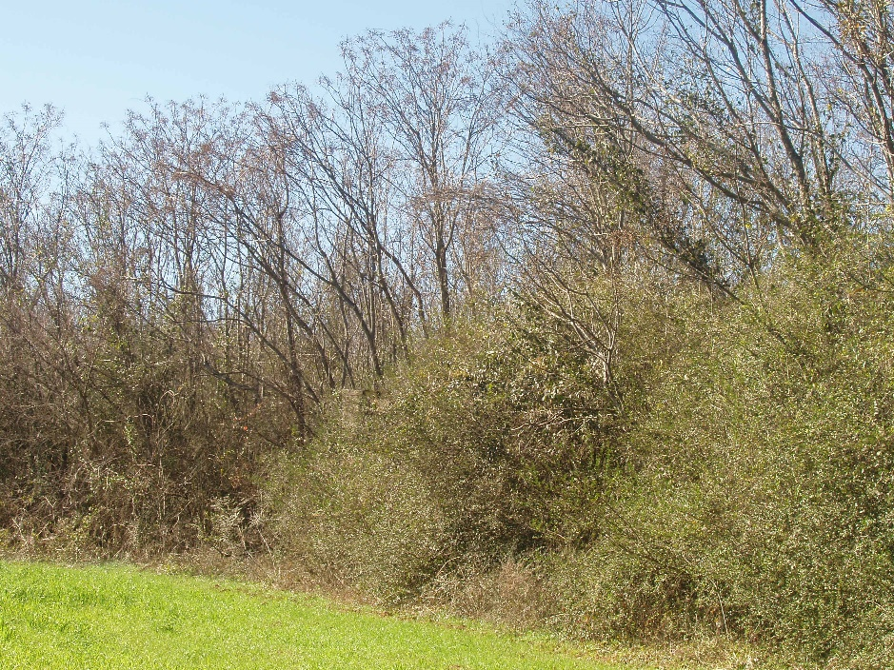
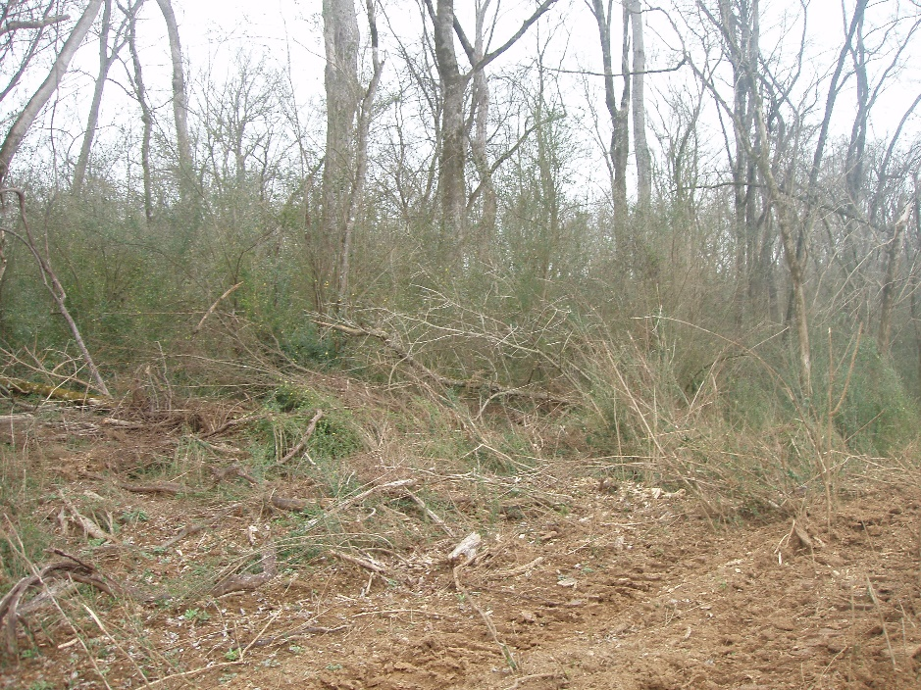
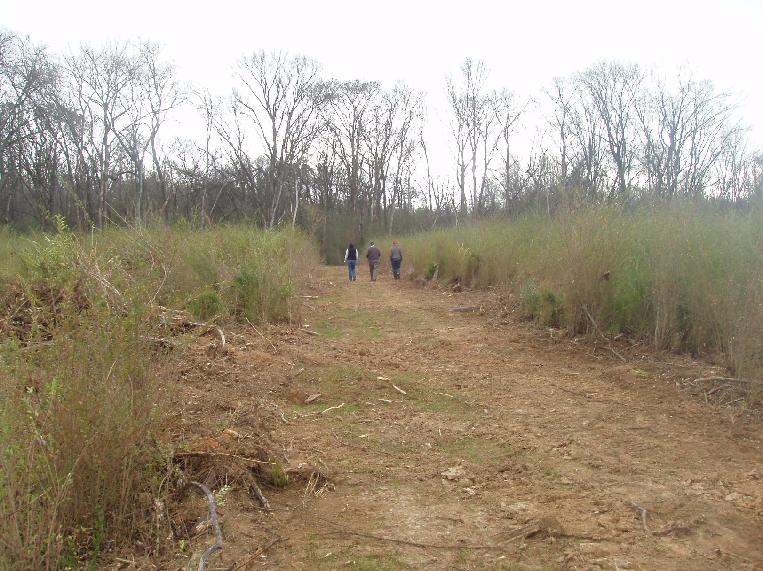
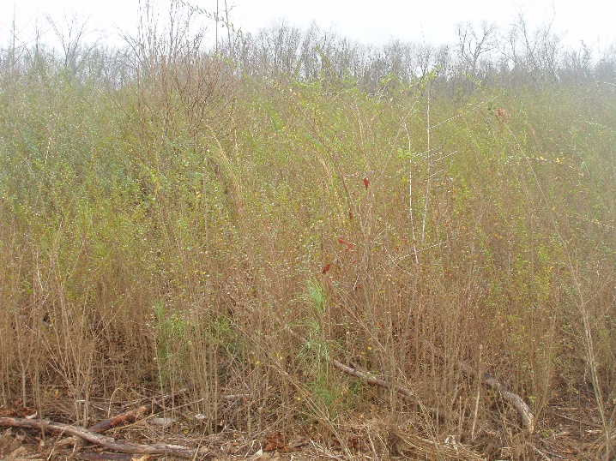
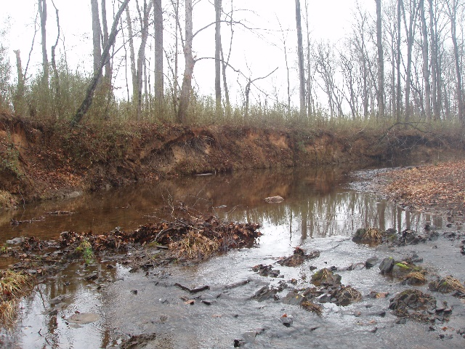
Chinaberry
Private land in Edgefield County, -EQIP
Brush Management (314) – Target: Ligustrum sinense, Melia azedarach
Stream within watershed known to harbor Carolina Heelsplitter, consulted with FWS, no foliar spray of herbicide within 50 feet of stream

Slide 23
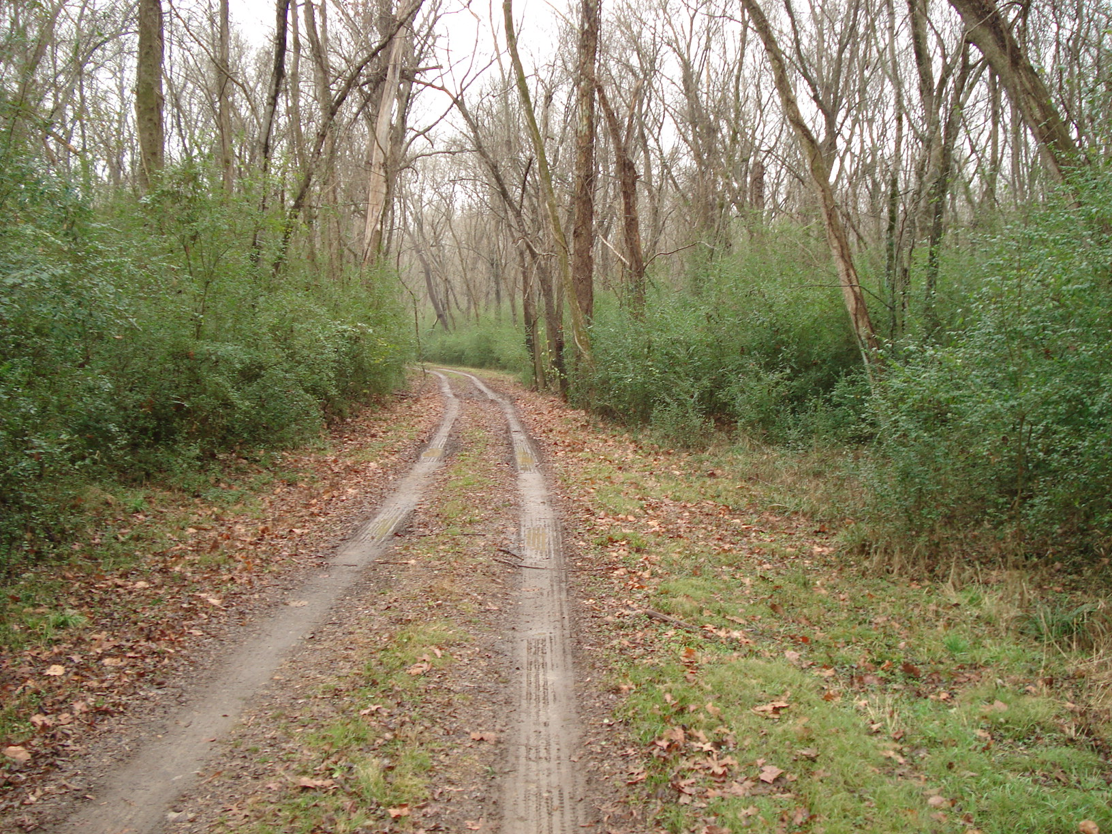
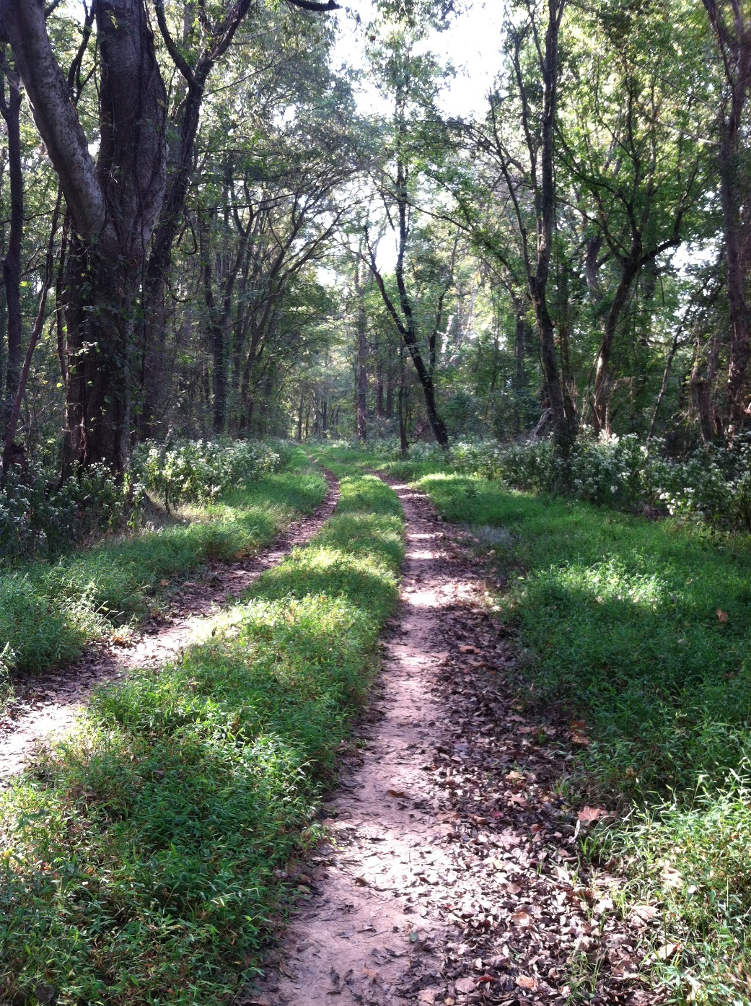
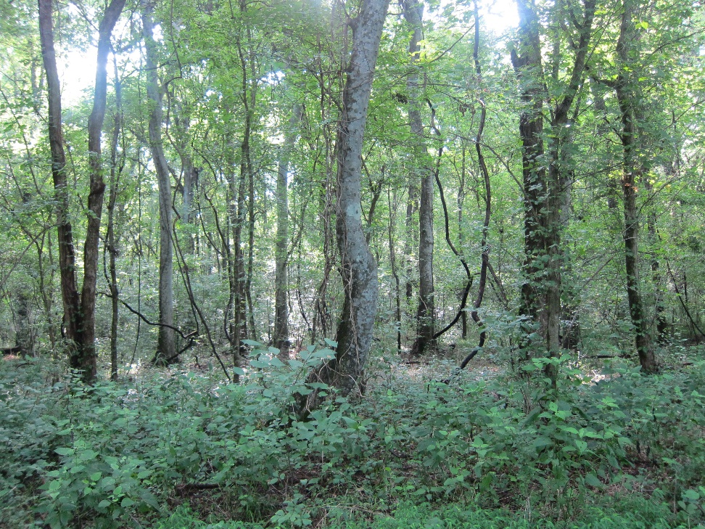
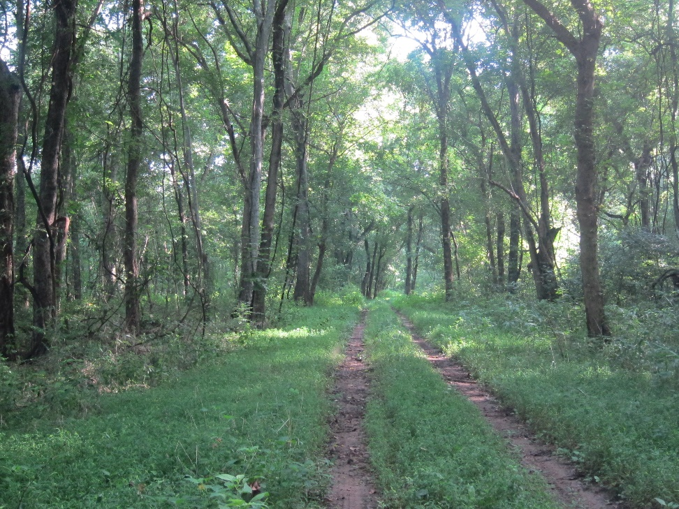
Private land in Kershaw County, Wateree River floodplain
Brush Management (314) – Target: Ligustrum sinense
Before, several hundred acres covered
1 year post trtmt
3 years post trtmt
4 years post trtmt

Slide 24
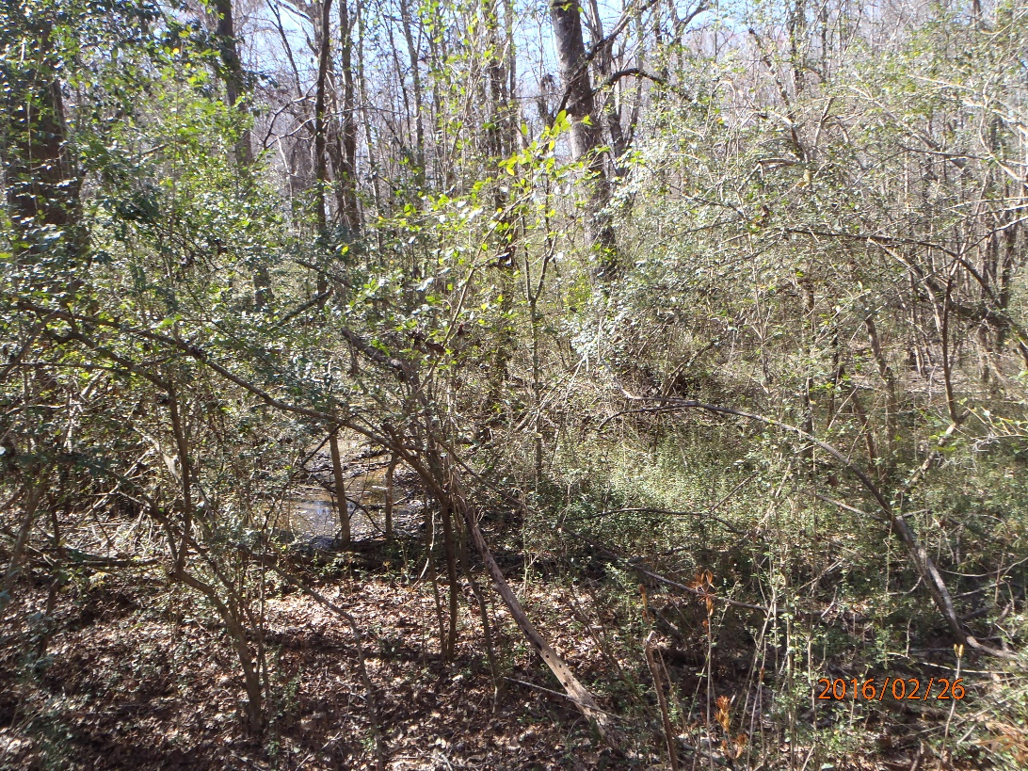
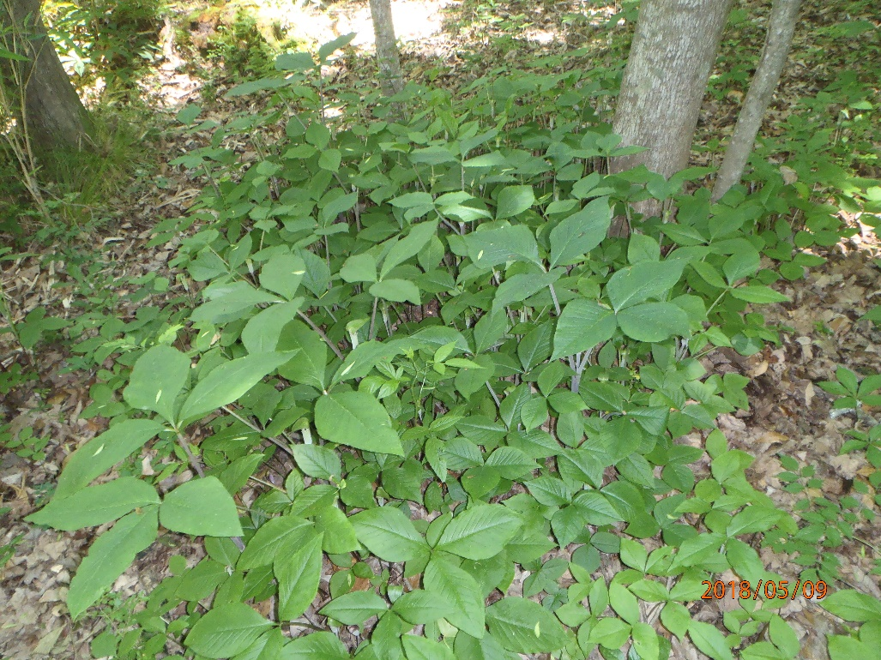
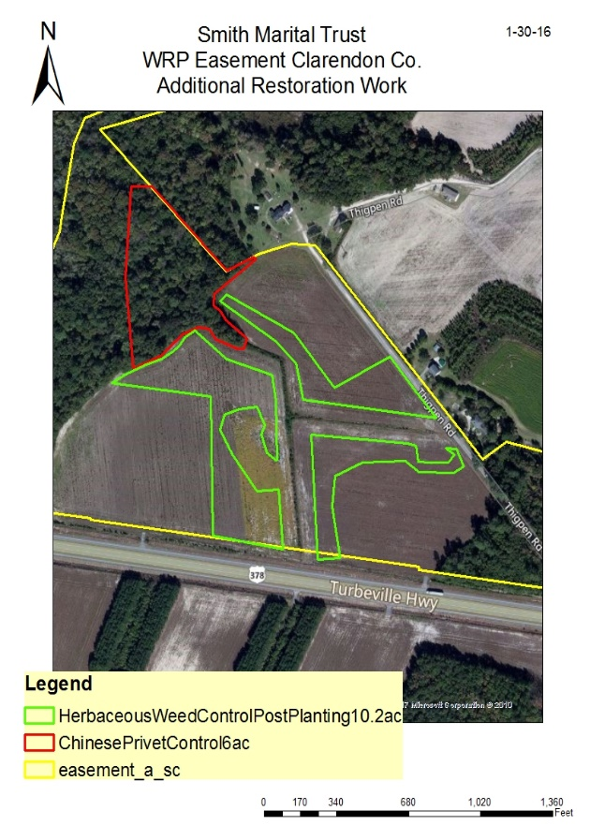
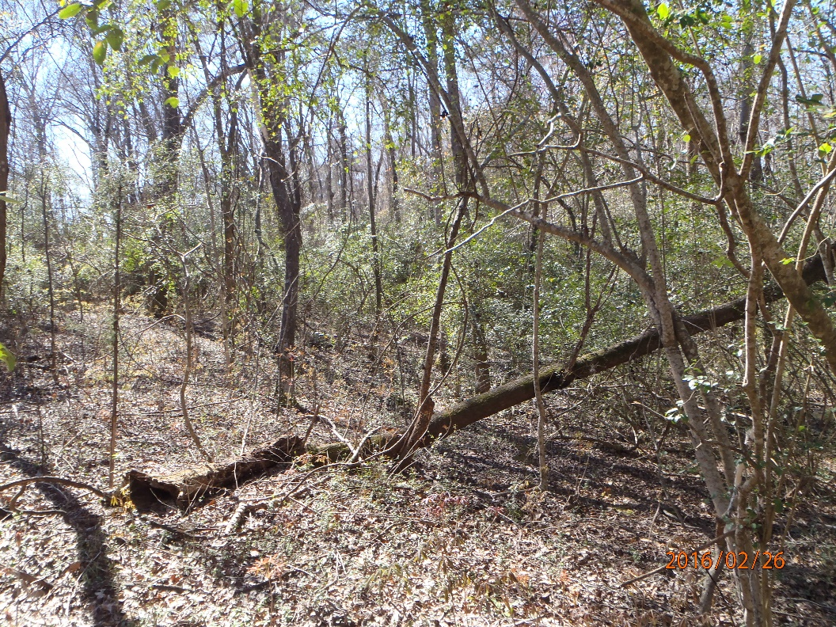
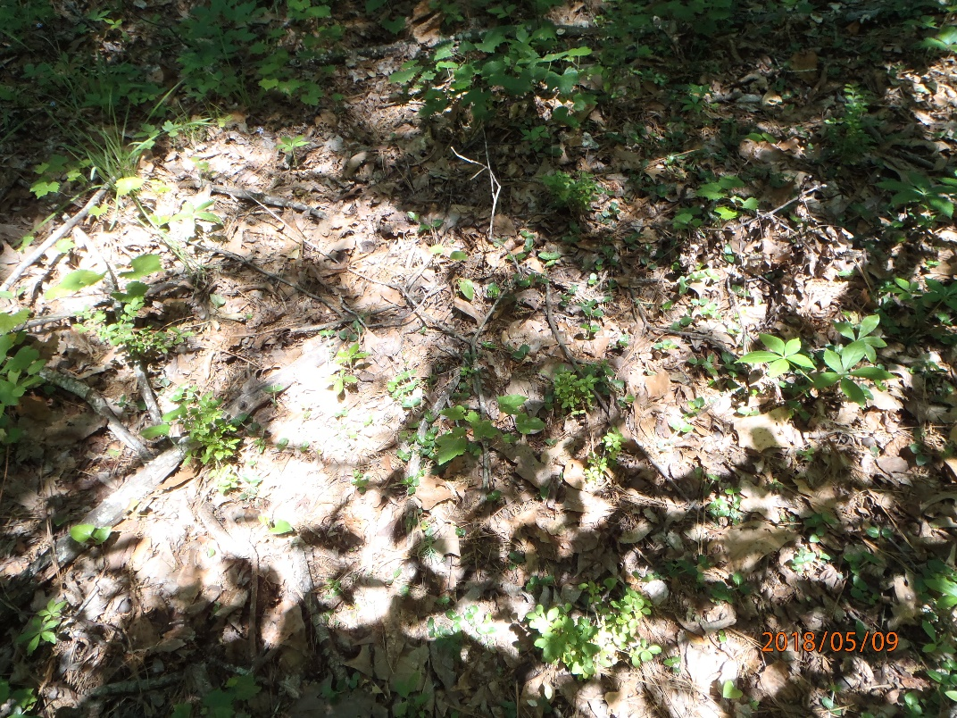
WRP Easement site Clarendon County, Douglas Creek
Wetland Restoration Target: Ligustrum sinense
2016
2018

Slide 25
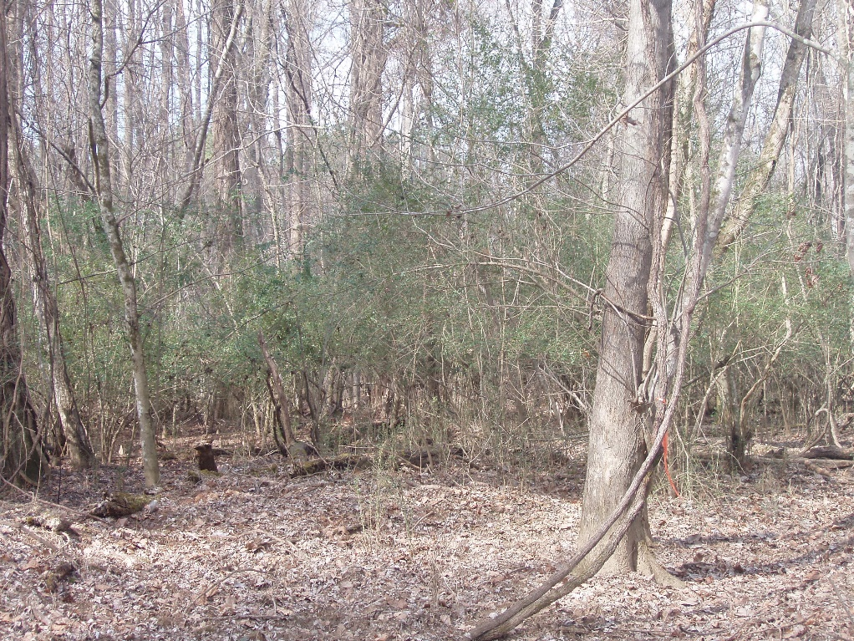
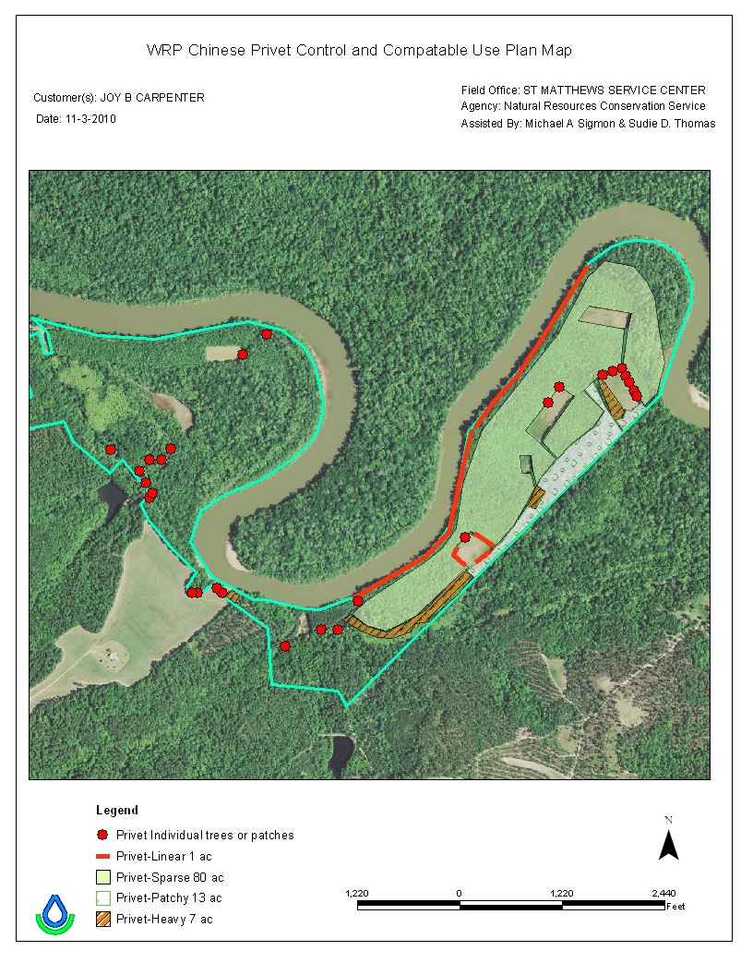
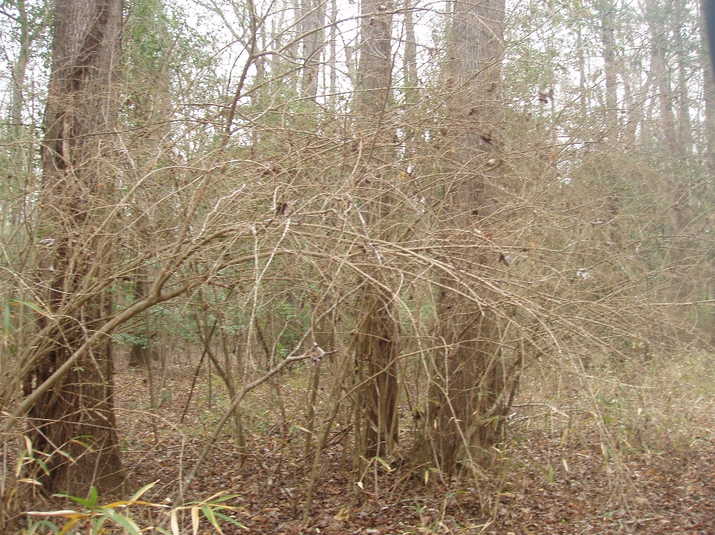


Wetland Restoration Target: Ligustrum sinense
Private land in Calhoun County, Chinese privet on WRP Easement, Congaree River floodplain
Additional wetland restoration on site, berm/fill removal from wetlands, reconnect aquatic passage
After treatment
Next door

Slide 26



Private land in Beaufort County, Chinese Tallow Tree on WRP Easement

Slide 27






Private land in Beaufort County, Chinese Tallow Tree on WRP Easement
Brush Management (314) – Target: Triadica sebifera, 3 annual treatments
https://vimeo.com/59610808

Slide 28



Private land in Calhoun County, New application for EQIP, planning
Chinese privet and Chinaberry on site also
Trifoliate orange (Poncirus trifoliata)
Thorny olive (Elaeagnus pungens)

Slide 29




Other species found on private lands in SC, control efforts included in Farm Bill Program projects
Brush Management (314) or Herbaceous Weed Treatment (315)
Chinaberry
Golden Bamboo, Chinese Wisteria
Alamo cultivar, Switchgrass

Slide 30

Other species found on private lands in SC, control efforts included in Farm Bill Program projects
Conservation practices planned: Herbaceous Weed Treatment, Wetland Restoration, Aquatic Organism Passage (EQIP)
Phragmites australis – coastal private lands
Private land in Charleston County

Slide 31


Other species found on private lands in SC, control efforts included in Farm Bill Program projects
“Lark” selection large-flowered partridge pea
Crotalaria spectabilis

Slide 32




Other species found on private lands in SC, control efforts included in Farm Bill Program projects
Spartanburg
Sumter
Callery pear Pyrus calleryana
Marlboro
Edgefield

Slide 33




Other species found on private lands in SC, control efforts included in Farm Bill Program projects
Lygodium japonicum

Slide 34


Other species found on private lands in SC, control efforts included in Farm Bill Program projects
Non-native plants not allowed under most conservation practices
A few non-native grasses remain as recommendations for pasture/hay and for critical area plantings.
Sawtooth oak spreading
Sawtooth oak planted on WRP Easement, they had to remove it…

Slide 35








Planting native flora often included in Conservation Plan: woody trees and shrubs, herbaceous grasses and wildflowers
Practices:
Conservation Cover (327) Hedgerow (422)
Tree and Shrub Establishment (612)

Slide 36






NRCS staff much more aware of exotic invasive pest plant problems, identification, and how to address
Invasive exotic pest plant problems considered at many stages of the planning process
Application ranking for program funds
NEPA/CPA- 52
Field checklists for conservation planning
Assessment tools (WHEG, Wetland Functional Assessment)
Many different conservation practices and components included to address various types of infestations/species
1-2 annual plant ID training days for staff
Workshops for staff and landowners, partners

Slide 37
CPA- 52
South Carolina NRCS Wildlife Habitat Index Guide

Slide 38
Guidance for planners

