Slide 1
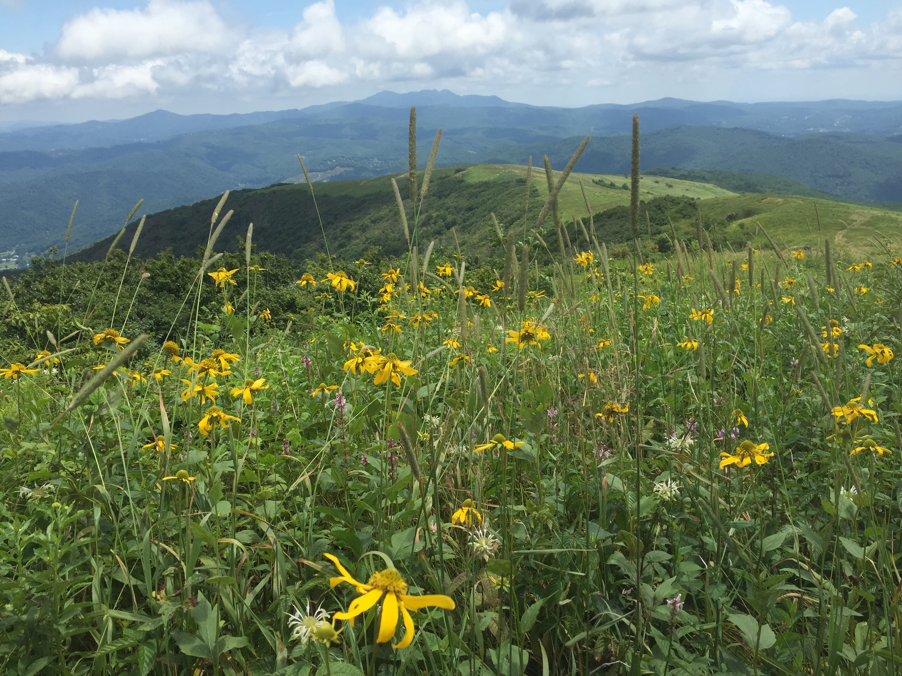
Managing Invasive Plants on the Appalachian National Scenic Trail
People, Plants, and Partnerships

Slide 2
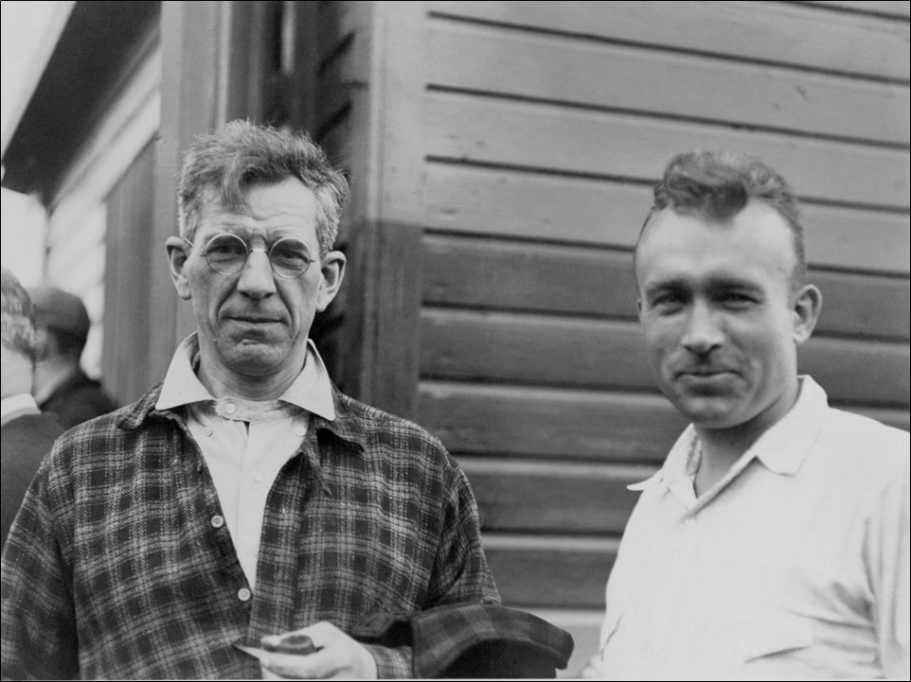
Benton MacKaye and Myron Avery

Slide 3
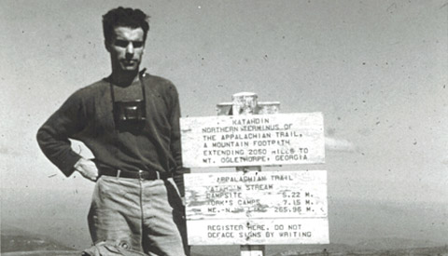
Appalachian Trail Completed 1937
First thru-hike completed by Earl Shaffer in 1948

Slide 4
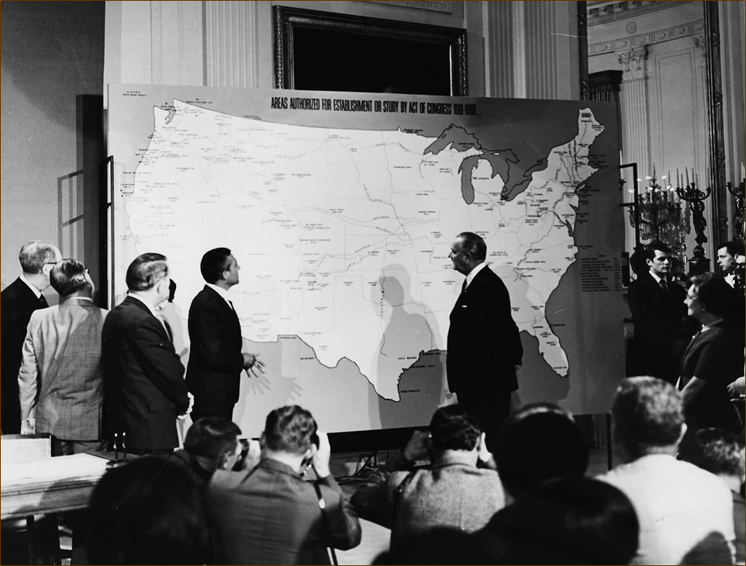
National Trails Systems Act
1968

Slide 5
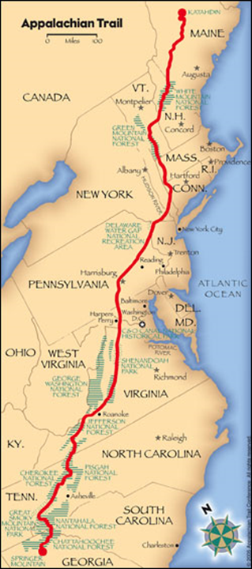
2,190.9 miles
14 states
6 National Parks
8 National Forests

Slide 6
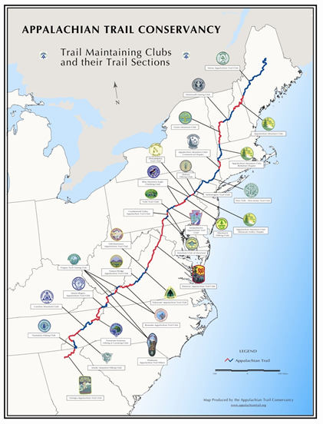
Cooperative Management Partners
The Appalachian Trail Conservancy
The National Park Service and Other Federal or State Land Management Agencies
Trail Clubs

Slide 7
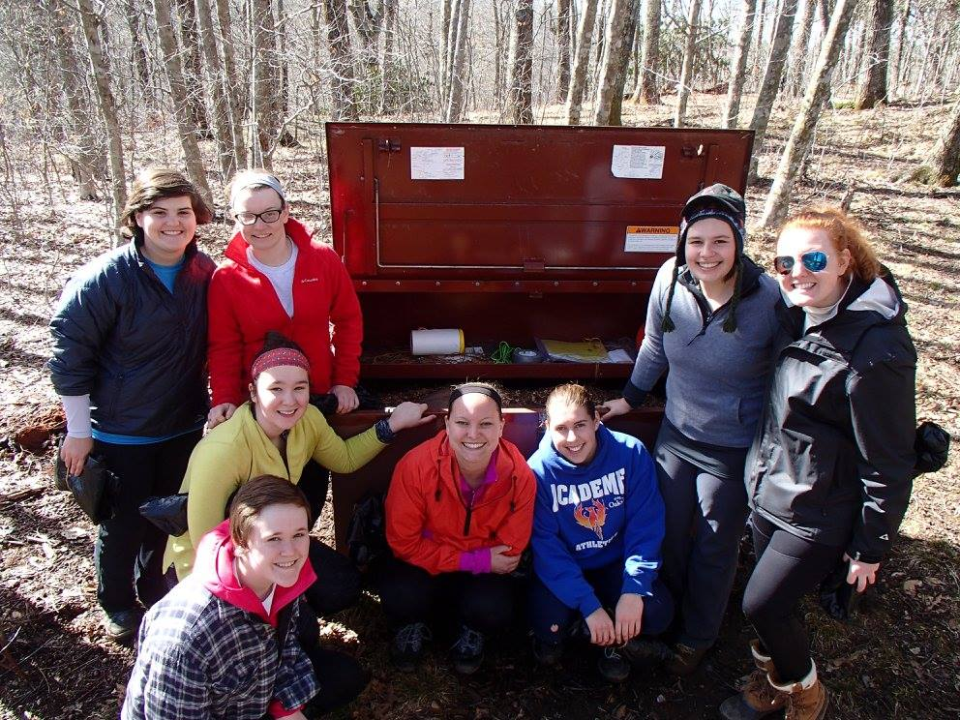
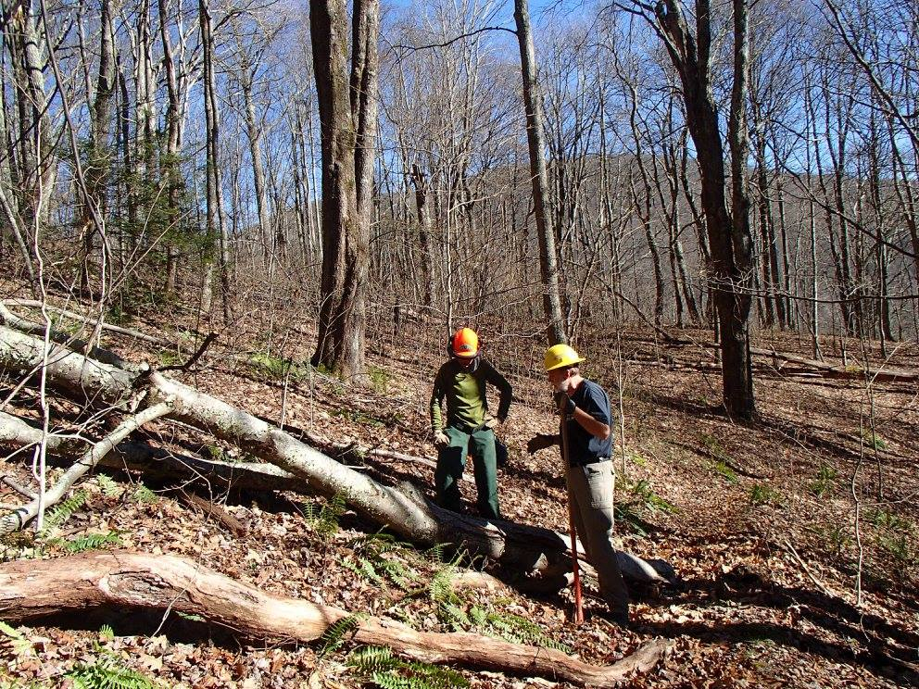
Volunteers on the A.T.
Most years, over 6,000 volunteers contribute over 220,000 hours to Trail maintenance projects.

Slide 8
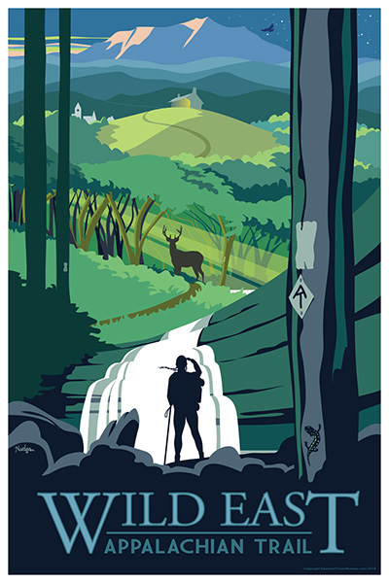
Welcome to Wild East™
What is the Wild East? The general geographic area adjoining and surrounding the Appalachian National Scenic Trail. The last remaining long-distance contiguous open space in the eastern United States.

Slide 9
What Makes the A.T. Exceptional?
250,000 acres of connected land spanning 11° of latitude, and over 6,500 ft in elevation
Protects 1st and 2nd order headwaters of major east coast watersheds
Acts as an ecological corridor, connecting otherwise disconnected conservation lands
Is a part of the most significant migratory pathway in the Eastern U.S.
Notes:
The AT Corridor is a treasure trove of Natural Resources.
includes many unique high-elevation ecosystems
will be increasingly critical to the movement and survival of wildlife under changing climates

Slide 10
A.T. Natural Resource Program at a Glance
Rare plant monitoring and management
Tracking seasonal life cycles (Phenology)
Invasive exotic species management
plants and animals
Open areas management
for vistas and wildlife
Wildlife habitat management
i.e. migratory birds and pollinators
Education and Outreach
(Ridgerunners, Leave No Trace, Workshops, Signage, VUM)

Slide 11
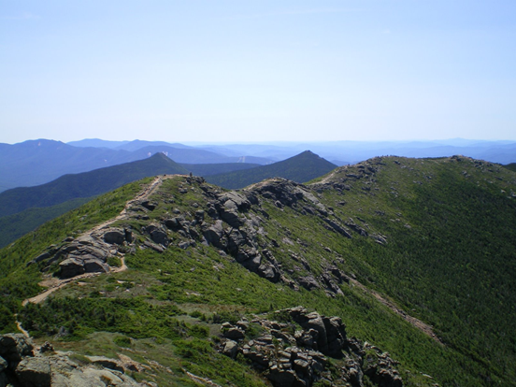
Why Monitor & Manage A.T. Natural Resources ?
Invasive species – forest pests and pathogens
Habitat loss – early successional, old growth, shifting predominate forest species and resulting species decline
Habitat fragmentation – energy infrastructure, housing development
Habitat mismanagement –species decline (lynx, hares, moose, etc.)
Loss of natural processes - i.e.predation and fire
Identify new & emerging threats to a functional A.T. landscape:
We can’t manage or protect what we don’t know exists.

Slide 12
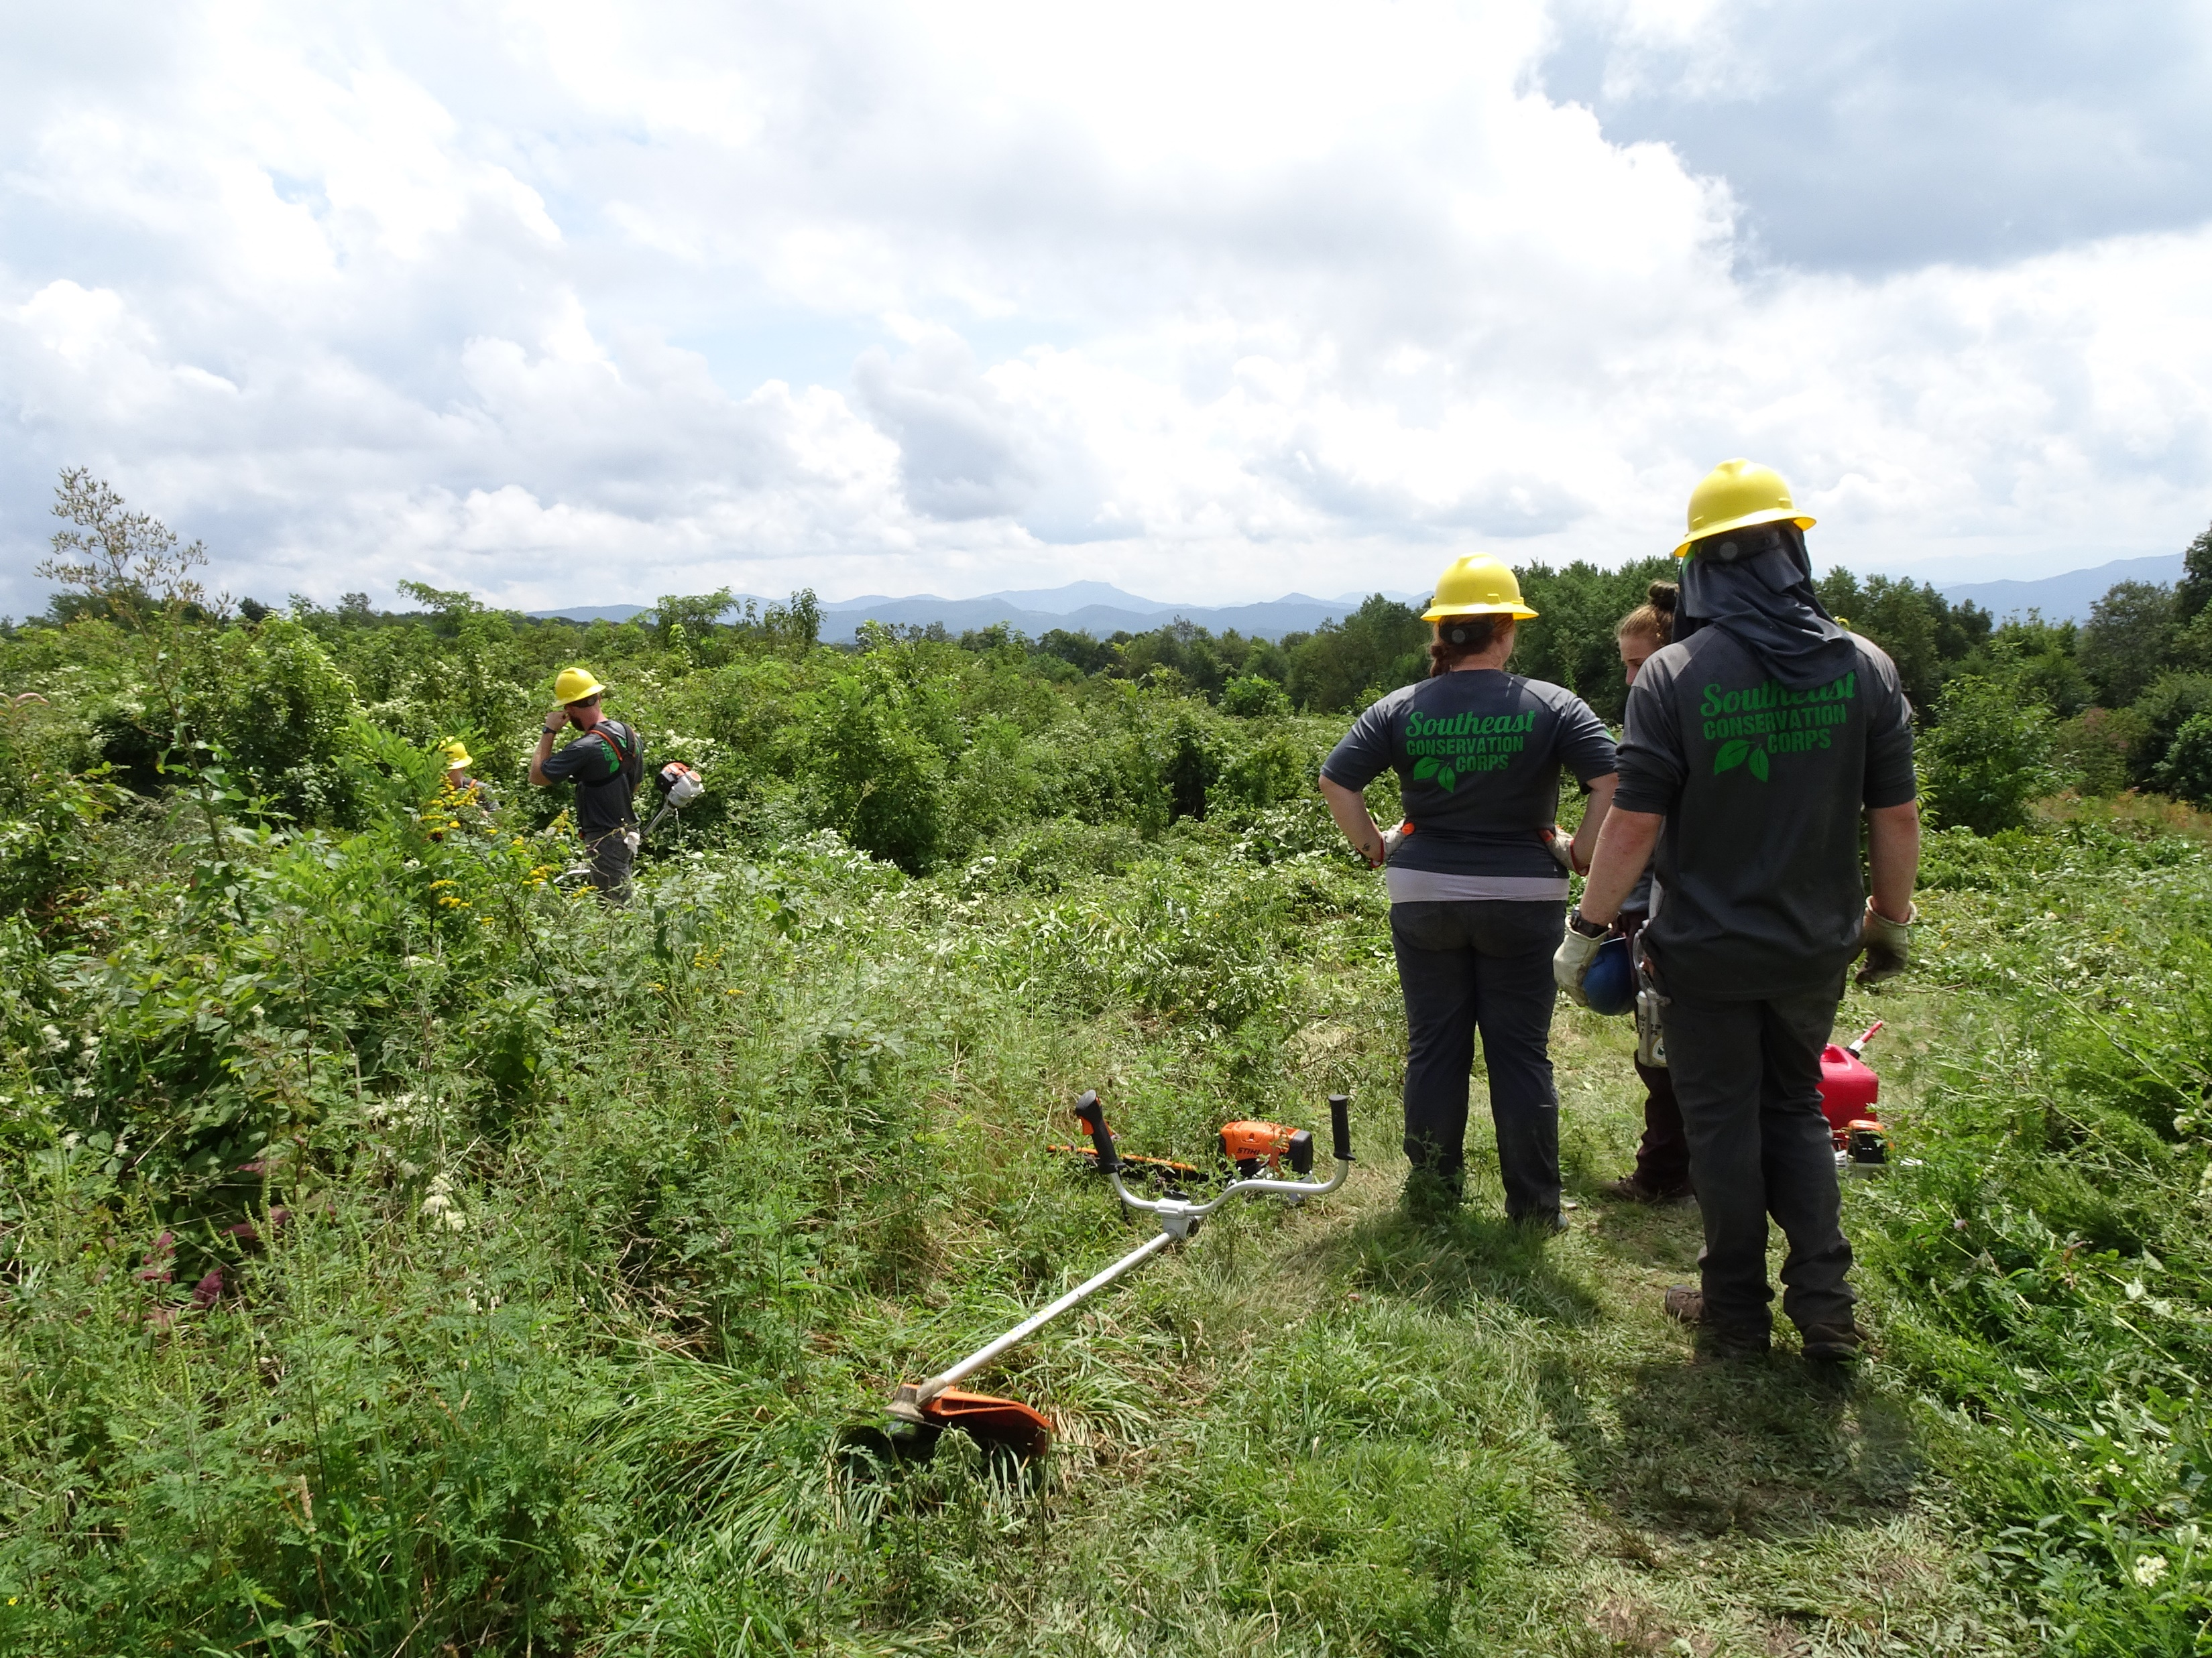
Open Areas Management

Slide 13
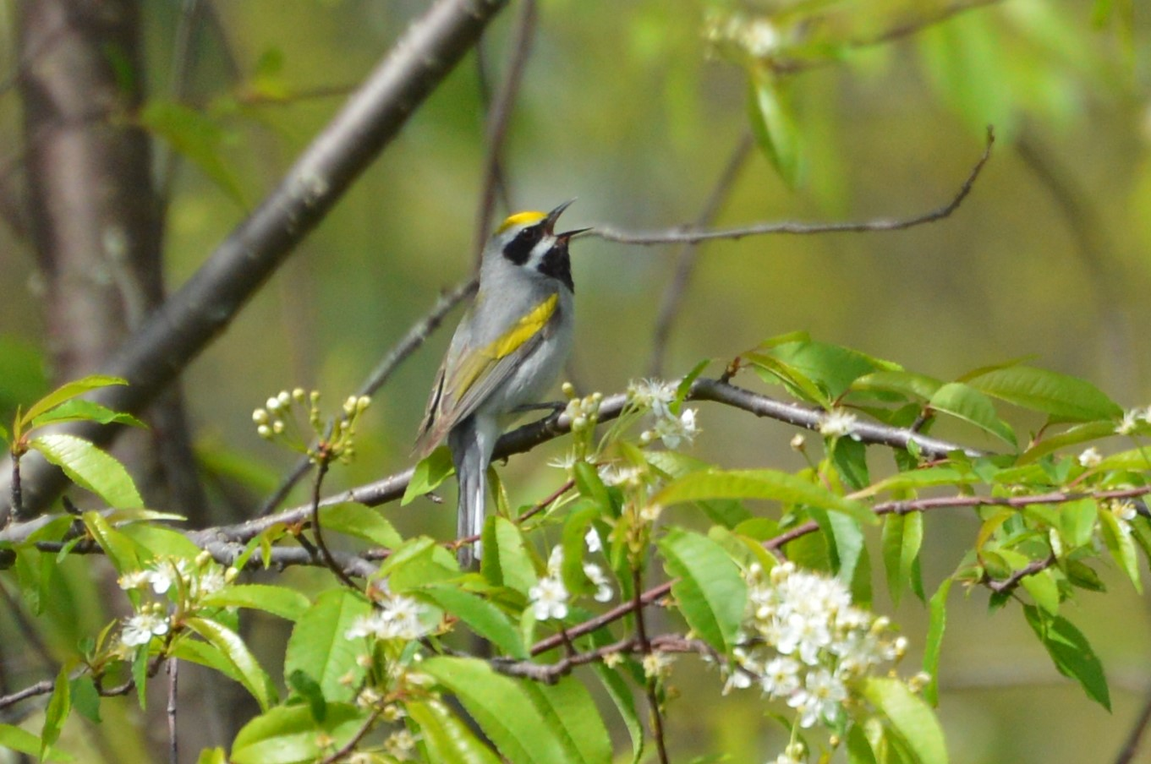
Golden-winged Warbler Management

Slide 14
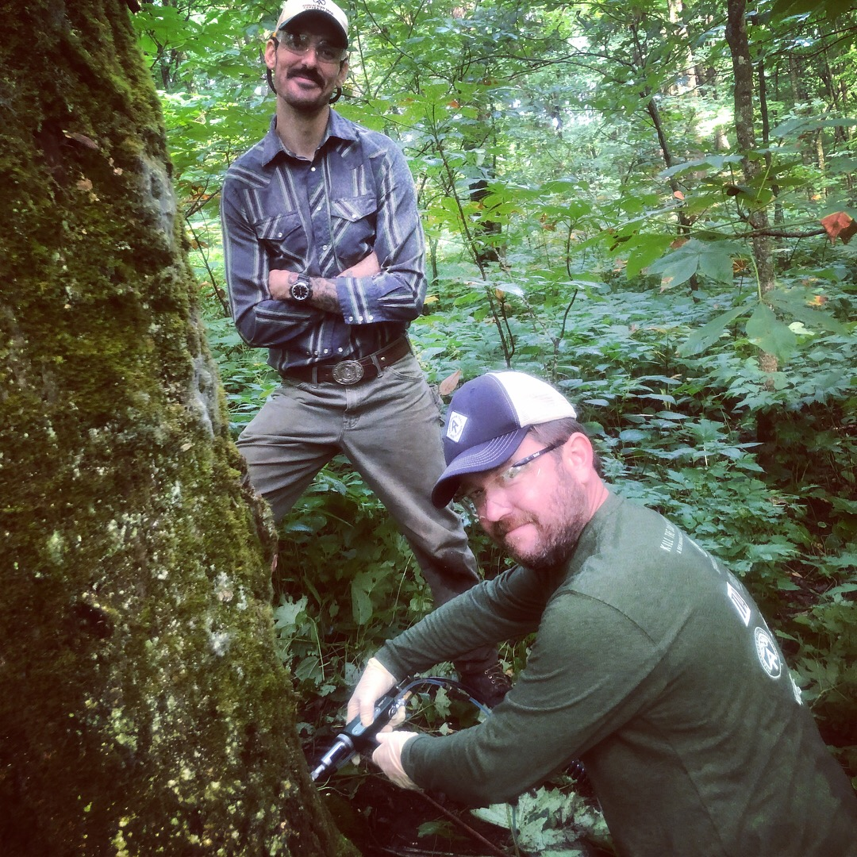
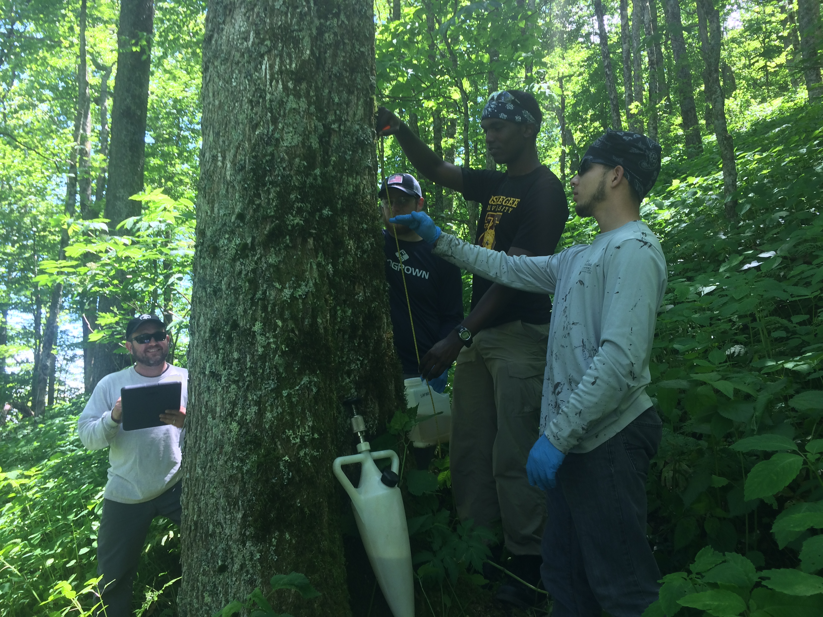
Save Our Ashes
Treated over 850 trees at 6 sites in NC and
TN in the last 2 years
Inventory and treatments ongoing,
We hope to treat in GA in 2019

Slide 15
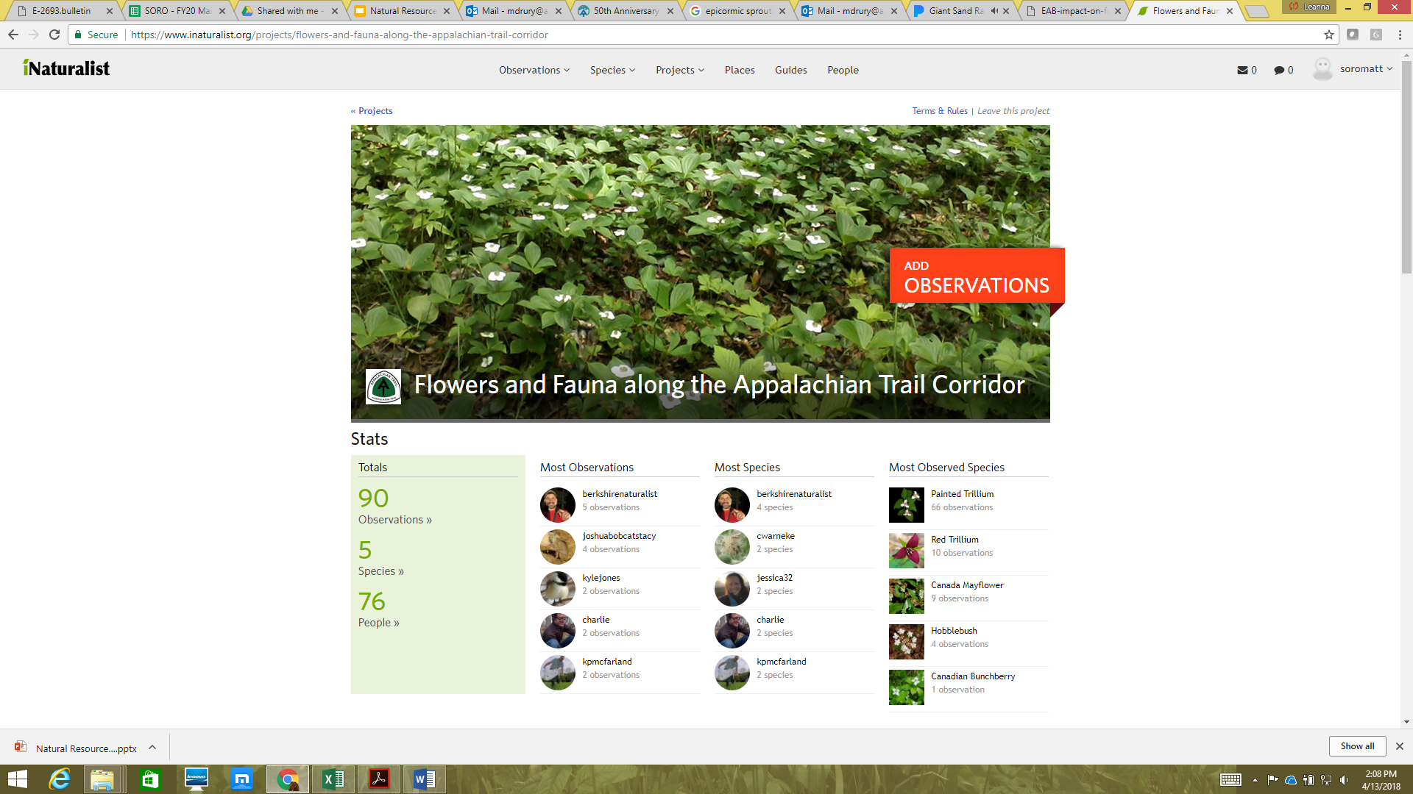
Inaturalist
https://www.inaturalist.org/

Slide 16
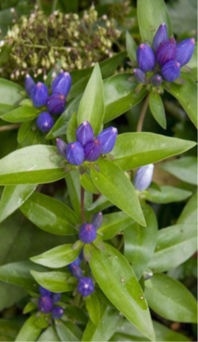
A.T. Natural Diversity Inventories
To identify/protect rare, threatened or endangered plants, animals and exemplary natural communities
Completed for all 14 Trail states between 1989 and 2001
All inventories - Vascular plants and exemplary natural communities
Some inventories - Rare vertebrates, Non-vascular plants and invertebrates
Notes:
To help identify the resources within the A.T. corridor, a Natural Diversity Inventory was completed for each of the 14 Trail states.

Slide 17
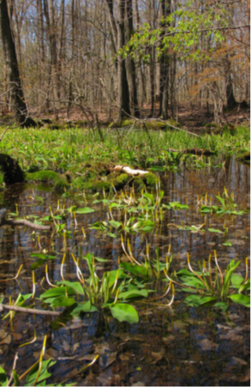
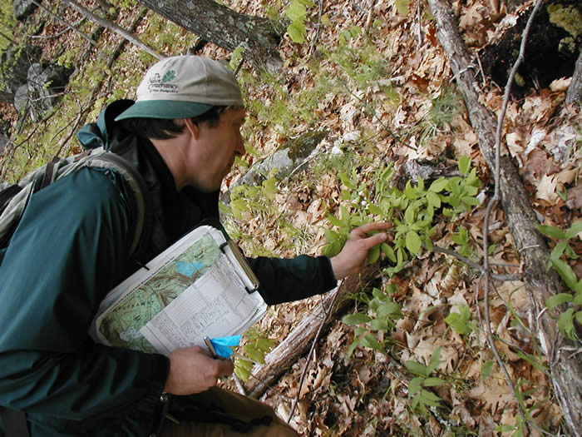
Natural Heritage Inventories Identified...
1,845 species occurrences (discrete populations)
297 significant natural communities
482 sites

Slide 18
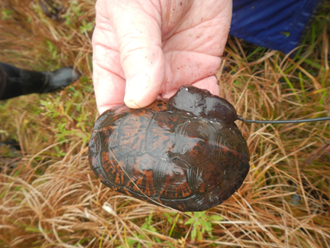
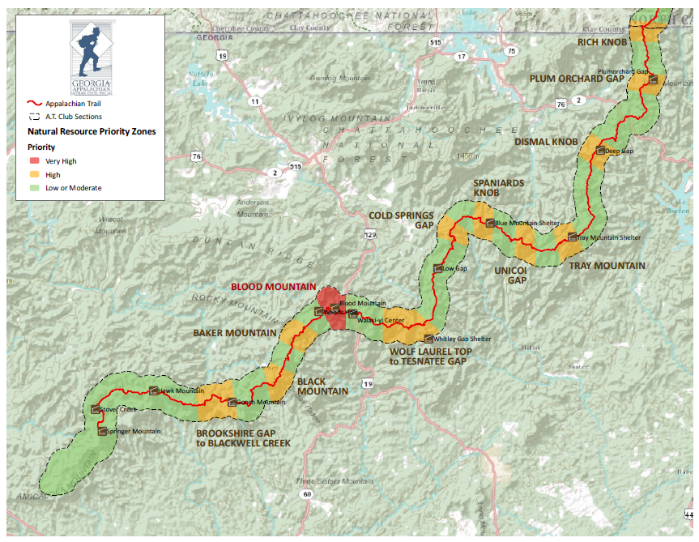
Natural Resource Priority Zones
Entire Trail divided intoVery High,High, and Moderate/Low Natural Resource Priority Zones
Priorities determined by
presence of rare plants
Rarity of species
Number of occurrences
Very-high priority zones
Take precedence for natural
resource protection
Require extra care during
Trail maintenance

Slide 19
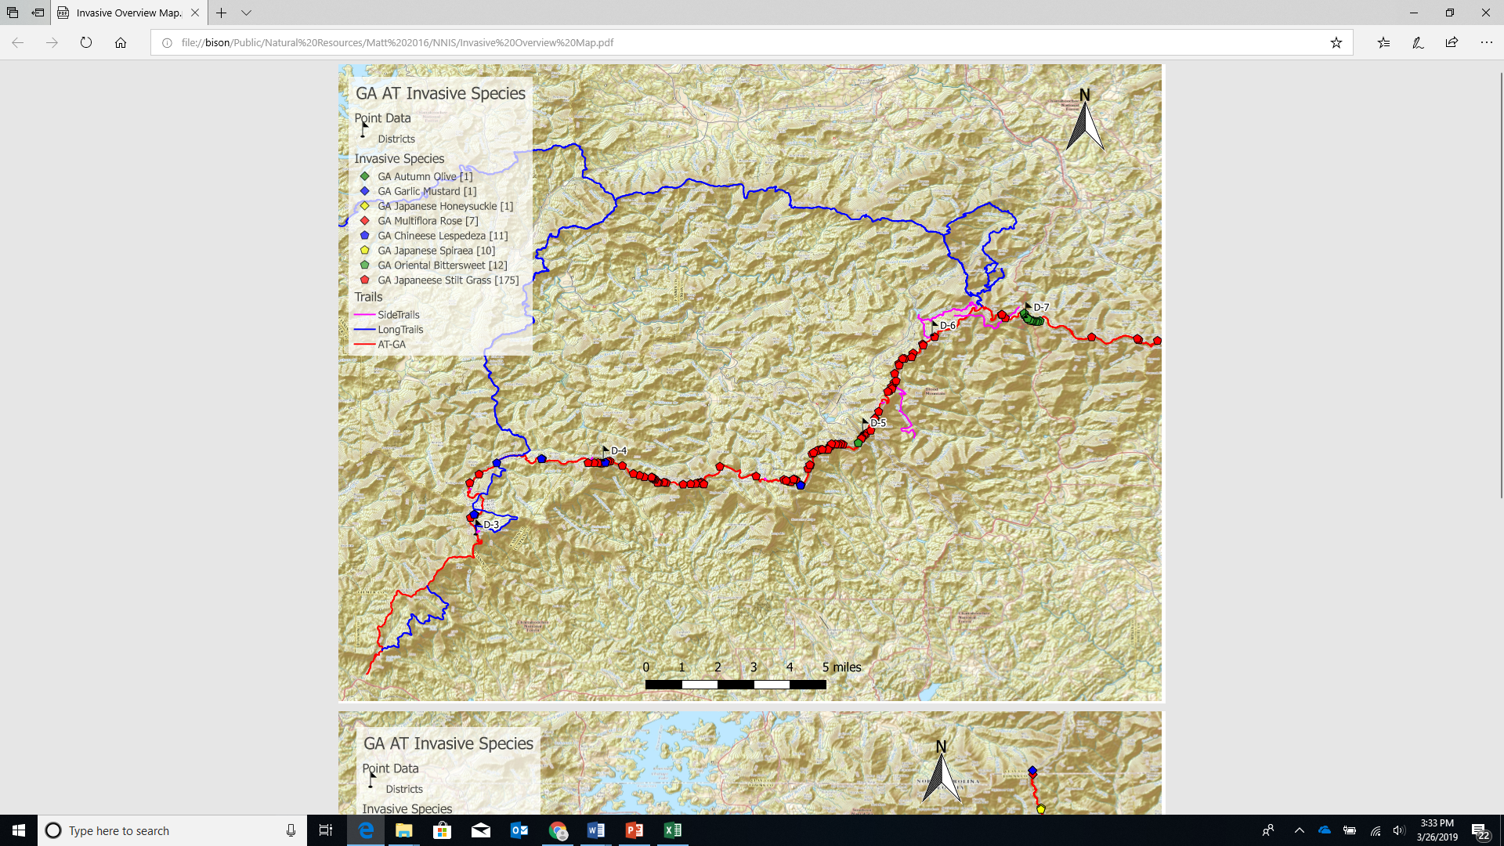

Slide 20
Mill Ridge Project

Slide 21
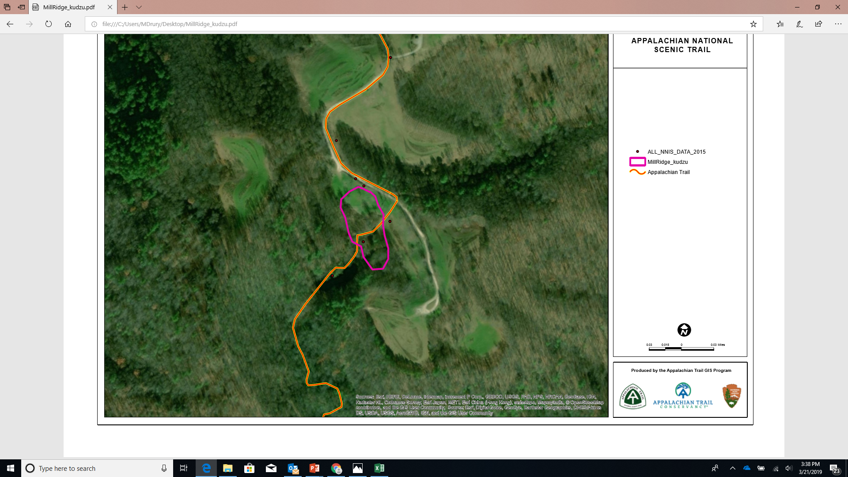
Stecoah Gap Golden-winged
Warbler/P. tomentosa Project

Slide 22
Reporting
Site Name | Target Species | Treatment method | Date of Treatment | Acres Treated | Chemical Used | Certified Applicator | Active Ingredient | Dilutant | Volume Applied | Percent Solution Applied | Directions to Site | GPS Cooridinates: NAD 84; Decimal degrees | Description of Treatment | Addistional NNIS not treated | Site notes
Roan - Carvers to RMSP | garlic mustard | hand pull | 4/21/2018 | 8 |  |  |  |  |  |  |  |  | road shoulders into forest, carvers to 1st houses, 634 lbs. | coltsfoot | CNF
Lemon Gap | garlic mustard | hand pull | 4/24/2018 | 2 |  | Matt Drury |  |  |  |  |  | 35.825, -82.937 | Lemon Gap and A.T. North to first gap | spirea | CNF/PNF
Devils Creek Gap | garlic mustard | hand pull | 4/28/2018 | 2 |  | Matt Drury |  |  |  |  |  | 36.045, -82.427 | cove West of Gap, wildlife opening, road shoulder and down into woods, 34 lbs. | coltsfoot | PNF
Devils Creek Gap | Autumn olive | cut/paint w/herbicide | 4/28/2018 | 2 | glyphosate | Matt Drury | glyphosate | water | 7 oz. | 50% |  | 36.045, -82.427 | majority of treatment at wildlife opening | coltsfoot | PNF
Roan - lower hwy 143 | garlic mustard | hand pull | 5/8/2018 | 3 |  | Matt Drury |  |  |  |  |  |  | lower section near RM State Park | coltsfoot | CNF/private
Neels Gap | oriental bittersweet | hand pull | 6/22/2018 | 2 |  |  |  |  |  |  |  | 34.734, -83.914 | Mtn. Crossing>Trail North |  | Chattahoochee
Mill ridge | multiflora rose, autumn olive | cut/paint | 6/27/2018 | 2 | glyphosate | Matt Drury | glyphosate | water | 9 oz. | 50% |  | 35.902, -82.791 | A.T. to pond, cove, and vicinity | Paulownia tomentosa, kudzu, privet, honeysuckle | PNF
Fontana Marina | multiflora rose, autumn olive, burning bush, oriental bittersweet, honeysuckle | cut/paint | 7/7/2018 | 2 | glyphosate | Matt Drury | glyphosate | water | 28 oz | 50% |  | 35.442, -83.796 | both sides of hwy 28, marina parking lot area, and Trail North of Parking lot | climbing euonymous | PNF
GRSM - Fontana |  | hand pull | 7/7/2018 | 2
TVA-Fontana |  | cut/paint | 7/7/2018 | 2 |  | Matt Drury
Mill ridge | m. rose, a. olive | cut/paint | 9/12/2018 | 1 | glyphosate | Matt Drury | glyphosate | water | 8 oz | 50% |  | 35.902, -82.791 | A.T. to pond, cove, and vicinity | Paulownia tomentosa, kudzu | PNF
Hot Springs A.T. TH | multiflora rose, privet | cut/paint | 9/12/2018 | 0.75 | glyphosate | Matt Drury | glyphosate | water | 4 oz | 50% |  | 35.890, -82.832 | parking lot area | Microstegium, kudzu, | PNF
Stecoah | paulownia | cut stump/hack&squirt | 9/18/2019 | 2
Garenflo Gap | m. rose, bittersweet, privet | cut/paint | 9/18/2018 | 0.6 | glyphosate | Matt Drury | glyphosate | water | 7 oz. | 50% |  | 82°52'33.74"W 35°51'10.09"N | gap to power line ROW, removed tree sleeves |  | PNF
Mill ridge | m. rose, a. olive, kudzu, paulownia | cut/paint | 9/20/2018 | 2.5 | glyphosate | Matt Drury | glyphosate | water | 18 oz. | 50% |  | 35.902, -82.791 | periphery of largest kudzu patch to pond, cut kudzu out of trees in preparation of foliar application |  | PNF
Charlie Johnson | multiflora rose | foliar | 9/23/2018 | 3.5 | glyphosate | J. McGuiness | glyphosate | water | 103 gallons | 3% |  |  | Wildwood reported activities directly to CNF |  | CNF
Decie Campbell | knotweed, Miscanthus, m. rose, oriental bittersweet | foliar | 9/23/2018 | 1.2 | tryclopyr | J. McGuiness | tryclopyr | water | 45 gallons | 4% |  |  |  |  | CNF
Bishop Hollow | m. rose | foliar | 9/23/2018 | 0.5 | glyphosate | J. McGuiness | glyphosate | water | 15 gallons | 4% |  |  |  |  | CNF
Mill ridge | kudzu | foliar | September | 2 | clopyralid 3 | Richard Sanders | clopyralid | water | 100 gallons | 21 oz. |  | 35.902, -82.791 | Wildwood Consulting sprayed out major kudzu patch | m. rose, olive | PNF

Slide 23
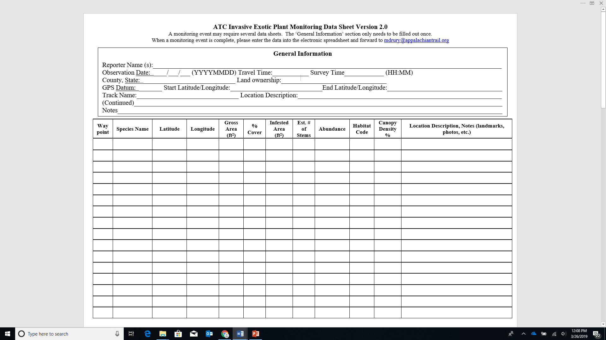
Inventory

Slide 24
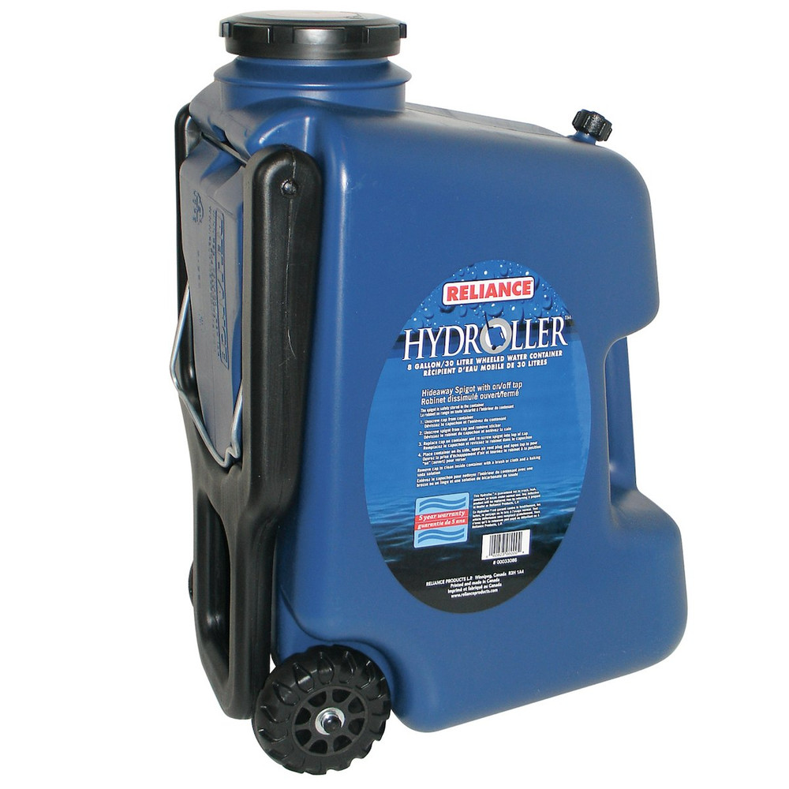
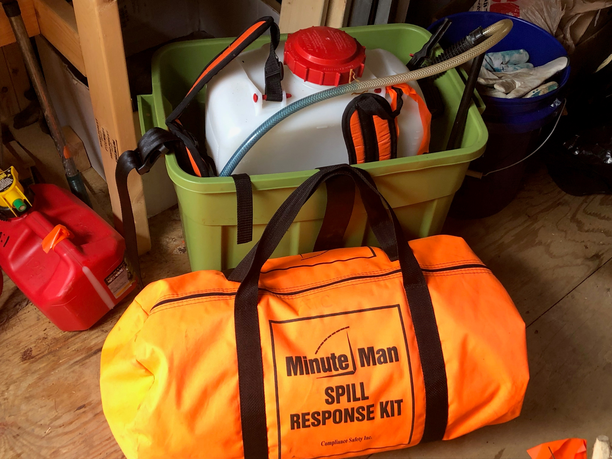
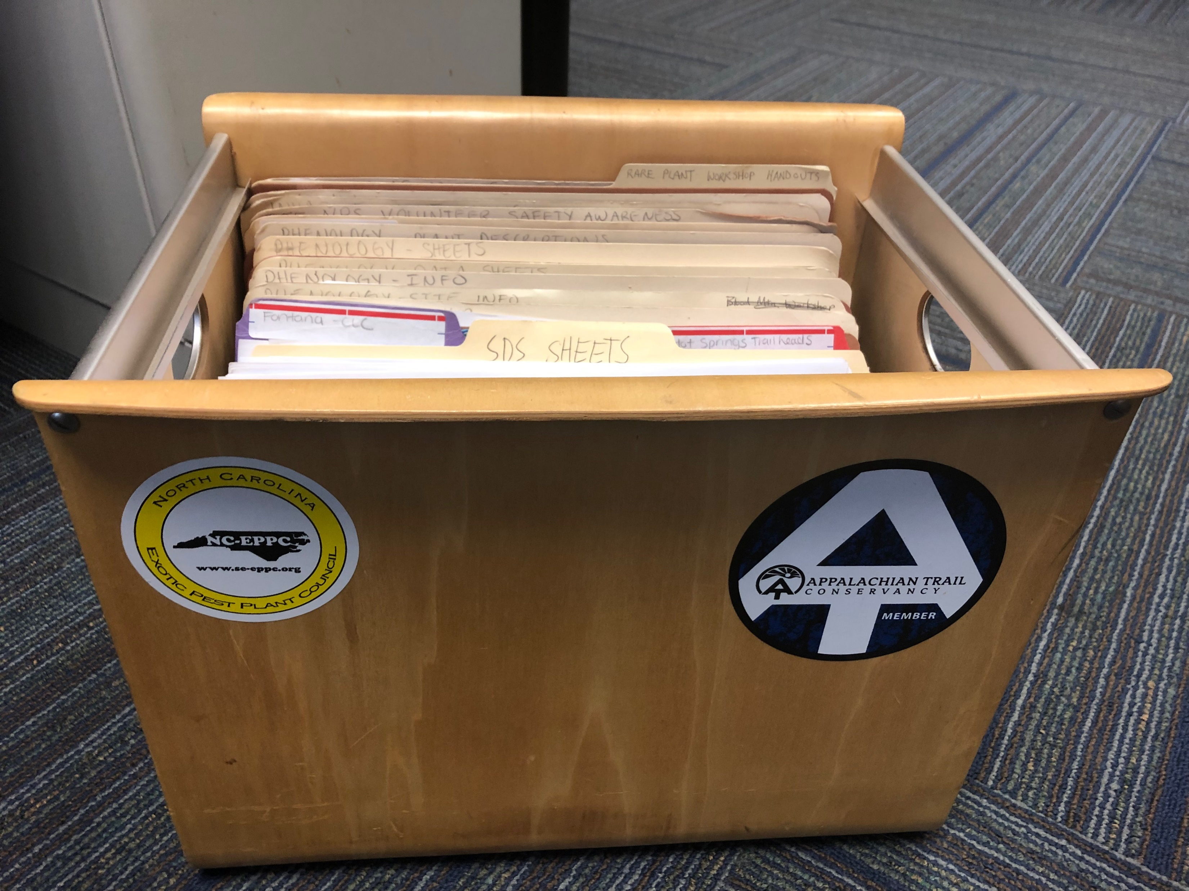
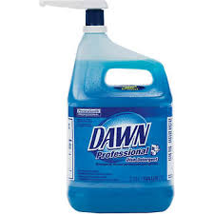
Work Day

Slide 25
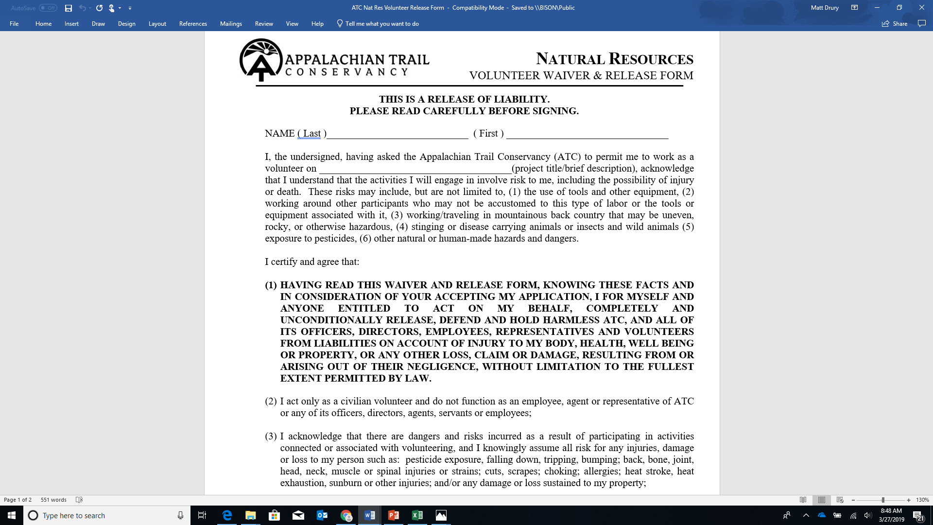
Liability and Compliance

Slide 27
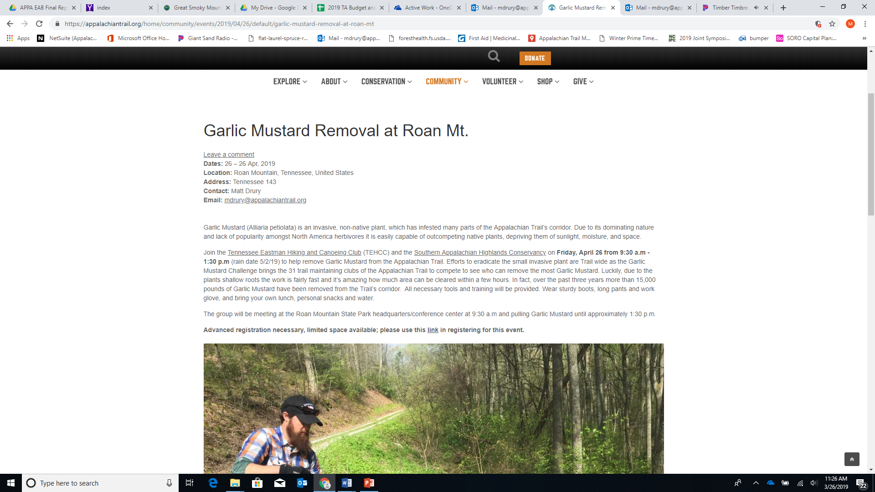

Slide 28
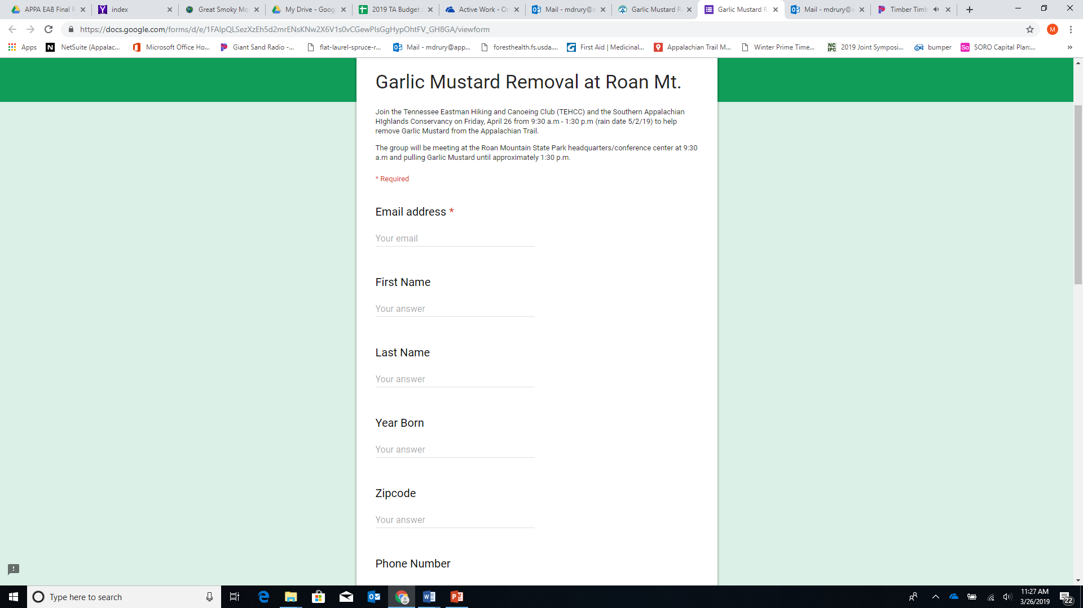

Slide 29
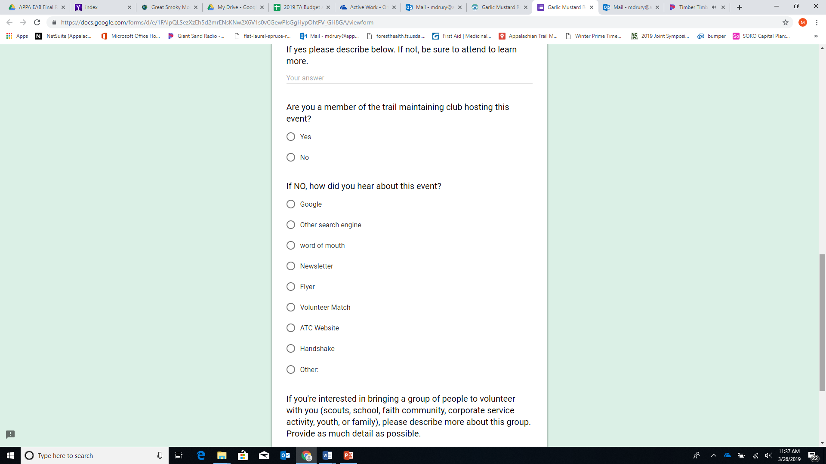

Slide 30
Recruiting
Trail Clubs
Partners – MountainTrue, SAHC
Students-
Interns
SACWMP FB Page
Tabling

Slide 31
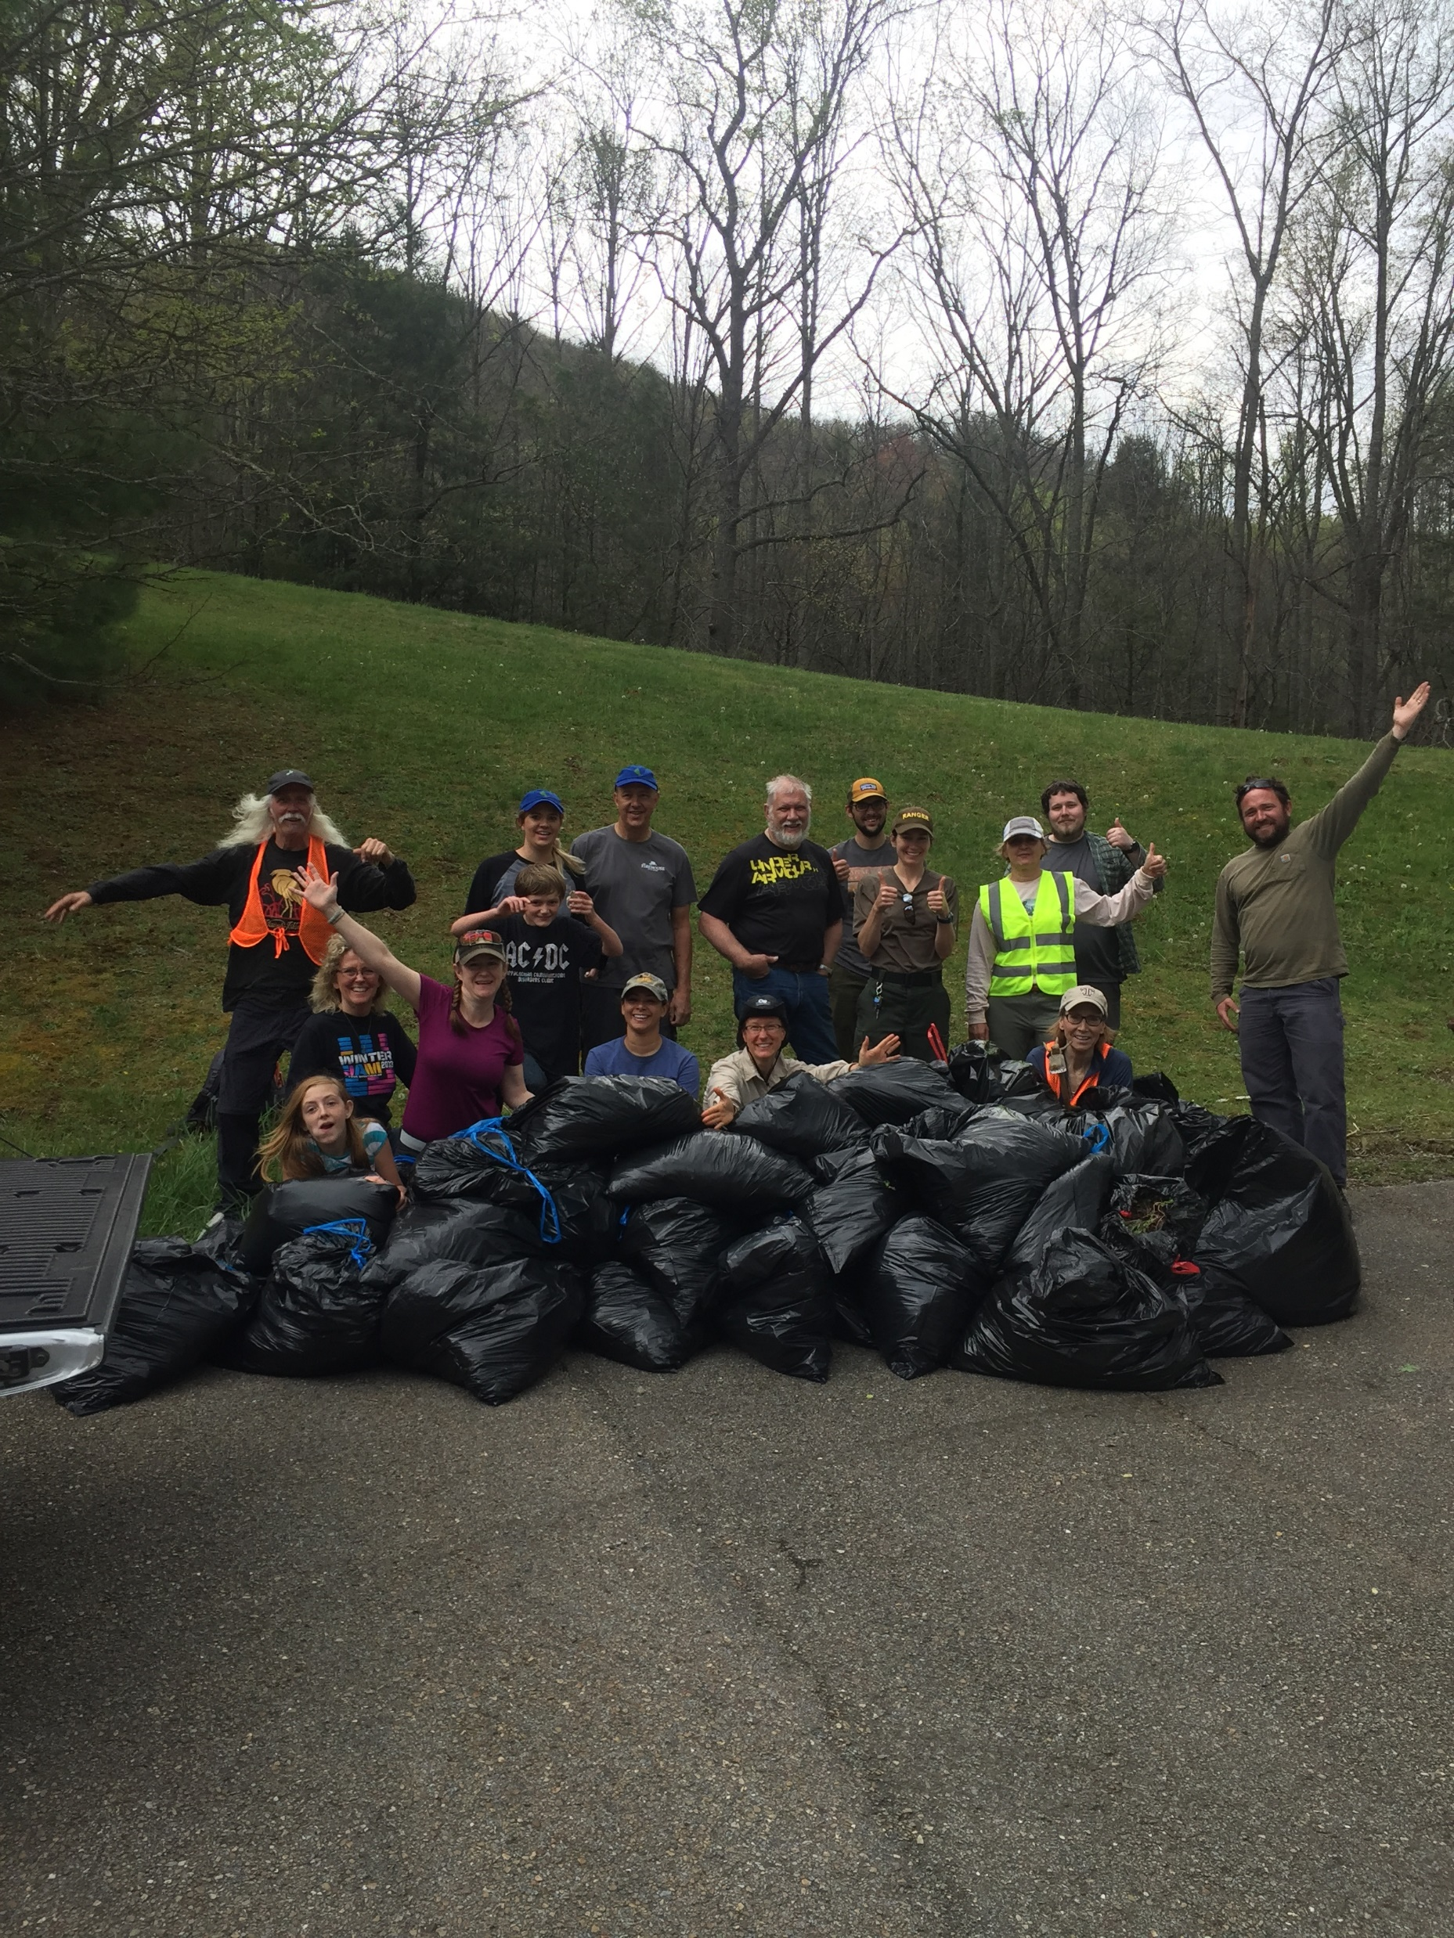
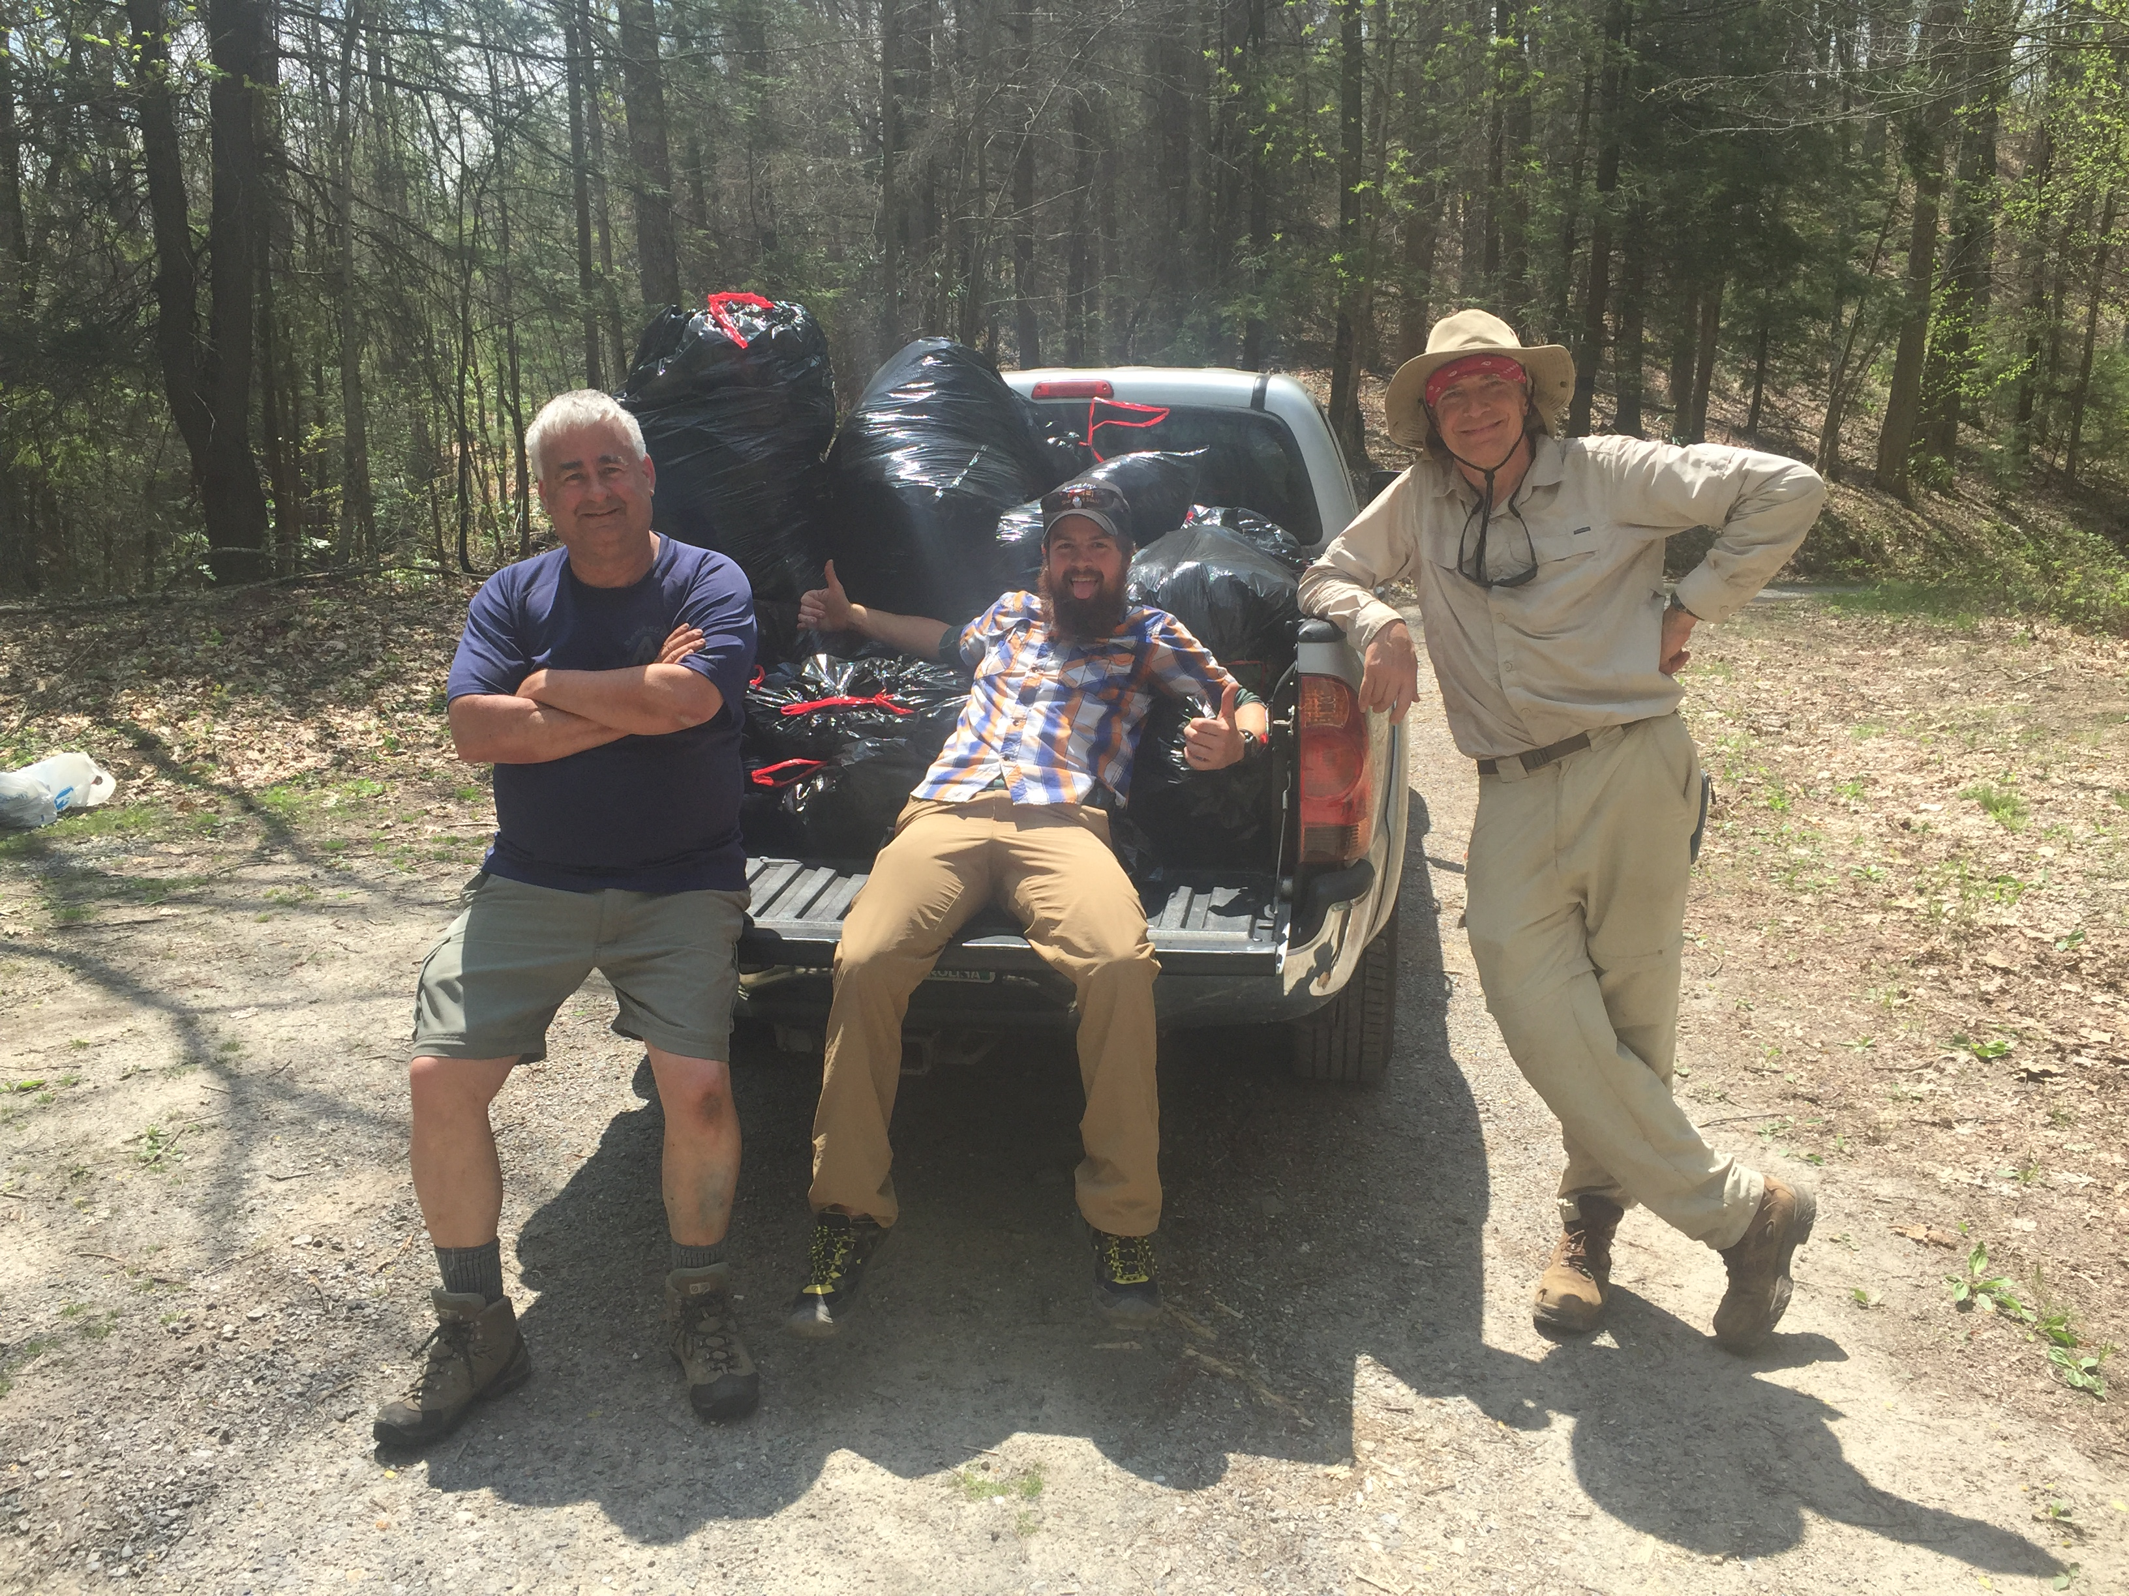
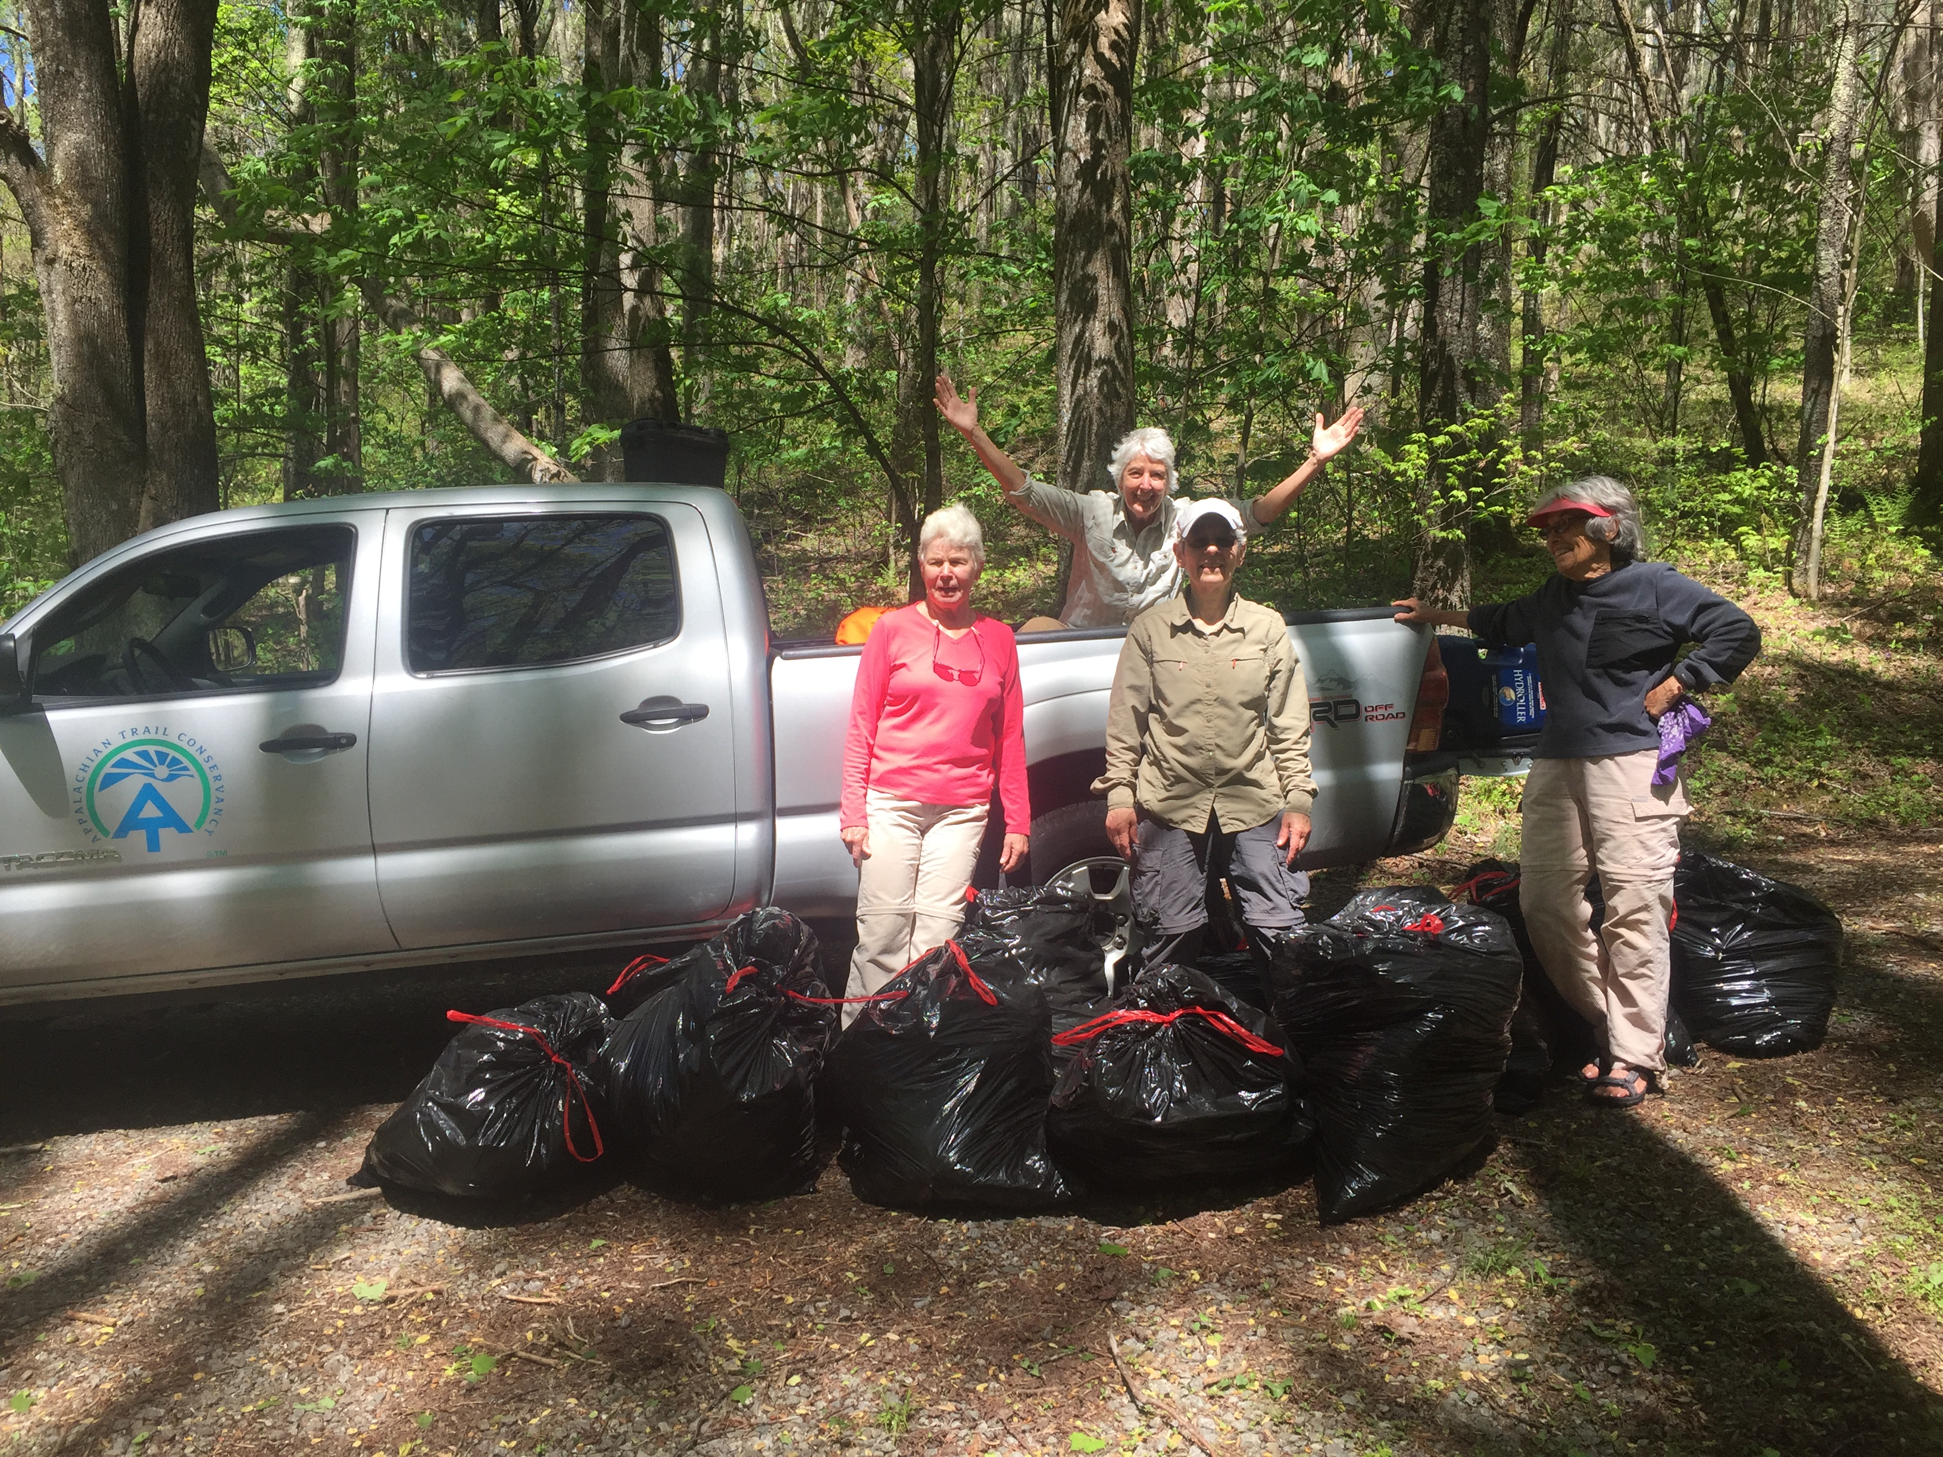
Events – Garlic Mustard Challenge
Over 15,000 lbs. pulled Trailwide in the last 3 years! (pulls have been going on at least 5 years)
Drastic reduction in amounts pulled between 2017 and 2018

Slide 32
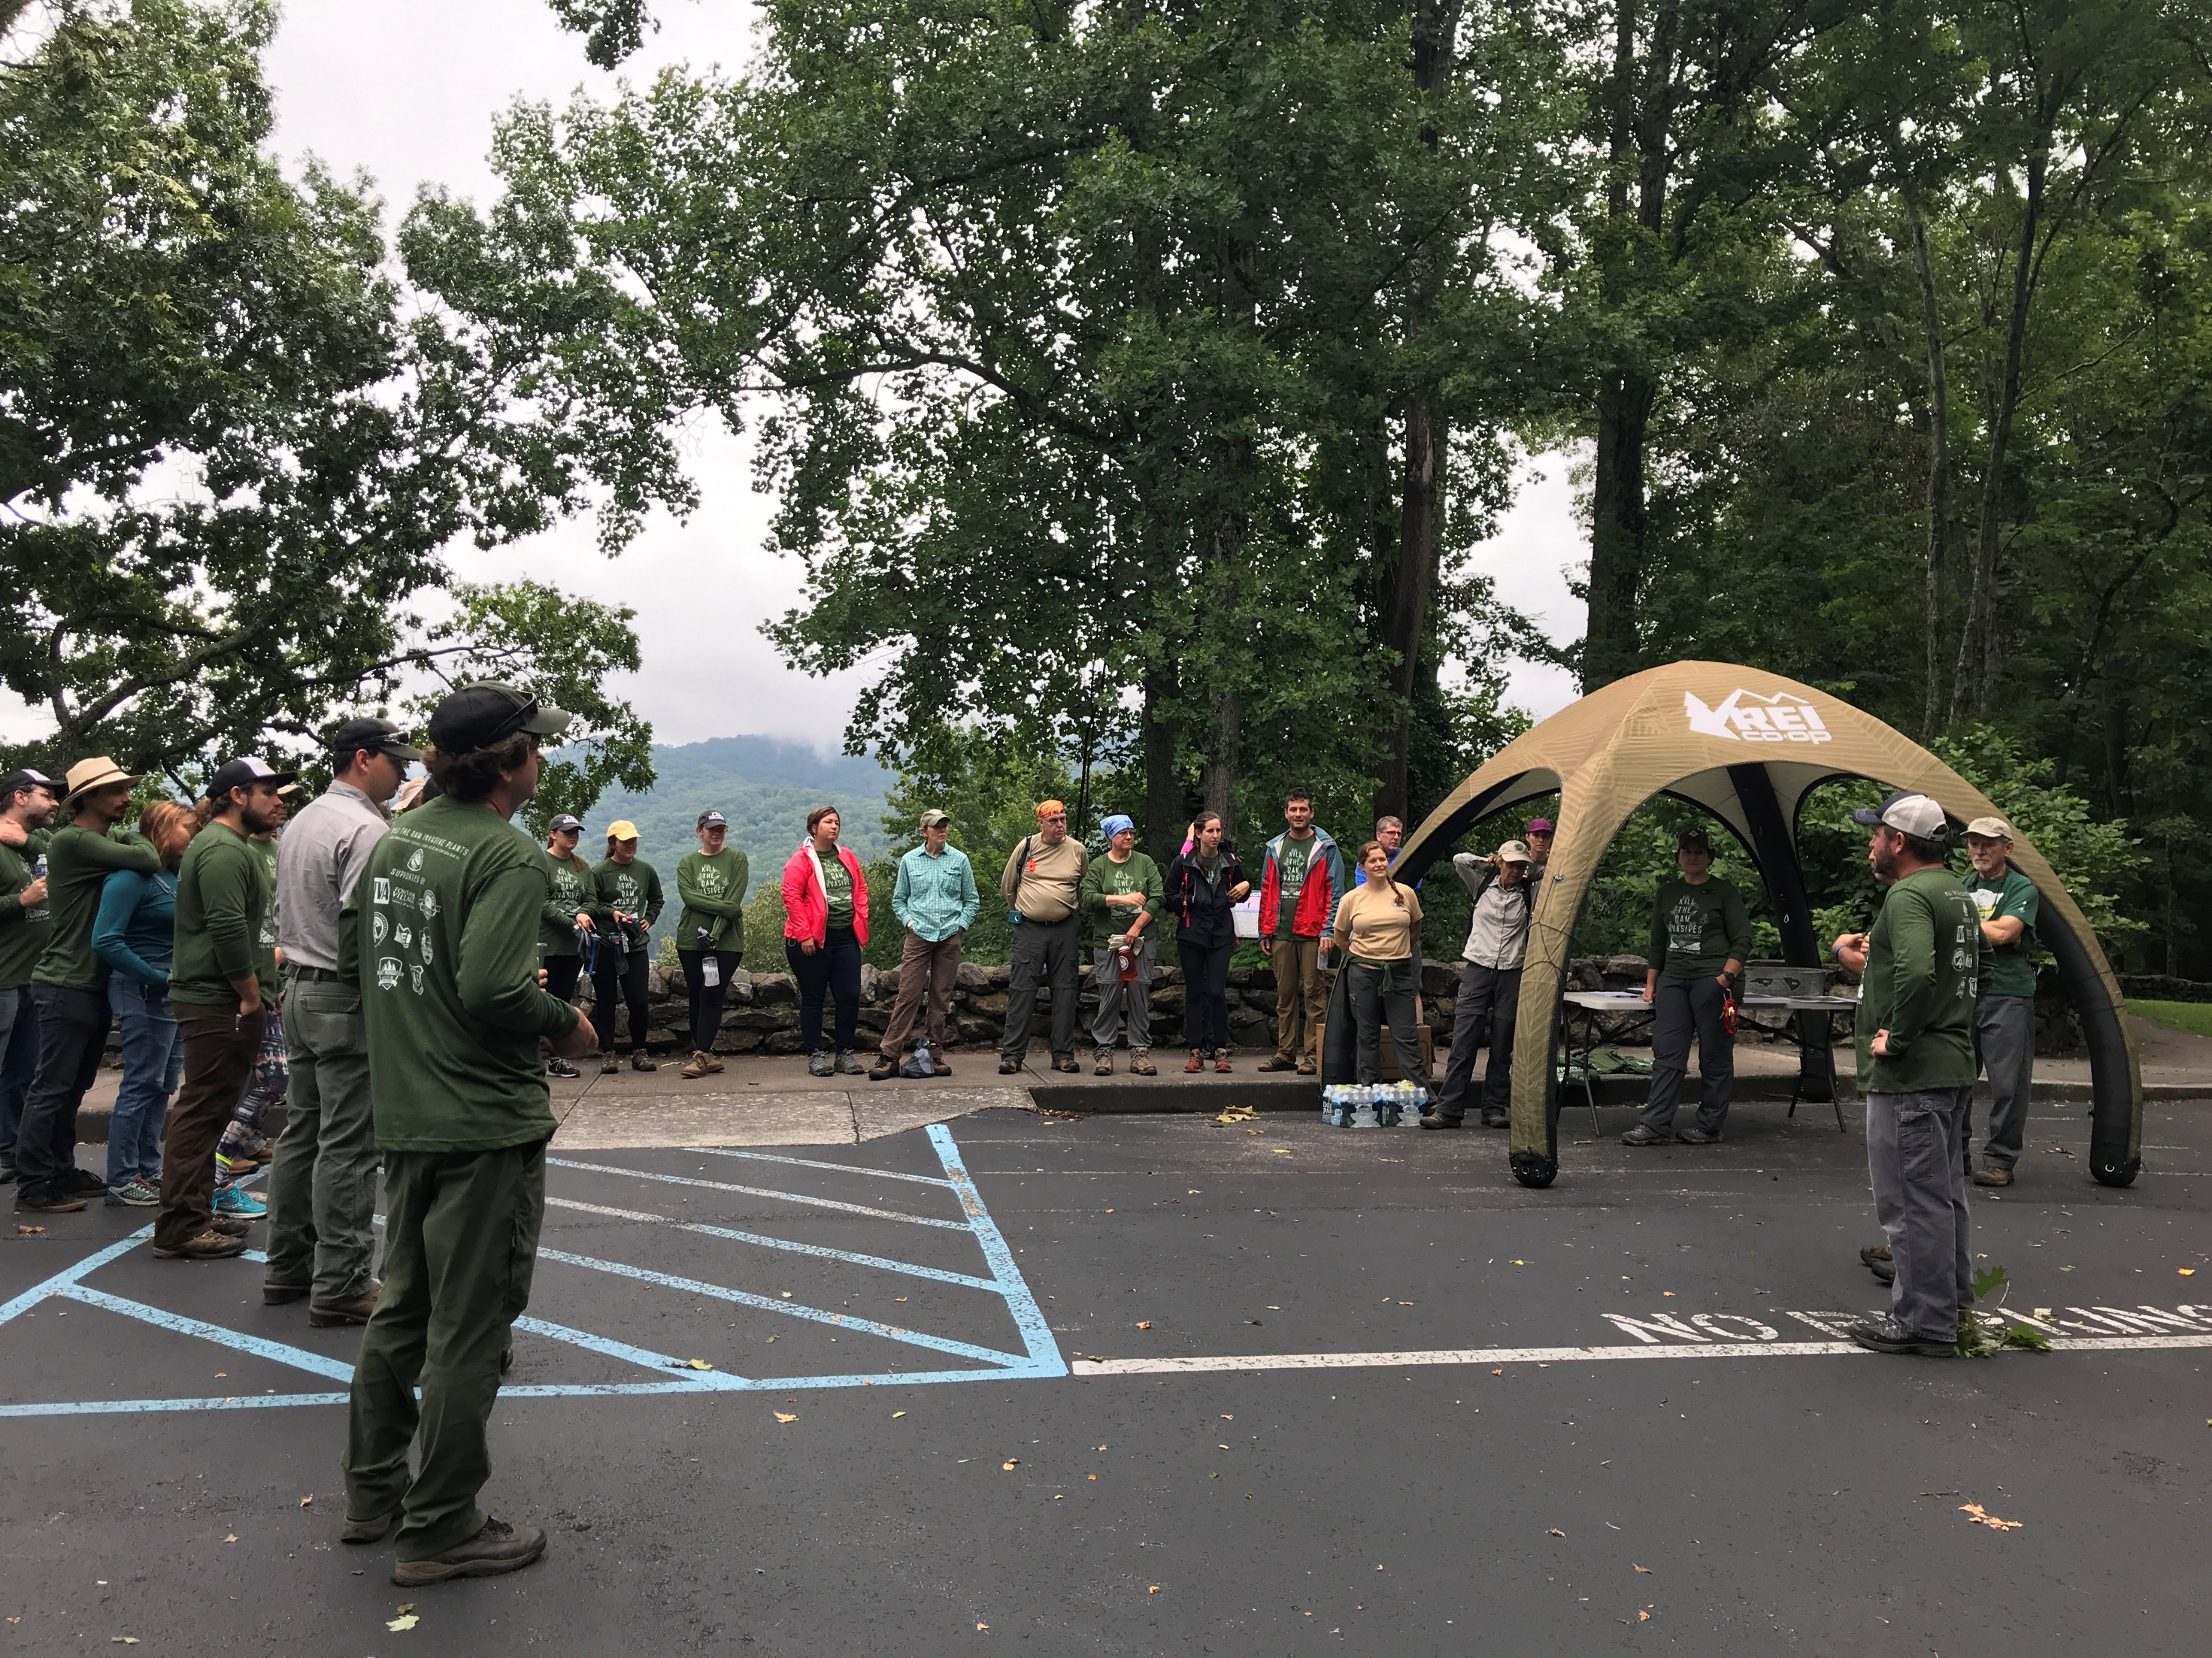
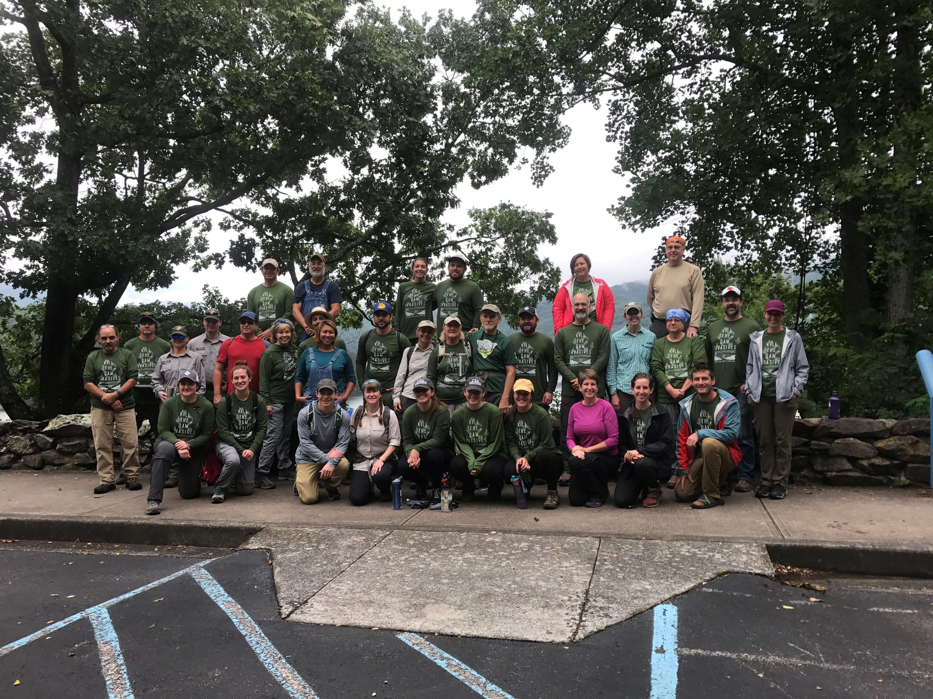
Events – Kill Dam Invasive Plants
Conceived as a regional “Volunteer Vacation” – live music, lunch, raffles, naturalist hike, and discounted hotel rooms.
Partnership – USFS, NPS, TVA, ATC

Slide 33
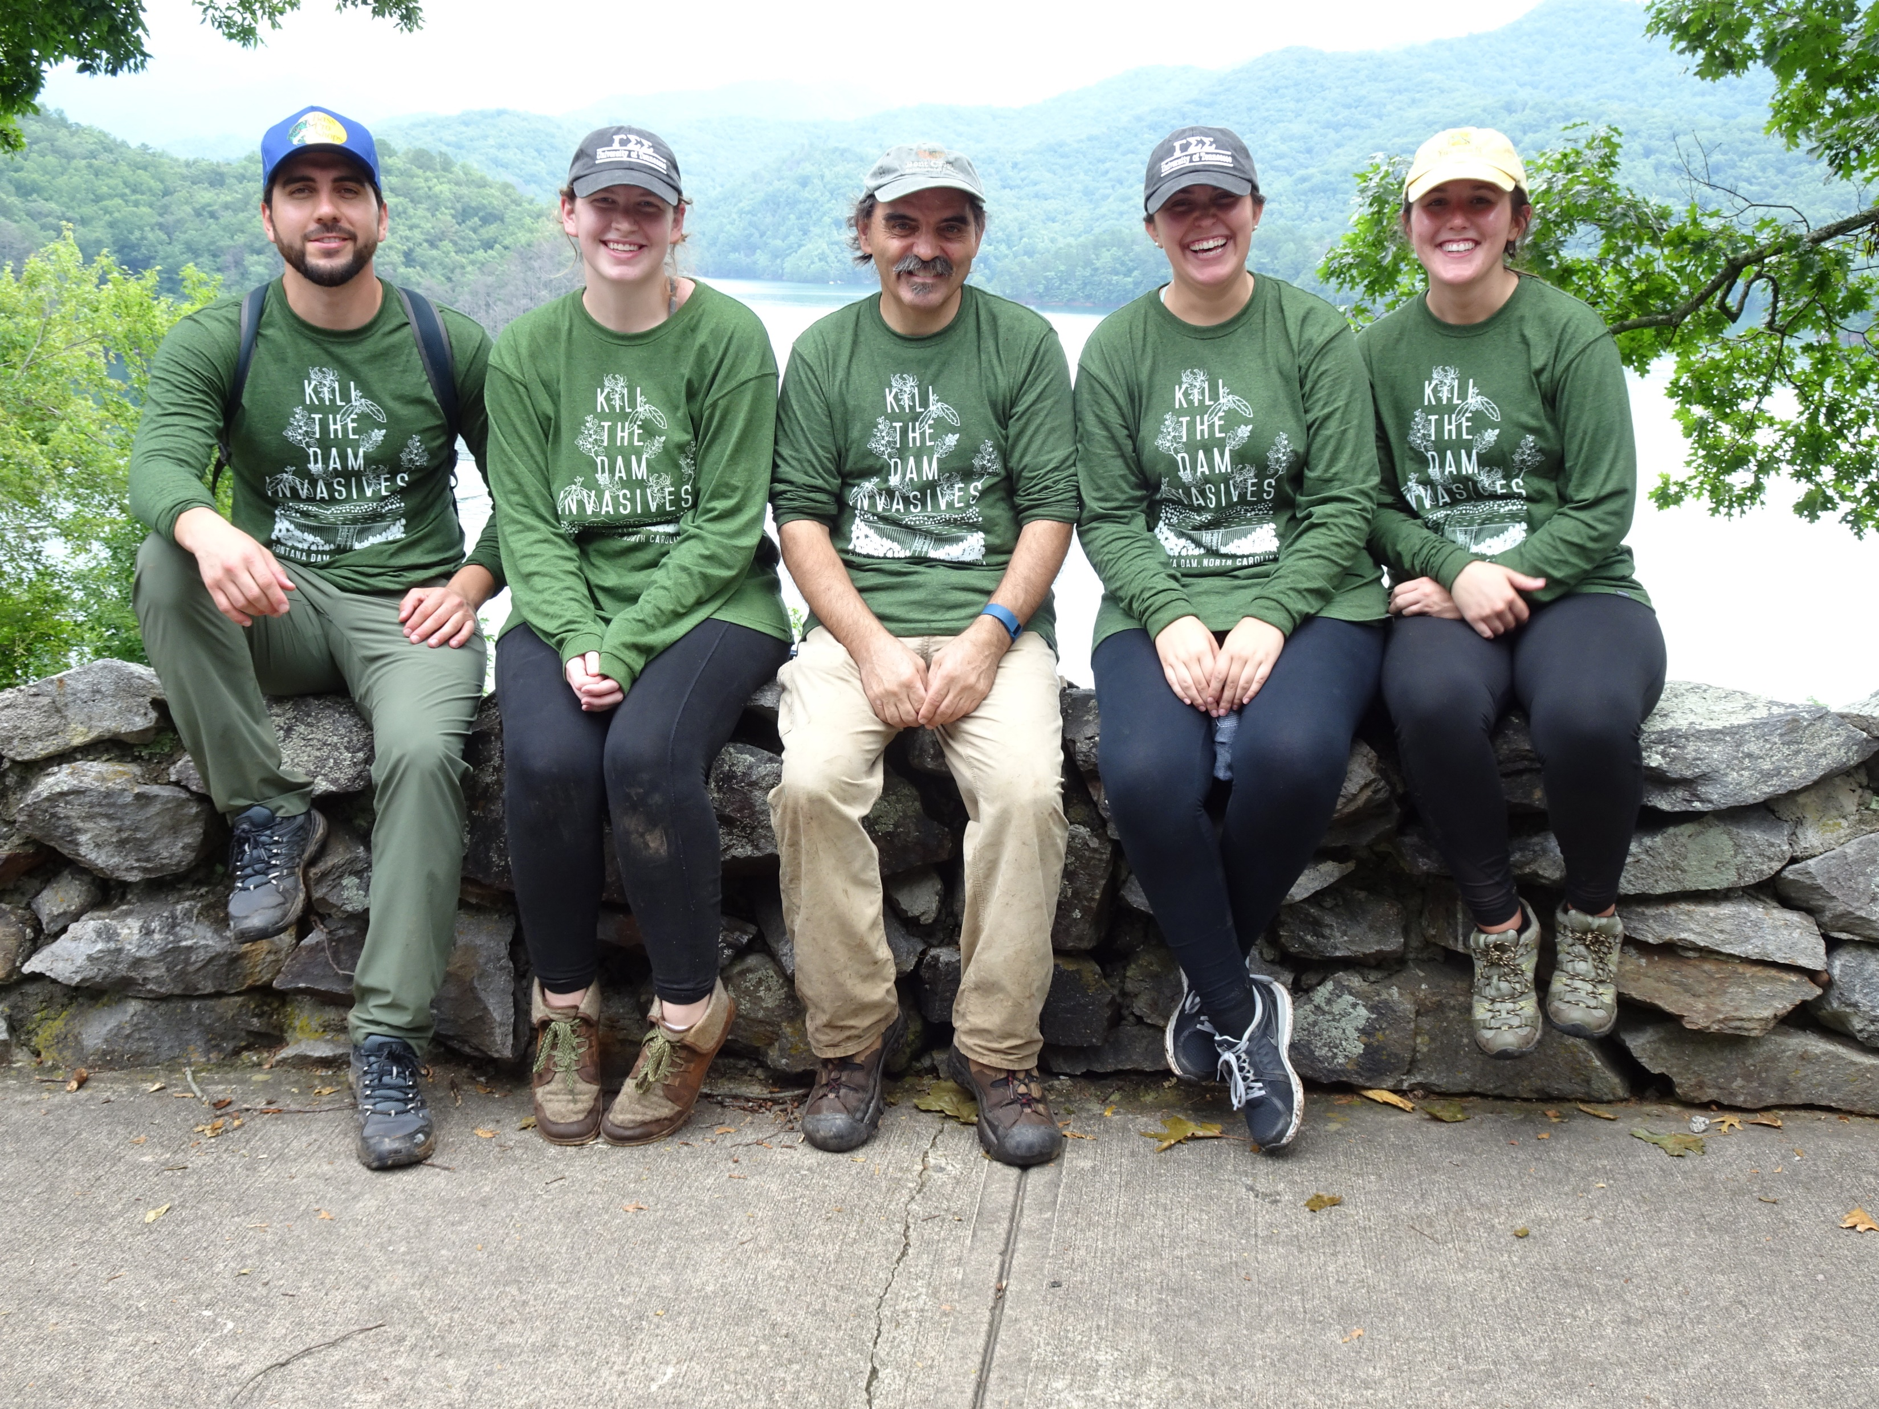
Events – Kill Dam Invasive Plants
Treatment Info:
Treatment Area – 7 acres total on TVA, USFS, and NPS land
Treatment Species – oriental bittersweet, thorny olive, burning bush, Japanese honeysuckle, mahonia, privet
People:
Volunteers – 32 (40 registered)
Volunteer Hours - 128
Staff – 6 (1 TVA, 2 ATC, 3 NPS, 1 USFS, 1 REI)
Sponsors:
REI – $2021+
-Music - Catered Lunch - Raffle items -swag
TVA - $700
Fontana Village Tourism Development Association - $700
Mount Inspiration Apparel Company – free custom design and screen fees ($340), shirts provided at cost
Fontana Village Resort – room and camping discounts

Slide 34
Bribes Work!

Slide 35
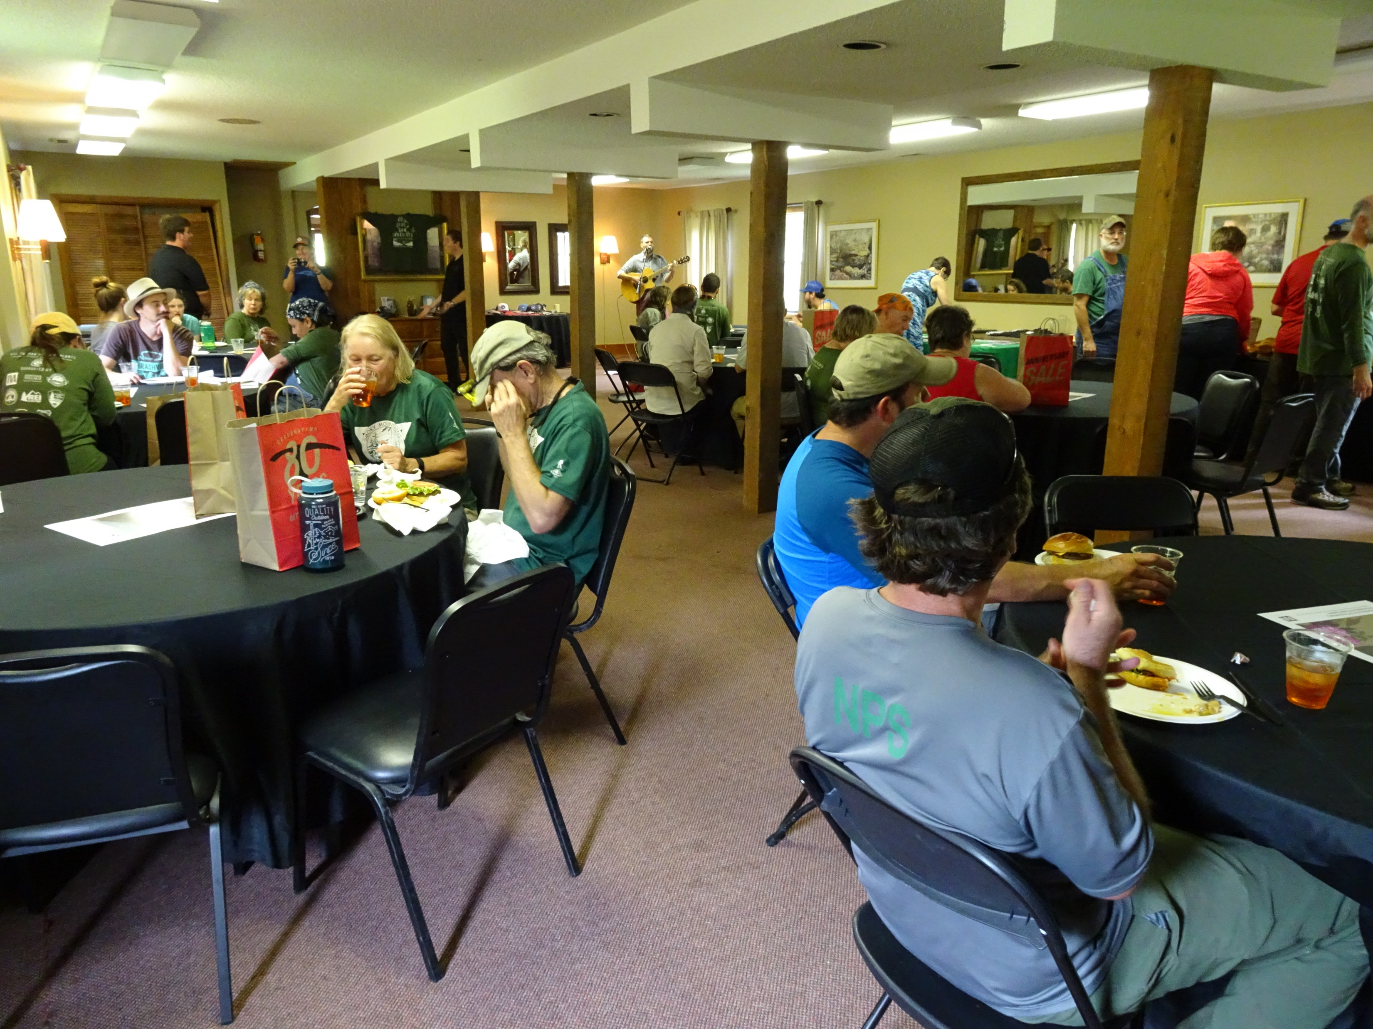
Bribes Work Pt. 2

Slide 36
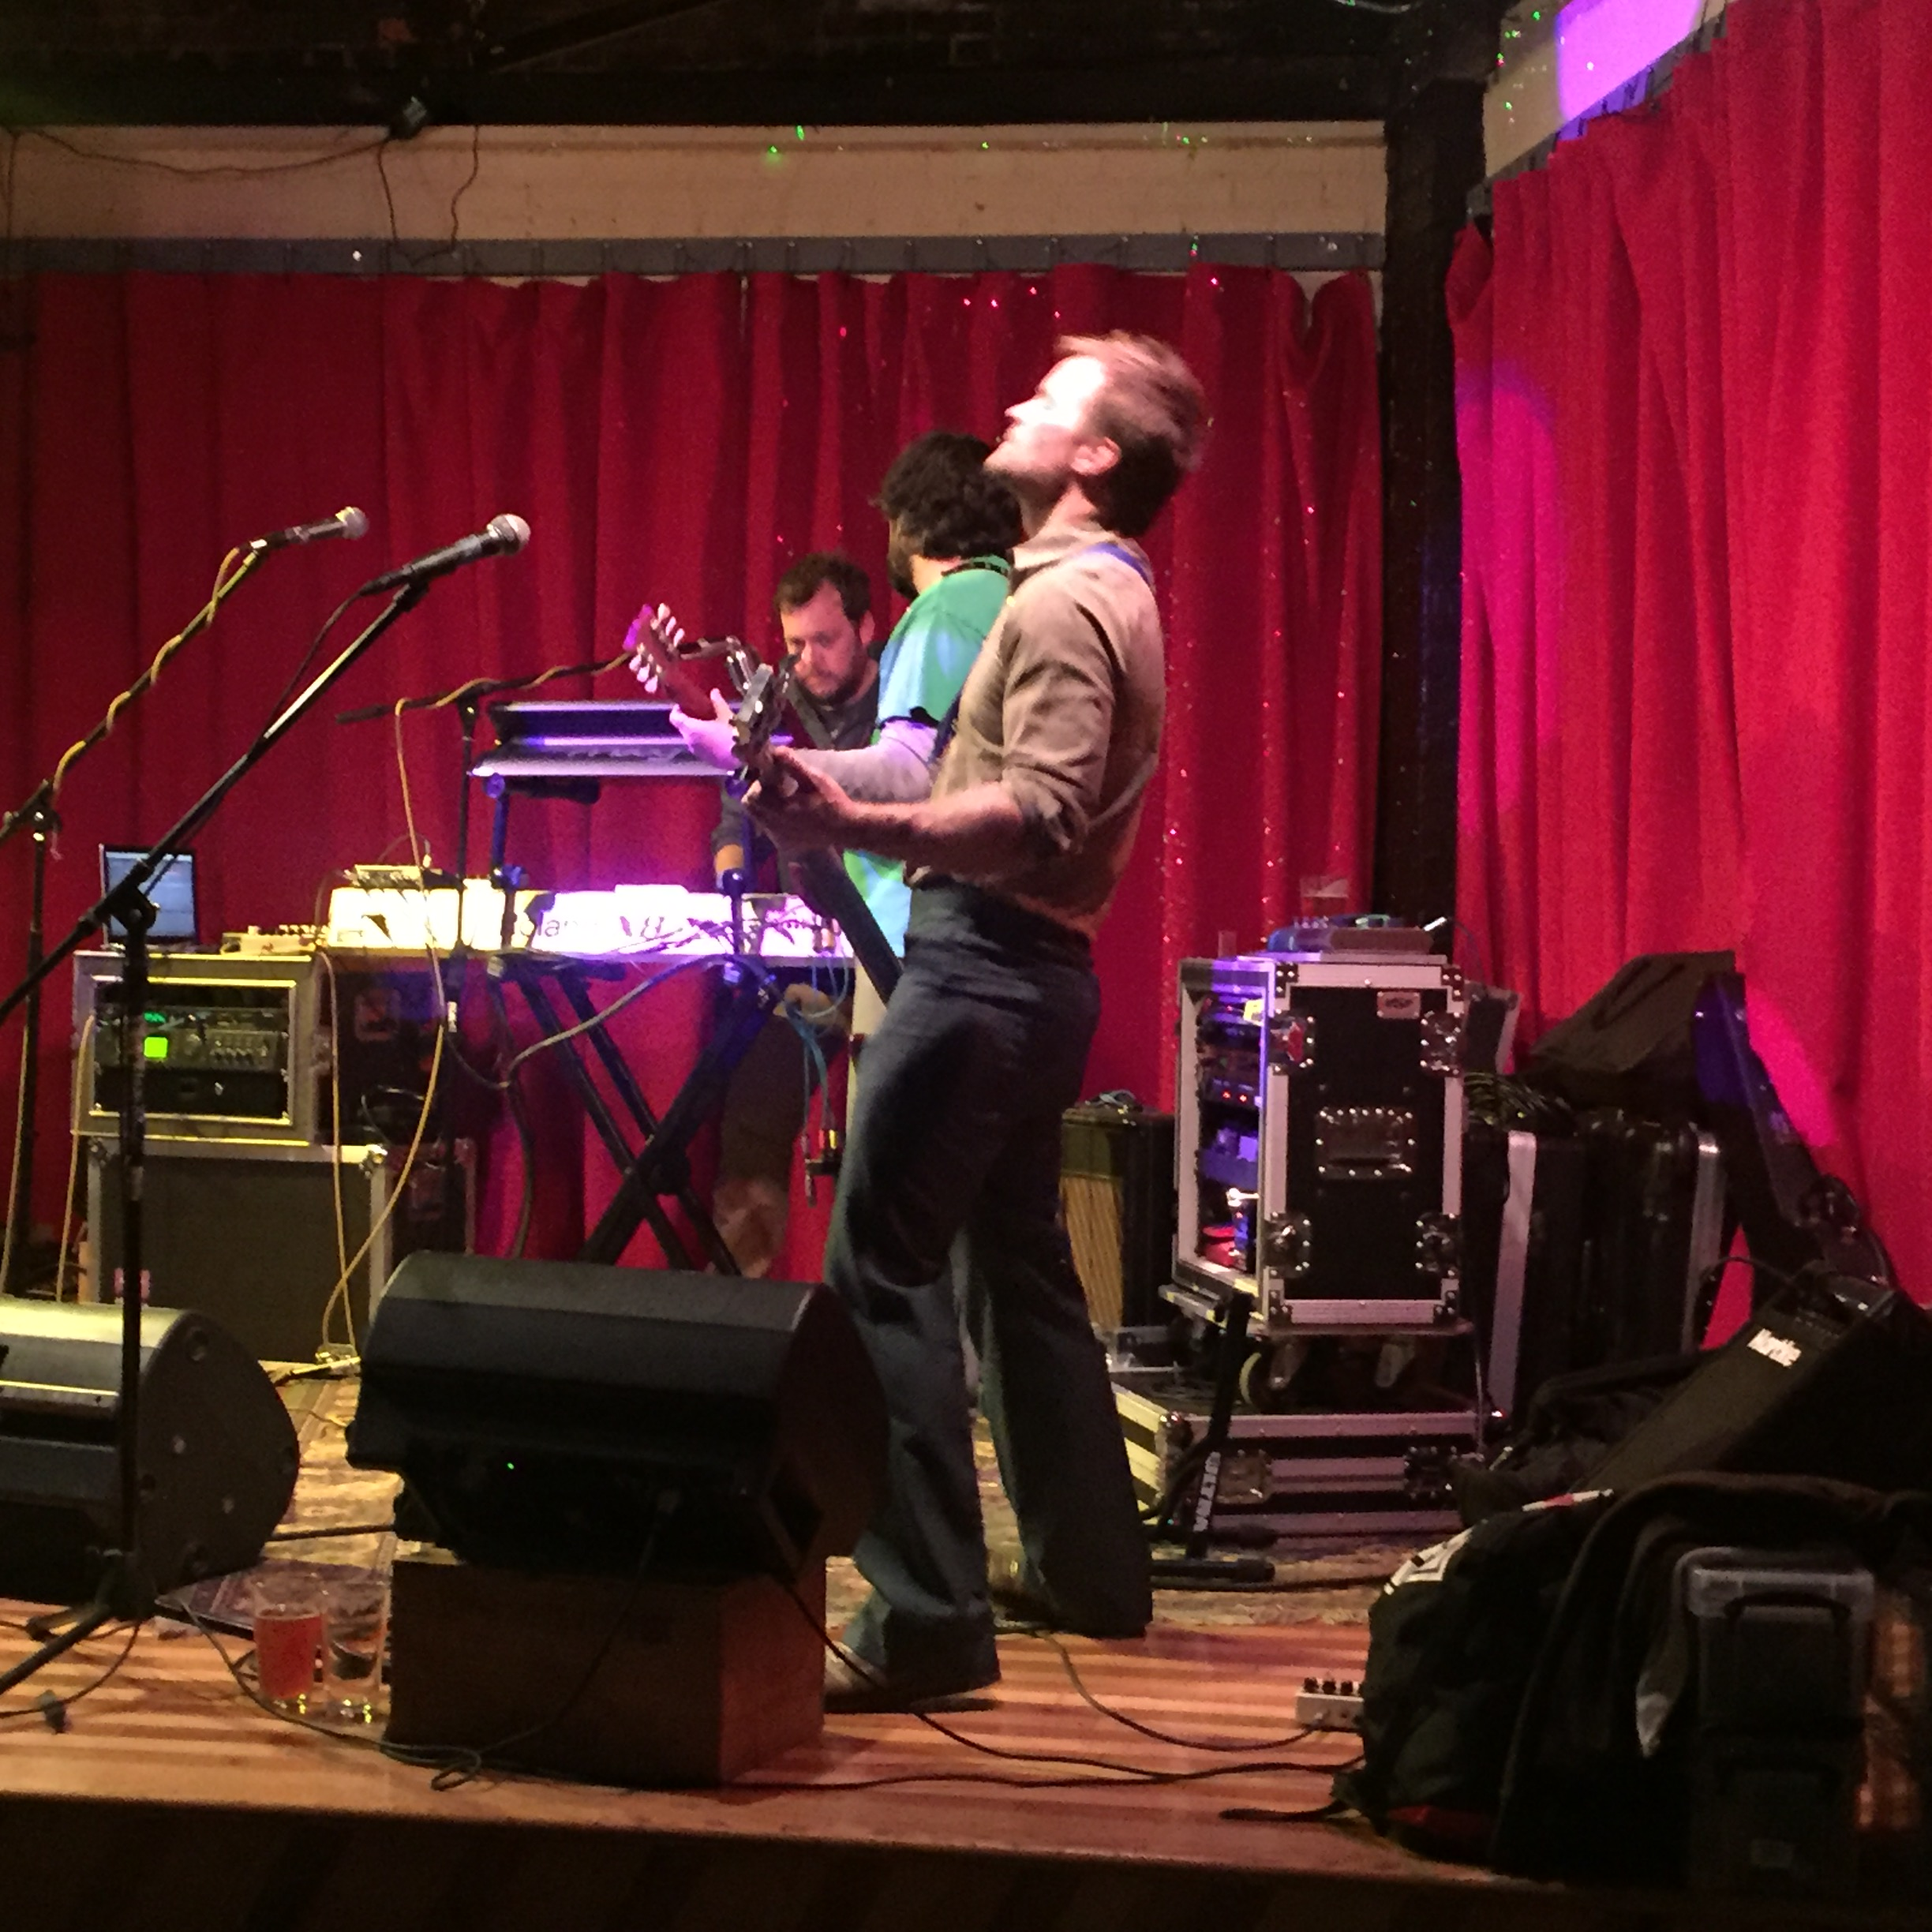
FUNDRAISING
With Analog Moon at UpCountry Brewing

Slide 37
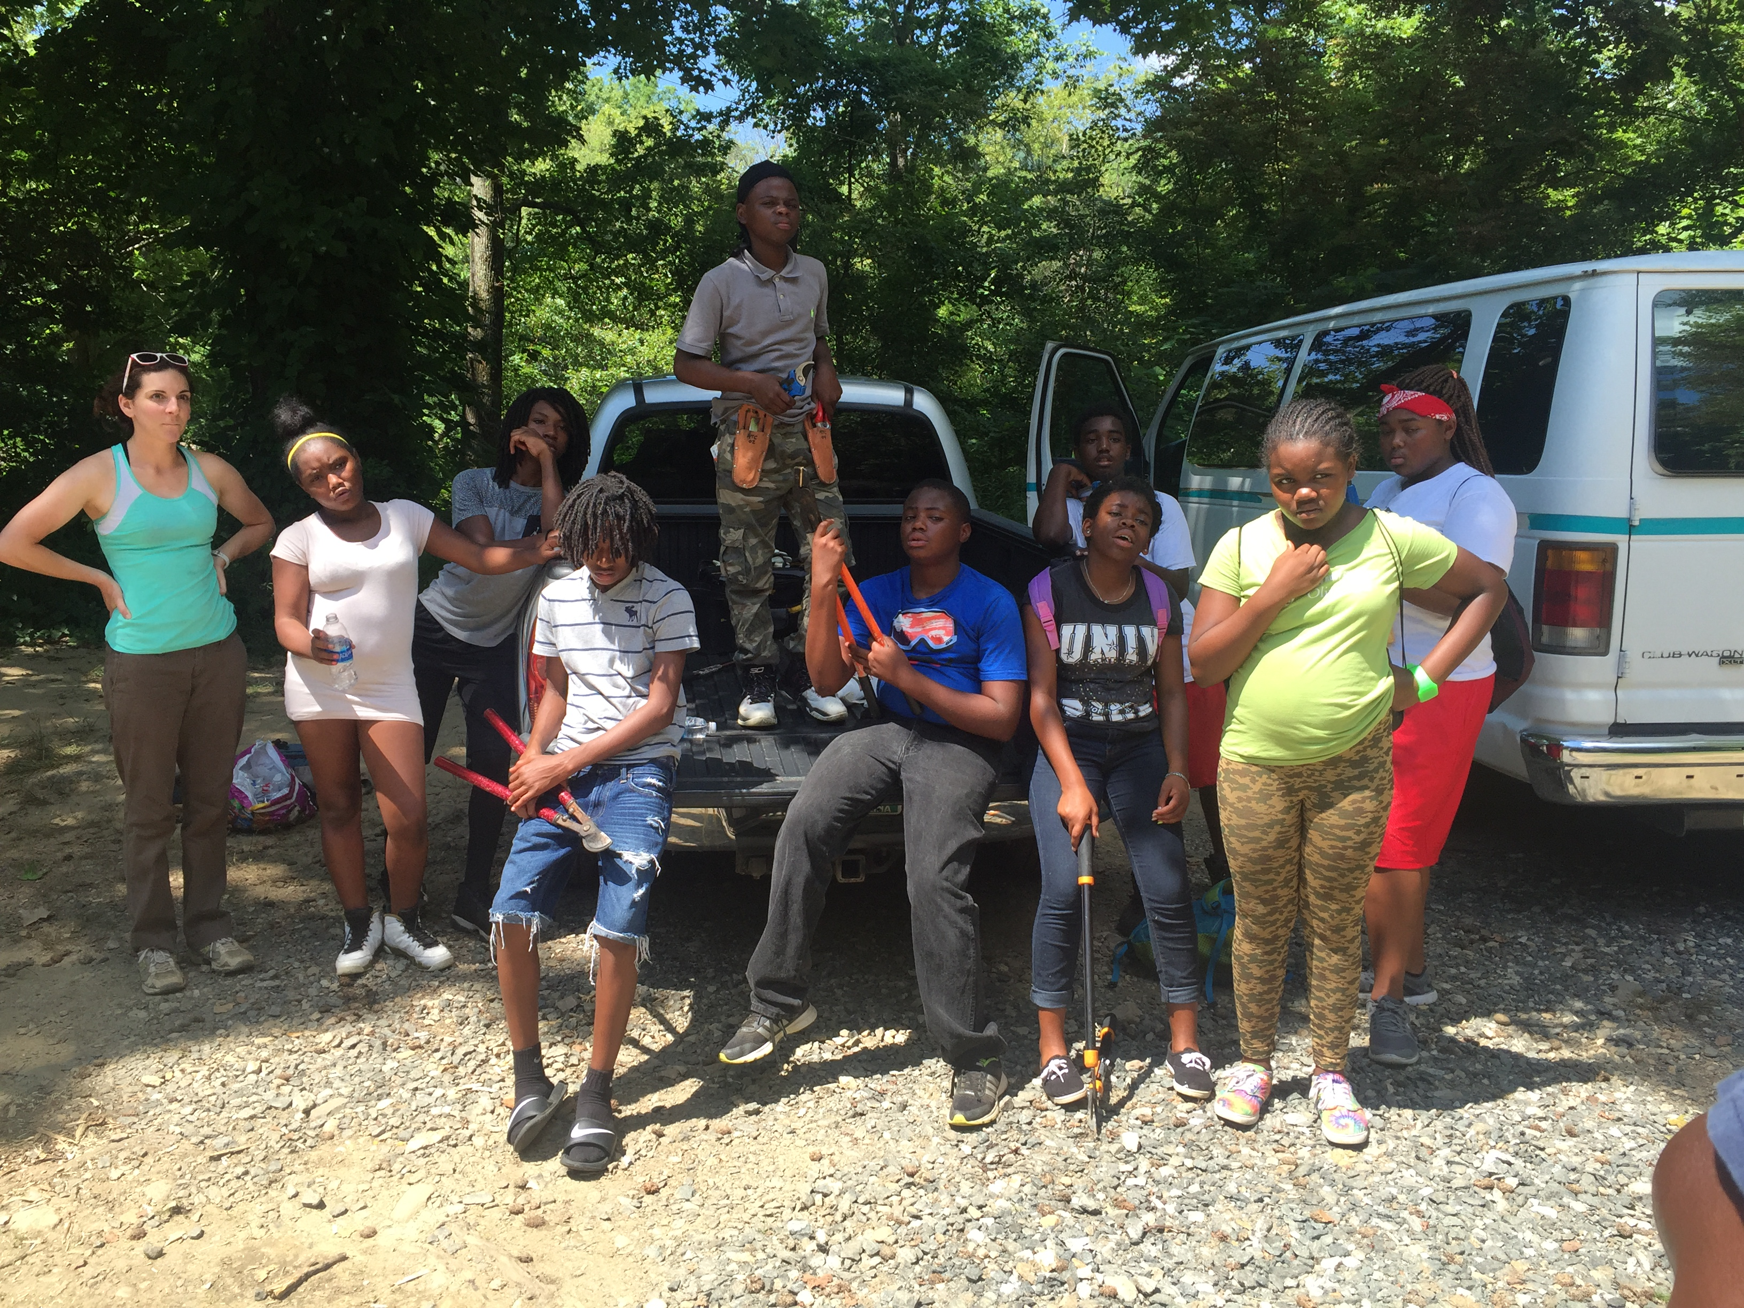
What’s Wrong With This Picture?

Slide 38
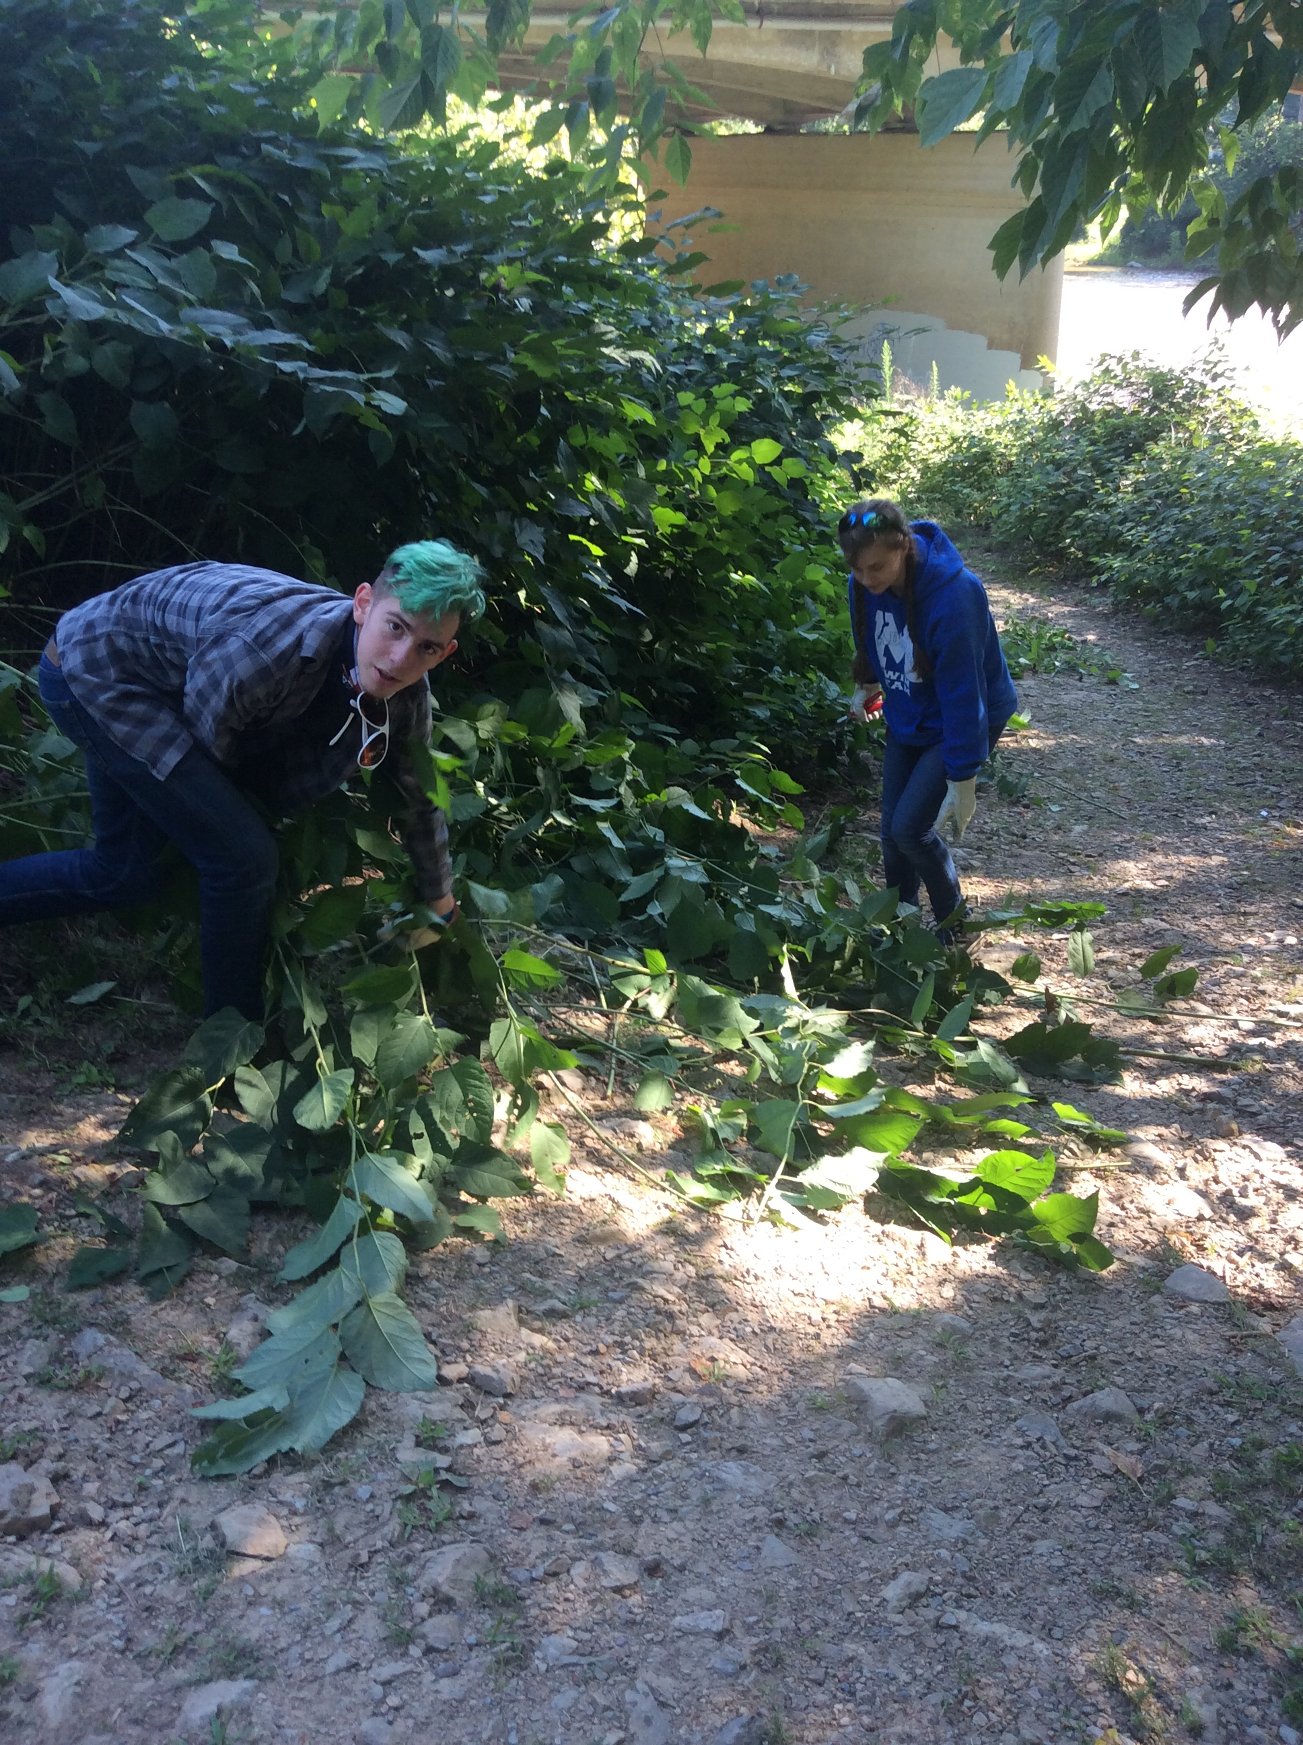
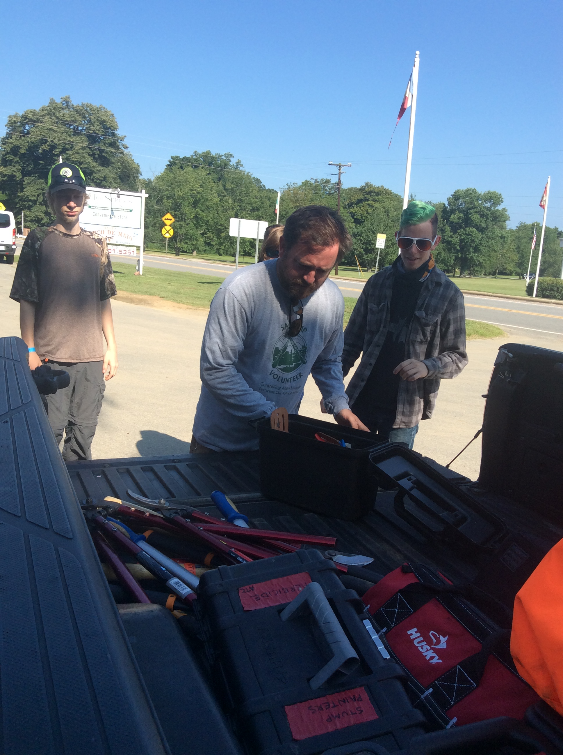
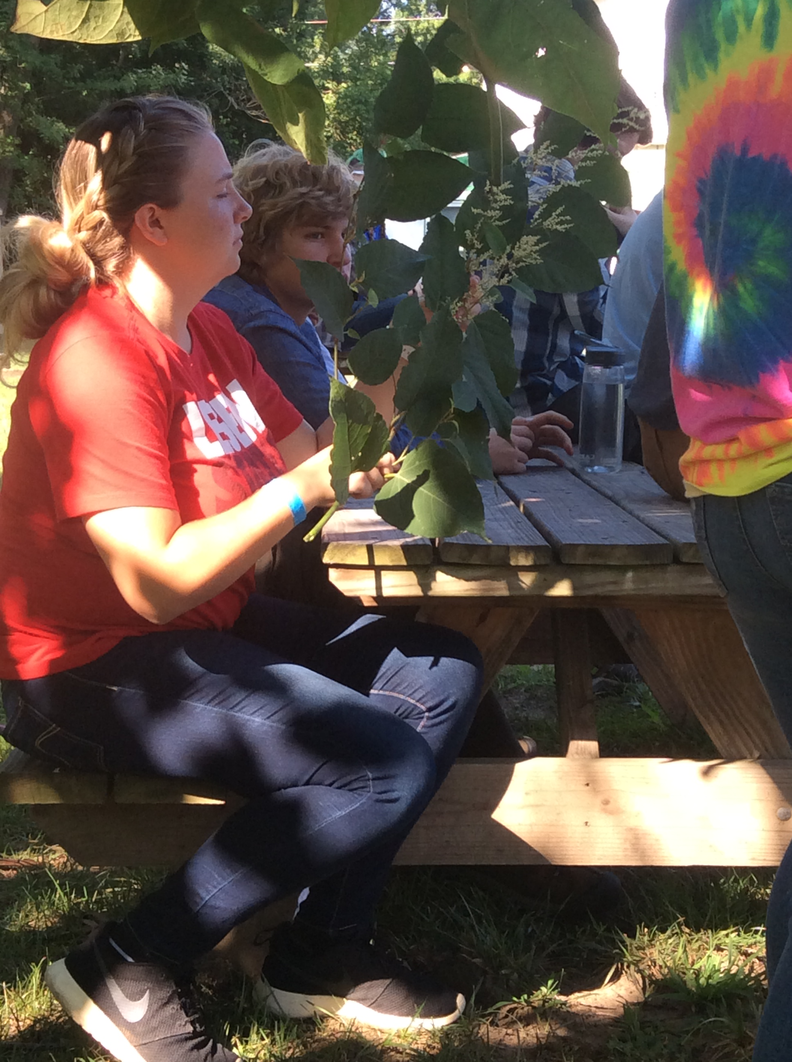
NC License Plate Program Sponsored Project

Slide 39
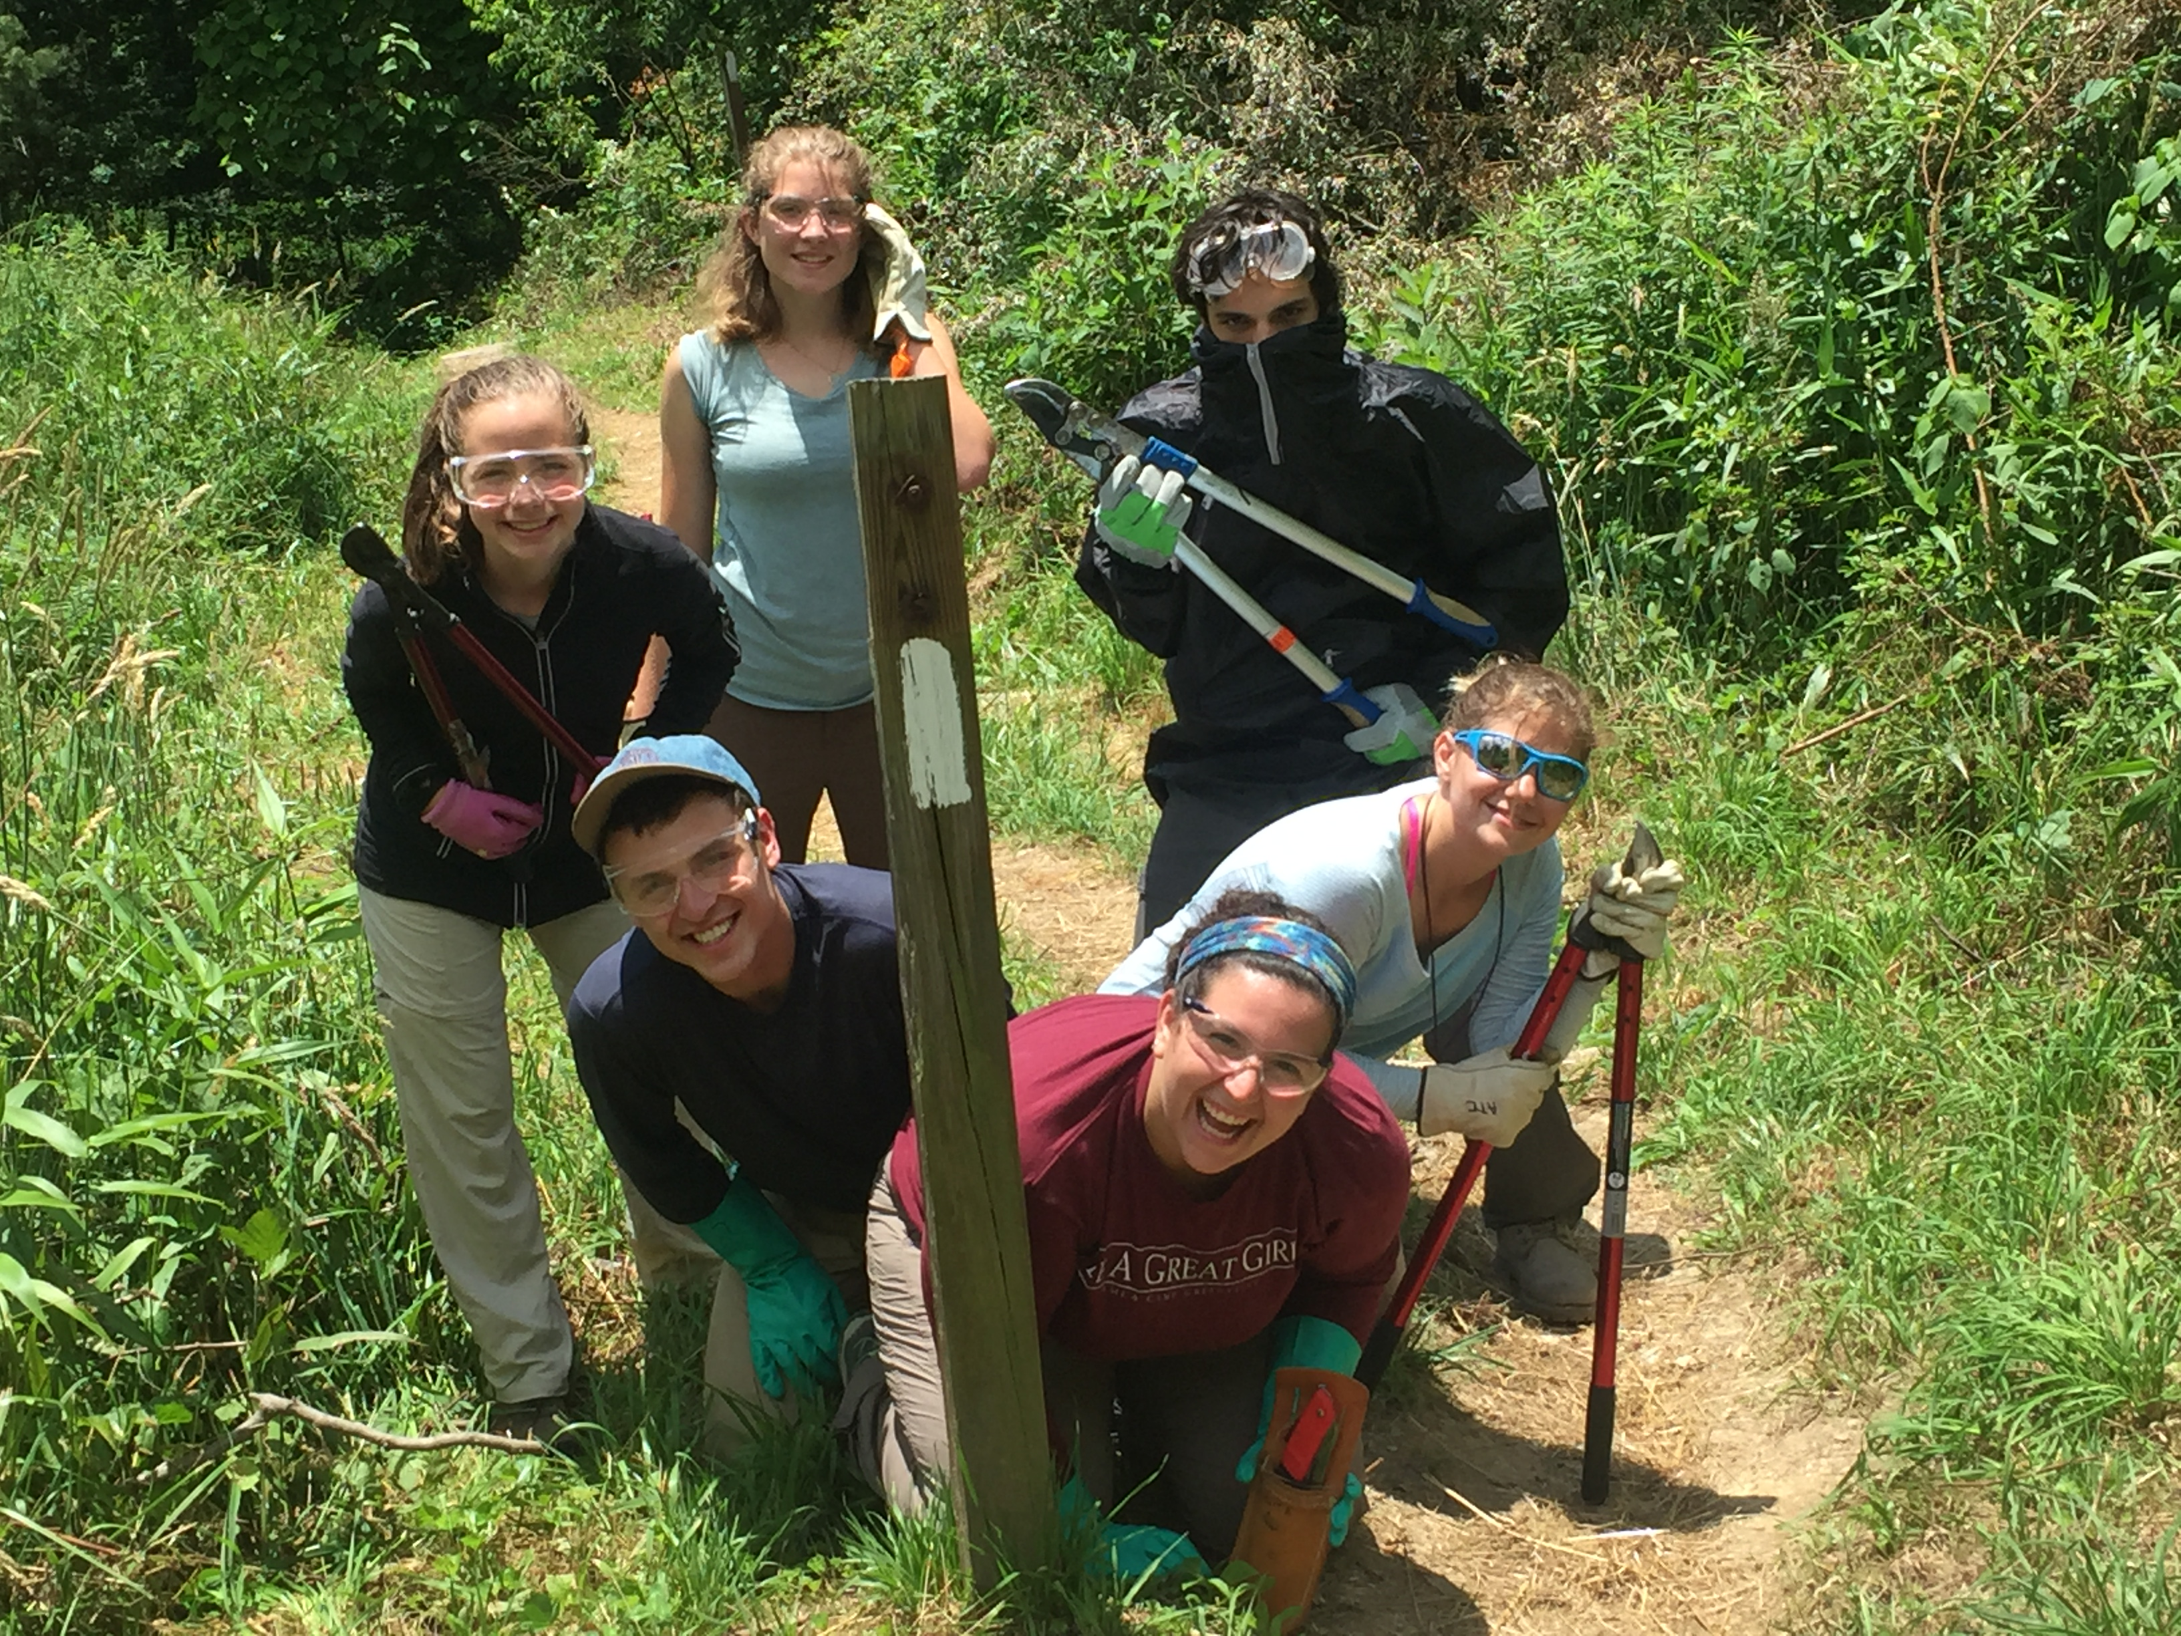
Camp Eagles Nest

Slide 40
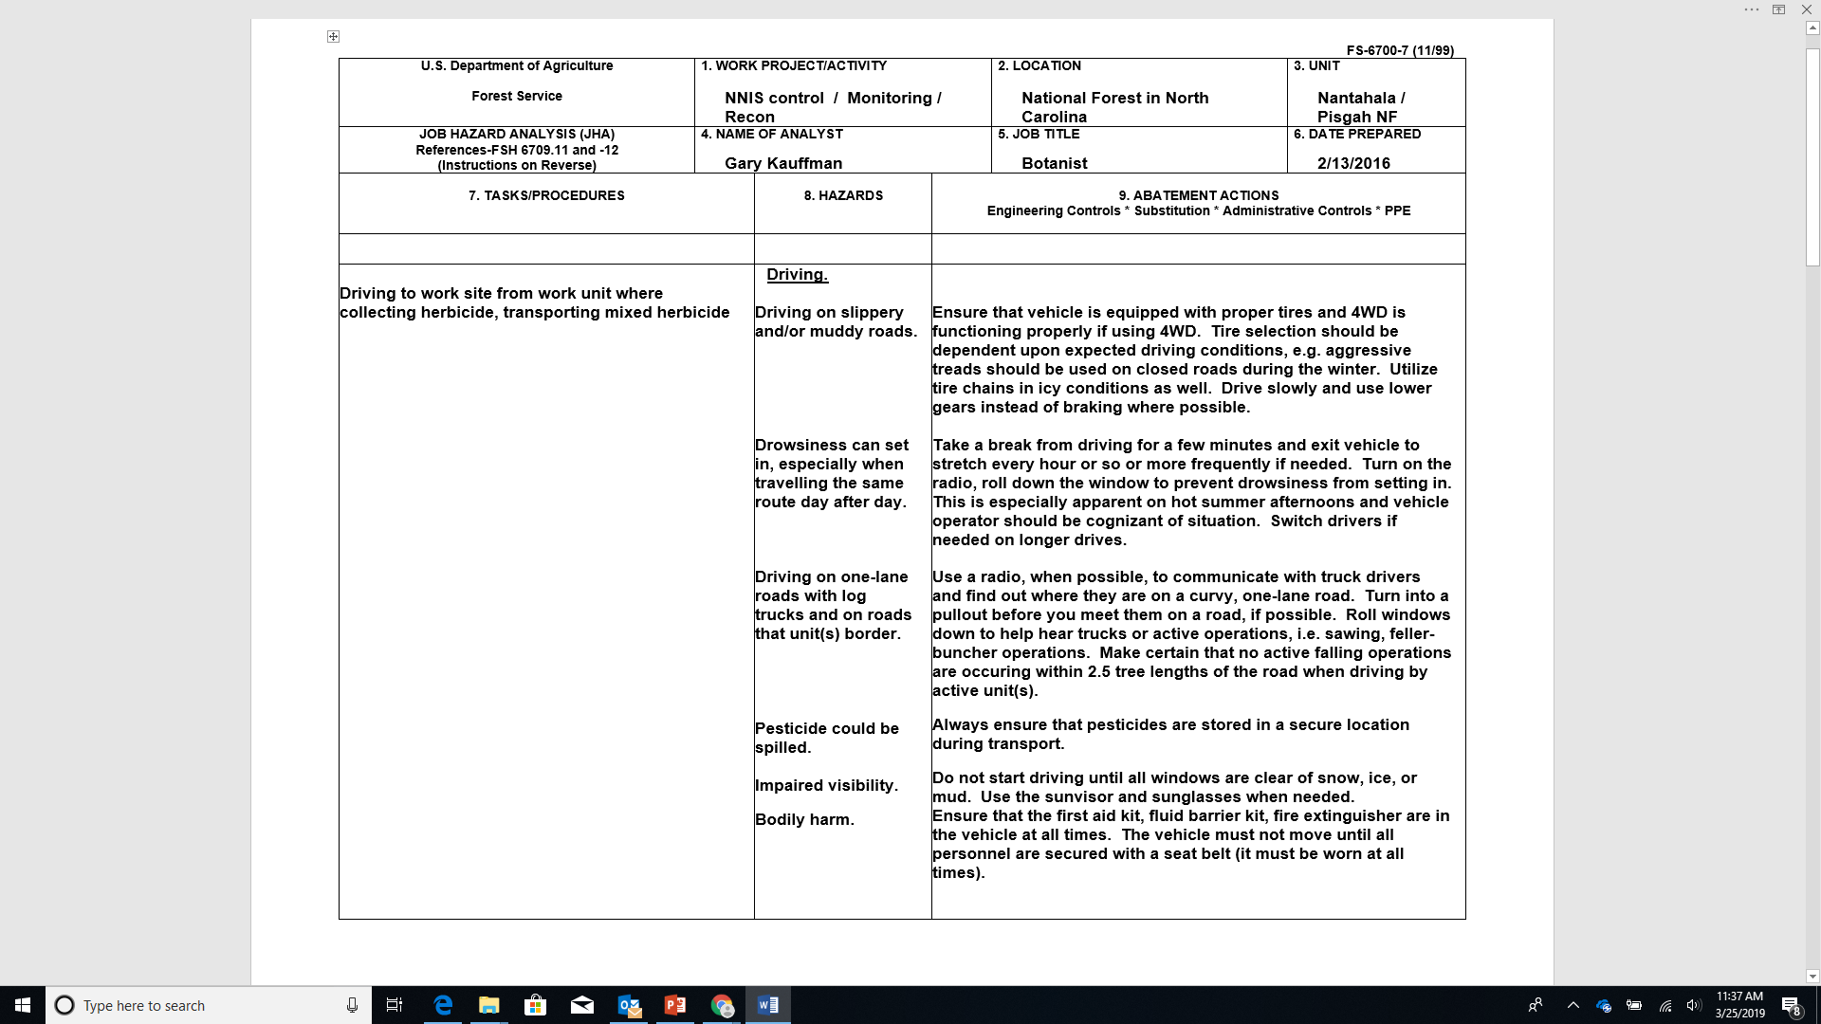
Job Hazard Analysis (JHA)

Slide 42
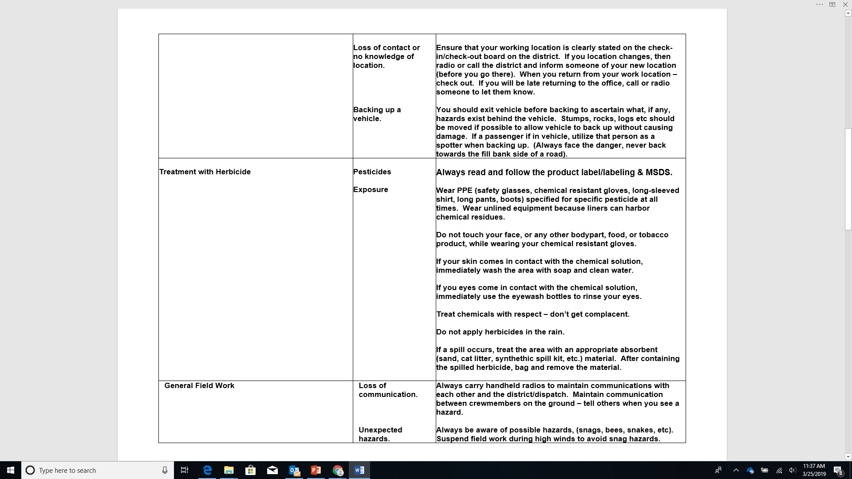

Slide 43
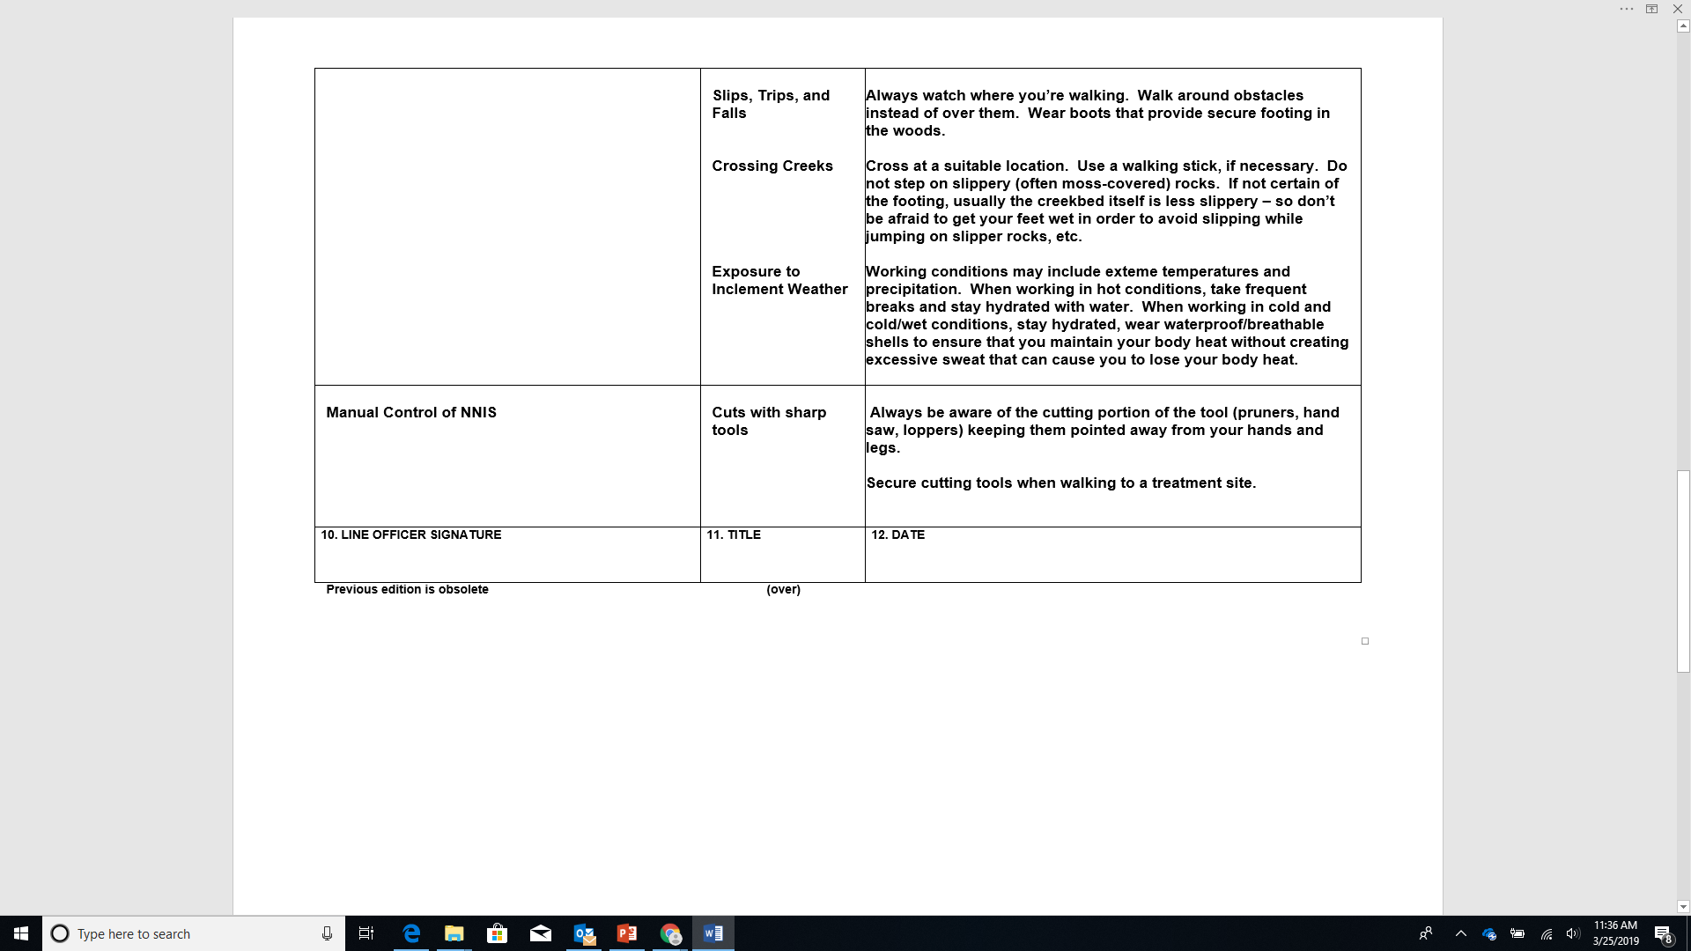

Slide 44
Managing Invasive Plants on the Appalachian Trail
Matt Drury
mdrury@appalachiantrail.org

